Slide 1
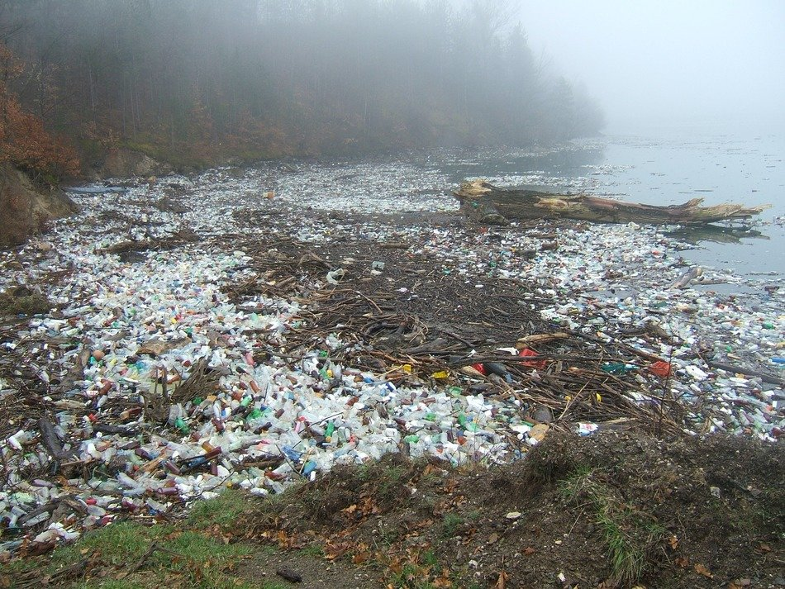
Plastic Pollution
M.Urena
PS 112
M.Urena
PS 112

Slide 2
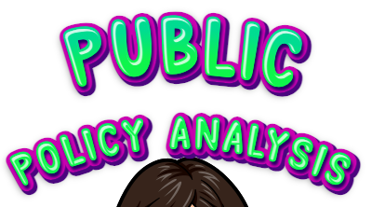

Slide 3
PUBLIC POLICY ANALYSIS
What is public policy analysis?
Public policy analysis is analyzing (thinking) about a policy (rule) that affects the public (people).

Slide 4
PUBLIC POLICY ANALYSIS STEPS
Step 1: Define the problem
Step 2: Gather evidence
Step 3: Identify causes
Step 4: Evaluate a policy
Step 5: Develop solutions
Step 6: Select best solution

Slide 5
STEP 1: DEFINE THE PROBLEM
Problem: Plastic pollution destroying our planet.
165 million tons of plastic debris (trash) is floating around in the ocean and polluting our planet.

Slide 6
STEP 2: GATHER EVIDENCE
Let’s think about how many times we use plastic each day: we use plastic toothbrushes to brush our teeth, we pack our lunch in plastic baggies, we drink from plastic water bottles, Plastic is everywhere!
All these things that we use, eventually get thrown out and end up in the ocean.

Slide 7
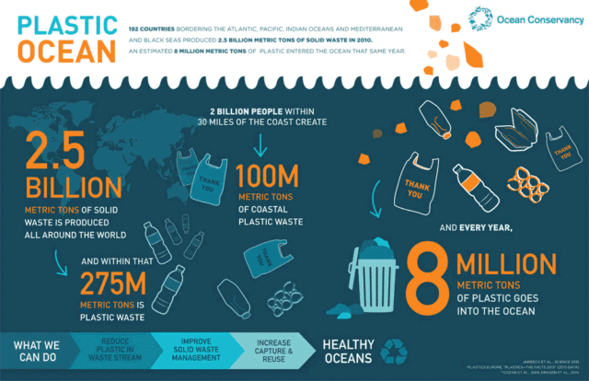

Slide 8
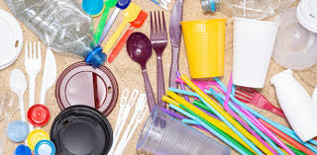
STEP 2: GATHER EVIDENCE
We have plastic that we use for a while, but we also have single use plastics. These are plastics that we use once then throw out, like grocery store bags, water bottles and straws.

Slide 9
CLEANUP GAME
It’s time for a little game break!
The fish need your help!
Use the red circles on the next slide to take the plastics out of the ocean and help the fish have a cleaner home.

Slide 11
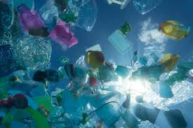
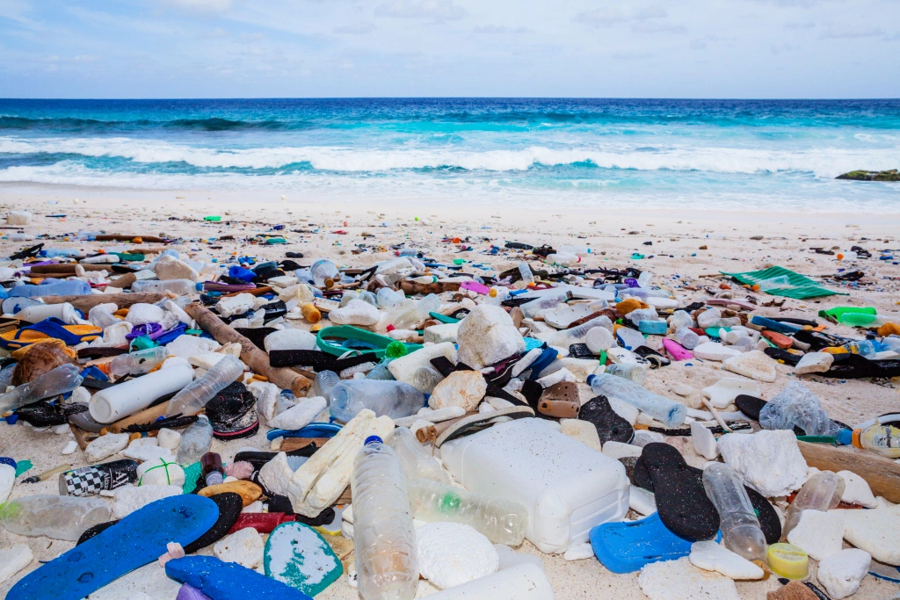
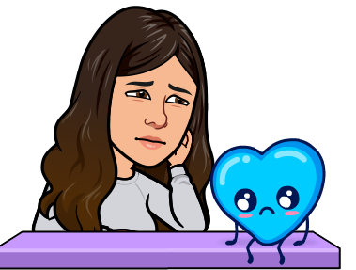
STEP 3: IDENTIFY CAUSES
Most plastic does not break down, it stays in the ocean forever. That means that in 32 years (when you’re 39 years old) there will be more plastic than fish in the ocean!

Slide 12
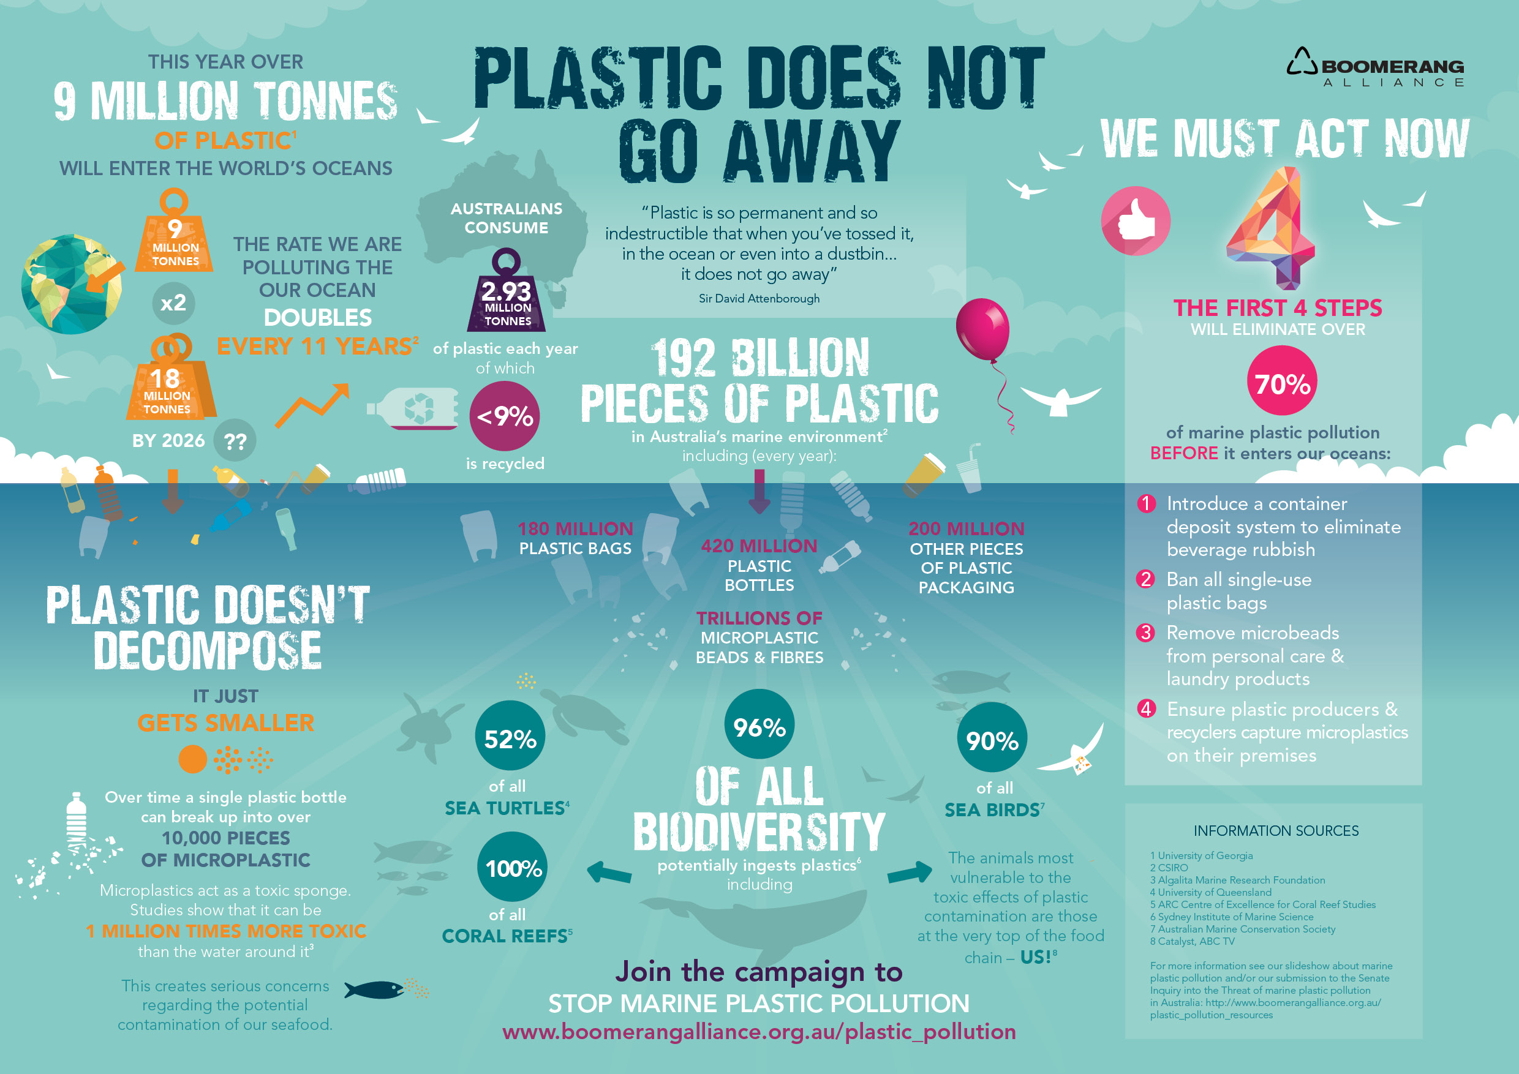

Slide 13
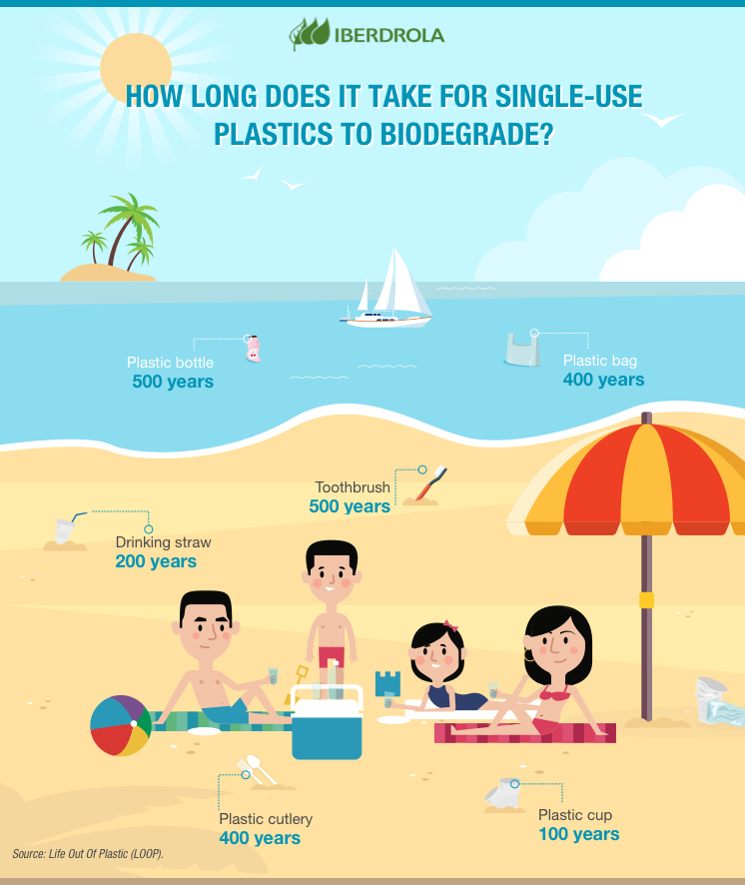

Slide 14
STEP 3: IDENTIFY CAUSES
Plastic is not only bad for the ocean and the animals that live there. There is so much plastic in our planet, that experts think it is now starting to hurt humans too.

Slide 15
STEP 3: IDENTIFY CAUSES
Let’s watch this video to learn more about plastic pollution and the things we can do to help our planet.

Slide 16
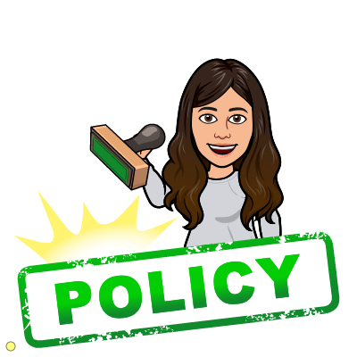
STEP 4: EVALUATE A POLICY
Now that we know what causes plastic pollution and how bad plastic pollution is for our planet. Let’s think about some policies that are in place to protect our planet.

Slide 17
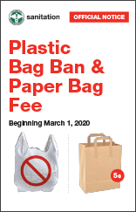
STEP 4: EVALUATE A POLICY
On March 1, 2020, a new bag waste reduction law took effect in New York State.
The law states that any business that collects New York State taxes is not able to give plastic bags to their customers.

Slide 18
STEP 4: EVALUATE A POLICY
Let’s think about this policy. In your breakout room, you will think and discuss these questions with your group:
Should we keep this policy? Should we get rid of it? Can we improve it?

Slide 19
STEP 4: EVALUATE A POLICY
Using plastic bags is bad for our planet and communities. Plastic bags can be seen stuck in trees, as litter in our neighborhoods, and floating in our waters.

Slide 20
STEP 4: EVALUATE A POLICY
This policy will reduce about 23 billion plastic bags that are typically used in New York State each year. The public has accepted this policy well, with #BYOBagNY trending on social media.

Slide 21
STEP 5: DEVELOP SOLUTIONS
Let’s think about some things that we can do to help reduce plastic pollution in our planet.
What are some things we can do to reduce the amount of plastic we use?

Slide 22
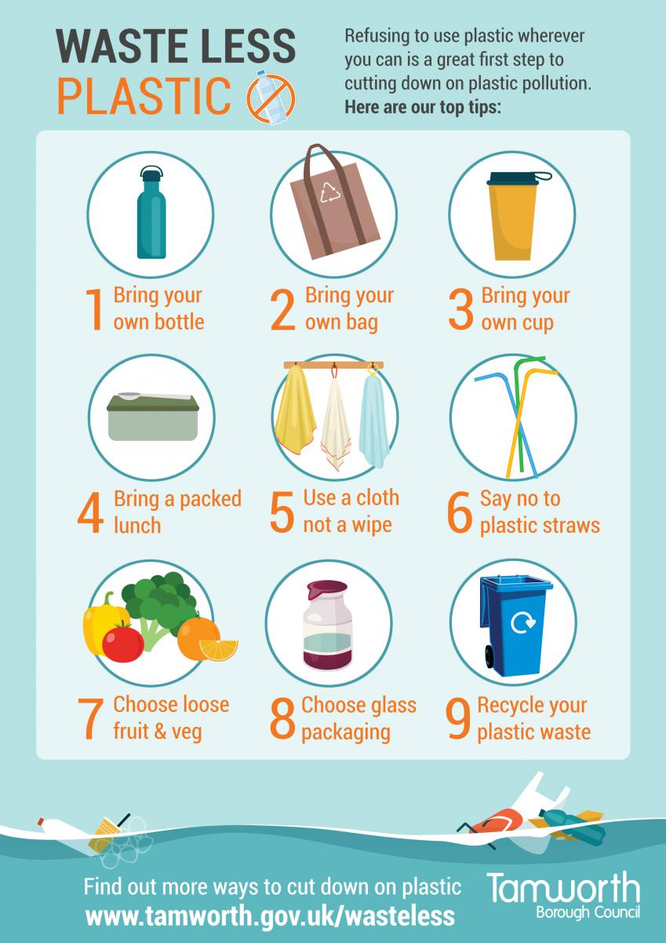
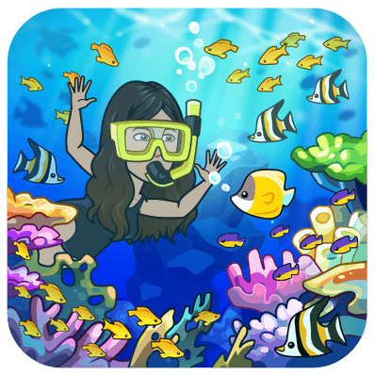
We can all do our part to help our oceans and wildlife!
Here are some simple ways to help. What else can we do?

Slide 23
STEP 5: DEVELOP SOLUTIONS
Bring your own water bottle everywhere.
Stop using plastic straws.
Stop using plastic containers and only use glass.
Organize a beach or park cleanup.

Slide 24
STEP 6: SELECT BEST SOLUTION
FEASIBILITY
 | High | Medium | Low
High | Bring your own water bottle everywhere
Medium |  | Clean up a park or beach
Low |  |  | Replace all plastic and use only glass containers
EFFECTIVENESS

