Slide 1
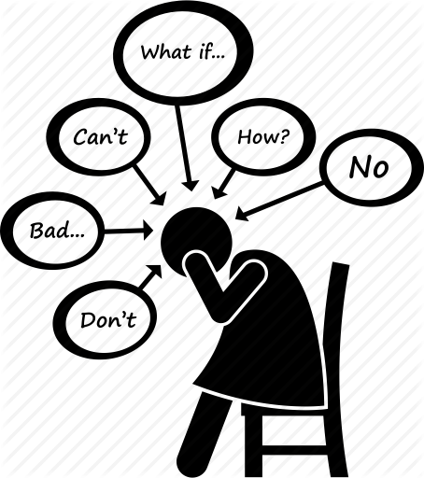
Public Policy Analyst (PPA)
How do we overcome test anxiety?
Social Problem: Test Anxiety
Grades 3 - 5
PS 85 Q: Mr. Tsimis

Slide 2
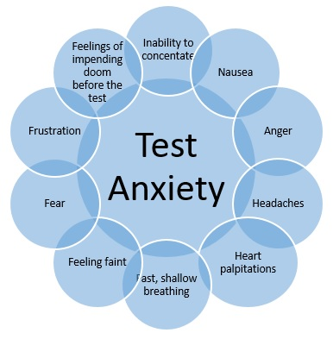
Step 1: What’s the problem?
The problem is students in grades 3 - 5 at PS 85 Q experience high test anxiety. Test anxiety can lead to:
Physical symptoms / ailments
Negative thoughts and perceptions
Fixed mindset (instead of growth mindset)
Poor self-esteem issues
Poor academic performance

Slide 3
Turn & Talk
Have you ever experienced test anxiety?
If so, what was it like?

Slide 4
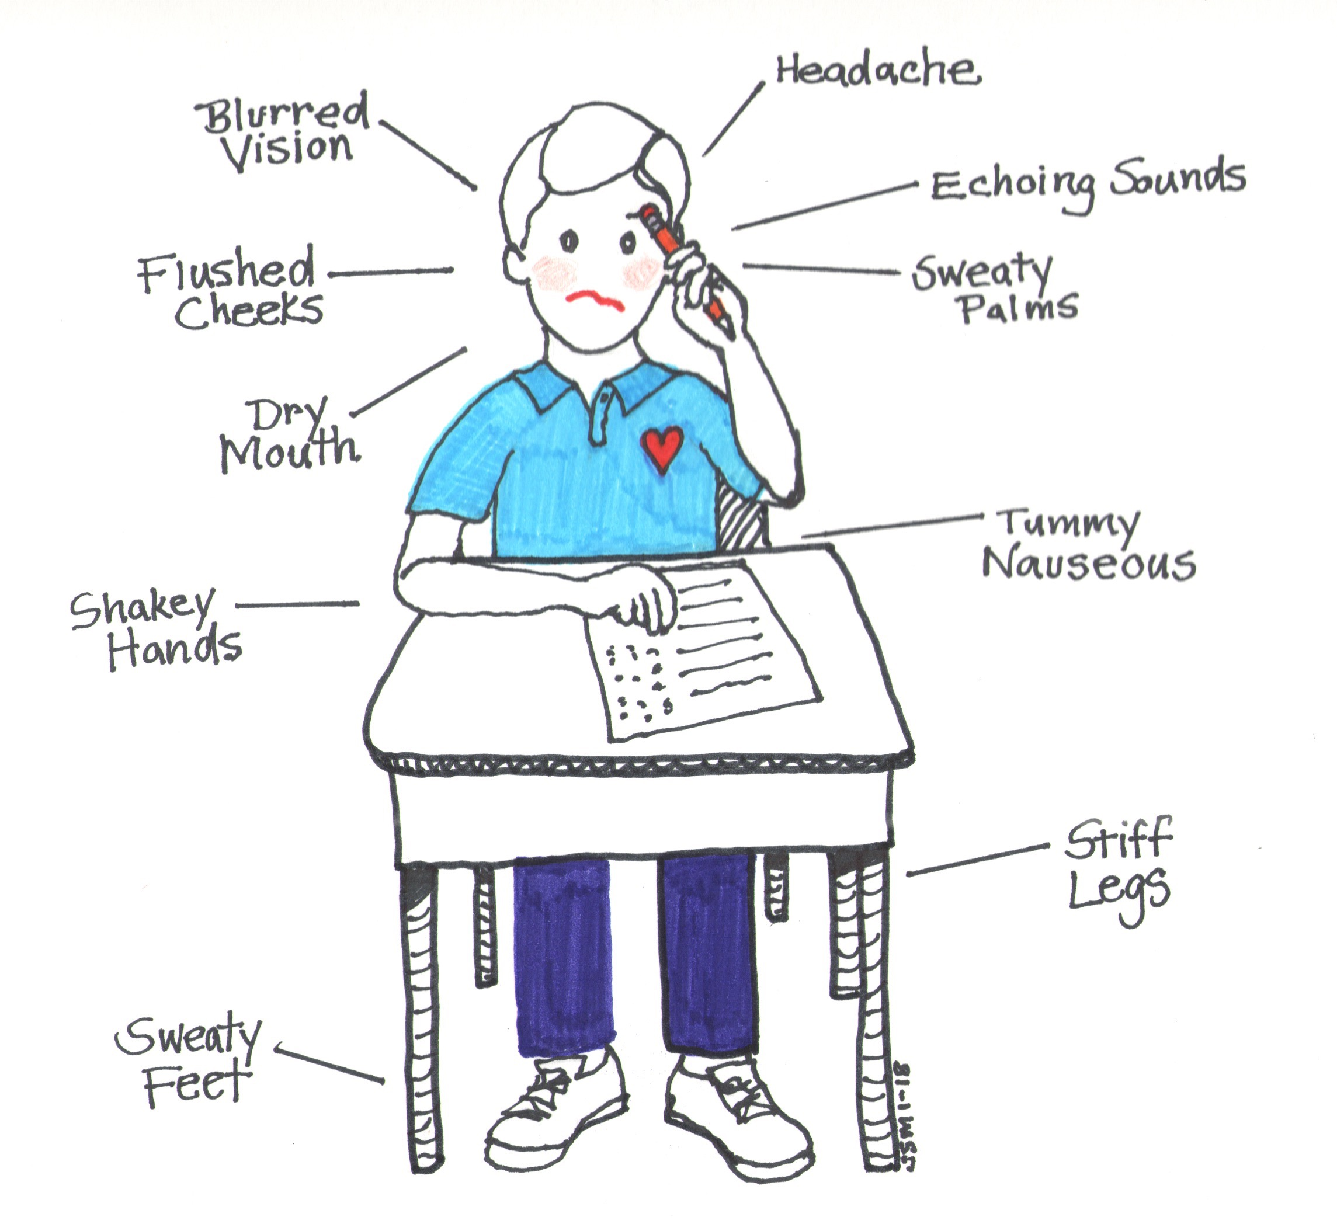
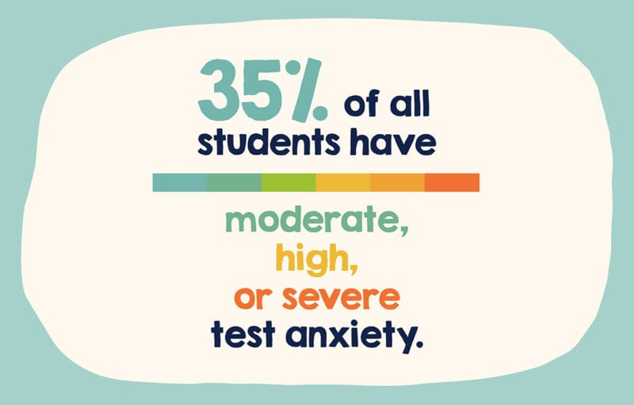
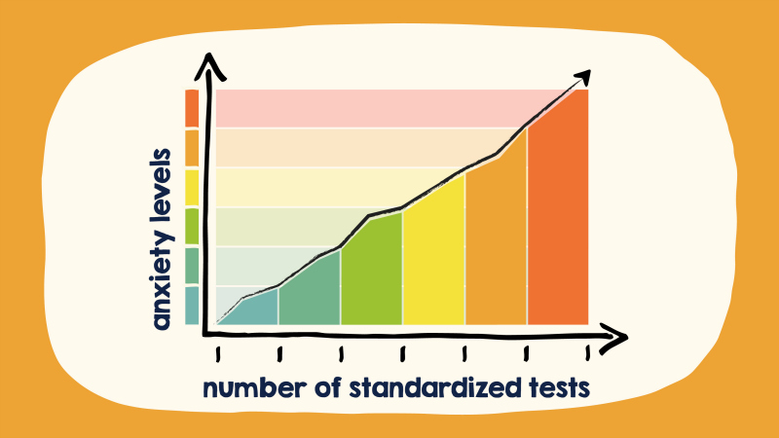
Step 2: Gather the Evidence
Do Your Research
Research articles about test anxiety. Read and reflect.
Teacher & Student Observations
Make observations about the signs of test anxiety.
Student Survey
Take a survey about how you feel before, during, and after a test.

Slide 5
Step 3: Identify the Causes
Fear of failure. While the pressure to perform can act as a motivator, it can also be devastating to individuals who tie their self-worth to the outcome of a test.
Lack of preparation. Waiting until the last minute or not studying at all can leave individuals feeling anxious and overwhelmed.
Poor test history. Previous problems or bad experiences with test-taking can lead to a negative mindset and influence performance on future tests.
(Source: ADAA, 2020)

Slide 6
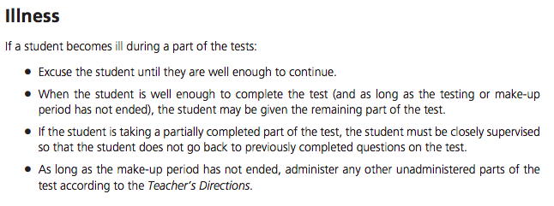
Step 4: Evaluate an Existing Policy
NYC Department of Education: Test Administration Handbook: Elementary and Middle Schools 2020-2021
There is currently no existing policy for how to manage test anxiety.

Slide 7
Step 4: Evaluate an Existing Policy
Social Emotional Learning (SEL) Programs are currently used to foster social-emotional growth that can lead to decreased test anxiety.

Slide 8
Step 5: Develop Solutions
Some solutions to reduce test anxiety include:
Prepare well for an exam.
Watch self-talk.
Visualize success.
Use relaxation strategies.
Stay healthy.
Focus during the test.
Reward yourself.
Have family workshops.

Slide 9
Step 6: Select the Best Solution
FEASIBILITY
 | HIGH | MEDIUM | LOW
HIGH | Prepare for an exam: Form study groups for upcoming assessments. Use relaxation strategies: Practice relaxation strategies in class daily.
MEDIUM | Have family workshops: Facilitate family workshops teaching them strategies on how to manage their child’s test anxiety.
LOW
E
F
F
E
C
T
I
V
E
N
E
S
S

Slide 10
Student Reflection
Which one of the strategies will you use to help you next time when you feel test anxiety?
Are there other solutions that can help with test anxiety that we did not discuss today?

