Slide 1
Google Classroom Assignments
Jennifer Tineo
P.S. 148 Queens

Slide 2
The 6 steps of Public Policy Analyst (ppa)
1. Define the Problem
2. Gather the Evidence
3. Identify the Causes
4. Evaluate an Existing Policy
5. Develop Solutions
6. Select the Best Solution (Feasibility vs. Effectiveness)

Slide 3
Step 1: Define the Problem
What is the ?
Students are not turning in their assignments on Google Classroom.

Slide 4
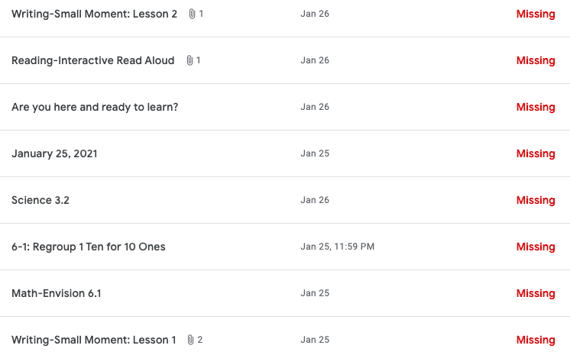
What does an incomplete assignment look like?
All the red words labeled Missing means that there was no assignment turned in.

Slide 5
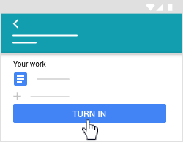
What does turning in an assignment look like?
Click on the assignment on your google classroom.
Read the instructions to the assignment.
Complete the assignment before the due date.
Click turn in.

Slide 6
Step 2: Gather The Evidence
When looking at the Grades tab on Google Classroom, you will find all the students who have not turned in the assignment.
There are about 20 out of 25 students who complete the assignments that are posted daily in our Google Classroom. This means that there are about 5 students who are not completing the assignments.

Slide 7
Step 3: Identify The Causes
Why are you not turning in the assignments?
Did you sign into your Google Classroom?
Did you forget you had an assignment?
Did you log into our live Zoom meeting to hear the teacher discuss the assignment?
Perhaps, you don’t know how to complete the assignment?

Slide 8
Step 4: Evaluate the Existing Policy
As a student, your responsibilities or jobs include paying attention in class and doing your best work in the effort to learn the lessons taught. Completing your assignments is also part of your job.

Slide 9
Step 5: Develop Solutions
How can we solve this problem?
In the next 2 slides, you will find some solutions to our problem. Then, I want you to think of some solutions to add to our slides.

Slide 10
Solution # 1
Here’s one solution:
We can earn class dojo points for every day that we turn in all of our assignments.

Slide 11
Solution # 2
Here’s another solution:
At the end of the live Zoom meeting, the teacher will remind the students of the assignments that are due for that given day.

Slide 12
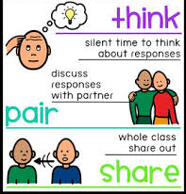
Solution # 3
Turn and talk: what are other solutions that we can add to our slides that will encourage students to turn in all of their assignments?
Student solutions:
1.
2.
3.

Slide 13
Step 6: Select the Best Solution
We need to make sure that we pick a solution that answers two important questions:
Feasibility- how easily it can be implemented or put into effect?
Effectiveness- will it fix the problem?

Slide 14
Feasibility vs. Effectiveness
Feasibility
High
Medium
Low
High
Effectiveness
Medium
Low

