Slide 1
Lack of Participation in Remote Learning
IS 10Q
Catherine Sarlo
Special Education (6-7-8 Math)

Slide 2
Six Steps- Public Policy Analyst (PPA)
1.) Define the PROBLEM
2.) Gather EVIDENCE
3.) Identify CAUSES
4.) Evaluate an Existing Policy
5.) Develop Solution
6.) Select the BEST Solution (Feasibility vs Effectiveness)

Slide 3
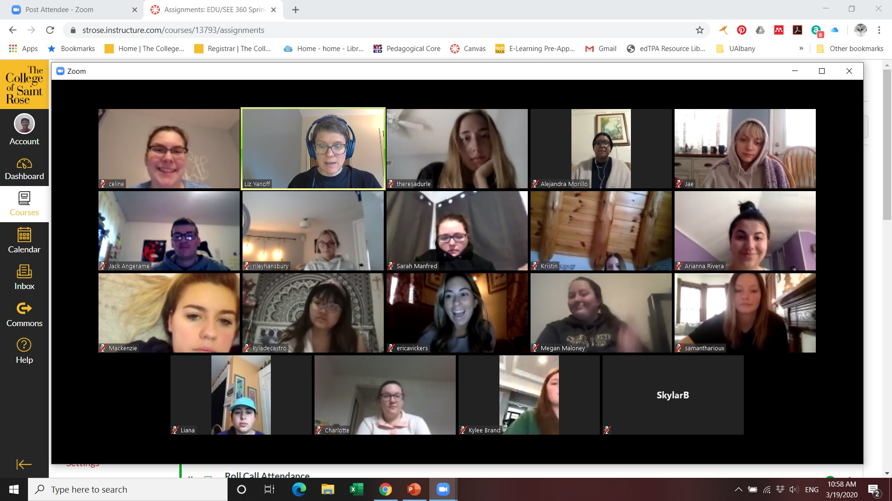
Define the Problem
Remote learning is where the student and the educator, or information source, are not physically present in a traditional classroom environment. Information is relayed through technology, such as discussion boards, video conferencing, and online assessments. Remote Learning can occur synchronously with real-time peer-to-peer interaction and collaboration, or asynchronously, with self-paced learning activities that take place independently of the instructor. (https://tophat.com/glossary)
Participation in remote learning is a holistically evaluating a students level of engagement in the online class.
-Volunteering in class discussion- Camera on –Responding when called on

Slide 4
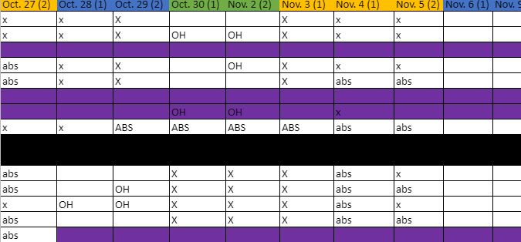
Gather Evidence
Evidence of online participation-
Attendance Records- Rosters with notes on student camera use-
Tally marks for Participation – Strikes for no response when called on

Slide 5
Identify cause
Lack of technology
Camera Broken – Microphone Broken
Student doesn’t care
Family Issues – Sibling Home-
Distracted by things at home- Noise- Construction- Video Games
No structure or Routine
Work is too Hard

Slide 6
Evaluate the Existing Policy
Classroom Policy-
To earn points for class participation student must
-Volunteer
Camera on or Respond when called on
Be Present
If the student is called on 3-4 times over the course of the period and they do not respond or have not participated parents are called.

Slide 7
Develop a Solution
Behavior Charts-emailed to parents
Incentives for Participation – Post cards- Raffles- Certificates- Themed Days- Homework Passes- ETC
Phone calls home- Both Positive and Negative

Slide 8
Select the best solution (feasibility vs Effectiveness)
Feasibility
Effectiveness
 | High | Medium | Low
High | Parents called to school for meeting | Phone Calls home to Parents | Incentives- Certificates and Homework Passes
Medium | Incentives- Rewards Raffles- Tokens- ETC | Incentives- Spirit Days Remote- Movie Day | Allowing students time to share weekly Advisory Period
Low | Student of the Week or Month | Grades drop and mandatory enrichment program | Email behavior Chart to parents

