Slide 1
Time Management
Mr. Polcari I.S. 126

Slide 2
Steps for a Public Policy Analysis
Define the problem
Gather Evidence
Identify Causes
Evaluate a Policy
Develop Solutions
Select the Best Solution

Slide 3
Step 1: Define the Problem
Students are not completing independent assignments outside of school hours.

Slide 4
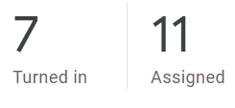
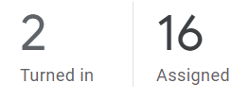
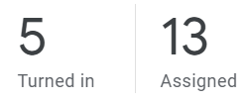
Step 2: Gather Evidence
Upon review of student work submissions, less than half of the students in this Social Studies class submitted work that required independant completion.
Students who log on while remote, will typically utilize class time to complete assignments. When assignments or completed either partially or in full outside of normal class hours, they are either incomplete or submitted blank.

Slide 5
Step 3: Identify Causes
Possible Causes
Lack of or shared technology
Distractions at home
Lack of motivation
Unclear directions
Procrastination
Difficulty balancing the workload remotely
Trouble managing time/due dates

Slide 6
Why do Students Struggle with Time Managment?
Some possible causes of poor time management:
Being Overextended | Fear of failure | Low Motivation | Lack of training | Perfectionism | Fear and Anxiety
Lack of interest in a subject | Reading Difficulty | Trouble getting started | You feel isolated | Difficulty with deadlines | Avoidance of negative experiences
Learn More Here: Click Here

Slide 7
Watch a short video about time management
Click here to watch a helpful video on time management.

Slide 8
Step 4: Evaluate a Policy
The policy for submitting assignments is that they must be submitted on time to receive full credit unless a clear reason is presented by a parent. We do accept late work on google classroom however 10 points are deducted for each day the assignment is past due. Students are made aware of the submission and grading policy both on the course overview distributed at the beginning of the year as well as when the work is initially assigned.

Slide 9
Step 5: Develop Solutions
Possible Solutions
Have students complete a time management tracker to designate specific work times and log progress
Break up assignments into smaller sections that can be completed in piecemeal daily
Eliminate due dates and allow students to submit work at any time throughout the unit

Slide 10
Step 6: Select the best solution
Feasibility
 | High | Medium | Low
High | Have students complete a time management tracker to designate specific work times and log progress | Break up assignments into smaller sections that can be completed in piecemeal daily
Medium
Low |  |  | Eliminate due dates and allow students to submit work at any time throughout the unit
Effectiveness

