Slide 1
Cyberbullying
Marina Pantelidis
I.S. 126
mpantelidis@schools.nyc.gov

Slide 2
Defining the Social Problem
Your Logo
What is cyberbullying?
Where does cyberbullying occur?

Slide 3
Cyberbullying
Your Logo
Cyberbullying is bullying that takes place over digital devices like cell phones, computers, and tablets.
The most common places where cyberbullying occurs are:
Social Media (Facebook, Instagram, Snapchat, and Tik Tok)
Text messaging and messaging apps
Online gaming communities

Slide 4
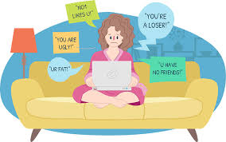
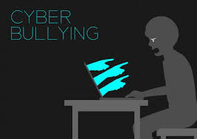
Gathering Evidence of the Problem
Cyberbullying can cause students to be or feel excluded at school.
Students can suffer from anxiety, depression, and other stress-related conditions.
May lose interest in school, which usually results in them having a much higher rate of absenteeism than non-bullied students.
https://www.verywellfamily.com/what-are-the-effects-of-cyberbullying-460558

Slide 5
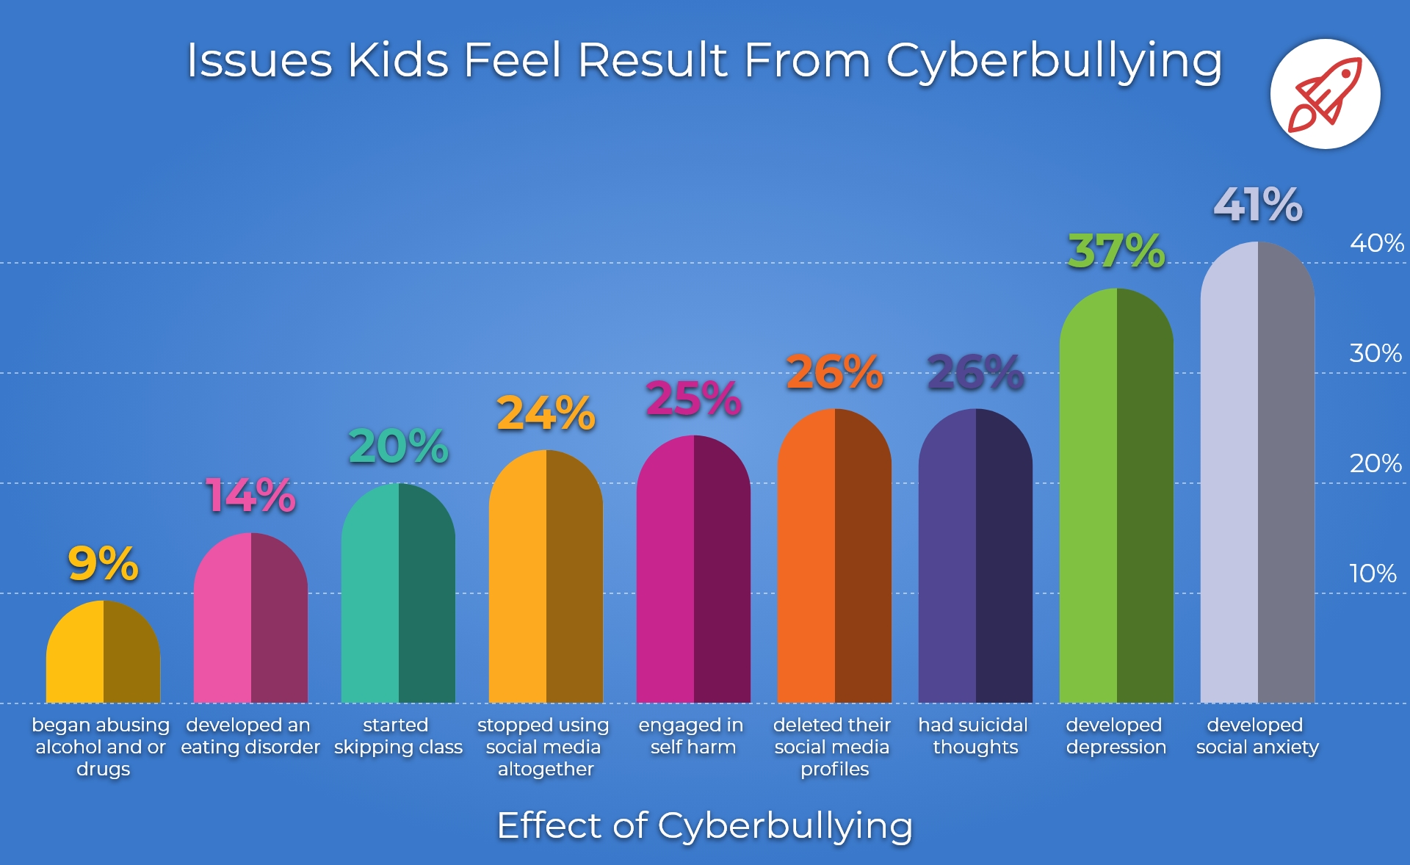
Evidence of the Problem

Slide 6
Identifying the Causes of the Problem
Technology
Supervision
Form of Entertainment
Peer Pressure
Enables students to distance themselves from a situation even while they are in it.
Students might choose to cyberbully because they lack attention and supervision from parents
Students who are bored and looking for entertainment will sometimes resort to cyberbullying.
Sometimes, students will cyberbully to fit in with a group of friends or a clique.

Slide 7
Evaluating the Existing Public Policies
Classroom Expectations and Rules
School Code of Conduct (ROAR Matrix)
Mission and Vision Statement

Slide 8
Developing Public Policy Solutions
Reach out for help
Training for School Staff
Social Media Restrictions

Slide 9
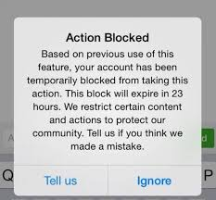
Selecting the Best Public Policy Solution
Reach out for help – Students should reach out to someone they trust (parent, friend, teacher, guidance counselor, or a trusted adult) to help process what’s going on and work through it
Social Media- Instagram recently introduced a new feature called “Restrict”, which allows users to secretly block other users from commenting on their posts without that user knowing.
Training for School Staff- This training can be used to help detect and prevent online bullying.

Slide 10
Turn and Talk:
Based on the 3 previous solutions for the problem of cyberbullying, which solution has the highest feasibility and effectiveness?

Slide 11
STRATEGY
DAY 1
DAY 3
DAY 1
Feasibility
 | High | Medium | Low
High
Medium | Social Media | Reaching Out for Help
Low |  | Training for School Staff
Effectiveness
Venus is terribly hot
Saturn has rings
Pluto is a dwarf planet

