Slide 1
Unhealthy Eating Habits
Sophia Natsis
PS 398Q

Slide 2
What is P.P.A?
* P.P.A stands for Public Policy Analyst
* A P.P.A helps us to solve problems that are going on in the world.
There are six steps that we have to follow:
Step 1: Define the Problem
Step 4: Evaluate an Existing Policy
Step 5: Develop Solutions
Step 2: Gather the Evidence
Step 3: Identify the Cause
Step 6: Select the Best Solutions

Slide 3
Step 1: Define the Problem
Problem:
Students do not make healthy eating choices.

Slide 4
Step 2: Gather the evidence
Let us think about what we bring to school for lunch. Is part of your lunch, cookies, chips, or a juice??
Many of you bring cookies, chips and juices that have a lot of sugar in them as part of your lunch.

Slide 5
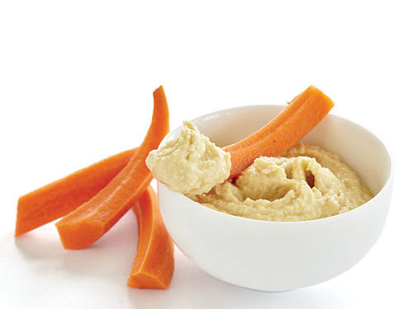
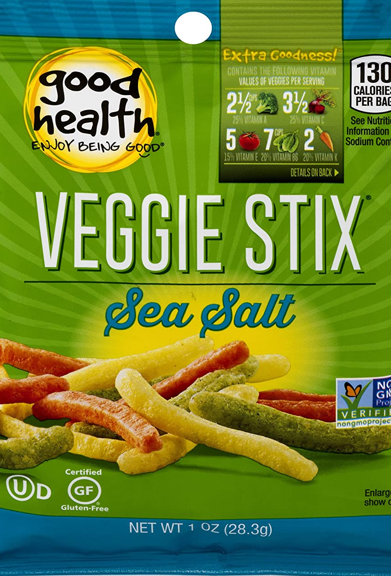
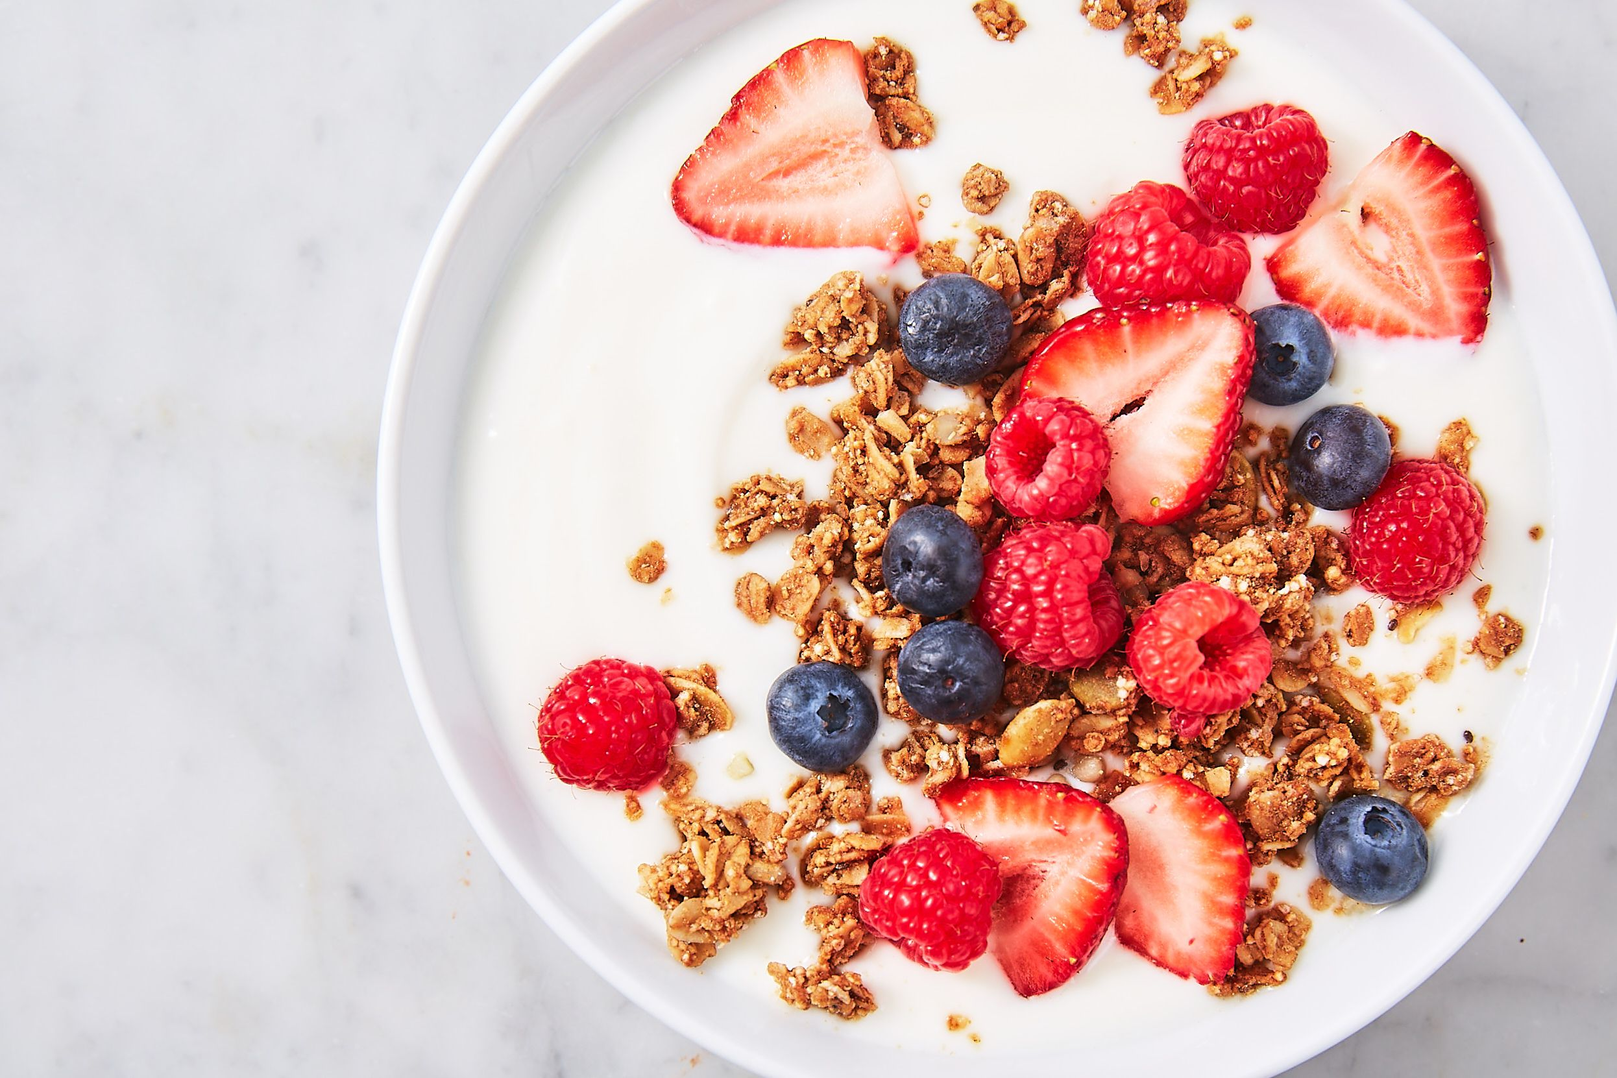
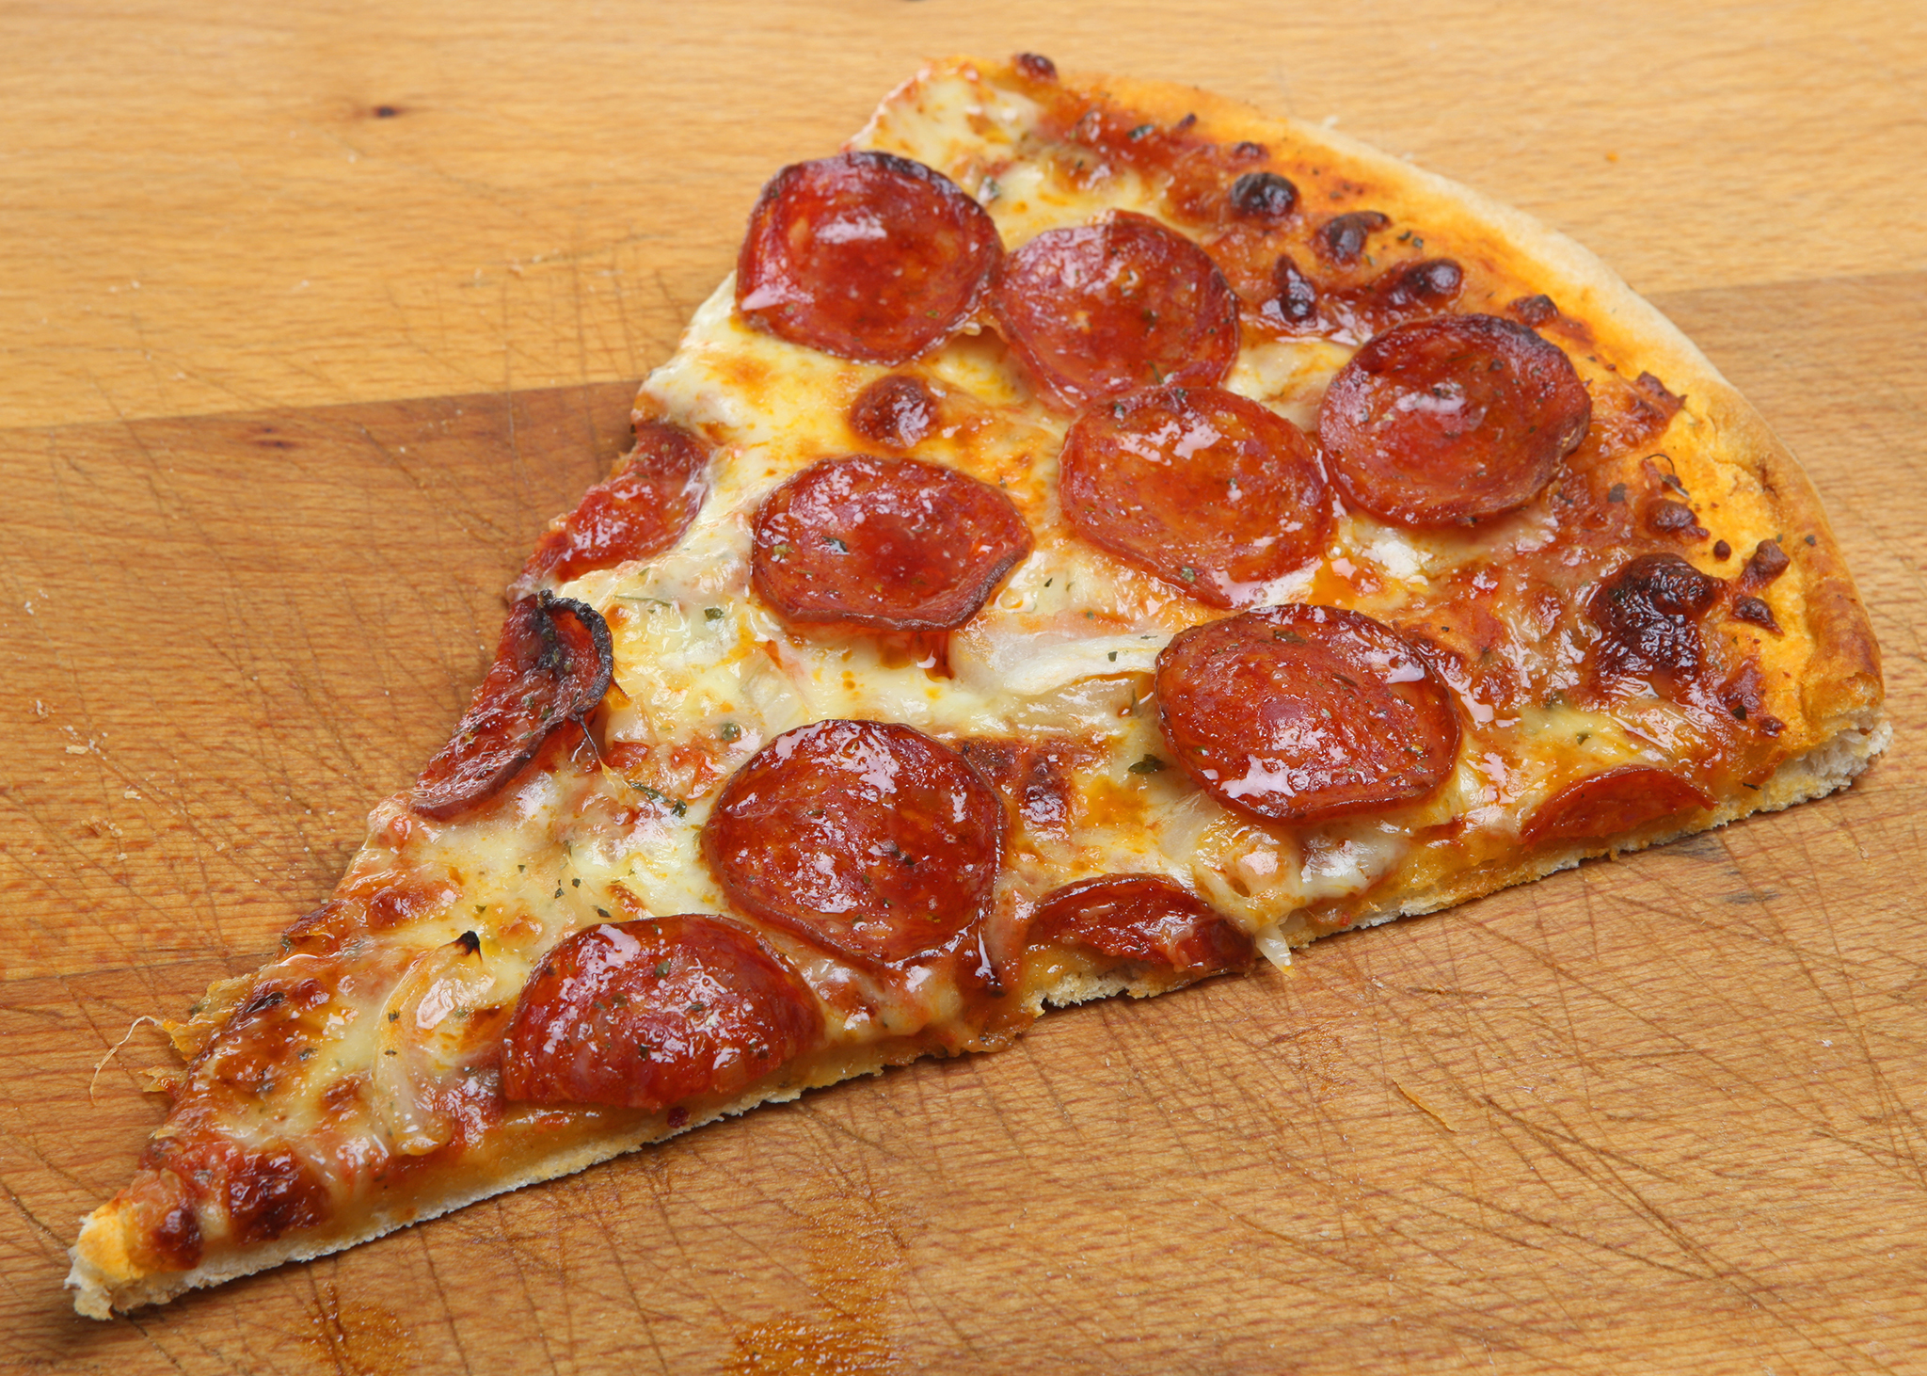
Game Time!
Directions: Look at the foods that are being compared below. Circle the healthier food choice.
Carrot sticks or veggie sticks
Yogurt with fruit and granola or a fruit roll up
Pizza or broccoli with chicken

Slide 6
Step 3: Identify the causes
There is a lot of sugar and salt in junk food. When walking into the supermarket, healthier food choices are higher up on the shelves. The unhealthy choices are more at eye level for you to see first!

Slide 7
Step 4: Evaluate an Existing Policy
Now that we know what the problem is, we are going to look at policies that we have in place that might help with unhealthy eating habits.

Slide 8
Step 4: Evaluate an Existing Policy
Schools play an important role in helping with healthy eating habits. School meals include: milk, fruit, vegetables, whole grains.

Slide 9
Step 5: Develop Solutions
Try to eat a school lunch
If you bring lunch from home, make sure that it includes: milk or water, fruit, vegetables, whole grains.

Slide 10
Step 6: Select the Best Solutions
Feasibility
 | High | Medium | Low
High | Try to eat a school lunch
Medium |  | If you bring lunch from home, make sure that it includes: milk or water, fruit, vegetables, whole grains.
Low
Effectiveness

