Slide 1
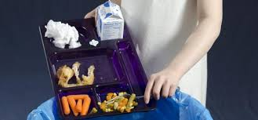
Tales of a Cafeteria Wasteland
The Food Waste Problem in Public Schools
Tina Papamichael
tpapamichael@schools.nyc.gov
The Judge Charles Vallone School, P.S. 85

Slide 2
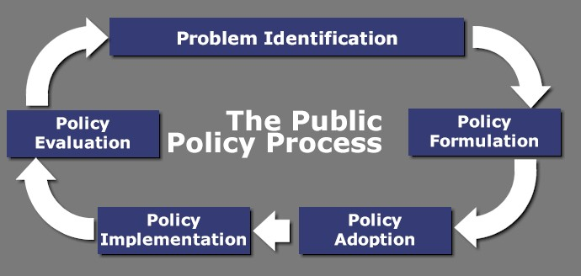
The 6 Steps of the Public Policy Analyst (PPA)
What is the meaning of public policy analysis?
Public policy analysis involves evaluating issues of public importance with the objective of providing facts and statistics about the extent and impact of the various policies of the government. The basic objective of public policy analysis is to assess the degree to which the policies are meeting their goals.
Define the Problem.
Gather the Evidence.
Identify the Causes.
Evaluate an Existing Policy.
Develop Solutions.
Select the Best Solution (Feasibility vs. Effectiveness)

Slide 3
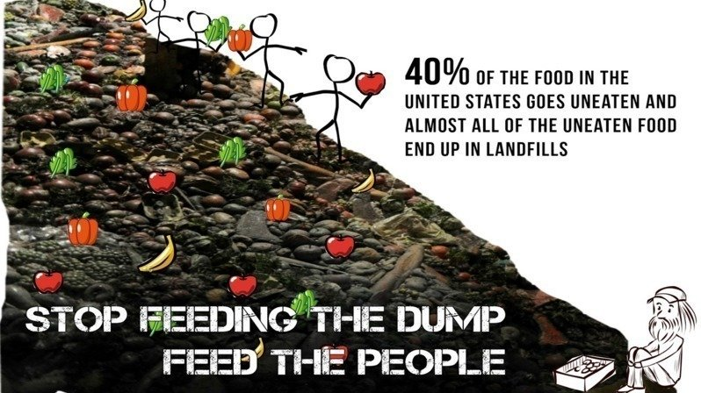
Define the Problem
An ongoing, public, social issue in the United States is food waste. The average American family disposes about 25% of the food and beverages they buy. Furthermore, the Natural Resources Defense Council found that 40% of the food in the United States goes uneaten and almost all of that food end up in landfills. Schools are one of the biggest culprits of this problem.

Slide 4
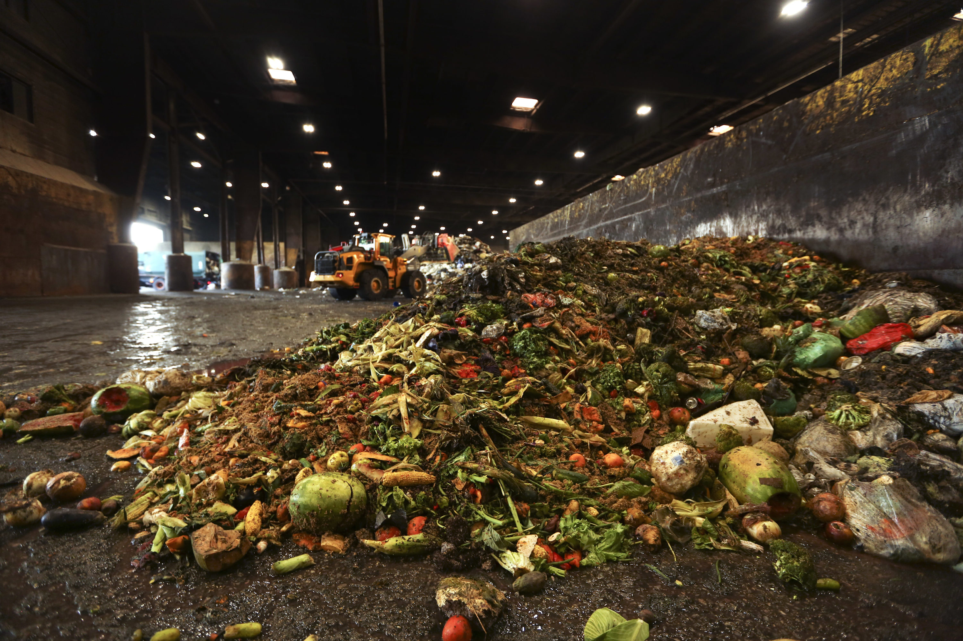
Gather the Evidence
In the United States, 44% of food wastes come from residents, 33% from restaurants, 11% from grocery stores, 10% from schools, and 2% from factories. American landfills are overwrought with unwanted food, yet 49 million Americans declare that their households are not secure in terms of daily food sources.
According to World Wildlife Fund report, U.S. school food waste totals 530,000 tons per year and costs as much as $9.7 million a day to manage, which breaks down to about 39.2 pounds of food waste and 19.4 gallons of milk thrown out per school per year, based on the results from the 46-school sample across nine cities.

Slide 5
Identify the Causes
In our Schools
Requiring students to place fruits and veggies on their tray increases waste substantially.
Disposable plates resulted in more food wasted than did permanent plates
Requiring students to take every part of the offered lunch
Serving more unappealing lunch choices
There are a variety of reasons for wasting food, both in our private homes as well as in schools
In our Homes
Food Labels are often a misleading factor for throwing away, perfectly healthy and edible food. In their homes, many people tend to dispose of food based on the expiration dates which are not always accurate.
People tend to buy more than they need, because they impulse buy in large bulk supermarkets. Therefore there is more food spoilage and waste.

Slide 6
Evaluate an Existing Policy
Zero Waste in Schools
Zero Waste Schools is a program whose main goal is to convert all recyclable and compostable waste from approximately 100 Zero Waste Schools in five years, starting in 2016. Zero Waste Schools work towards achieving zero waste by: • Reducing materials they use. • Reusing materials instead of buying new materials. • Recycling clean paper & cardboard, metal, glass, plastic, and cartons, and separating food scraps & food-soiled paper (organics) for composting.

Slide 7
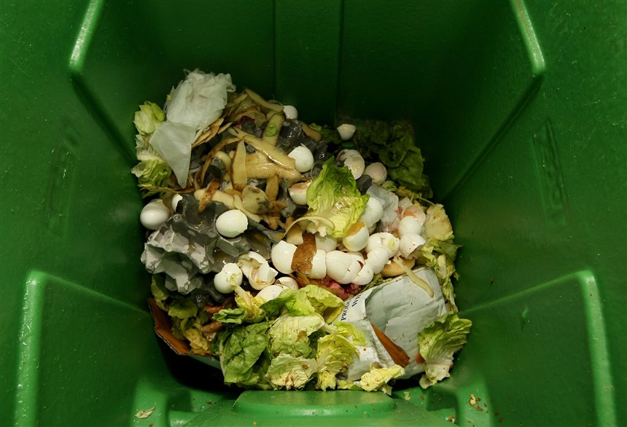
Develop Solutions
Steps towards Sustainable Solutions
Students can donate left-over, untouched food to local food banks.
Have students engage in the development of mini-gardens and compost bins.
Designate a hands on learning day where students learn about home food management, date labels, and ways to prevent food wastes from going to landfills.

Slide 8
Select the Best Solution (Feasibility vs. Effectiveness)
Feasibility
 | High | Medium | Low
High | Involve Students Student taste testing Let students vote on new menu items Have a contest for creative menu item names. Generate excitement among students with cooking demos or classes Students sustain school gardens Learning Lunches to educate on food waste | A minimum of 30-minute lunch period to allow students to sit and eat instead of feeling rushed. | Donate leftover food items to food banks or shelters.
Medium | Students who may not have time to finish their meal during the designated lunch period may save leftovers for later in the day. | Implement Share Tables to allow children to put items that they do not want on the share table for other students to take. | Schedule recess before lunch, so that children are not rushing to eat, resulting in much of their lunch being thrown away.
Low | Salad Bars in schools with variety of choices | Cutting up whole fruits and veggies makes them easier and more appealing for kids to eat. | Offer vs. Serve Allow students to decline foods that they are not interested in eating.
Effectiveness

Slide 9
References
https://www.change.org/p/new-york-city-public-schools-are-school-wasting-join-the-food-waste-conversation-today
https://www.k12dive.com/news/report-nations-school-food-waste-may-be-as-much-as-530k-tons-annually
https://www.fns.usda.gov/cn/updated-offer-vs-serve-guidance-nslp-and-sbp-beginning-sy2015-16
https://grist.org/article/schools-waste-5-million-a-day-in-uneaten-food-heres-how-oakland-is-reinventing-the-cafeteria/
https://www.nbcnews.com/mach/science/simple-way-we-might-turn-food-waste-green-energy-ncna827166
https://ensia.com/features/school-food-waste-solutions/
http://dsny.cityofnewyork.us/wp-content/uploads/2018/11/zero-waste-schools-guide-ZWSG.pdf

