Slide 1
Tracey Marchesini P.S. 69 Q February 2021

Slide 2
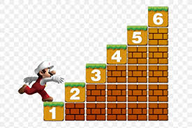
The 6 steps of the Public Policy Analyst
Define the Problem
2. Gather the Evidence
3. Identify the Causes
4. Evaluate the Existing Policy
5. Develop solutions
6. Select the Best Solution

Slide 3
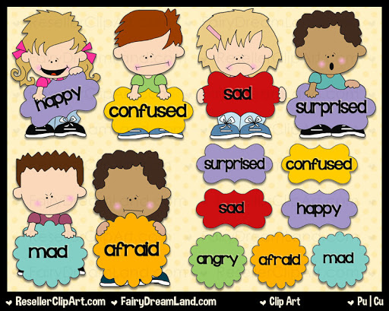
Step 1: Defining the Problem
Some students have trouble managing their emotions which inhibit them from learning.

Slide 4
Step 2: Gathering Evidence
Teacher Observations of Student
Meeting with Colleagues
Meeting with School Based Support Team
Meeting with Parents
Meeting with Parents and Student

Slide 5
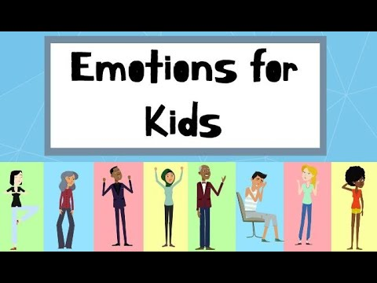
Step 3: Identify the Causes
What causes people to feel different emotions? Let’s watch the following video to learn about emotions.

Slide 6
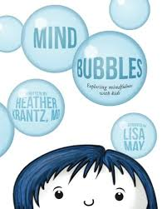
Let’s learn about thoughts and feelings that can fill your mind by reading Mind Bubbles.
https:/www.youtube.com/watch?v=MqQquQ6jvuA
Click to read

Slide 7
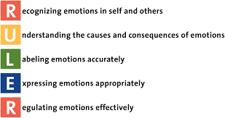
Step 4: Evaluating Existing Public Policies
The mood meter is a concrete tool that can shift conversations about feelings from rote responses like good to more nuanced responses like curious, excited, or worried.
Accurately labeling and discussing feelings helps adults and children acknowledge the role that emotions play throughout the day.
RULER is a systemic approach to SEL developed at the Center for Emotional Intelligence.
RULER aims to infuse the principles of emotional intelligence into the immune system of pre-K to 12 schools, informing how leaders lead, teachers teach, students learn, and families support students.

Slide 8
Step 5: Developing Solutions
The Benefits of Mindfulness
Research finds that practicing mindfulness:
decreases stress and anxiety
increases attention
improves interpersonal relationships
strengthens compassion felt for others
Notes:
Resource: https://www.mindfulschools.org/about-mindfulness/research-on-mindfulness/

Slide 9
What Are Benefits of Mindfulness?
Improved Attention
Improved attention helps students perform better on tasks that require an extensive concentration span.
Emotional Regulation
Mindfulness creates changes in the brain that help students focus and engage in tasks even when emotions are activated.
Greater Compassion
Mindfulness training helps students to more likely to help someone in need and have greater self-compassion.
Reduction of Stress and Anxiety
Mindfulness reduces feelings of stress which improves anxiety and helps students distress when placed in a stressful social situation.
Notes:
Resource: https://www.mindfulschools.org/about-mindfulness/research-on-mindfulness/

Slide 10
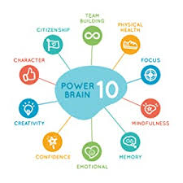
Research-based Activities: Using exercise science and cutting-edge research, we’ve designed all of GoNoodle’s activities to be healthy for the body, engaging for the attention, and beneficial to the brain in specific ways.
Brain Power Wellness teaches physical and mental brain breaks, mindfulness practices, and social emotional wellness strategies that support a positive classroom atmosphere.
Ways to Implement Mindfulness In The Classroom

Slide 11
Step 6: What’s the best solution?
Feasibility
 | High | Medium | Low
High |  |  | Removal from class.
Medium |  | Able to remain in class and participate in activity with class.
Low | Able to remain in class and NOT participate in activity with class.
Effectiveness

