Slide 1
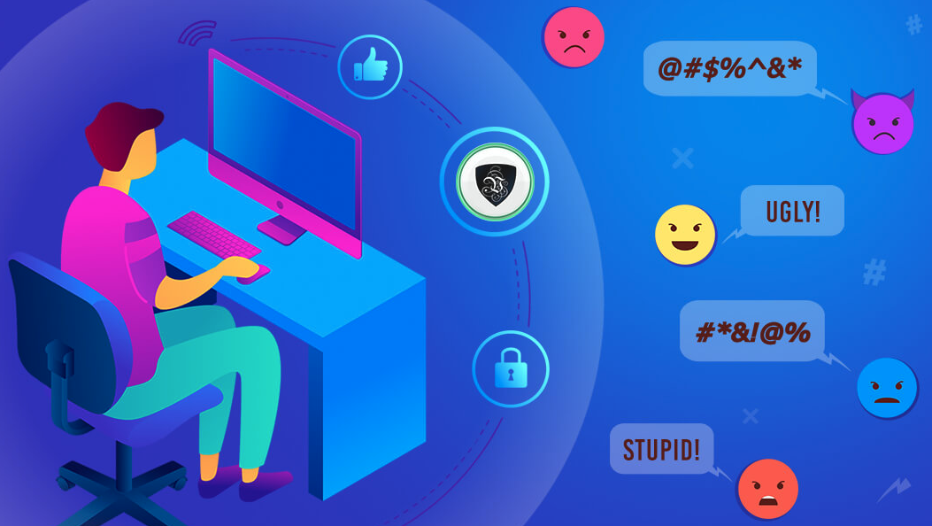
Cyberbullying
Ms. Jayme Klapman
I.S. 145Q
School of Innovation & Applied Learning

Slide 2
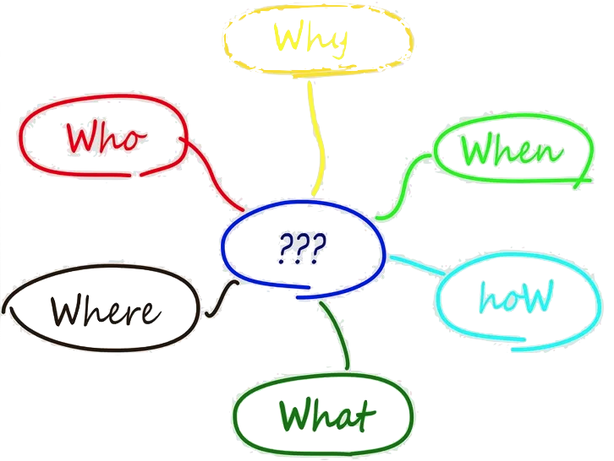
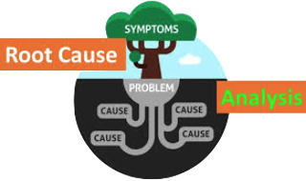
The 6 steps of the Public Policy Analyst
Define the Problem
Gather the Evidence
Identify the Causes
Evaluate the Existing Policy
Develop solutions
Select the Best Solution

Slide 3
Step 1: Define the Problem
Cyberbullying is the use of electronic communication to bully a person, typically by sending messages of an intimidating or threatening nature via social media.

Slide 4
Step 2: Gather the Evidence
Research the signs of Cyberbullying (StopBullying.org)
Students attendance (don’t want to attend school or try to leave early during the school day)
Teacher Observations of Student (looking for confidence level)
Meeting with Teacher Team of Student (look at interest level of activities that they once participated in.)
Meeting with School Based Support Team
Meeting with Parents
Meeting with Parents and Student

Slide 5
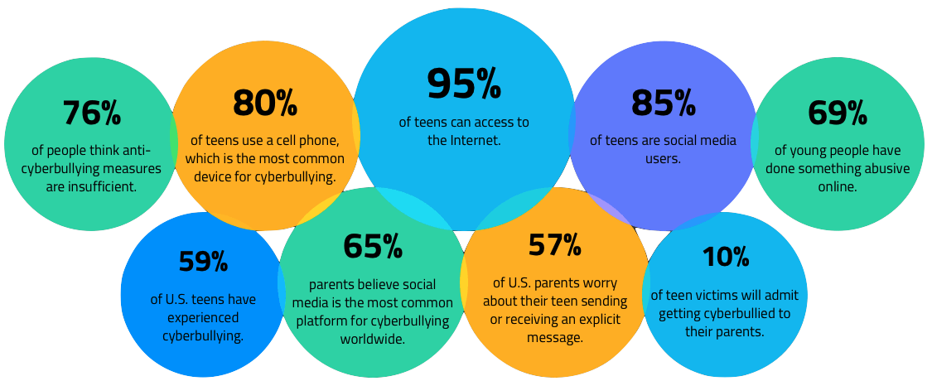
Step 3: Identify the Causes
Internet and Smartphones are apart of everyday life
Students have access to electronic devices at school and home (phones, laptops, IPads, etc.).
Lack of parental supervision.
Students don’t know the extent of how harmful bullying can be.
Prior to internet/social media students were able to escape their bully when they go home, now they are bullied 24/7

Slide 6
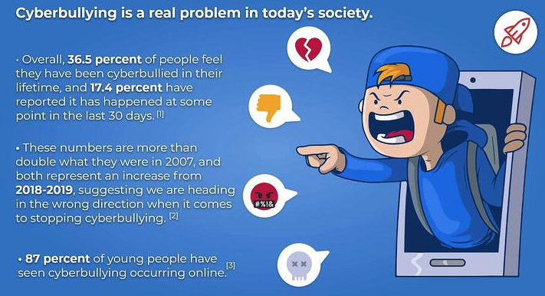
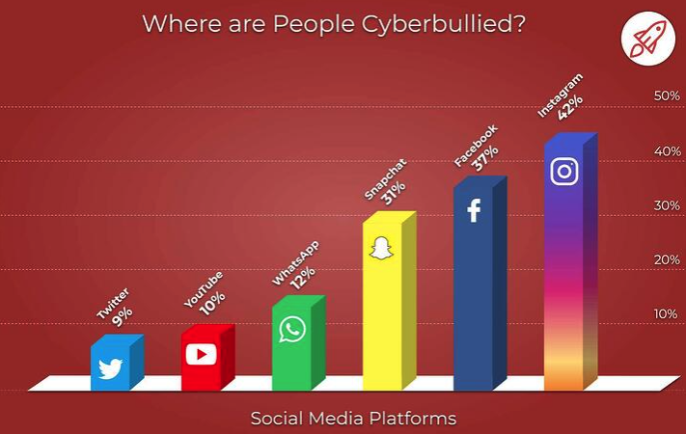
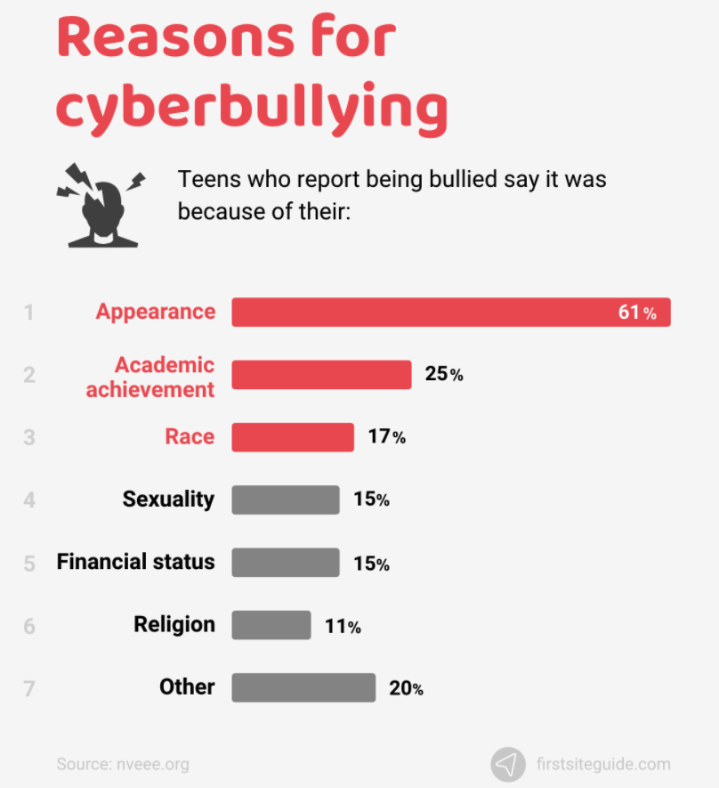
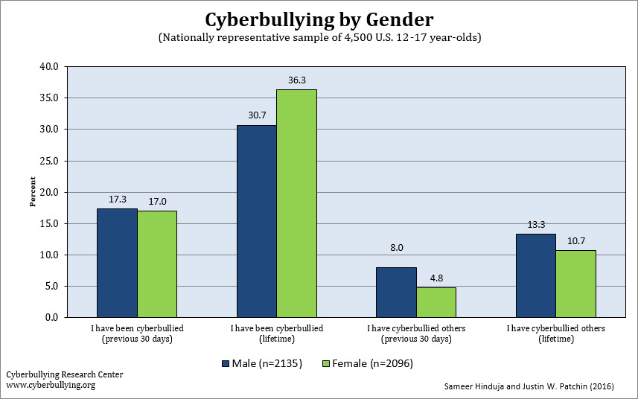
Step 3: Identify the Causes

Slide 7
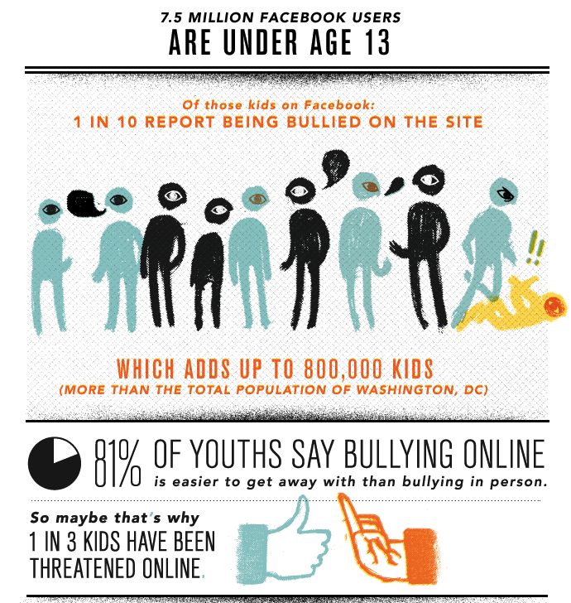
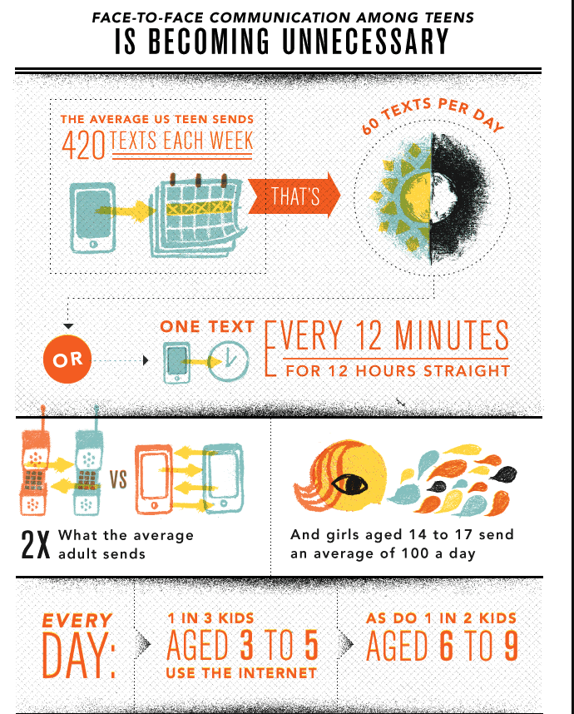
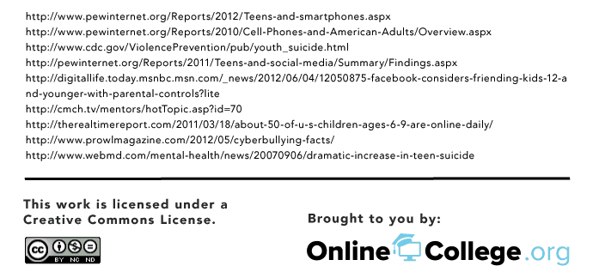
Step 3: Identify the Causes

Slide 8
Step 4: Evaluating Existing Public Policies
New York City Department of Education/District 30 Policy (NYC DOE)
School Policy (Respect for all)
Classroom Set of Rules (as per each teacher)

Slide 9
Step 5: Developing Solutions
Have a Advisory period built within school schedule (they can talk about a types of topics)
Bring more awareness of the effects cyberbullying has on children
Guest Speakers
Assemblies
Create Posters to hang around the school/community
Create a Stop Cyberbullying Day (include T-shirt w/ school logo)
Call to action days in the school (Anti-Bullying Day)
Stricter punishments for cyberbullying.
More support from school counselors and social worker.

Slide 10
Step 6: What’s the best solution?
Feasibility
 | High | Medium | Low
High |  | Awareness Day | Advisory Period within Schedule
Medium |  | Guest Speaker Assemblies Guidance Counselor | Stricter Punishment
Low |  | Posters
Effectiveness

