Slide 1
Food Miles
Kristen Jados
Q300

Slide 2
Public Policy Analysis (PPA):
Define the Problem
Gather Evidence
Identify Causes
Evaluate an Existing Policy
Develop Solutions
Select the Best Solution

Slide 3
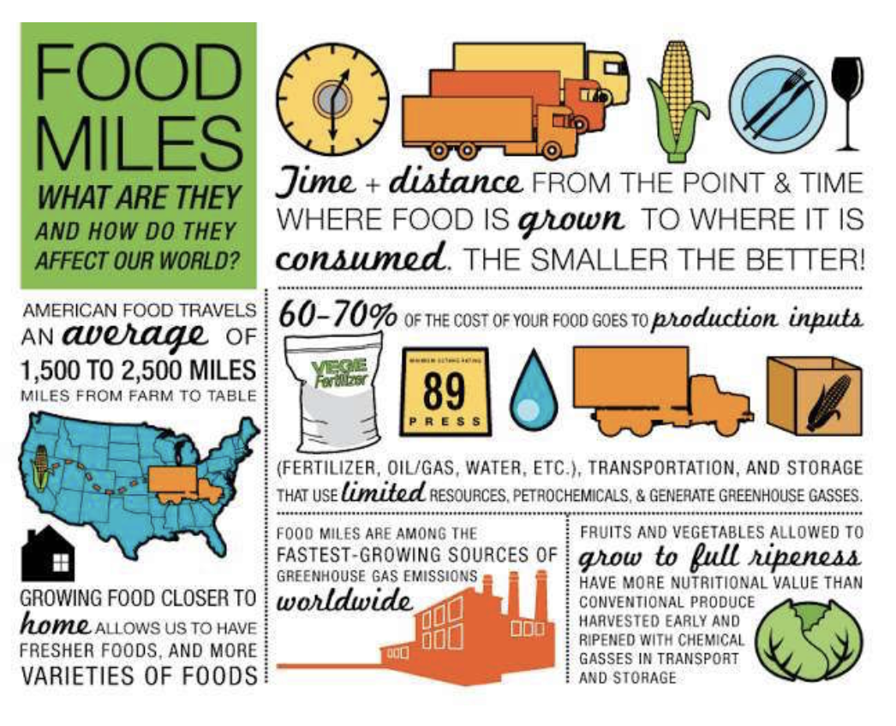
Problem: Where Does Our Produce Come From?
Much of the produce we see at grocery stores does NOT come from the United States.

Slide 4
Gathering Evidence:
Let’s watch the following video to better understand this problem.

Slide 5
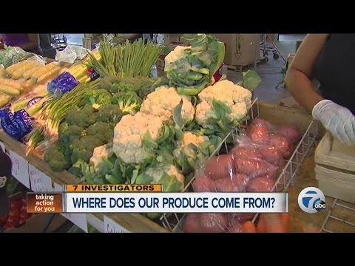

Slide 6
Don’t let the video crawl under your skin…
Today we will be thinking about solutions to this problem but first we are going to gather some more evidence.

Slide 7
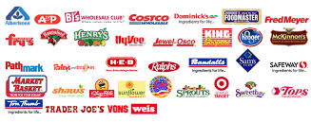
Where do you and your family get your groceries?
Think-Pair-Share: Where does your family get their fruits and vegetables from?

Slide 8
But where do the stores get the produce from? How long does it take to get to the stores?

Slide 9
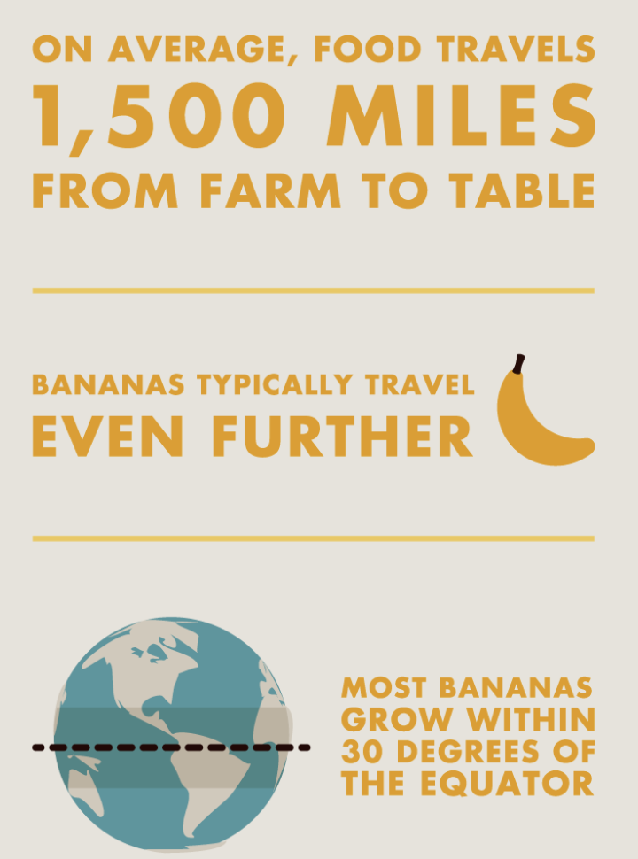
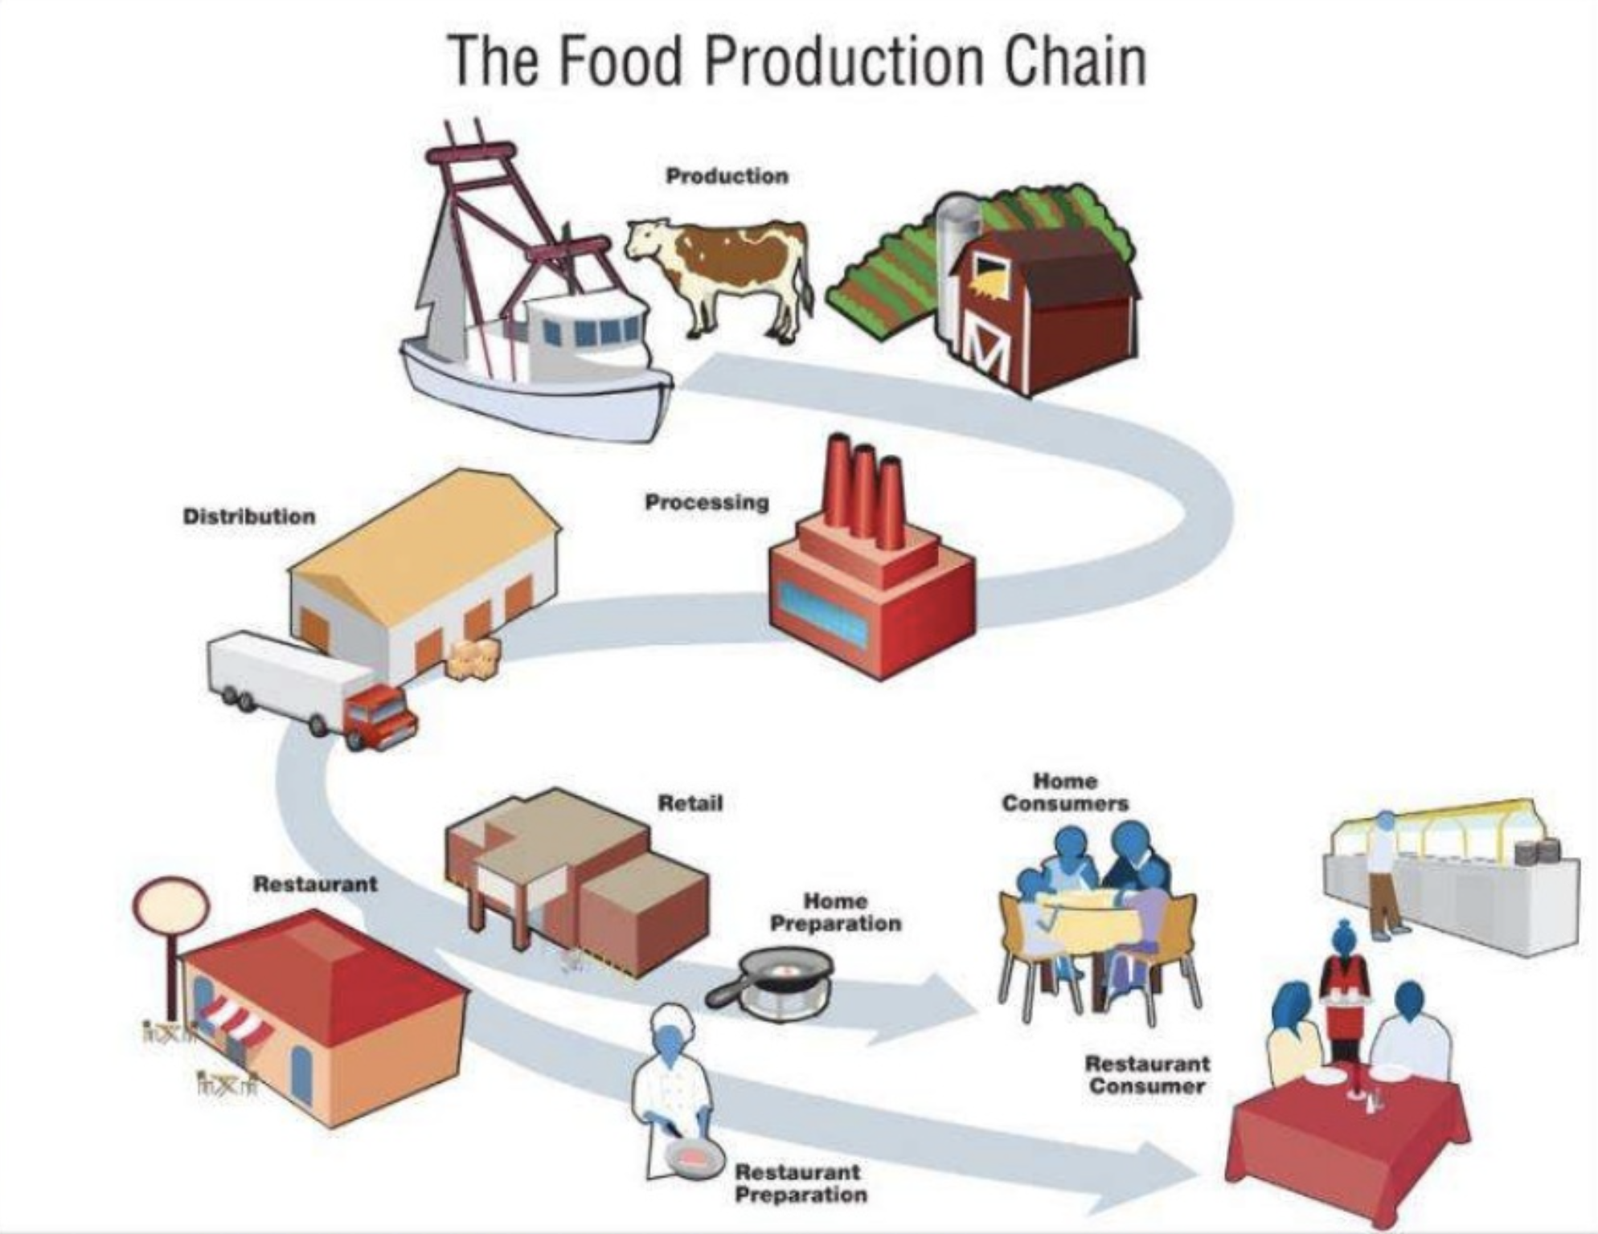
On average the American meal comes from 15 different countries!
Food takes about 14 days to get to YOUR supermarket

Slide 10
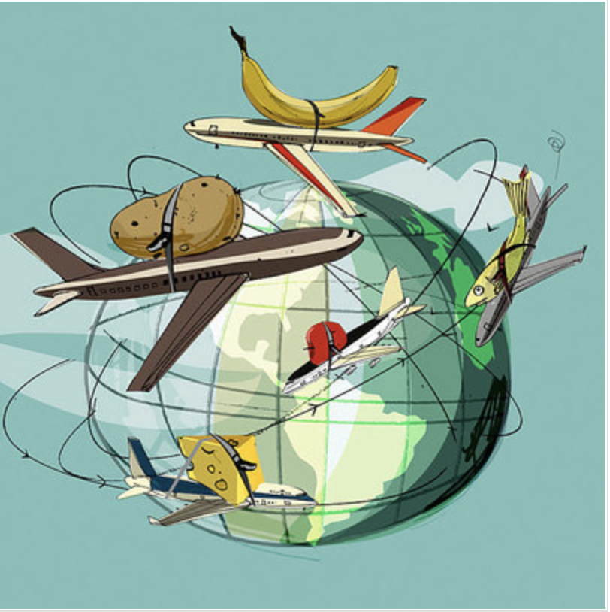
What causes this problem?
Often times we eat fruits and vegetables that are out of season. This means that the produce has to TRAVEL from areas where it is in season.

Slide 11
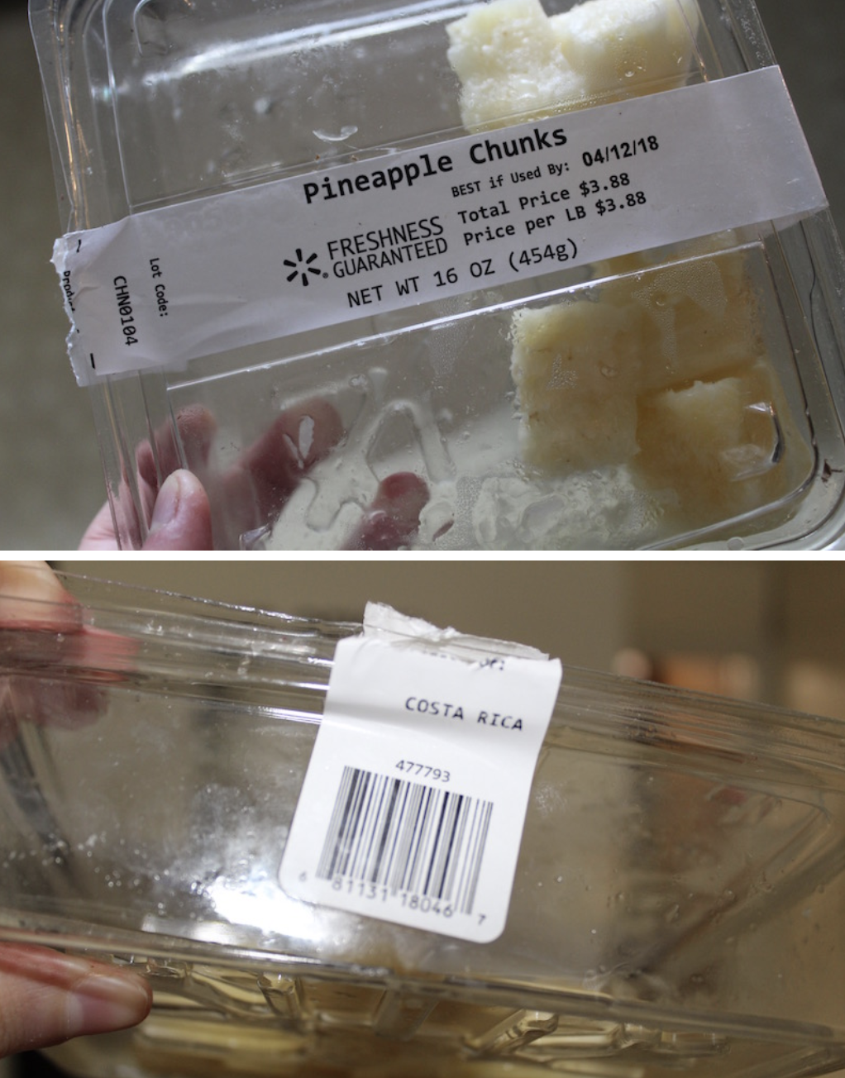
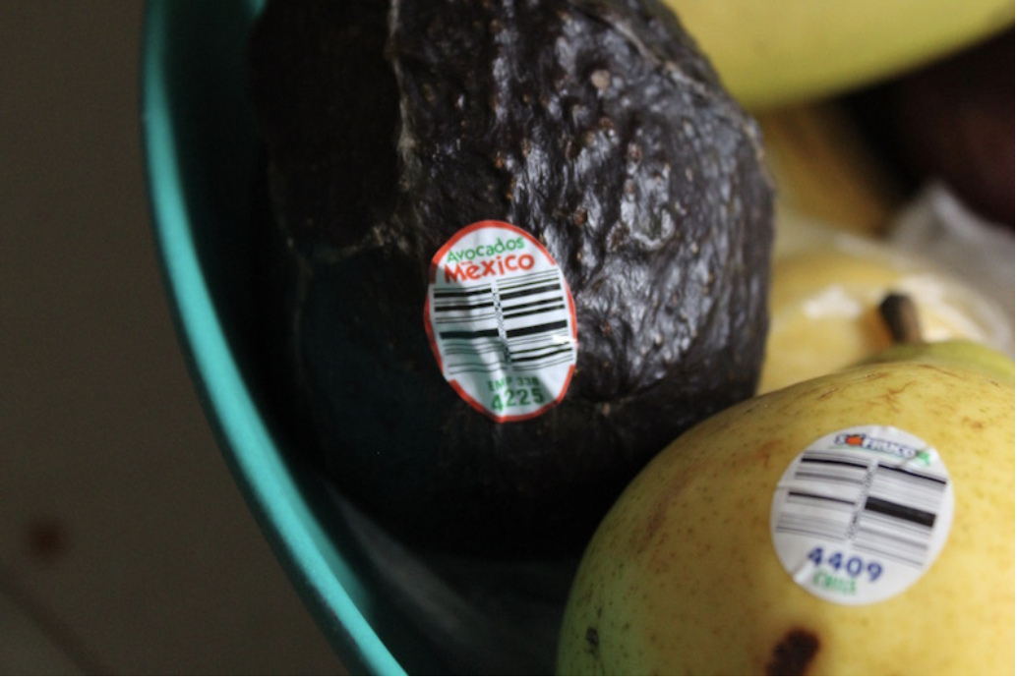

Slide 12
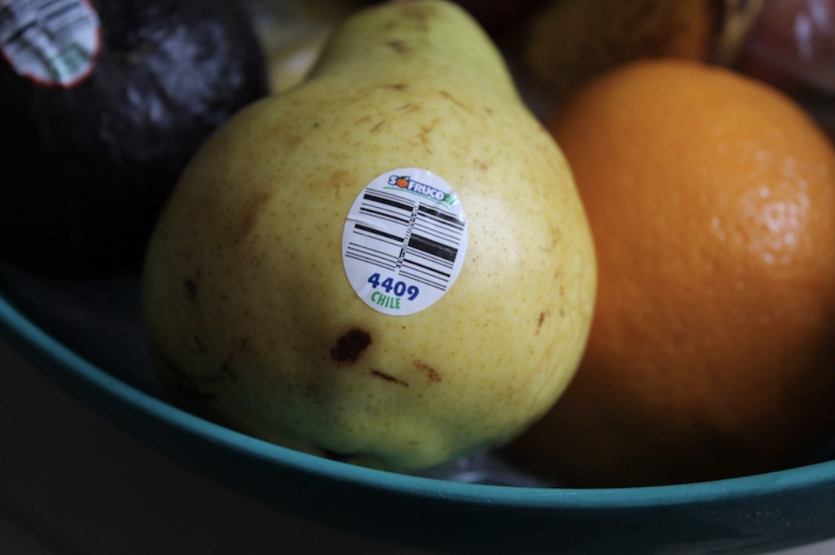
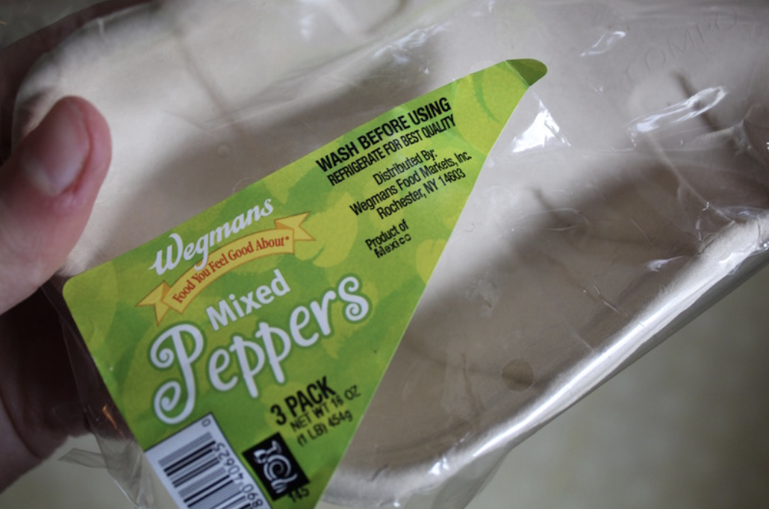

Slide 13
Traveling food means more gas...
which means more pollution.

Slide 14
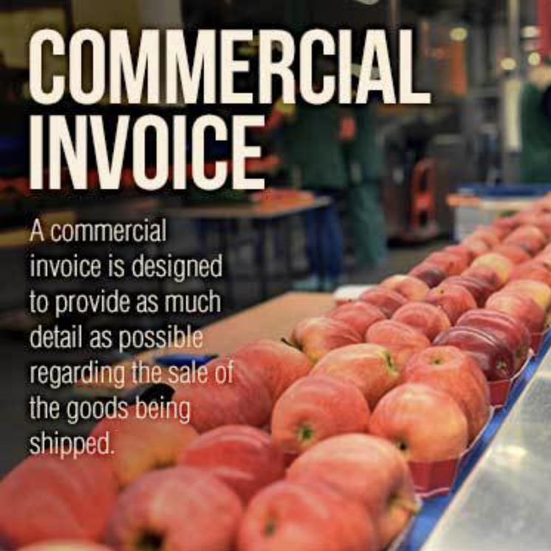
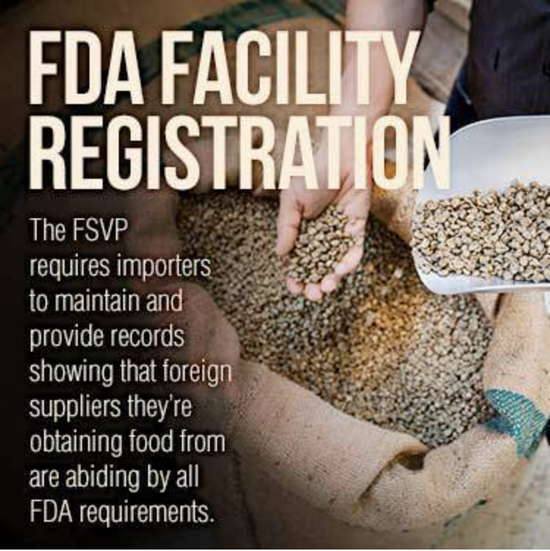
Evaluate Existing Policies

Slide 15
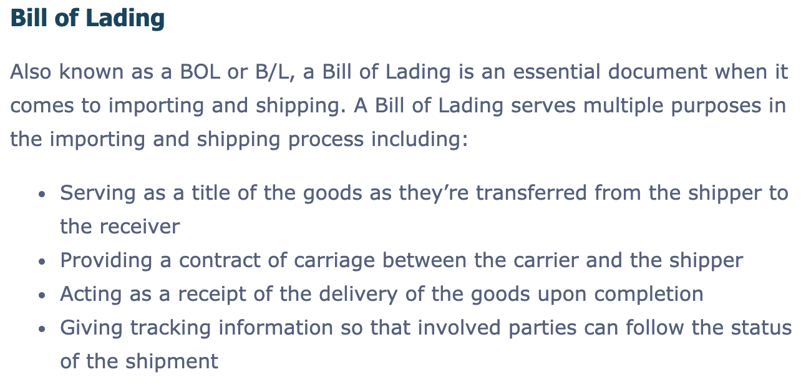
Online Resource

Slide 16
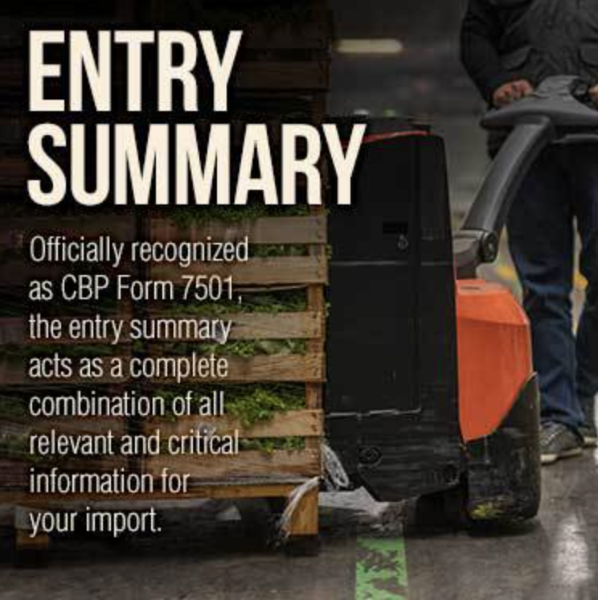
Online Resource

Slide 17
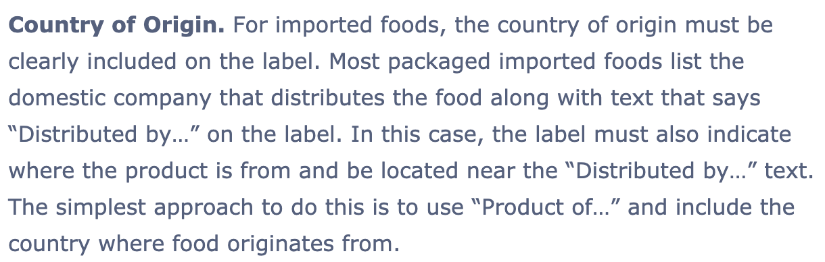
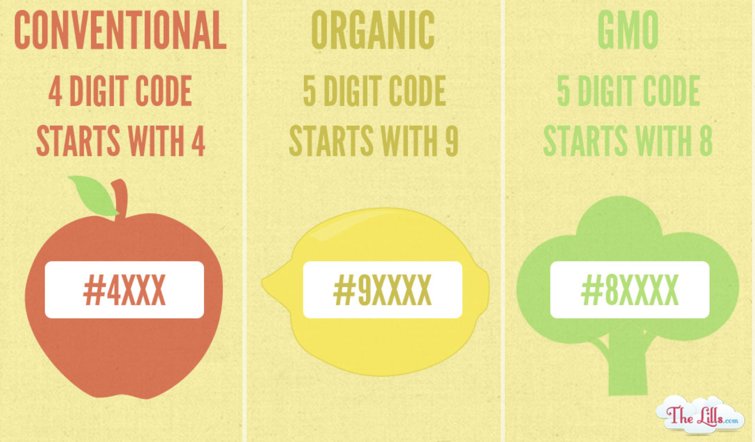
Online Resource

Slide 18
What can you do?
Let’s Brainstorm Solutions

Slide 19
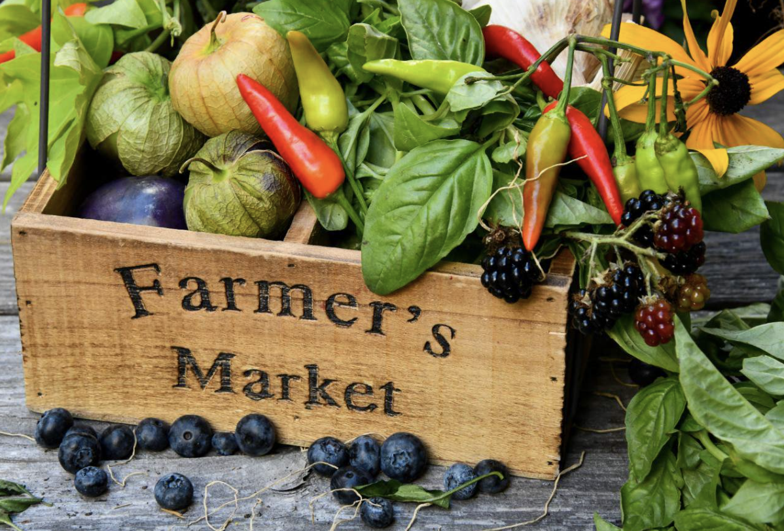
Develop Solutions:
Option #1 Shop Local
We can get our produce right from the source at local farmers markets.

Slide 20
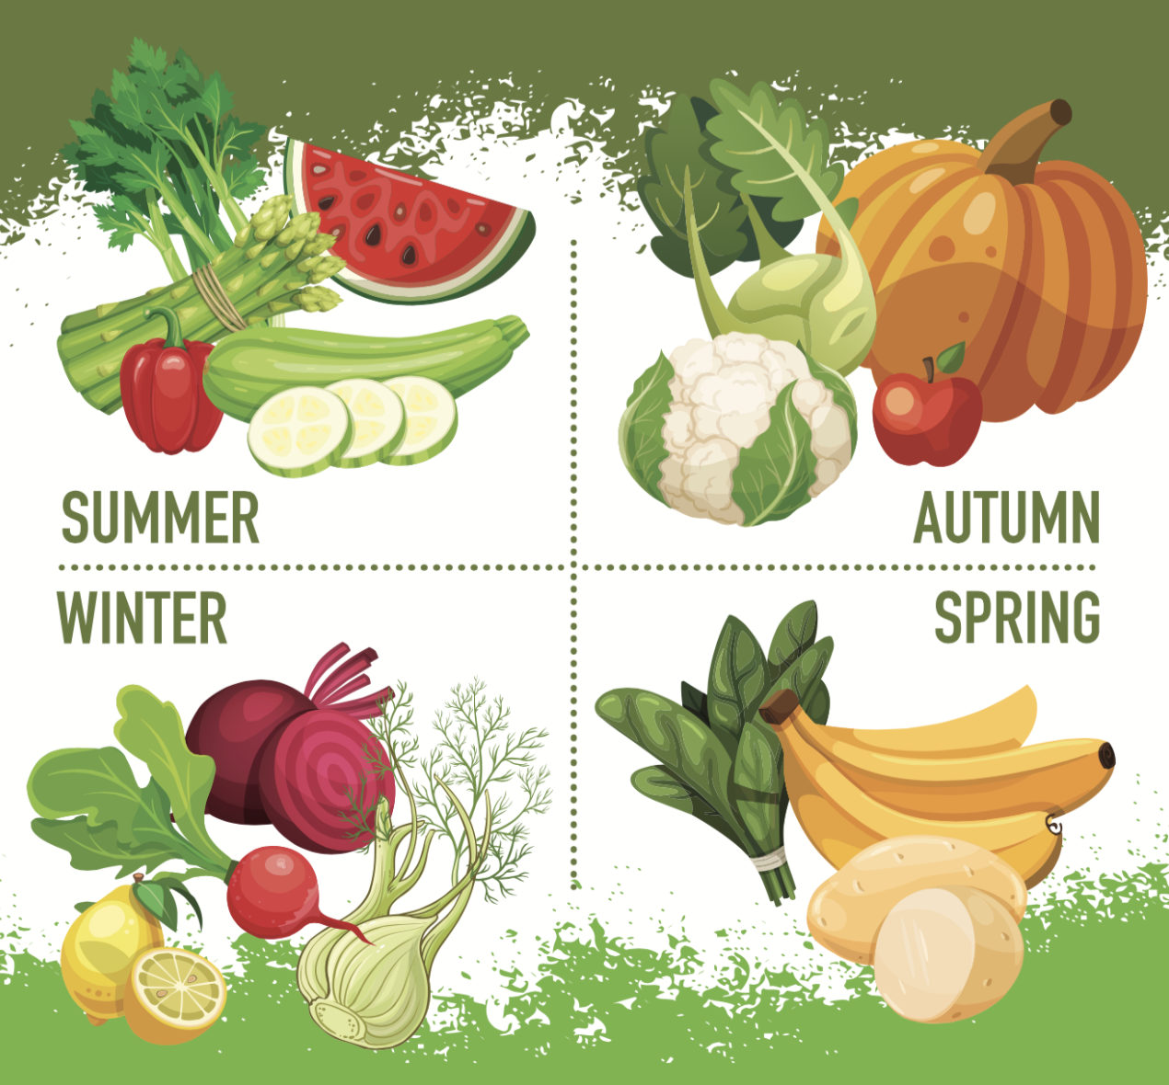
Option #2- Eat Seasonally
We can eat what is currently in season and consider canning items that go out of season.

Slide 21
Option #3-
Students will discuss in groups another option for dealing with the problem of food miles.

Slide 22
Selecting the Best Solution:
Let’s consider two things...
Feasibility-how easily can it be implemented?
Effectiveness-how much good will it do improve the problem?
Feasibility
 |  | HIGH | MEDIUM | LOW
 | HIGH
 | MEDIUM
 | LOW
Effectiveness

