Slide 1
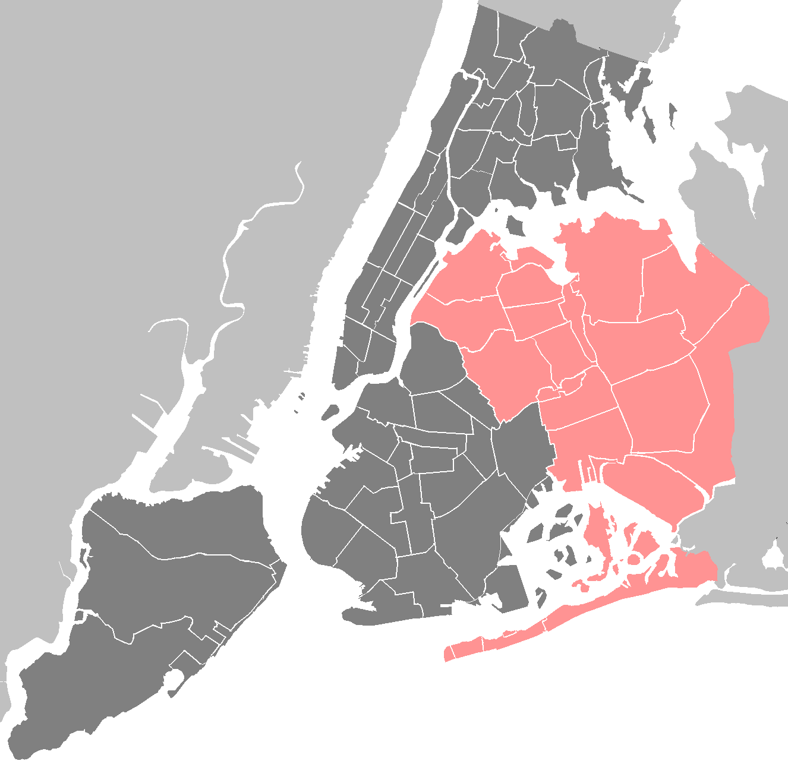
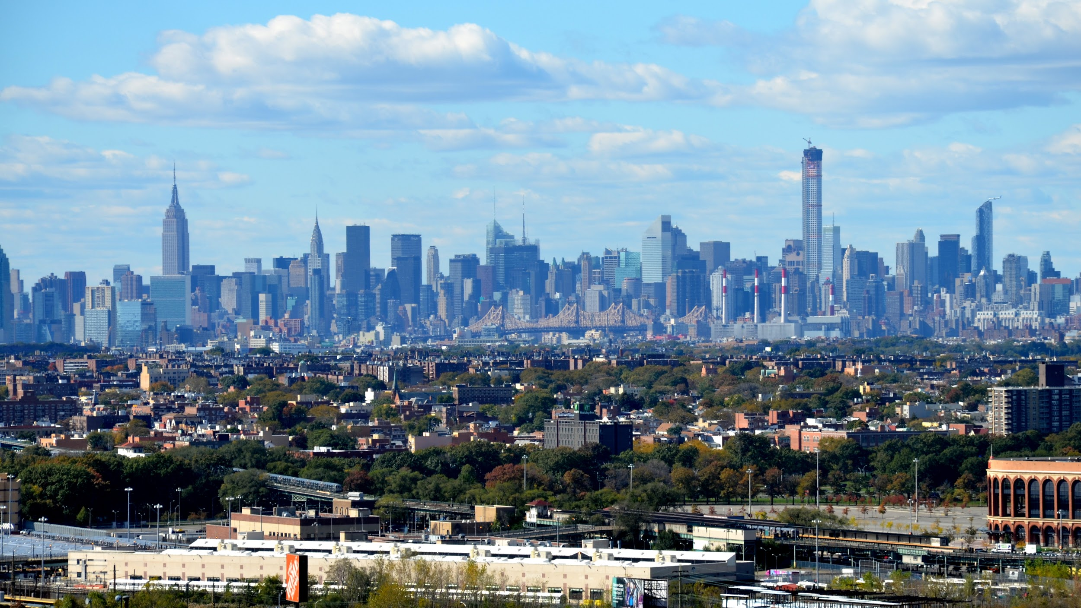
Food Insecurity
Queens, New York
A. Cheng
PS 84Q
The Steinway School

Slide 2
Public policy Analyst Steps:
Step #1: Defining the Social Problem
Step #2: Gathering Evidence of the Problem
Step #3: Identifying the Causes of the Problem
Step #4: Evaluating Existing Public Policies
Step #5: Developing Public Policy Solutions
Step #6: Selecting the Best Public Policy Solution

Slide 3
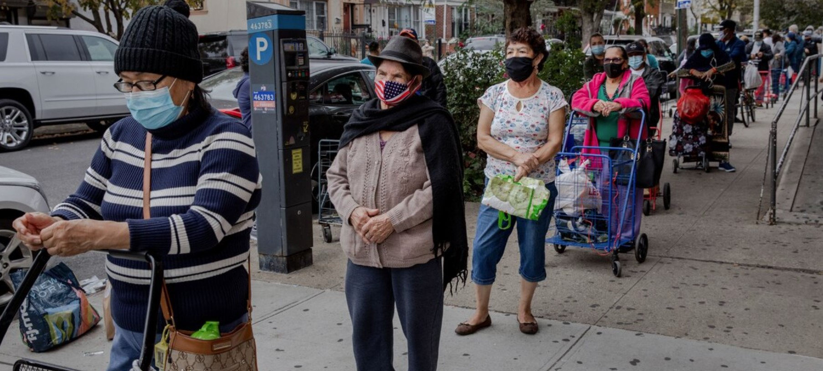
Define the Social Problem
What is food insecurity?
Feeding America defines food insecurity as “...a household’s inability to provide enough food for every person to live an active, healthy life. Food insecurity is one way we can measure and assess the risk of hunger.” Source: https://www.feedingamerica.org/hunger-in-america/food-insecurity
Food Pantry Line in Astoria, New York Photo: https://www.nationalgeographic.com/history/article/queens-one-first-covid-19-epicenters-faces-new-crisis-hunger

Slide 4
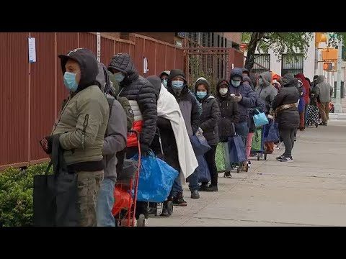
Gather Evidence: Food Insecurity in Queens, New York
What You Need To Know
Last year, 1.2 million New Yorkers were hungry, and because of the pandemic, that number is approximately 2 million.
Many more people are working through government and community efforts to help feed hungry New Yorkers.
Rates of hunger and food insecurity have made consistent headline news.
Food insecurity during the pandemic has affected certain racial/ethnic communities more than others.
Sources: -https://www.cunyurbanfoodpolicy.org/news/2020/12/21/food-security-in-new-york-city-in-the-time-of-covid-19-reports-from-the-cuny-sph-covid-19-survey
-https://www.nationalgeographic.com/history/article/queens-one-first-covid-19-epicenters-faces-new-crisis-hunger
-https://wp.nyu.edu/foodandcovid19/links-and-resources/food-insecurity/
May 6,2020-ABC7News reported on a food pantry line in Queens that stretched for 8 blocks.

Slide 5
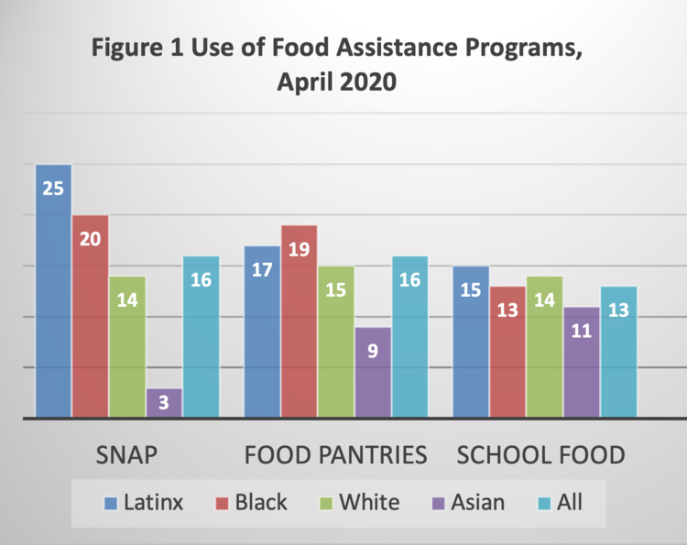
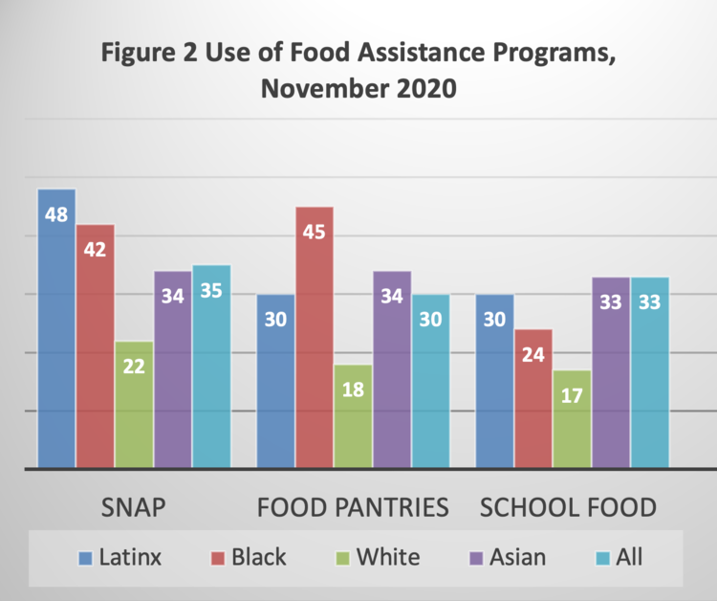
Let’s look at the data
What do you notice about many New Yorkers’ need for food assistance programs from April to November 2020?
Source: https://www.cunyurbanfoodpolicy.org/news/2020/12/21/food-security-in-new-york-city-in-the-time-of-covid-19-reports-from-the-cuny-sph-covid-19-survey

Slide 6
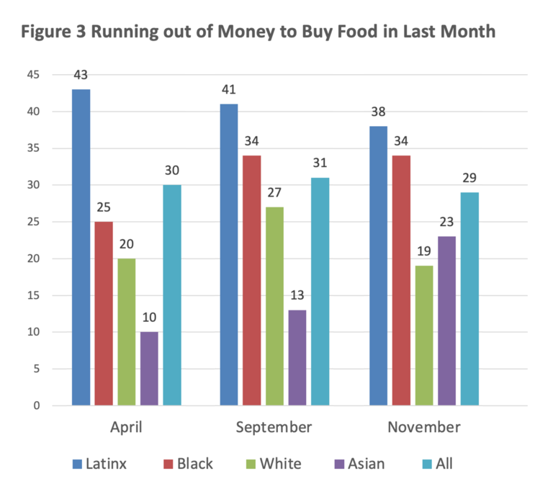
Let’s look at the data, Continued
Which racial groups seem most affected of running out of money to buy food during the pandemic?
2020
Source: https://www.cunyurbanfoodpolicy.org/news/2020/12/21/food-security-in-new-york-city-in-the-time-of-covid-19-reports-from-the-cuny-sph-covid-19-survey

Slide 7
Identify the Causes
High unemployment affects the rise of food insecurity.
-Queens’ official unemployment rate in October 2020 was 13.1 percent, according to the New York State Department of Labor. National Geographic reported, “...the real [unemployment] number was likely higher given the large number of undocumented immigrants working informal...jobs not reflected in state data.”
COVID-19
-During the summer, numerous social-services organizations across New York City reported at least 75 percent of their immigrant clients had lost jobs because of the pandemic.”
A study by food centers at Hunter College, CUNY and Teachers College found that New York City was ill-prepared for a food crisis of this length.
Source: https://www.nationalgeographic.com/history/article/queens-one-first-covid-19-epicenters-faces-new-crisis-hunger

Slide 8
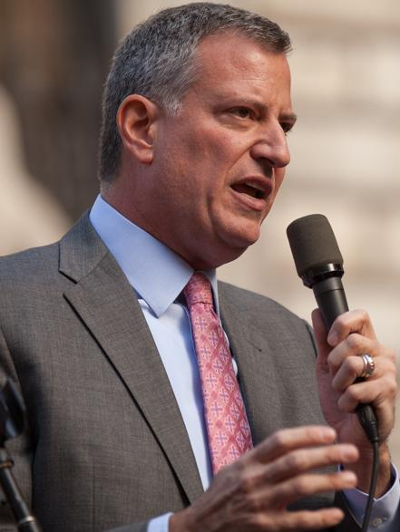
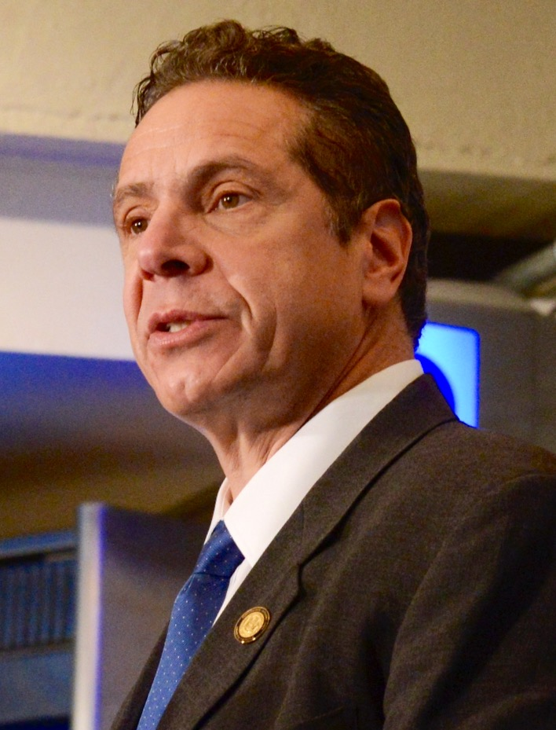
Evaluate Existing Policy solutions
How are New York State and New York City government programs helping with food insecurity?
Existing Policy:
In April 2020, New York City Mayor Bill De Blasio announced a $170 million plan to help feed New Yorkers struggling during the COVID-19 pandemic, paying particular attention to children, the elderly, and those who are homebound.
The plan included: hiring 11,000 TLC drivers to deliver meals and earmarking $50 million for an emergency food supply.
City Hall has also provided $25 million in emergency aid to food banks.
In July 2020, New York state announced an additional $100 million in food assistance for SNAP recipients.
https://wp.nyu.edu/foodandcovid19/links-and-resources/food-insecurity/

Slide 9
Evaluate Existing Policy, continued
Problem:Existing policy is still unable to meet the demand for families who are facing food insecurity. A study by food centers at Hunter College, CUNY and Teachers College found that the city was ill-prepared for a food crisis of this length.
Six months into the pandemic, rates of food insecurity remained high and various efforts to feed hungry New Yorkers still continues.
source:https://wp.nyu.edu/foodandcovid19/links-and-resources/food-insecurity/

Slide 10
Evaluate Existing Policy, continued
New York City has also expanded the number of its school Meal Hubs, which are open Monday to Friday, from 7:30 a.m. to 11:30 a.m. There are approximately 475 Meal Hubs operating across the five boroughs which have served approximately 11 million plus meals, averaging about 485,000 a day.
Existing Policy:

Slide 11
Evaluate Existing Policy, continued
Problem:City Limits exposed that Meal Hubs do not greet or post signs to help families find them.
“On a recent weekday, the grab-and-go offerings at two different Meal Hub sites in Astoria — P.S. 234 on 29th Street and I.S. 126 on 21st Street — included items like peanut butter and jelly, cheese and turkey sandwiches...and assorted pieces of fruit. Aside from a front door propped open, there weren’t many signs of activity outside P.S. 234. Inside, take-out meals were set up on tables for visitors to grab. The school food workers and security guards who staff the building stood inside behind another set of doors, but were visible through windows so that visitors wouldn’t have to interact with them face-to-face. Around 8:30 a.m., a handful of visitors had lined up at the site...”
Source: https://citylimits.org/2020/05/18/citys-efforts-to-meet-food-crisis-evolve-questions-about-long-term/

Slide 12
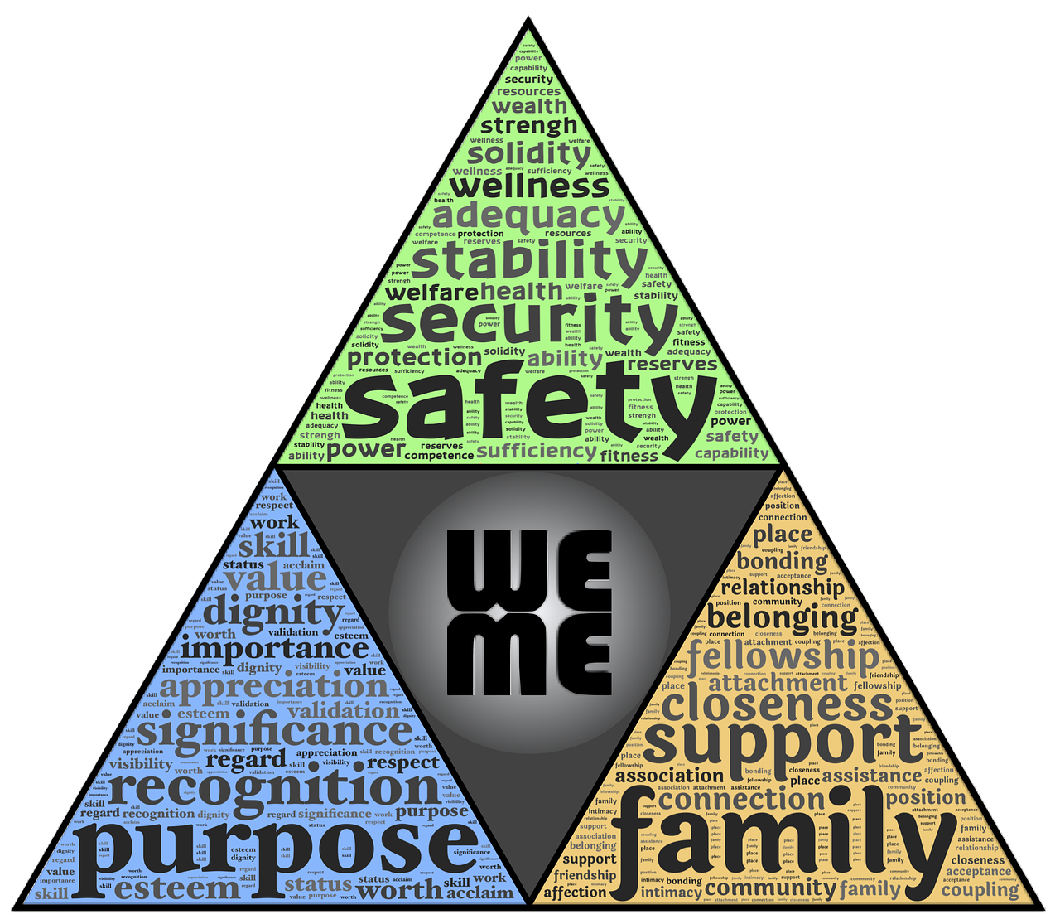
Developing Solutions
Let’s watch how one 8-year-old decided she could help with food insecurity in her community:
What can I/WE do to help?

Slide 13
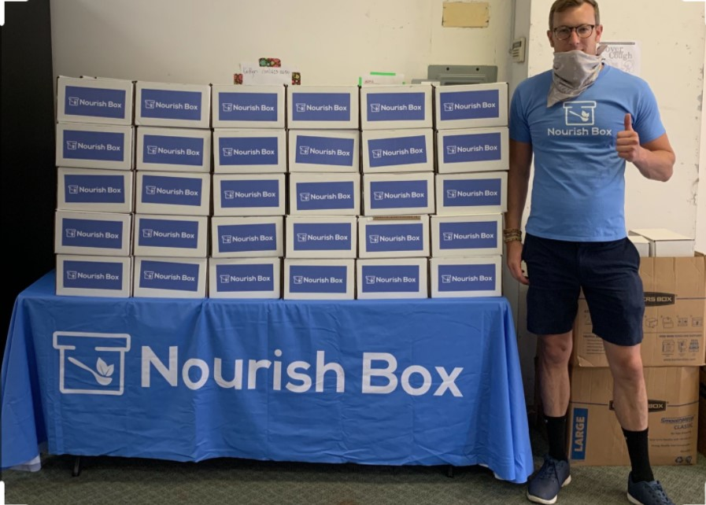
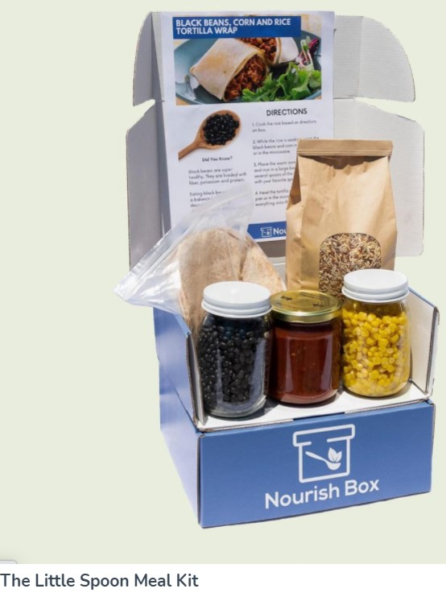
Developing Solutions Continued
Look how, Daniel Calder, a resident of Astoria decided to help students and their families.
Calder decided to pack and deliver these small and large meal kits to students and their families when NYC schools closed last spring.
Click here to read more about Daniel Calder's work to end hunger in Astoria.

Slide 14
Brainstorming solutions
●How can we stop Food Insecurity?
●What are some things we could do, as a school, to help prevent Food Insecurity?
With your group, think of some ideas!

Slide 15
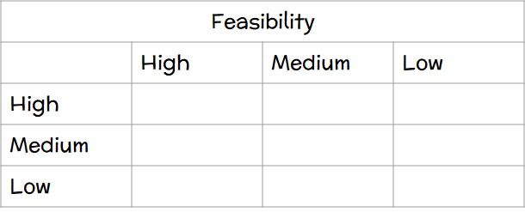
Selecting the Best Policy solution
Effectiveness
Organize school food drive w/ PTO
School’s Go Fund Me Page to support local pantries
School Fundraiser
(i.e. bake sale) to support local pantries

