Slide 1
Lack of Student Engagement
Academically & Socially

Slide 2
Public Policy Analyst Steps
1.Define the Problem
2.Gather the Evidence
3.Identify the Causes
4.Evaluate the Existing Policy
5.Develop solutions
6.Select the Best Solution

Slide 3
Step 1: Define the Problem
Student engagement refers to the degree of attention, curiosity, interest, optimism, and passion that students show when they are learning or being taught. This extends to the level of motivation they have to learn and progress in their education. The concept of “student engagement” is predicated on the belief that learning improves when students are inquisitive, interested, or inspired, and that learning tends to suffer when students are bored, dispassionate, disaffected, or otherwise “disengaged.” We have identified the problem as a lack of student engagement.

Slide 4
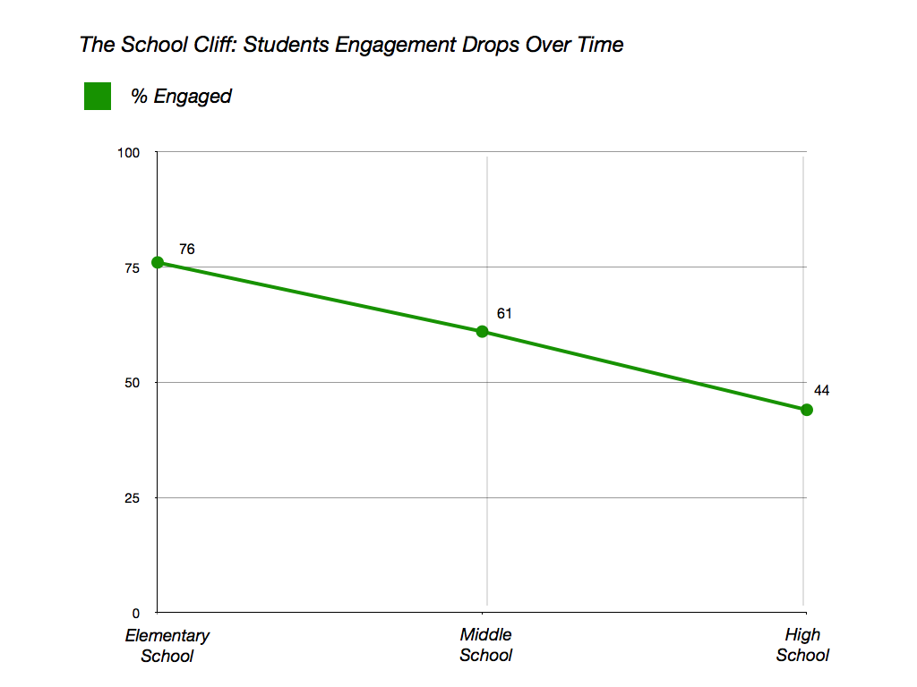
Step 2: Gather the Evidence
Student Attendance (Remote and In-Person)
Teacher Feedback
Teacher/Classroom Observations (Domain 3)
Questioning and Discussion Techniques
Assignment Completion
Student Behavior
Student Participation
Assessment
Flexibility and Responsiveness

Slide 5
Step 3: Identify the Causes
Students are used to hyperstimulation
Distractibility while students are learning from home
Television
Phone
Snacks (access to the kitchen)
Learning from the bedroom (laying on the bed, couch)
Emotional Distress
Change of scheduling
Lack of technology

Slide 6
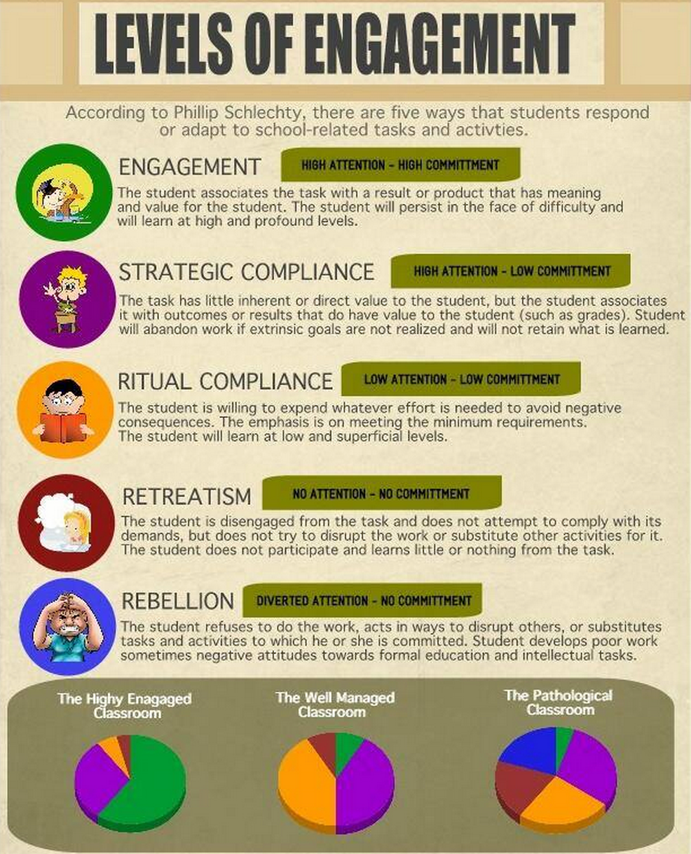
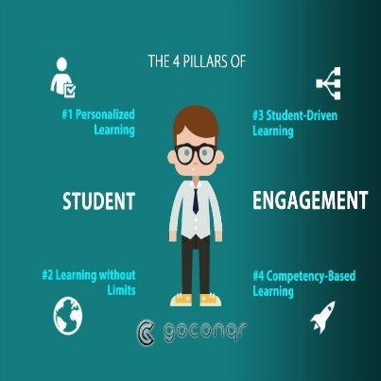
Step 4: Evaluate the Existing Policy

Slide 7
Step 5: Develop Solutions
Online Collaboration Tools
Pear Deck
Flip Grid
Youtube
Padlet
Kahoot
School Events
Selfie Awareness Campaign
Dance Parties
Residencies
Dance Theatre of Harlem
City Lore
Disney Musicals in Schools
Alvin Ailey

Slide 8
Step 5: Develop Solutions
Specials
(Art, Dance, Theatre, Technology, Music, Physical Education)
Virtual Trips
Professional Development
Use a variety of teaching methods
Devote class time to getting to know your students
Project-based learning
Student Choice
Learning Games
Personalize Learning

Slide 9
Step 5: Develop Solutions
Monthly Spirit Days
Culture Day: Dress in something to represent your culture
Superhero Day: So many superheroes both fiction and real. Choose one you would like to represent
StoryBook Character Day: Dress as your favorite character
Pajama Day: Cozy up in your pajamas
80’s Day: Celebrating the great decade of the 80’s-the music, clothes, history and of course the hair
Career Day: Dress as a career you admire or inspire to be
Team Spirit Day: Rock your favorite sports team or create your own team and show your spirit
Crazy Hat/Crazy Hair Day: Get crazy up top, crazy hair or hats are the fashion of the day
Time Traveler Day: Travel through time to dress up as a historical figure from the past or push forward and show us what the future holds
Luau Day: Grab your shades and get ready for summer fun
Infusing Real World Events into Curriculum
Black History Month
Lunar New Year
Women’s History Month
Poetry Cafe
Earth Day

Slide 10
Step 6: Select the Best Solution
 | High | Medium | Low
High |  | Professional Development
Medium | Spirit Days School Events
Low |  |  | Outside Residencies

