Slide 1
Brandon Wright
Frank Sinatra High School of the Arts High School
Brandon.W.Wright1988@gmail.com
Global History 1
EQ:How do we make historical comparisons?
Learning target: I can Analyze the structure and process of historical comparison.
Essential Question: How can we make historical comparisons of different empires.

Slide 2
Introduction
For this unit we will be conducting a historical comparative analysis of both the Ottoman Empire and the Ming Dynasty.
We will engage in this process by using a scientific method of research called the Global History Public Policy Analyst. (GHPPA) (GHPPA)
(AHPPA)

Slide 3
GHPPA STEPS
Now let’s take some time to familiarize yourselves with the GHPPA CYCLE
Identify Problem
Gather the Evidence
Determine Causes
Evaluate the Policy
Do a Comparative Analysis

Slide 5
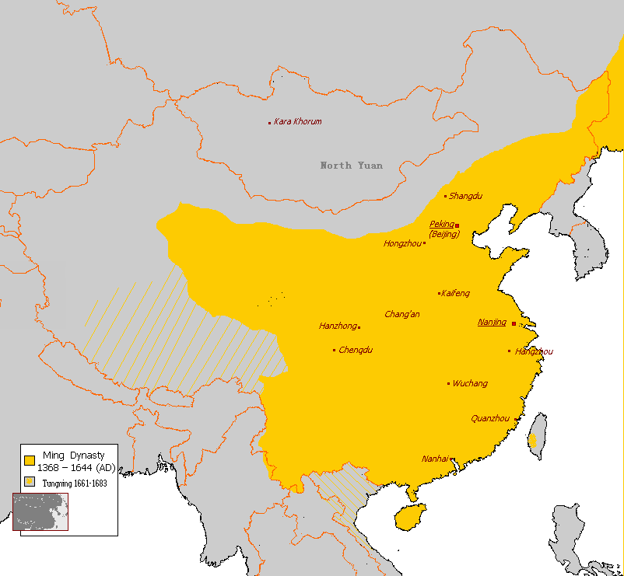
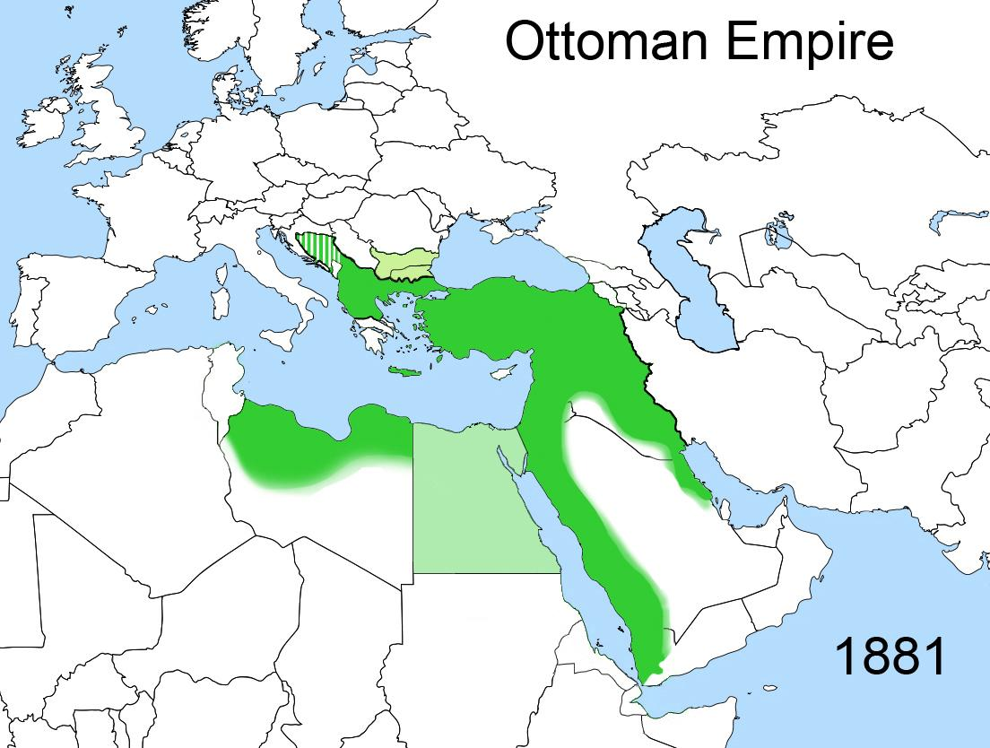
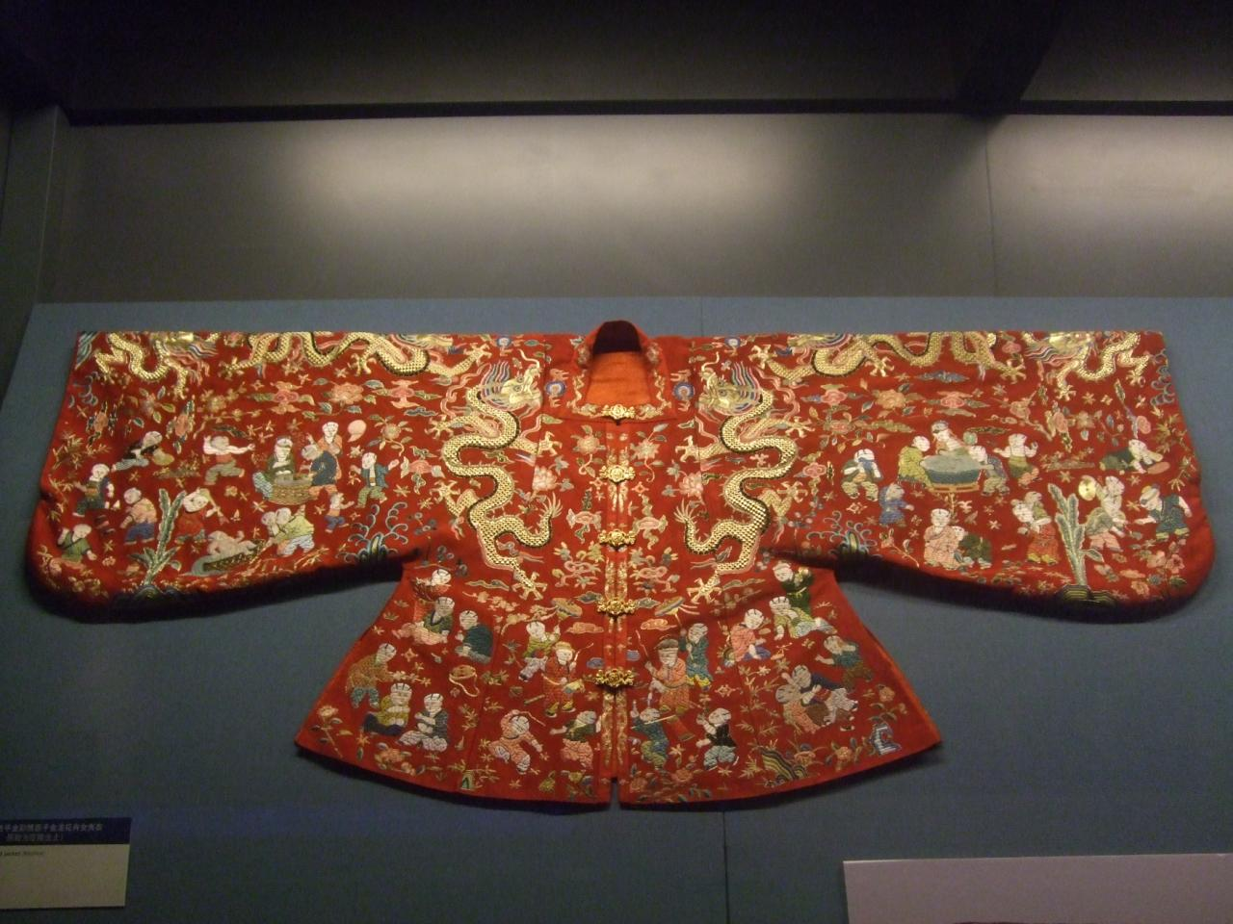
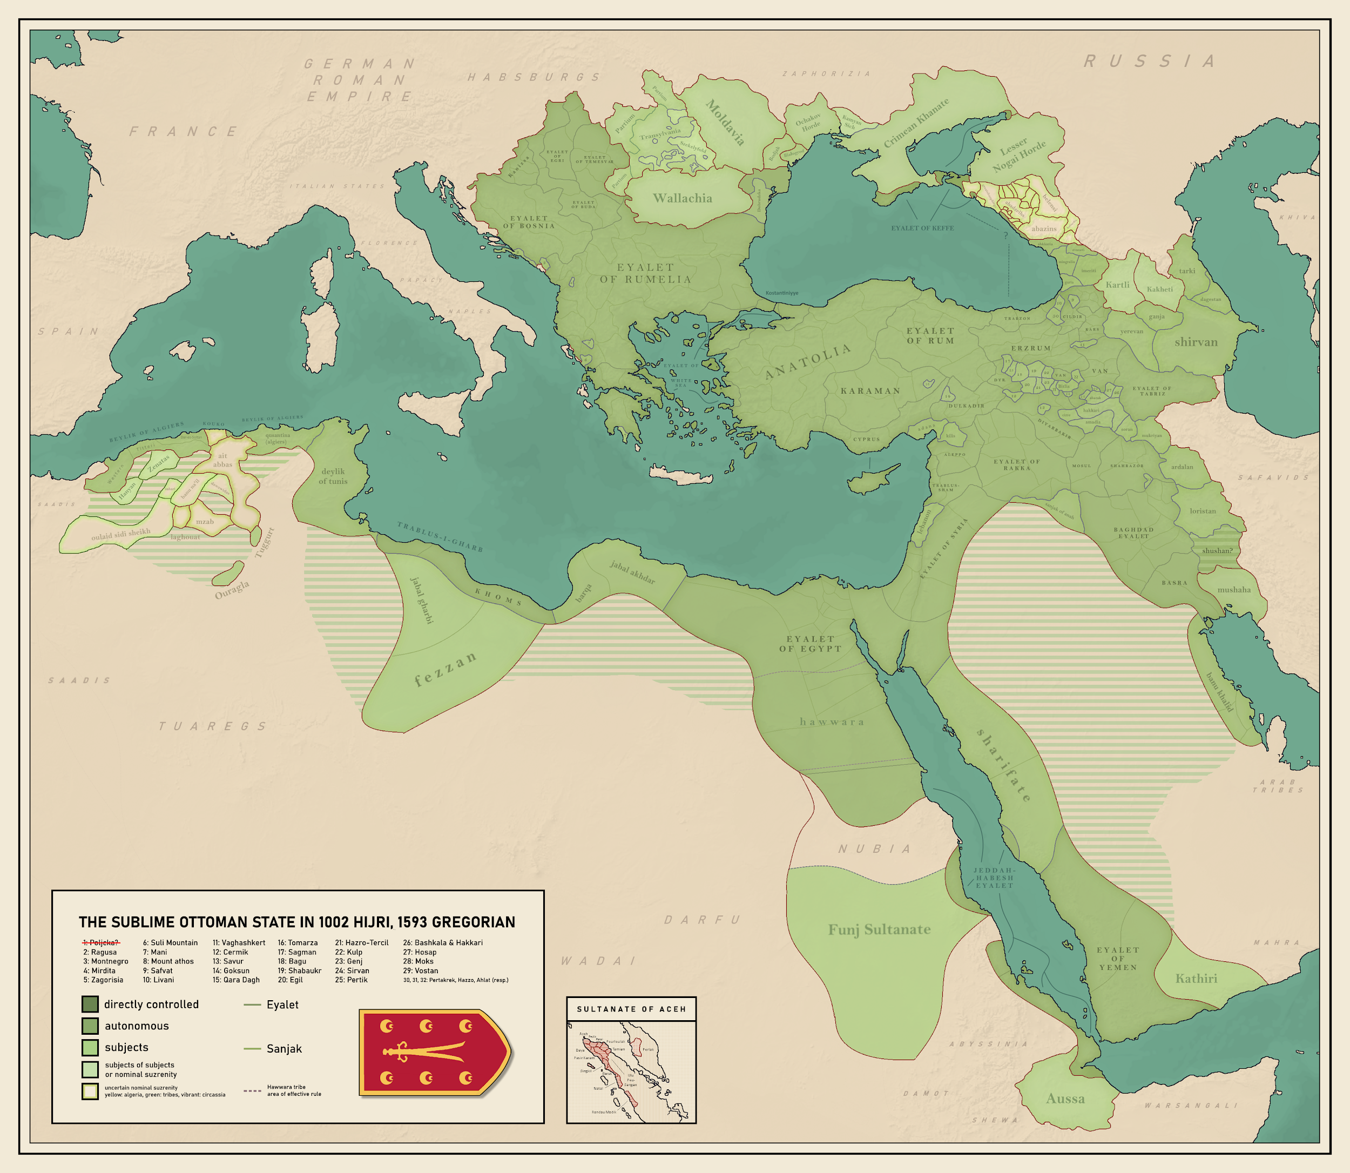
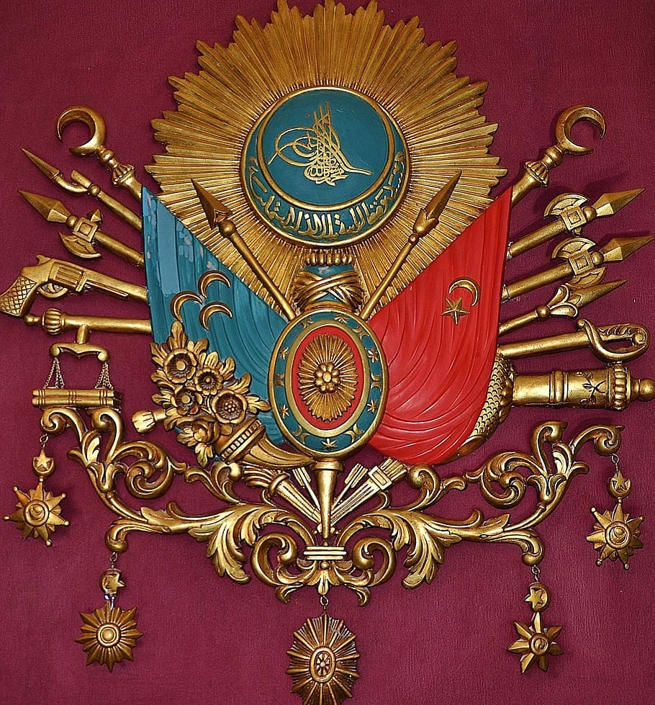
Step 1: Define the Problem
Problem: Conducting a comparative analysis of two different empires.
To better understanding how this comparing empires can be a social problem take 10 minutes to review this short video from Khan Academy common causes for falling empires.
Comparison: Fall of empires (video) | Khan Academy

Slide 6
Step 2:Gather the Evidence
Now that you have taken some time to recognize why conducting a comparative analysis of the Ming Dynasty and Ottoman Empire may prove to be challenging. Let’s begin the process of gathering the evidence to compare this two empires.
Take a look at the resources below to begin gathering evidence of the how the Ming Dynasty and the Ottoman Empire rose and fell. Pay close attention the how they used, spread and consolidated their power. For each source complete the analytical reading tool
Comparative Analysis Resources

Slide 7
Reading Analysis Tool
Text Title: | Historical Background and Context:
Step 2- Read the text for the once for the author’s argument and write a short summary. Then conduct a second read for how each dynasty used power.
Introduction | Section I-Political Systems of Ottoman Turks and Ming China | Section II-Ming and Ottomans’ Use of Culture

Slide 8
Step 3: Identify the Causes
Now that you have familiarized yourself with the problem and the gathered the evidence to analyze the challenges with comparing the Ming Dynasty and the Ottoman Empire, now we need to identify the causes of this issue.
Go back to your The Ottoman and Ming: A Comparison of Cultural Power by Morris Rossabi essay and identify the Economic, Political, Cultural and Social Factors that impacted both of these empires.
Then answer the following questions:
Why is it difficult for historian and students to compare these two empires?
What criteria might we want to look at in order to help mitigate the challenges with comparative analysis?

Slide 9
Step 4:Evaluate the Policy
Now it’s time to close our research by evaluating the policy. Go back to your Comparative Analysis Resources document, examine the policies of the Ming Dynasty and Ottoman Empire. Consider the following:
How effective were these policies in consolidating each Empires Power?
Research the process of Comparative Analysis
NEXT STEPS: Writing a comparative analysis essay on the Ming Dynasty and Ottoman Empire, based on your studies and research.

Slide 10
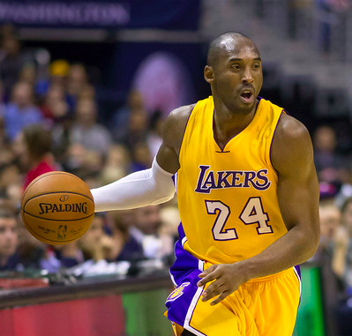
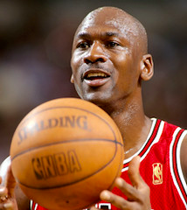
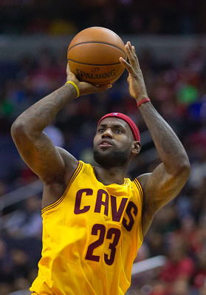
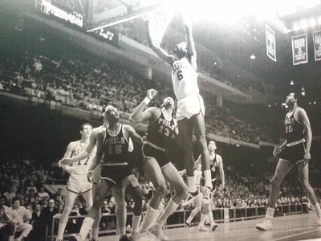
The GOAT Game: Who is the Greatest NBA PLAYER OF ALL TIME?
Kobe Bryant
Michael Jordan
Lebron James
Wilt Chamberlain
Bill Russell
Career Statistics (1996-2016)
Games Played: 1346
Points Per Game: 25.0
Total Rebounds Per Game: 5.2
Assists Per Game 4.7
Field Goal % 44.7
Three Point FG% 32.9
Free Throw % 83.7
Effective FG% 48.2
NBA Championships: 5
All Star: 18 times
Career Statistics (1984-1993; 1994-1998; 2001-2003)
Games Played: 1072
Points Per Game: 30.1
Total Rebounds Per Game: 6.2
Assists Per Game 5.3
Field Goal % 49.7
Three Point FG% 32.7
Free Throw % 83.5
Effective FG% 50.9
NBA Championships: 6
All Star: 14 times
Career Statistics (2003-present)
Games Played: 1265
Points Per Game: 27.1
Total Rebounds Per Game: 7.4
Assists Per Game 7.4
Field Goal % 50.4
Three Point FG% 34.4
Free Throw % 73.4
Effective FG% 54.1
NBA Championships: 4
All Star: 16 times
Career Statistics (1959-1973)
Games Played: 1045
Points Per Game: 30.1
Total Rebounds Per Game: 22.9
Assists Per Game 4.4
Field Goal % 54.0
Three Point FG% N/A
Free Throw % 51.1
Effective FG% N/A
NBA Championships: 2
All Star: 13 times
Career Statistics (1956-1969)
Games Played: 963
Points Per Game: 15.1
Total Rebounds Per Game: 22.5
Assists Per Game 4.3
Field Goal % 44.0
Three Point FG% N/A
Free Throw % 56.1
Effective FG% N/A
NBA Championships: 11
All Star: 12 times
Pair Share: First, In your notebooks, write at least 3 sentences about who is the GOAT. Explain why you chose that person.
Then discuss in your groups why you picked that person. Write down the GOAT your group member selected and why.
‹#›

Slide 11
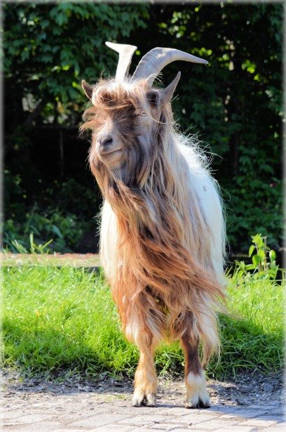
Step 4: Do a Comparative Analysis
Before we begin to prepare to conduct a comparative analysis of the Ottoman Empire and the Ming Dynasty let’s first practice by looking at more modern day examples beyond by doing a comparative analysis to determine the greatest NBA basketball players of all time.
On the next slide you will see a list of basketball players without prior knowledge you will choose who your GOAT, or Greatest Player of all Time is. You may only use the achievements and statistics on the card to make you selection.
Write a 3-4 sentence statement choosing your GOAT and explaining why you selected that player.

Slide 12
Comparative Analysis Debrief
Now share in your small groups tell two people why you selected your player as GOAT, provide your rationale.
Now consider how we can apply this practice of historical comparative analysis to our knowledge of Social Studies and specifically the Ottoman Empire and Ming Dynasty, before we begin our essays?
What made this process most challenging ?
What did you learn from this process?

