Slide 1
CyberBullying among US Teens
By: Mr.Wright/Special Music School
English 1o

Slide 2

PPA Steps
1. Define the Problem
2. Gather the Evidence
3. Identify the Causes
4. Evaluate an Existing Policy
5. Develop Solutions
6. Select the Best Solution (Feasibility vs. Effectiveness)

Slide 3
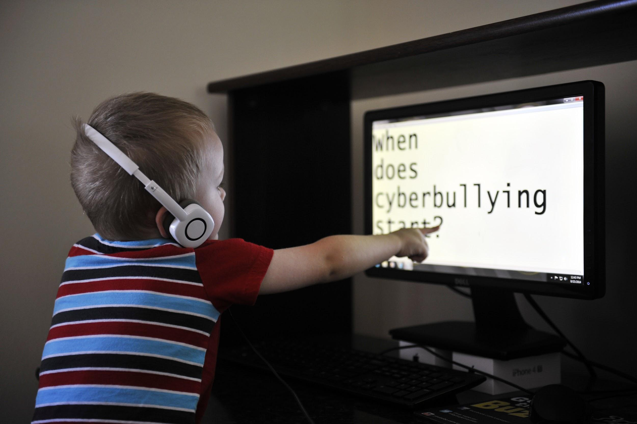
Step One: Defining the Problem
The practice of cyberbullying remains prevalent amongst teens in the U.S. as the usage of social media increases.
Cyberbullying, is similar to the bullying that occurs amongst children in schools but instead takes place online.
Cyberbullying is essentially anything that is posted online with the intent to hurt, cause harm or upset someone.
Cyberbullying is any type of harassing, threatening, demeaning language. It can also involve embarrassing another person online. Typically, this is done through mean comments, online rumors, and even sexual remarks. They’re usually connected with appearance, intelligence, race, or sexuality.
Essentially, anything that is posted online that’s intended to hurt or upset someone else, regardless of what the topic is, is considered to be cyberbullying.

Slide 4

Step 2: Gather the Evidence
Take a look at the following links to begin your research on cyberbullying.
Below are a list of resources to get your research started stop and jot down any important facts, statistics, or other key details that come to mind then TURN and TALK about your findings with a partner.
https://www.stopbullying.gov/cyberbullying/what-is-it
https://kidshealth.org/en/teens/cyberbullying.html
https://www.newportacademy.com/resources/restoring-families/teen-cyberbullying/

Slide 5
Gathering the Evidence: Excerpt of Evidence from NewPortAcademy
A new report on online bullying found that 81 percent of cyberbullying organizations saw an increase in this behavior during 2020. In addition, the report found that 62 percent of American youth have been the victims of cyberbullying—up from 36.5 percent in 2019. Meanwhile, the number of perpetrators went up from 14.8 to 25.2 percent during that time frame.
Another study, from the AI startup L1GHT, analyzed data from websites, social platforms, chatting forums, and gaming sites in 2020. The study documented a 70 percent increase in cyberbullying among kids and teens during online chats, and a 40 percent increase in toxic interactions on popular video gaming platforms such as Discord.
More parents are seeking help for teen cyberbullying as well. According to Google Trends, 80 percent more parents have been searching for information on cyberbullying since the start of 2020.
How do these statistics show that cyberbullying among teens is a problem ?

Slide 6

Step 3:Identify the Causes
While it may be difficult to pinpoint the exact causes of
Cyberbullying. Some possible causes included but not
limited to are:
Revenge-cyberbullies often want to get back a the victim for something they feel wronged about.
Insecurity/Jealousy-A lack of self confidence/self esteem can cause teens to bully other who appear either higher or lower up on the social hierarchy.
Lack of Empathy- When engaging in bullying or cyberbullying teens are often unaware of the pain, and trauma they are inflicted upon others or haven’t developed the ability to feel and care for the pain of others.

Slide 7
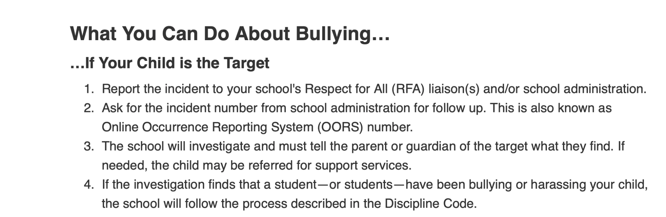
Step 4: Evaluate and Existing Policy
A

Slide 8


STEP 4 EVALUATING THE POLICY
The previous slide shows the NYC Department of Education’s discipline code and policy towards cyberbullying and harassment.
What do you notice and wonder about this policy ?
The NYC DOE investigates all claims of cyberbullying. Knowing other schools, cities and states may have more of less restrictive laws…
What do you think is missing from this policy ?
Create the language that you feel would make this policy stronger.

Slide 9


Step 5: Develop Solutions
Now that you’ve gathered all of the relevant information on teen cyberbullying and looked at some policy it’s time that you develop a solution to address the problem.
Your task: You are the student council president of a school that is experiencing cyberbullying at an alarming rate. Your principal and student body have asked you to create a google slides presentation that is UNIQUE and engaging for all students to inform them of the dangers of cyberbullying for teens in the U.S. You must develop a solution for your school community to address the problem of teen cyberbullying.
You may include any modality, pictures, videos, music, art, poetry. Etc to enhance your presentation.

Slide 10
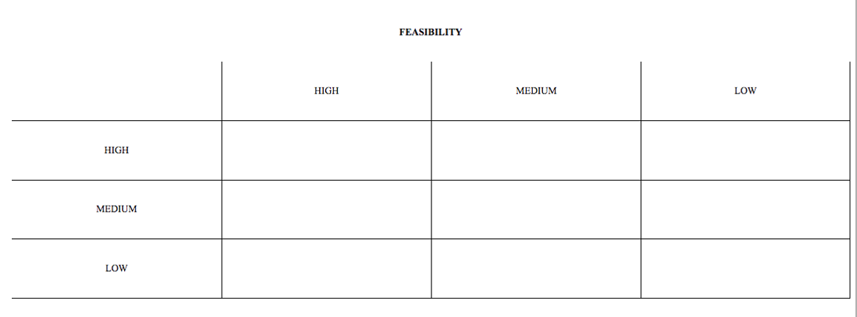
Feasibility vs Effectiveness
TGtttt

Slide 11

Step 6:Select the Best Solution
Keeping in mind feasibility vs effectiveness we conduct flash presentations, each student will present there google slides presentation proposals for 2 mins. As a class we will vote on the winning proposal.
The final presentation that is selected as the best solution will be posted on the bulletin board and will be announced as the winner during morning announcements.

