Slide 1
TARDINESS FOR CLASS 3-226 PS 92M
THERESA WILSON-PHILLIPS

Slide 2
THE 6 STEPS OF THE PUBLIC POLICY ANALYST
1. Define the Problem
2. Gather the Evidence
3. Identify the Causes
4. Evaluate an Existing Policy
5. Develop Solutions
6. Select the Best Solution (Feasibility vs. Effectiveness)

Slide 3
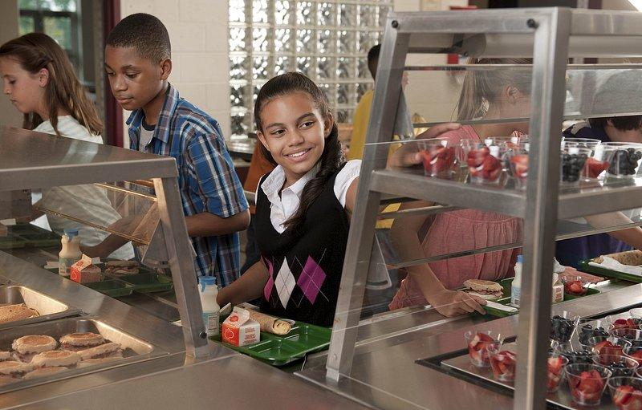
DEFINE THE PROBLEM
Tardiness is the state or quality of being later than the usual or proper time.
At PS 92 students are allowed to enter the building at 7: 30 am to have breakfast in the cafeteria.
At 8:00 am school begins.
On any given day at least 25% of my class arrive after 8:00 to my class with breakfast trays to sit and eat breakfast during my instruction time.

Slide 4
GATHER THE EVIDENCE
Students who are at school on time receive a Bethune Buck . These Bethune bucks can be used to purchase items from the Bethune school store. If students arrive after 8:00 they get a late pass.
Since the beginning of this school year 2023 – 2024, 25 – 30 percent of my students are late every day, based on the late pass record.

Slide 5
IDENTIFY THE CAUSES
STAYING UP LATE PLAYING GAMES. INCONSISTENT BEDTIME. FAMILY BASED ISSUES.

Slide 6
EVALUATE AN EXISTING POLICY
While there are policies by the New York State Department of Education on absenteeism , there seem to be none on tardiness. I think this needs to be taken into consideration as our students not only need to be present but also to be on time.
Late coming to school has been a problem for years. Just getting them there is important, but on time is of equal importance.
According to Pellicer and Summers ,“Tardiness is a problem – a serious one. It is a subtle thief which steals a most precious possession”

Slide 7
DEVELOP SOLUTIONS
At PS 92 students who are on time receive Bethune Bucks to be used in the School Shop. The store on the other hand has not been opened since the beginning of school, hence the students lack of interest in obtaining them.
Some solutions are:
Teacher will work with parents/guardian to find possible ways to help students be on time;
Students can accumulate extra computer time
Push to have the School store open on a regular basic.
1- day Homework pass

Slide 8
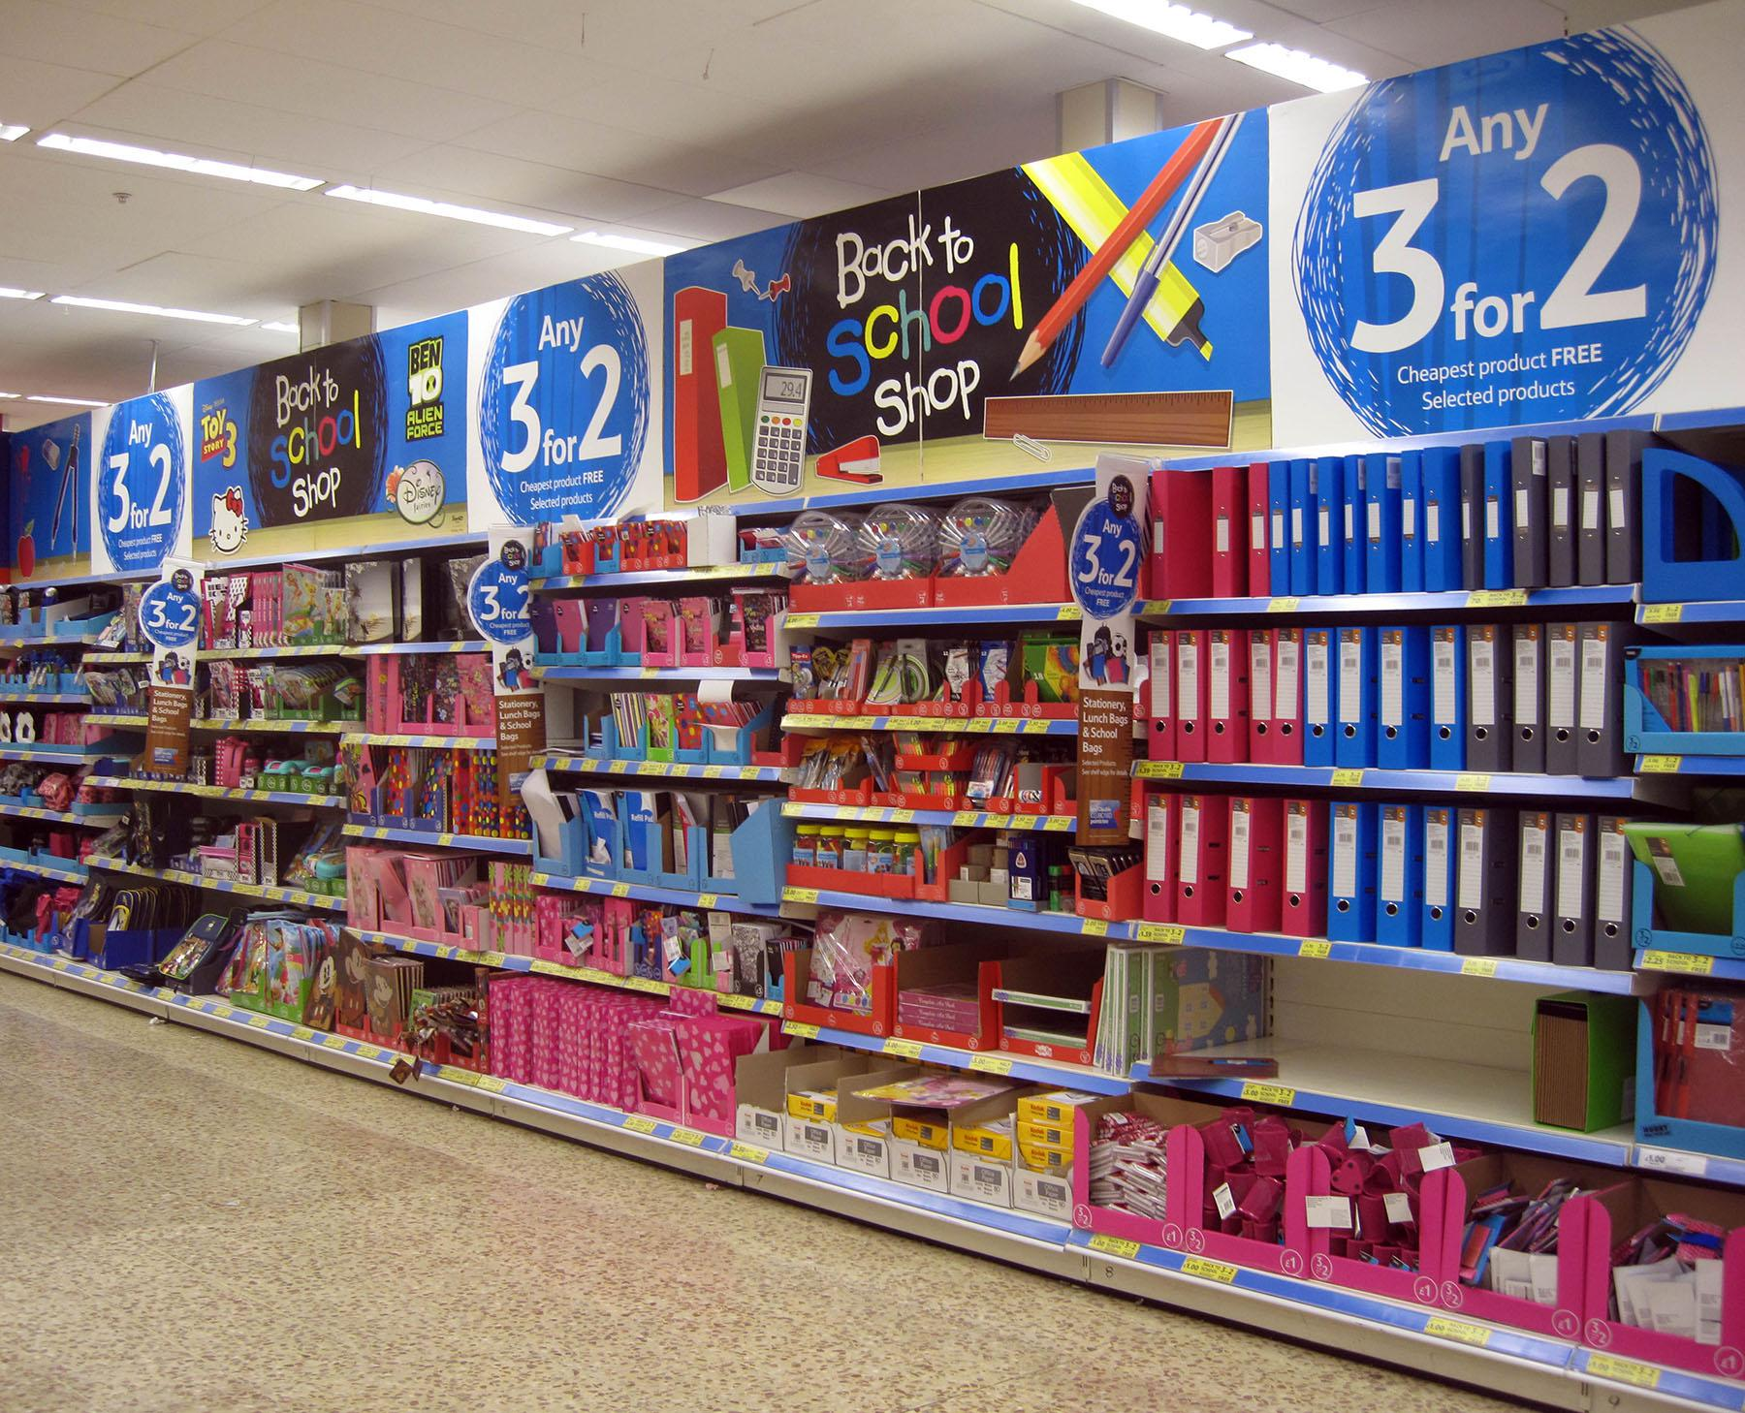
SELECT THE BEST SOLUTION
The best solution would be the regular opening of the School Store so students can use your Bethune Buck earned for being on time or 1-day homework pass.
These two solutions were equally supported by the students.
This Photo by Unknown Author is licensed under CC BY-SA

Slide 9
SELECT THE BEST SOLUTION
 |  | FEASIBILITY
 |  | HIGH | MEDIUM | LOW
EFFECTIVENESS | HIGH
 | MEDIUM
 | LOW

Slide 10
RESOURCES ON TARDINESS
https://www.athlosutah.org/attendance-matters-the-impact-of-tardiness-on-student-success/
https://www.teachermagazine.com/au_en/articles/the-effect-of-student-tardiness-on-learning
https://dune.une.edu/cgi/viewcontent.cgi?article=1310&context=theses

