Slide 1
Public Policy Analyst
Problem Solving Project
Specialized High Schools Low
Acceptance Rates for People of Color
B. Williams
Arthur Tappan PS 46

Slide 2
Specialized High Schools Low
Acceptance Rates for People of Color
Is the hot topic this fall with the 2022-2023 test just around the corner. Seventh grade students across the five boroughs were given the opportunity to join a six week enrichment program in May 2022 and again in July 2022 with hopes of increasing acceptance rates of Black and Latinx students into the New York City Specialized High Schools.
Define the Problem

Slide 3
NYC Specialized High Schools
Did you know?
The Bronx High School of Science
The Brooklyn Latin School
Brooklyn Technical High School
High School for Mathematics, Science and Engineering at City College of New York
High School of American Studies at Lehman College
Queens High School for the Sciences at York College
Staten Island Technical High School
Stuyvesant High School
Nearly half of the total amount of students who took the NYC Specialized High School Admissions Test (SHSAT) for 2021-2022 were Black and Latinx students of color. Out of that, only 9% received an offer.
Notes:
https://www.nbcnewyork.com/news/local/nearly-half-of-nyc-students-who-took-shsat-were-black-or-latinx-only-9-got-an-offer/3737289/

Slide 4
Public Policy Analyst (PPA)
The purpose of this project is for you to better understand social problems in your community. By the end of this project all student will propose solutions to existing policies that create problems within your school or community.
You will:
Work with your group to complete the 6 Steps of the PPA.
Write a final research paper on the assigned social problem.
Create a presentation to present your final project to the class.

Slide 5
6 Steps of Public Policy Analyst (PPA)
1. Define the Problem
2. Gather Evidence
3. Identify the Causes
Define a social problem that is a condition that some people in a community view as undesirable.
Use online resources to gather evidence that the problem exists.
Identify causes and factors that contribute to the social problem.
4. Evaluate an Existing Policy
3. Develop a Solution
6. Select Best Solution
Evaluate the advantages and disadvantages of the current existing policy.
Use your research to develop multiple possible solutions.
Select the best possible solution that will meet the needs of the community.

Slide 6
Specialized High Schools Low
Acceptance Rates for People of Color
Meet with your group to gather evidence and do online research.
You will use credible online sources to complete your research. Here are a few to get you started!
NBC Network | Ivy Coach | Preparing for the Test
Chalkbeat NY | NYC DOE | DREAM Program

Slide 7
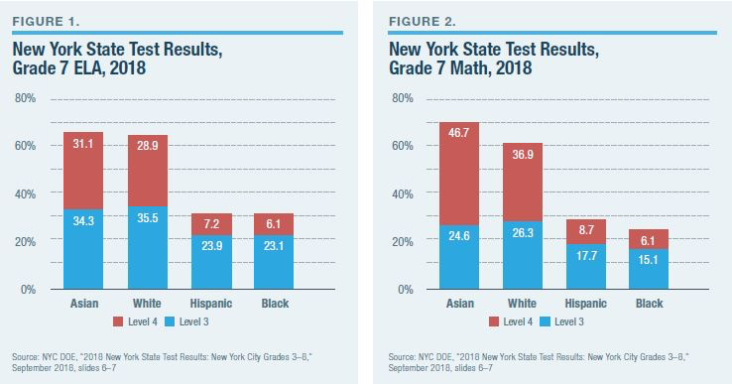
Testing Constraints
Identifying Causes
Private Tutoring
Lack of Funding in Schools
Identify causes and factors that contribute to the social problem
Teach to the State Exam
Culturally Bias
Emphasis Not on SHASAT

Slide 8
Evaluate the advantages and disadvantages of the current existing policy.
After School
Enrichment
Program
Economic Advantages
Evaluate
Existing Policy
Dream Academy
Feeder Schools

Slide 9
What are some possible solutions to the problem?
Propose at least three new/original public policy alternatives. Be sure that all of your public policy alternatives are at the same geopolitical level as your social problem. Each alternative must specify the actual government or government agency that will carry out the proposed action. List the proposal that your group considers the most promising first.
Determine Possible Solutions
Identify multiple possible solutions

Slide 10
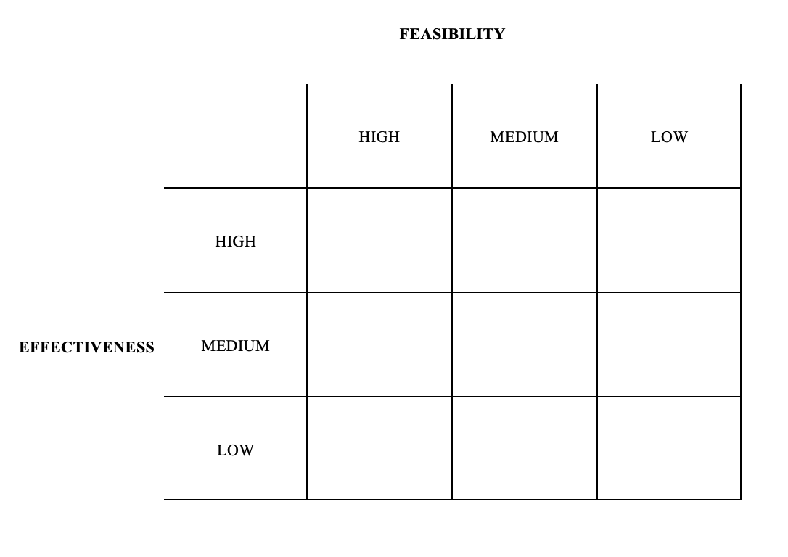
Use the matrix below to determine which solution is the best solution.
Determining the Best Solution

