Slide 1


BULLYING IN NEW YORK CITY PUBLIC SCHOOL SYSTEM
ANGELA WILLIAMSON
FREDERICK DOUGLASS ACADEMY 1
Email: AWilliamson3@schools.nyc.gov

Slide 2

Steps to PPA
1. Define the Problem
2. Gather the Evidence
3. Identify the Causes
4. Evaluate an Existing Policy
5. Develop Solutions
6. Select the Best Solution
This Photo by Unknown Author is licensed under CC BY-SA

Slide 3

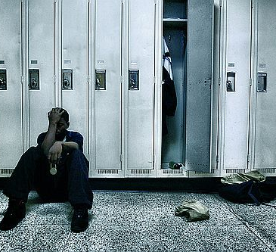


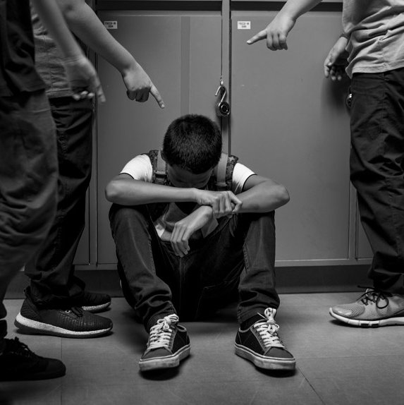
What is the Problem?
Bully has increased significantly in New York City Public Schools.

Slide 4
1. Define the Problem
DO NOW:
1. Gather in your groups.
2. Write the question below and answer it in your notebooks:
What is your definition of bullying?___________________

Slide 5
How is Bullying Defined?
DO NOW CON’T
Look at the definition below
What is considered bullying?
There must an imbalance of power between the parties involved, such as physical strength, information that is embarrassing, and social status at the school.
It must occur more than once or some type of repetition of the behavior.

Slide 6
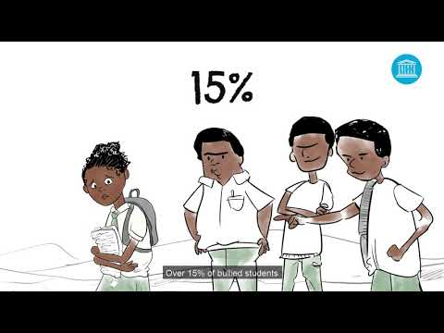
COMPARE AND CONTRAST
1.Briefly COMPARE AND CONTRAST what you wrote down to the actual definition.
2. Is it different or similar?
Watch Video on Bullying in school.
1. What did you notice in the video?
2. What are your wonderings?
3. Interview your peers about their
personal experience of being bullied.

Slide 7
MINI-LESSON
THINK-PAIR-SHARE
Write down one example of what bullying among peers looks like to you in school, the community, and social media on paper.
Share in your group and take turns discussing what you wrote down on your paper.
Briefly share with the class what your peers wrote down in your groups and your thoughts.

Slide 8

What are the Different Types of Bullying?
Verbal bullying
Social bullying
Physical bullying
Sexual bullying
Cyber bullying
Emotional bullying

Slide 9
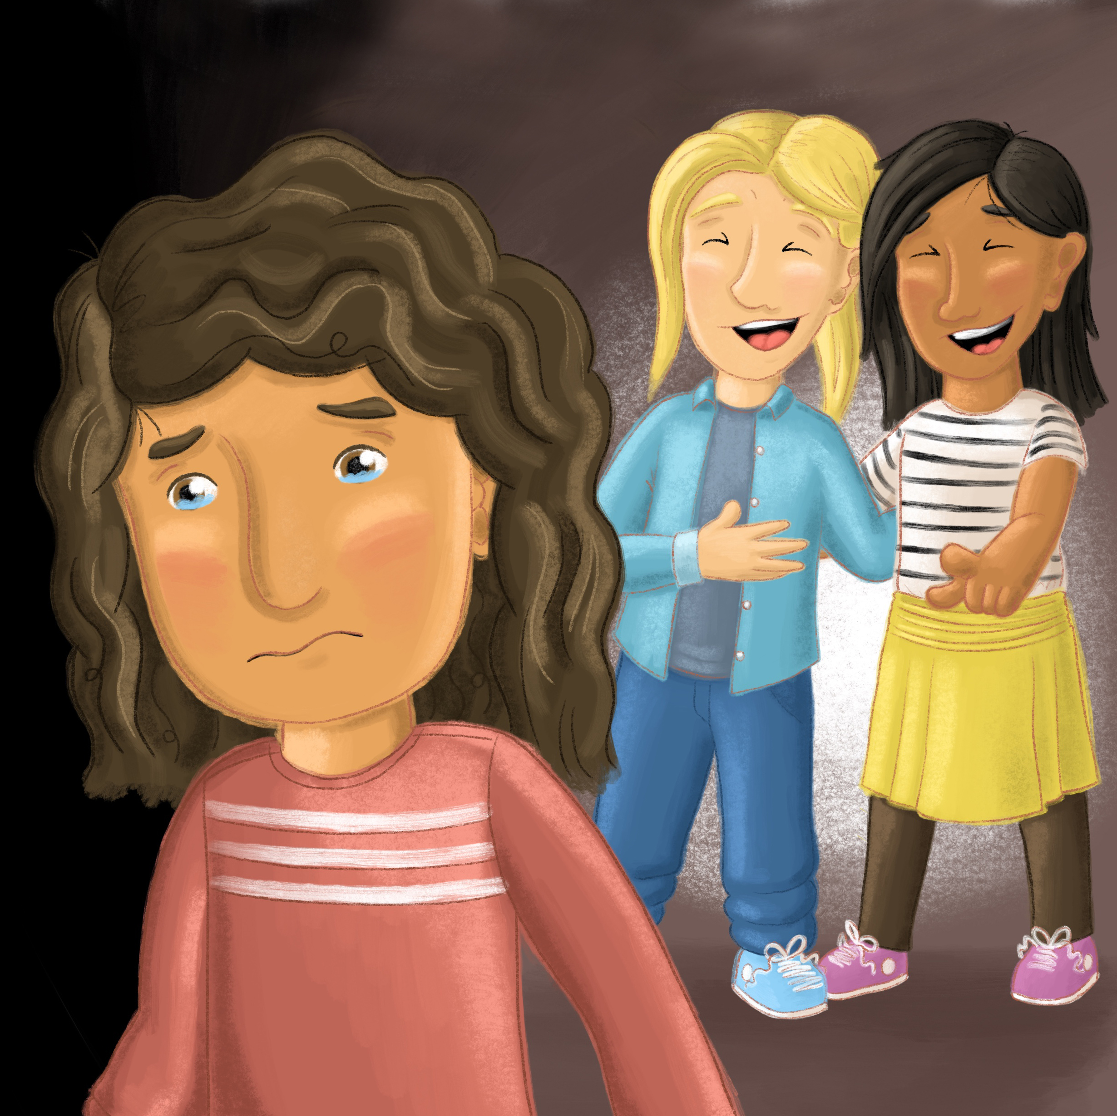
Verbal Bullying
Verbal Bullying – saying or writing derogatory things about another student.
Teasing
Name Calling
Threating to Cause Harm
Inappropriate Sexual comments
Taunting

Slide 10

Social Bullying
Excluding someone on purpose.
Telling other classmates or peers not to be friends with someone.
Spreading rumors around school or in the community about someone.
Embarrassing someone on purpose in front of others.

Slide 11
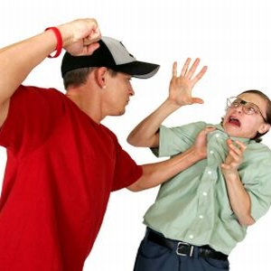
Physical Bullying
Physically harming someone with hands, objects, etc.
Threatening to harm some physically again to get them to comply.
It is used to intimidate or gain power over someone with physical violence.

Slide 12
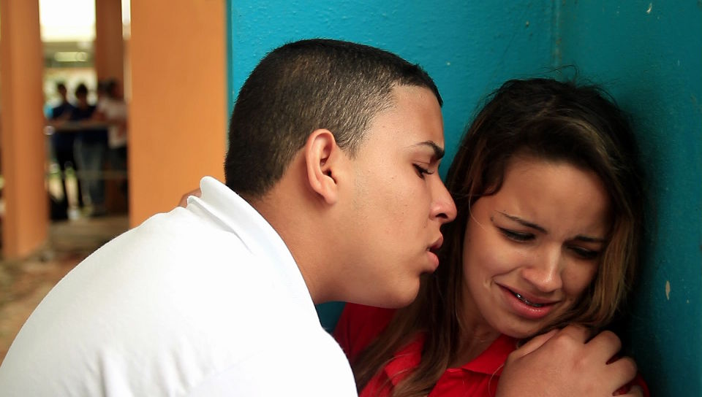
Sexual Bullying
Someone forced or coerced another person to engage in unwanted sex or sexual activity.
Sexual harassment or making sexually inappropriate comments.
Public shaming or cyberbullying someone sexual in nature.
Sending someone unwanted sexually explicit pictures.
Writing sexually inappropriate or explicit comments on the wall of the bathroom or public places.

Slide 13

Cyberbullying is when bullying takes over social media.
Bullying through text messaging on cellular or smartphones.
Bullying someone in chat rooms, online, emails, etc.
Bullying on gaming communities online.
Making inappropriate websites to public shame someone on the internet.

Slide 14
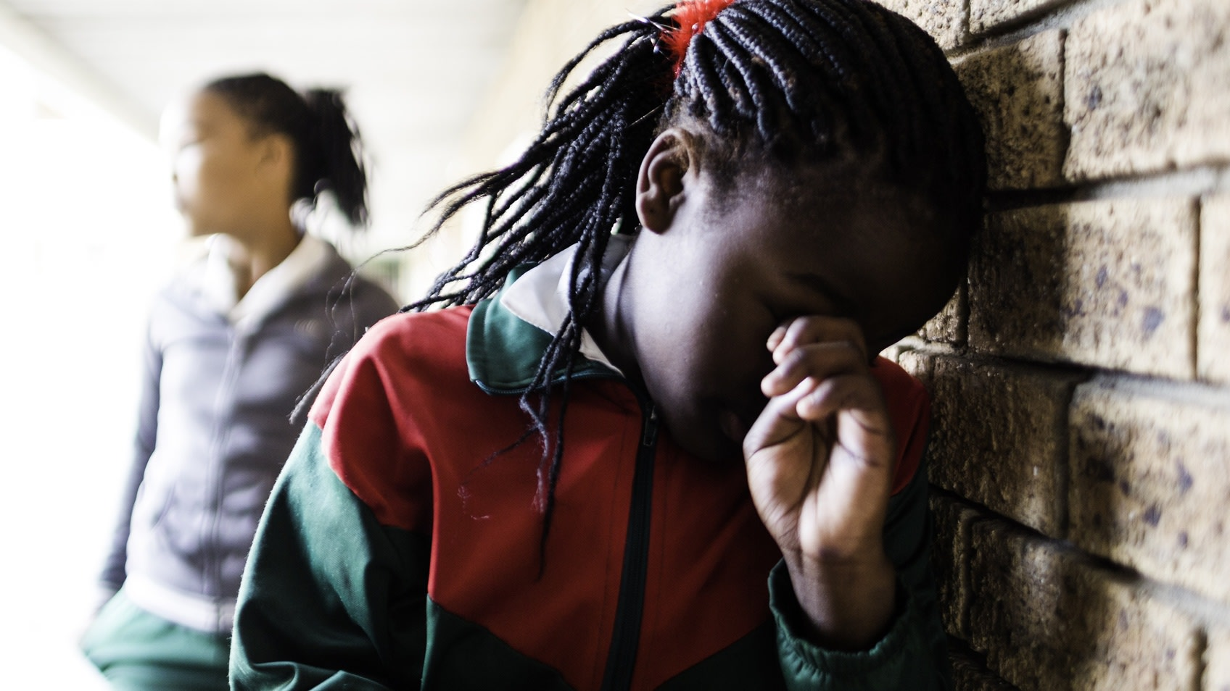
Emotional Bullying
Threatening to exclude someone because they talk or hang out with someone they do not like.
Telling someone if he pr she does not do what you say you will not be friends with them anymore.
Playing mind games or tricks to confused or control someone.
Social excluding others on purpose.
Making up lies about someone.
Backstabbing or betrayal to someone on purpose.

Slide 15
Gather Evidence
Each group may gather evidence from the following articles below or research for scholarly articles on bullying in New York City Public Schools.
Bullying Prevention in New York City Public Schools: School Safety Agents' Perceptions of Their Roles (cuny.edu)
Bullying in NYC schools hit unprecedented levels last year (nypost.com)
NYC Schools Underreporting Bullying and Harassment | Office of the New York State Comptroller​
NYC schools were most ‘violent and disruptive’ in state last year (nypost.com)
Devastated family of 12-year-old Brooklyn student who died after school bullying demand answers (msn.com)

Slide 16


Identifying the Cause
1). Each group will create ten multiple-choice survey questions based on their research on bullying in New York City Public Schools.
2). We will narrow it down to the best questions covering our research.
3). Submit our best questions for review and to be added to Survey Monkey.
4). Students in grades 6th through 12th will complete the survey electronically on their smartphone or computer during their lunch period.

Slide 17



Evaluate an Existing Policy
Each group will research the New York Anti-bullying Laws and Policies from the following links.
New York Anti-Bullying Laws & Policies | StopBullying.gov
The Dignity for All Students Act (nysed.gov)
Respect for All:

Slide 18

What Kind of Solutions Can We Develop?
Each group researches the solutions below to see how effectively to use them in school to prevent bullying. You may explore other methods.
Teaching emotional intelligence to students to promote empathy for others.
Using the restorative circles inside classrooms.
Fully implementing Respect For All or Dignity for All Students Act
Implementing the Respect for All Week during February 2023
Peer Mediation

Slide 19
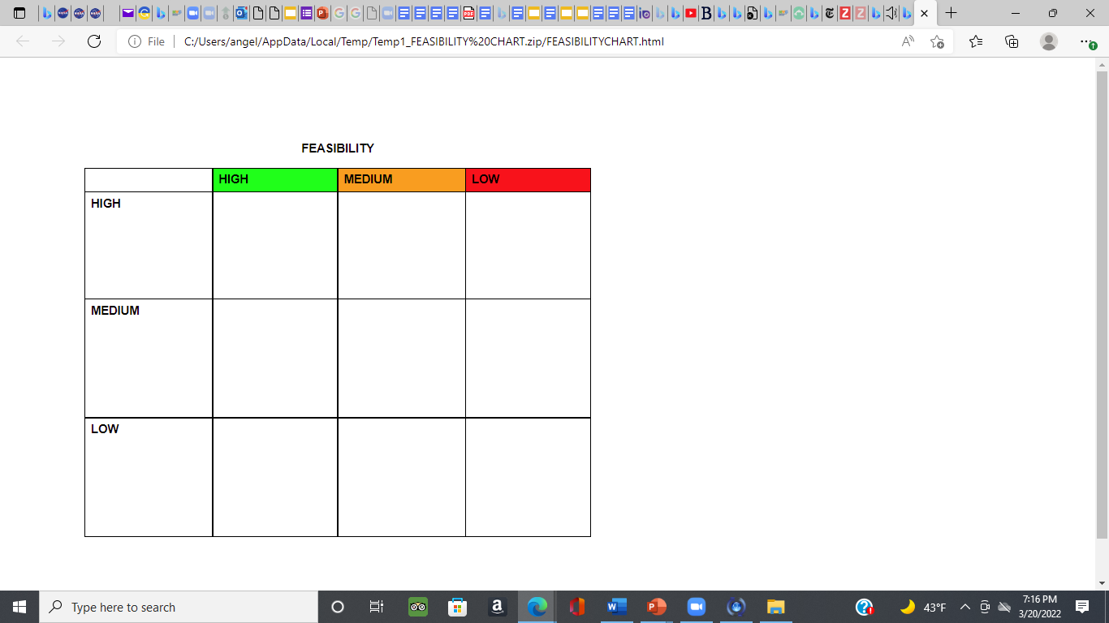
Selected the Best Solution
•Each group discusses their research findings and selects at least three methods that will be the best solutions based on your research and the survey results.•
•Use the FEASIBILITY CHART for our proposed best solutions.

Slide 20
Presentation and Proposal
•1. Each group will be assigned a page and a slide to complete our anti-bullying proposal and presentation for our school from our research and survey results.•
•2. Each group will put their sections on a shared document and submit them for review.
•3. Each group will select a presenter to present the presentation and proposal to the principal.

