Slide 1
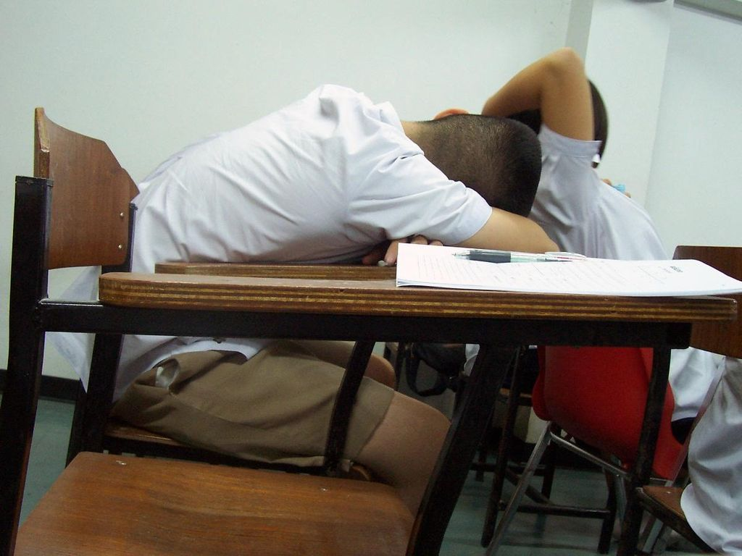
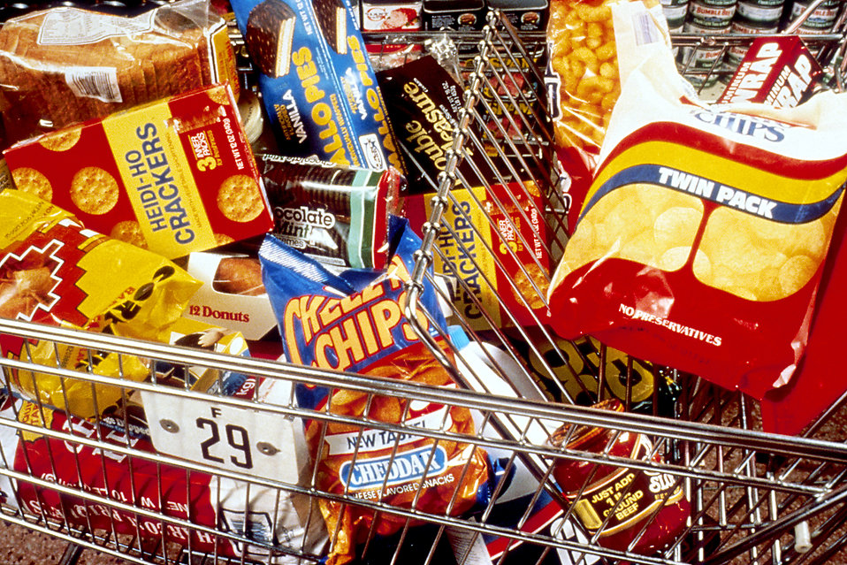
LACK OF NUTRITION (junk foods) CAN CAUSE PROBLEMS IN ACADEMIC RETENTION
For Middle Schoolers in
Harlem
By Lynda Watkins-Turner
NEW DESIGN MIDDLE SCHOOL/PS514
Nw Design Middle Schoo
b

Slide 2
THE STEPS OF PUBLIC POLICY ANALYST
1. Define the Problem
2. Gather the Evidence
3. Identify the Causes
4. Evaluate an Existing Policy
5. Develop Solutions
6. Select the Best Solution (Feasibility vs. Effectiveness)

Slide 3
The PROBLEM:
“Poor Academics
Fast food can lead to impaired academic performance because high sugar levels followed by sugar crashes and poor concentration levels make it difficult to accomplish tasks which need extended periods of focused attention. Blood sugar fluctuations can also result in mood swings and lack of alertness, lowering classroom participation.”
“Junk food lacks the essential nutrients that provide alertness to the brain. Teens may face issues with concentration, lower retention capabilities, and reduced learning abilities.”

Slide 4
Article/Video#1: Class activity:1. Turn and Talk 2.Chart
Please read this article that gives 5 examples of how junk food can affect learning and behavior.
https://www.rmit.edu.au/news/all-news/2016/sep/five-ways-junk-food-changes-your-brain
Turn and Talk Questions:
Do you eat junk food? Defined as “food that has low nutritional value, typically produced in the form of packaged snacks needing little or no preparation.”
How do you feel after you eat lots of sweets, chips and/or drink soft drinks full of sugar?
At this time we will make a T-Chart of junk foods that we eat and write adjectives of how we feel after eating these junk foods.

Slide 5
Gather Evidence:
Class Assignment: Food Journal Experiment
Over the next week, we will create a food journal
COLLECT DATA: In your Journal marked Monday, Tuesday, Wednesday, Thursday and Friday.
You will list all of the junk food that you eat in a given day. Put the approximate time after
Consumption–or when you ate the junk food. Example:
“Monday: November 21, ____________
Time: 9:06 AM Food1 bag of Takis and 1 Dr. Pepper: 16 0z. 2 frosted (small donuts)
*Please write within 30 minutes of the snack how you felt:
HUNGRY AGAIN!! I have some Sour Patch Kids candy in my bookbag. I can’t wait to snack on them! I’m gonna skip the nasty school lunch and will eat the Sour Patch Kids, more chips: Nacho Cheese Doritos and
I have an Arizona Ice Tea in my locker.
*Feeling light-headed; sleepy and don’t feel like sitting for my History class: TOO MUCH WRITING!!!”

Slide 6
MORE EVIDENCE: From RELIABLE SOURCES
Articles/Videos here for references for students
https://childlifenutrition.com/adverse-effects-of-junk-food-on-children/
https://www.rmit.edu.au/news/all-news/2016/sep/five-ways-junk-food-changes-your-brain
https://www.news-medical.net/health/How-Fast-Food-Affects-Childrens-Health.aspx
https://www.ncbi.nlm.nih.gov/pmc/articles/PMC4998375/

Slide 7
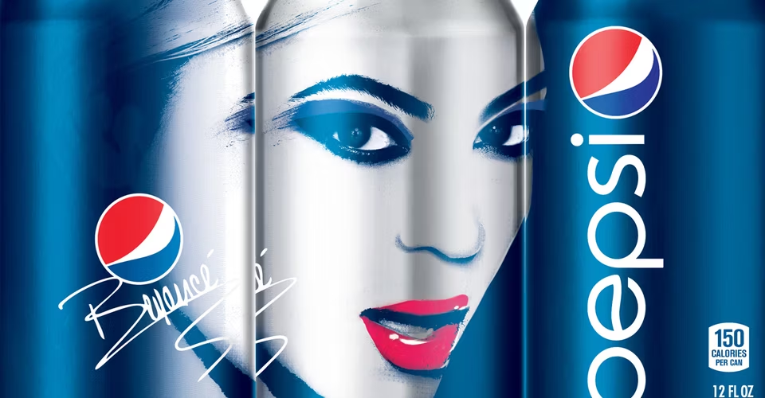
Causes of the Problem
The Food and Beverage Industry's Role in the Formation of Food “Preferences”
“How often have you seen a food advertisement for broccoli?
Healthy foods are advertised less than 3% of the time in comparison to their counterparts.
This has a direct impact on children's food preferences—considering food and beverage companies spend $2 billion dollars a year on food marketing campaigns directed at children.
The fast food industry spends nearly 5 million dollars a day marketing products high in sugar, fat and salt, while also suggesting portion sizes grossly disproportionate to a child's energy needs. Increasingly, fast food companies are also using toy tie-ins with major children's motion pictures to try to attract young people. Remarkably, studies demonstrate that even very young children exposed to persuasive ads can develop food cravings for unhealthy foods that they have never even tasted!
Regulation—or lack thereof
–The marketing of food to children on media is unregulated in the U.S.”
—https://www.healthychildren.org/English/healthy-living/nutrition/Pages/How-Children-Develop-Unhealthy-Food-Preferences.aspx

Slide 8
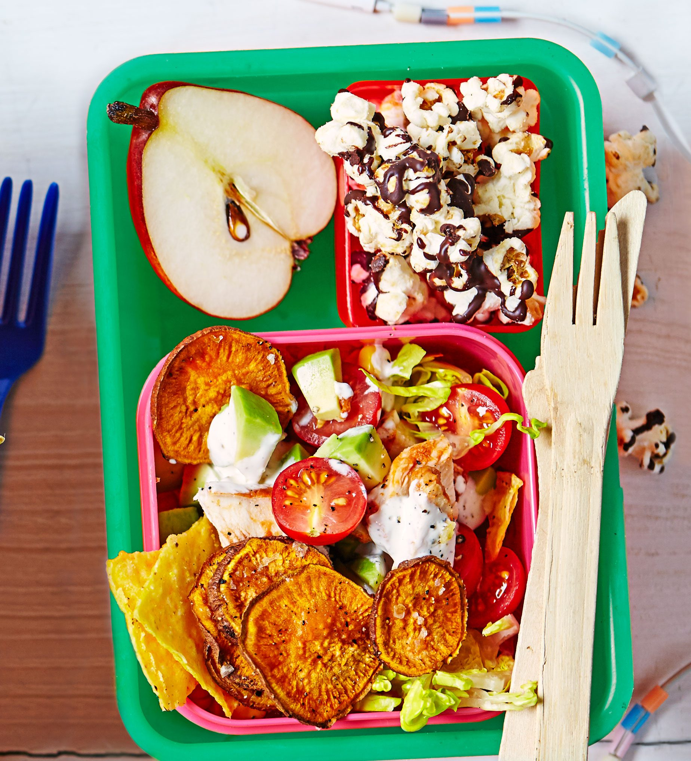
Examine the Existing Policy
Governance Initiatives (The New York City Department of Education)
“Access to food is a fundamental human right. The Mayor’s Office of Food Policy strives to increase food equity through improving food governance.
We believe that all New Yorkers should have equal ability and opportunity to access nutritious, affordable food in their communities. We also believe that our resources should be harnessed to drive connections between health and sustainability.
Our food governance initiatives ensure that the money we spend on food improves the health of our residents and our planet.
We lead by example and looks to share our experiences and learn from others across the country and beyond.
Since 2014, NYC has been a signatory city of the Milan Urban Food Policy Pact. It also participates in the C40 Food Systems Network. And the Cool Food Pledge, with a commitment to reduce greenhouse gasses associated with the food we serve by 25 percent by 2030.”
The above policy challenges the “fast food model: High sugar, salt and fat: “Empty calories.”
For example, New Design Middle School does not have vending machines with fast/junk food choices. This would defeat the purpose of trying to promote healthier diets.

Slide 9
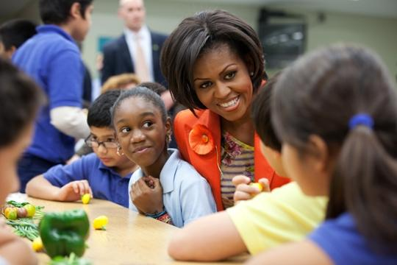
Develop Solutions:
WHAT SUGGESTIONS WERE GIVEN TO ENCOURAGE HEALTHIER EATING HABITS OF ADOLESCENTS IN PARTICULAR to these WEBSITES?
–Educate yourself on what is HEALTHY and what is NOT
–Food Diaries
–Read Labels
Add links here
https://www.fns.usda.gov/pressrelease/2013/usda-015013
Government steps in with subsidized programs such as SNAP. “Healthy” foods can be purchased with SNAP–”UNhealthy” foods are discouraged.

Slide 10
SWHAT IS THE BEST SOLUTION TO THIS PROBLEM? WILL IT BE AN EASY SOLUTION or MORE DIFFICULT? Best Solution: *Effectiveness v. **Feasibility
 |  | FEASIBILITY
 |  | HIGH | MEDIUM | LOW
EFFECTIVENESS | HIGH –Read Labels –Educate yourself |  | Food Diaries
 | MEDIUM
 | LOW
*Effectiveness is defined as: something is successful in producing a desired result; success.
**Feasibility is defined as: the state of something being possible

Slide 11
CONCLUSION:
We have discovered some things about our snack habits that may have an impact our learning.
Since we are primarily (first) in school to learn, we want to do whatever we can to enhance (help) our
learning.
FINAL EXIT TICKET: What did you learn from this Unit that can help you make better decisions when choosing snacks?
I learned_______________________________________________________________________________________.
Instead of eating ________________________________________ as a quick snack, I can substitute _____________________________.
2. Let’s devote a space in our room–a small Bulletin Board? With our findings: healthy foods v. junk food.
HERE’S TO HEALTHY LEARNING!!
Licensable

Slide 12
THE CONVERSATION CONTINUES. . .
Let’s continue to do our research!
STARTING WITH YOU!!!!

