Slide 1
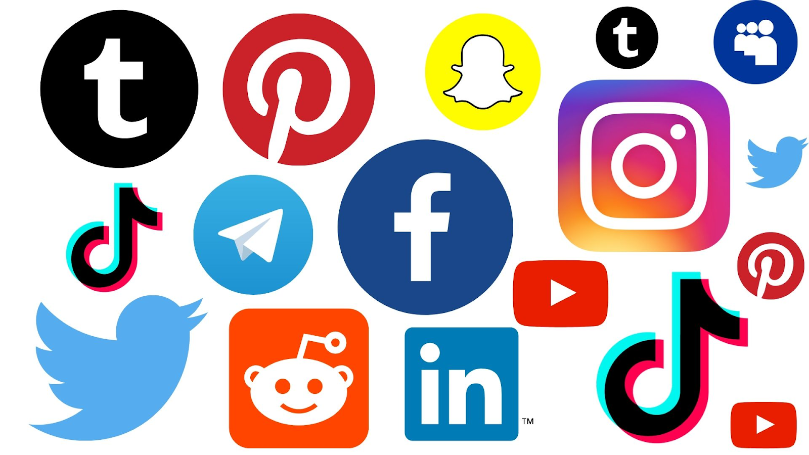
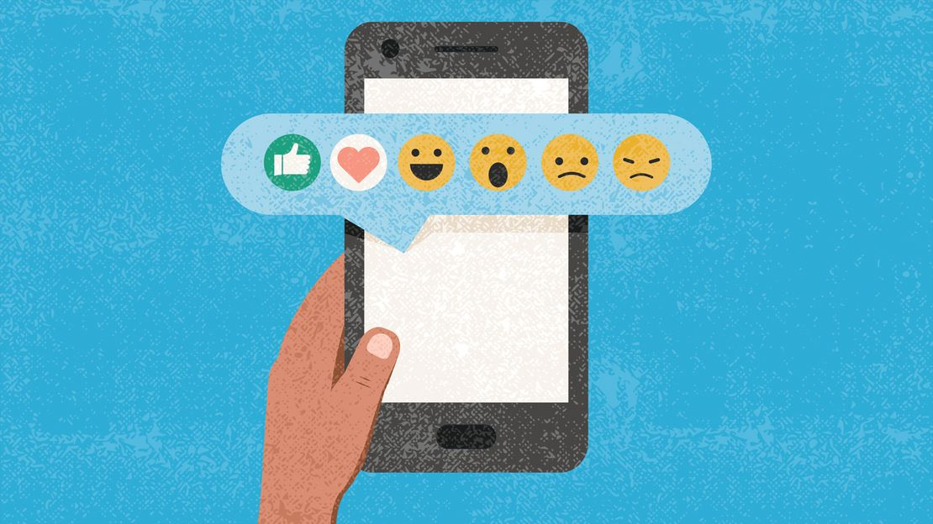
SOCIAL MEDIAS INFLUENCE
On
ADOLESCENTS
at
NEW DESIGN MIDDLE SCHOOL
By Lynda Watkins-Turner New Design Middle School; 0514
lwatkins-turner@newdesignmiddle.org

Slide 2
How to use the PUBLIC POLICY ANALYST (PPA)
There are 6 STEPS:
Each STEP will GUIDE you from
1. DEFINING THE PROBLEM to 6. SELECTING THE BEST SOLUTION.

Slide 3
THE STEPS OF PUBLIC POLICY ANALYST
1. Define the Problem 2. Gather the Evidence 3. Identify the Causes 4. Evaluate an Existing Policy 5. Develop Solutions 6. Select the Best Solution (Feasibility vs. Effectiveness)

Slide 4
The Problem:
Research (and parents and teachers) are concerned that adolescents are consuming (spending) too much time on social media. This could be affecting their attention span, sleep (lack of) patterns and study skills.
One of the main issues presently is that a growing number of adolescents have become “addicted” to social media to the point where they do not want to “turn it off.”
As it is a very prosperous industry, one need only look to the giants in this field’s (social media) profit margins.
Last year alone, Apple grossed: Net Worth 2022: $958 Billion. YES! That is almost a TRILLION DOLLARS–OR–A LOT of “LIKES!”

Slide 5
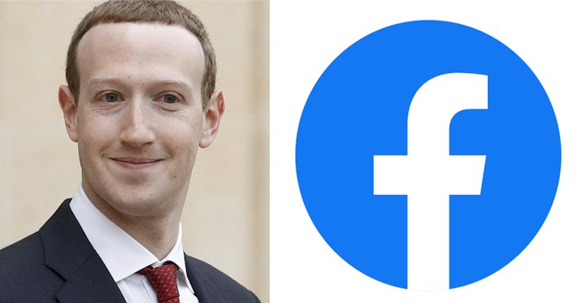
FACEBOOK “RULES?”
Facebook (also owner of Instagram)
The criticism directed towards these companies has grown, and culminated into Senate Hearings in which the CEOs appeared before a panel to answer questions and publicly defend their companies.
On the other side of the argument were whistleblowers who shared formally confidential, but very damning evidence against the Titans of social media companies.
These whistleblowers exposed logarithms put in place to
Deliberately “addict” users to stay on social media longer, make purchases and continue to recruit followers who could “like” their own sites: Facebook, (now Meta,) Instagram, Tik Tok, etc.

Slide 6
Gather Evidence:
DO NOW:
Please take the attached Survey to determine how many hours a day you spend on Social Media.
This information is anonymous and will be used only for comparison purposes.
https://docs.google.com/forms/d/1fvpERu4XLtsmuu7Y8hh8DwDUDiAI180Tm89xZzoILbk/edit
GUIDING QUESTION:
>Based on the data you provided, do YOU think you spend too much time on Social Media?
>Brief Class Discussion (5-7 minutes.)
In YOUR opinion, is it a GOOD or BAD thing that you spend _____ hours a week on social media?
GOOD: How do you JUSTIFY this? BAD: How will YOU change? (*Please jot down in your notebook.)
*THE BENEFITS OF WRITING: PEN TO PAPER (on occasion)
https://www.oxfordlearning.com/writing-by-hand-is-good-for-the-brain/

Slide 7
MORE EVIDENCE: From RELIABLE SOURCES
The following are links that provide more information on the influence (Good and Bad) of Social Media on the Adolescent:
EFFECTS of SOCIAL MEDIA on YOUTH
https://health.clevelandclinic.org/dangers-of-social-media-for-youth/
DOES SOCIAL MEDIA AFFECT YOUR HEALTH?
https://healthblog.uofmhealth.org/childrens-health/a-third-of-children-ages-7-9-use-social-media-apps
The BENEFITS of Social Media
https://www.internetmatters.org/resources/social-media-advice-hub/social-media-benefits/
FACEBOOK/META and PROFITS:
https://www.sciencenewsforstudents.org/article/facebook-meta-instagram-profits-teen-safety-mental-health
TIKTOK, ANYONE? THE EFFECTS of TIKTOK: POSITIVE and NEGATIVE
https://medium.com/linens-n-love/how-tik-tok-is-affecting-youth-the-positive-and-negative-effects-7381b17ac43a

Slide 8
Identify the Cause
Adolescents aged 10 to 19 (for our purposes) admit to spending “most of their free time using social media.”
See Survey results.
With easy access to social media, such as streaming on their Smart phones (and even watches!) most adolescents admit that they could not go a day without access to social media.
It is right there in the title social media. It is very important to be “connected” to their base of friends, communities and social networks for what it known as “FOMO” or Fear Of Missing Out.
https://images.app.goo.gl/HgQ1jjZpkvQYZXxy8

Slide 9
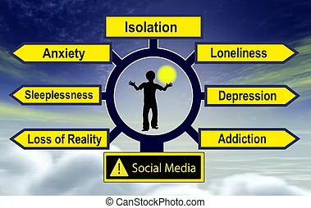

Slide 10
Evaluate an Existing Problem
FOMO: Fear Of Missing Out to many adolescents is as important as oxygen!
Many students complain that they don’t even want to give up their phones during the school day because they fear that they have missed “something important:” a text, a new video, a “like” on their social media page; a new tip from an “influencer” (someone who has appointed themselves and expert in a certain field: hairstyling, makeup, dance, etc.) a new follower, etc.
Oh, and you must receive this information in REAL TIME!!

Slide 11
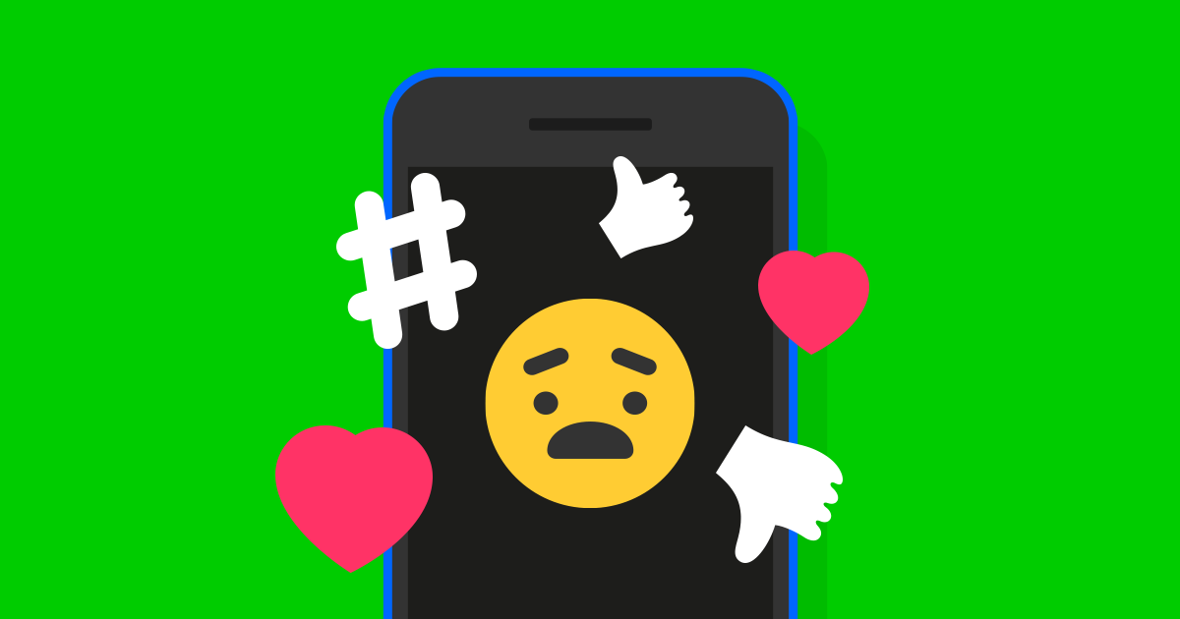

Slide 12
Develop Solutions:
WHAT SUGGESTIONS WERE GIVEN TO STOP THE ADDICTION OF ADOLESCENTS IN PARTICULAR to these WEBSITES?
ARTICLES/REFERENCES:
Whistleblowers (People who were insiders in a company, for example, who expose (show) what the company does not want others (the public) to know.
This information is guarded by the company. The company, in this case, Facebook, was accused of deliberately manipulating (changing things to their advantage for profit: more money!) logarithms to get users to:
stay online longer, buy things they don’t need, and even promote misinformation campaigns.
https://www.reuters.com/technology/facebook-whistleblower-says-transparency-needed-fix-social-media-ills-2021-12-03/
Ideas are outlined by whistleblowers, concerned parents, teachers, and even students on how to spend less time on social media.

Slide 13
SWHAT IS THE BEST SOLUTION TO THIS PROBLEM? WILL IT BE AN EASY SOLUTION or MORE DIFFICULT? Best Solution: *Effectiveness v. **Feasibility v.
 | HIGH | MEDIUM | LOW
HIGH
MEDIUM
LOW
*Effectiveness is defined as: something is successful in producing a desired result; success.
**Feasibility is defined as: the state of something being possible

Slide 14
CONCLUSION:
We studied our Social Media “habits” by taking a survey and documenting the number of hours that we spent on social media in a day/week. Your results may or maynot have surprised (even shocked) you. We compiled this data to help us to understand that social media is a powerful–in some cases a even an addictive source of “entertainment.”
We discovered that some of the forces behind social media are designed to “hook” us into “codependency.” This dependence on social media can frame our opinions, our beliefs and entice us into action (sometimes negative) and inaction (usually negative.)
Some of the government policies–such as de-regulation– have allowed, especially, the larger social media companies to thrive and make unimaginable profits from their dependent subscribers.
We learned that “whistleblowers” are changing the conversation to the point where people are waking up and seeing the actual effects of social media’s influence on us.
Congressional Hearings were held and these major companies were exposed as exploiting the average subscriber by keeping us “hooked” on their “product.” See https://www.usatoday.com/story/news/politics/2021/10/06/facebook-whistleblower-mark-zuckerberg-congress-legislation-reform/6017553001/
Mark Zuckerberg (Facebook/Instagram founder) found himself finally having to answer for some of his lucrative, but unethical practices.
Licensable

Slide 15
THE CONVERSATION CONTINUES. . .
Let’s continue to do our research!

Slide 16
MORE RESOURCES: HOW MANY “LIKES?”
RESULTS of SURVEY HERE*
*CLASS 1 COMPARE to CLASS 2

