Slide 1
STUDENTS & HOMEWORK
P.S. 129M, The John H. Finley School
Ms. Tyler, Class 3-214

Slide 2
PPA: Public Policy Analyst
Q: What is a public policy analyst?
A: A public policy analyst is a researcher that works to make people aware of social issues in their communities.
The 6 Steps of the Public Policy Analyst (PPA)
1. Define the Problem
2. Gather the Evidence
3. Identify the Causes
4. Evaluate an Existing Policy
5. Develop Solutions
6. Select the Best Solution (Feasibility vs. Effectiveness)

Slide 3

HOMEWORK
Homework is a task that is assigned to students by their instructor to be done and completed outside the classroom.

Slide 4
Step 1 : Defining the Problem
Think for a moment, pair up with a partner and share your thoughts.
Why do you think teachers assign homework to students?
Be ready to share with the class. Your ideas will be recorded on the chart at the front of the room.

Slide 5

STEP 2: Gathering evidence
Did you do your homework?
https://forms.gle/5sU3sGzjvArGVR6a8
Yes or No?

Slide 6
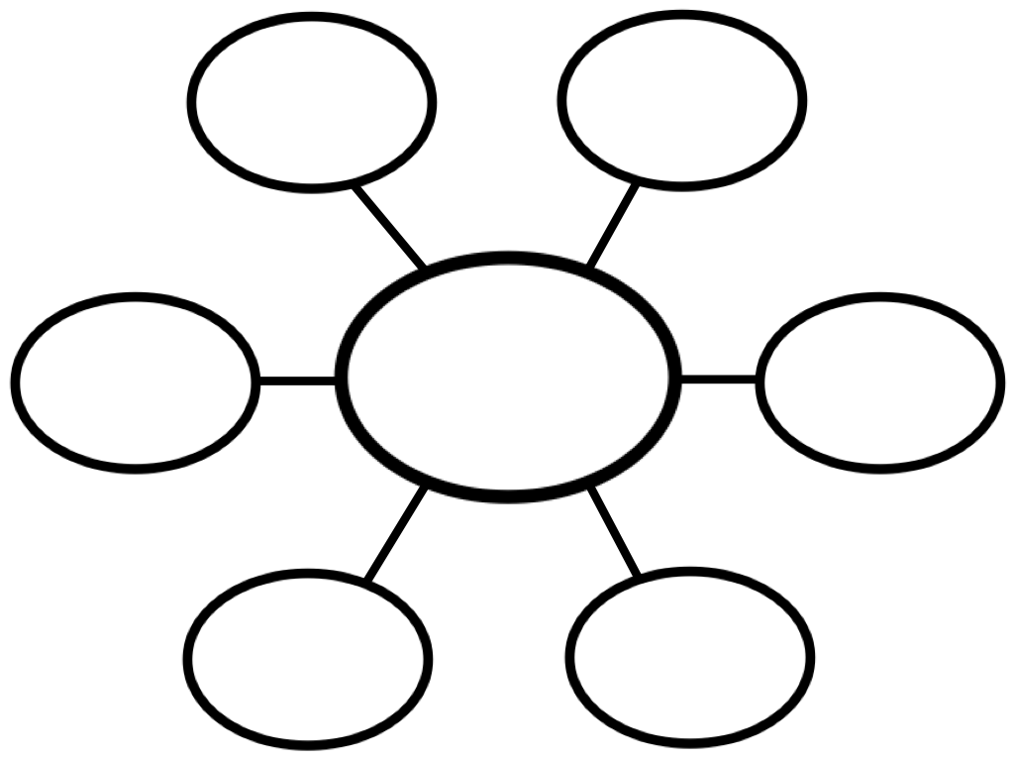
Step 3: Identify Causes
Problem: Many Students in our classroom at P.S.129M do not complete their homework.
Group Work
In your group discuss why students do not complete their homework. Then record your reasons in the web located on your desk.
Reasons students do not do homework

Slide 7

Click on the link to read the article to about reasons why students do not complete homework. How do your groups reasons compare to this information?
https://www.teachthought.com/pedagogy/why-students-dont-do-their-homework-and-what-you-can-do-about-it

Slide 8
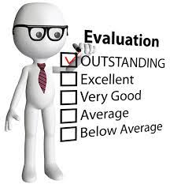
Step 4:evaluating an existing problem
Policy evaluation is when you review, check, and improve a current policy to make it better and more effective

Slide 9

THINK
Does NYC schools have a clear homework policy in place for students?
Does P.S. 129M have a clear homework policy?
Does our classroom have a homework policy?

Slide 10

Discuss the following questions with your group. Record your answers on the sheet provided.
1.What are the advantages of this policy?
2.What are the disadvantages?
3.Should this policy be totally replaced, strengthened, or improved?

Slide 11

Step 5: Develop Solutions
After you know what is the problem you need to solve, you can develop a solution or answer to the problem.

Slide 12

Turn and Talk
In your group think of 3 new ideas or ways that can be developed to help improve students completing their homework. Then record them on the graphic organizer listing the most successful policy first.
BE READY TO SHARE!!

Slide 13

New Suggested Policies
New Suggested Policies
Which policy do you think would be the most successful in addressing the problem? List it first and then list the next best one.
Policy | Who will carry it out?
1.
2.
3.

Slide 14

Step 6: Selecting the Best Policy Solution
As a group you suggested 3 new policies to help solve the problem. The policies were ordered as the most successful to the least successful. Which one is feasible? Which one is effective?
Feasible - Most likely to get done.
Effective - Able to produce the results we want.

Slide 15
The Best Policy
E
F
F
E
C
T
I
V
E
N
E
S
S
Review and discuss the 3 policies for their feasibility and effectiveness. Place the policy on the matrix. Is it feasible?(High, Medium, and Low) Is it effective? (High, Medium, and Low)
FEASIBILITY
 | High | Medium | Low
High
Medium
Low

Slide 16

Public policy analyst work to raise awareness of social problems in our communities. They identify and evaluate social problems to find the best alternative solution. They help to make changes for the better.

Slide 17
Did you do your homework?
Yes, I did my homework !
No, I did not do my !homework!

