Slide 1
Problem: NYC Schools face safety challenges to open
Mark Torres, Edward A. Reynolds WSHS, markt@earwshs

Slide 2

Solving problems: Public Policy analyst (PPA)
Public Policy Analyst (PPA)
Step 1: Define the Problem
Step 2: Gather the Evidence
Step 3: Identify the Causes
Step 4: Evaluate an Existing Policy
Step 5: Develop Solutions
Step 6: Select the Best Solution

Slide 3
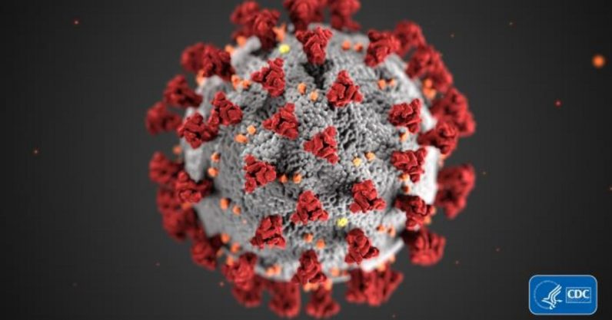
Gather Evidence: DOE Staff Deaths
As of June 22 , 2020 we have lost 79 DOE employees during the COVID-19 pandemic:
75 school-based employees
  31 are teachers
  28 are paraprofessionals
  5 are food service staffers
  3 are guidance counselors
  2 are administrators
  2 are facilities staff
  2 are school aides
  1 is a parent coordinator
  1 is a School Computer Tech Specialist
4 central office employees

Slide 4
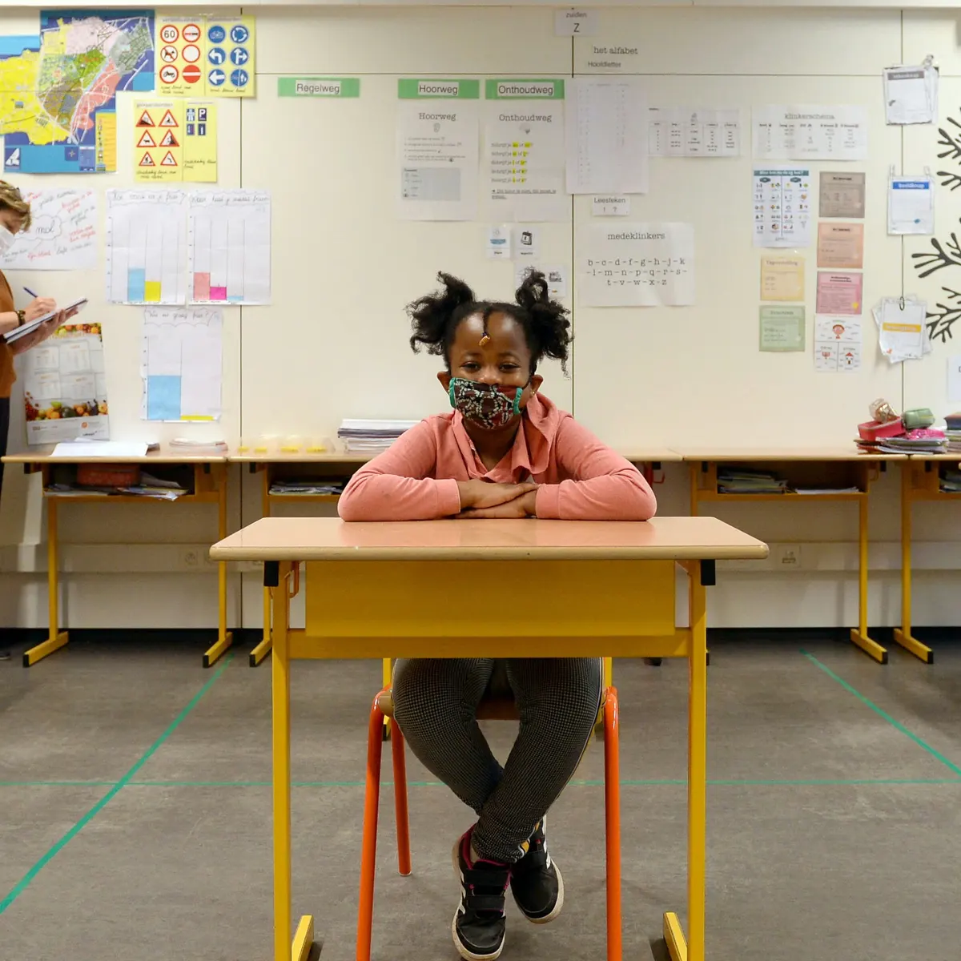
Gather Evidence: Is reopening schools easy?
Most Schools Are Not Opening
Preparing to Reopen Schools

Slide 5
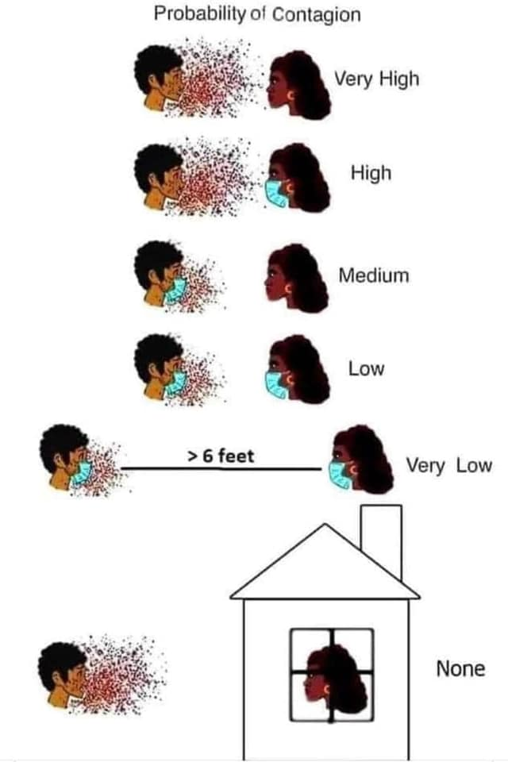
Identify Causes: How do you get the Coronavirus?
Easier to Catch the virus indoors.

Slide 6
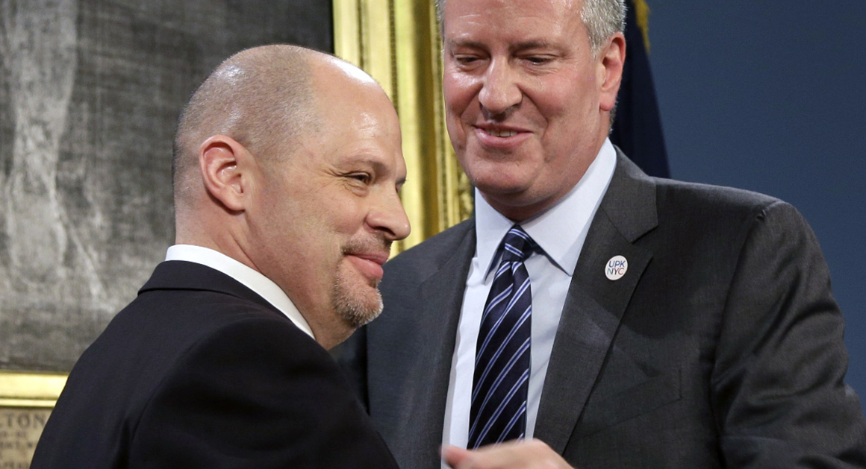
Examine Existing Polcy: What is the Deal?
Mayor and Teachers' Union Make a Policy

Slide 7

Develop New Solutions: How not to reopen Schools
Israel Gets it Wrong!

Slide 8
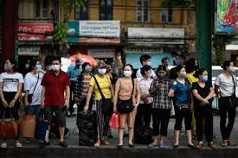
Develop new solutions: Has anybody reopened safely?
Vietnam Reopened Safely

Slide 9

Develop new solutions: Using Music & Animation
Parent and Student Buy-in

Slide 10
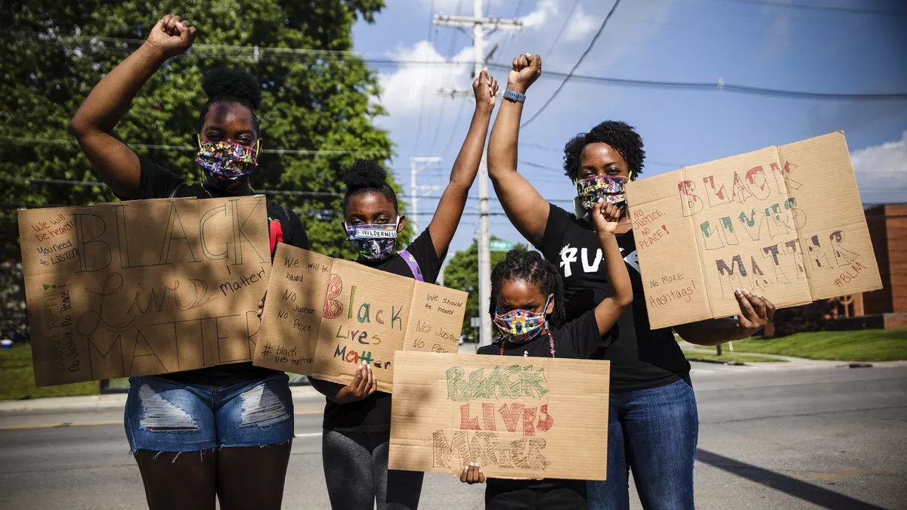
Select best solution: Using what works and Adding
How would you adapt ideas
that worked in Vietnam so
they can work in NYC?
How can we make sure that
our Best Solutions are made
into policy?
What kind of pressure
tactics do we need to use
to make sure NYC public
schools are safe?

