Slide 1
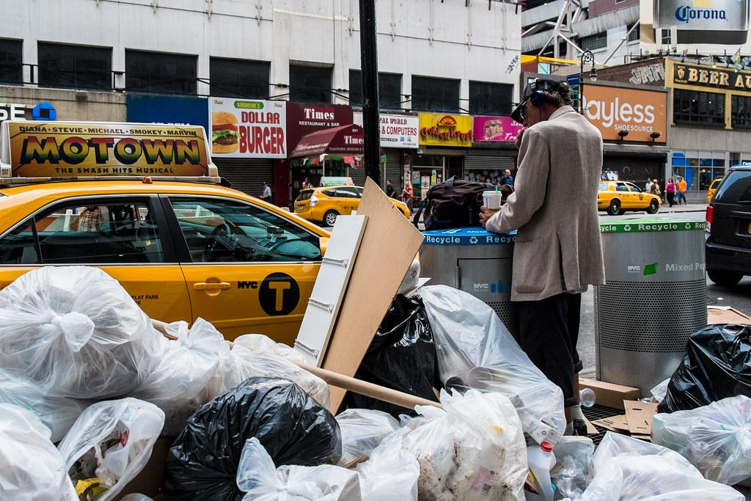
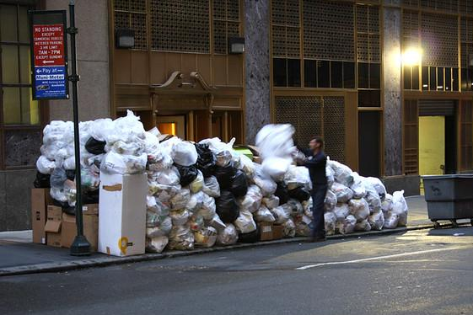
Litter In Our Harlem Community
Urban Academy for Future Leaders
Mr. H. Title

Slide 2
The 6 Steps of the Public Policy Analyst (PPA)
1. Define the Problem
2. Gather the Evidence
3. Identify the Causes
4. Evaluate an Existing Policy
5. Develop Solutions
6. Select the Best Solution (Feasibility vs. Effectiveness)

Slide 3

Do Now: Answer the following question . . .
1. Define the Problem
Do you feel our community has a littering problem?
Explain . . .

Slide 4
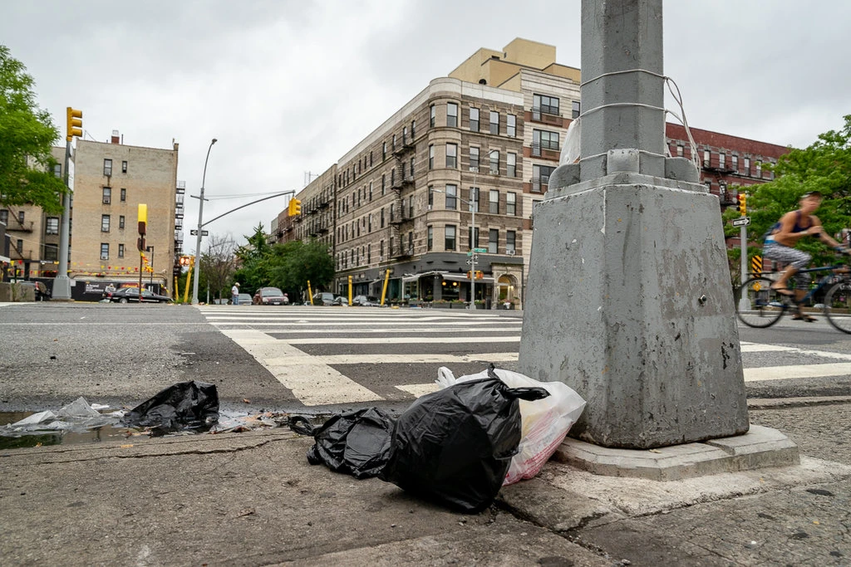

2. Gather the Evidence
Evidence of the Problem
Click on the link below to read the article.
Harlem’s Trash Bins Were Overflowing, So the City Took 223 Away.

Slide 5
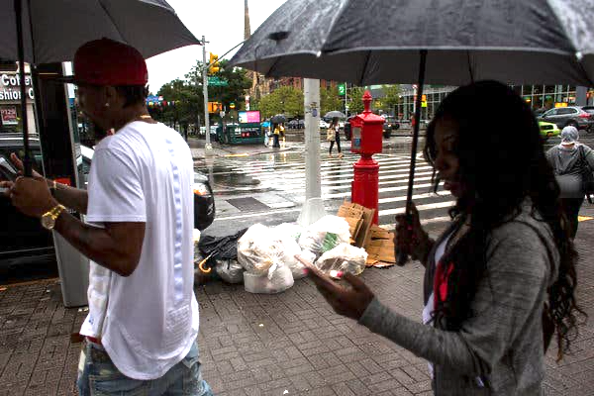
Additional Evidence of the Problem
Click on the link below to read the article.
Business Is Booming on 125th Street. So Is the Trash.

Slide 6
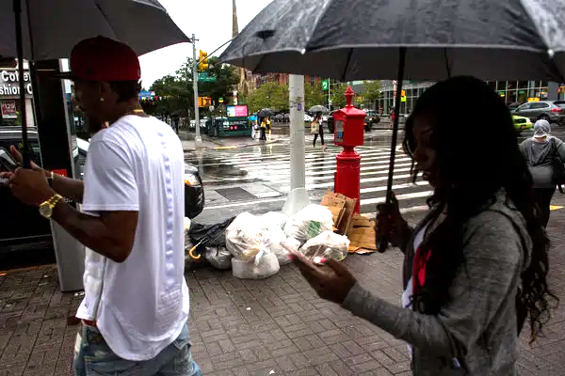
3. Identify the Causes
Let’s Identify the Causes . . .
With a partner Identify what you think some of the causes are?
1. 2.
3. 4.
5

Slide 7
Let’s Identify the Causes . . .
For example, some of the causes are?
Not enough trash cans
Community awareness
NYC Sanitation Dept.
. . .
. . .

Slide 8
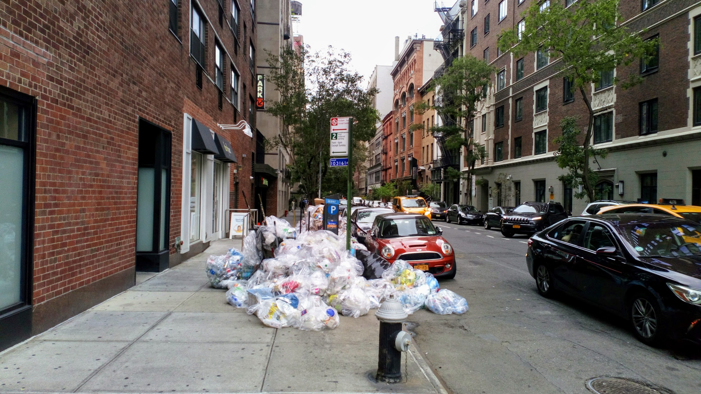
4. Evaluate an Existing Policy
What is the current law in New York City?
With a partner Identify what do you think the current laws are on regarding litter in NYC?

Slide 9
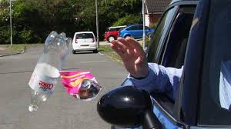
The existing Policy in New York City is . . .
It’s a crime to litter in NYC. It is poorly enforced. In addition to that, several organizations have anti-littering campaigns. Some schools have active programs to reduce litter on school property. These only benefit the school.

Slide 10
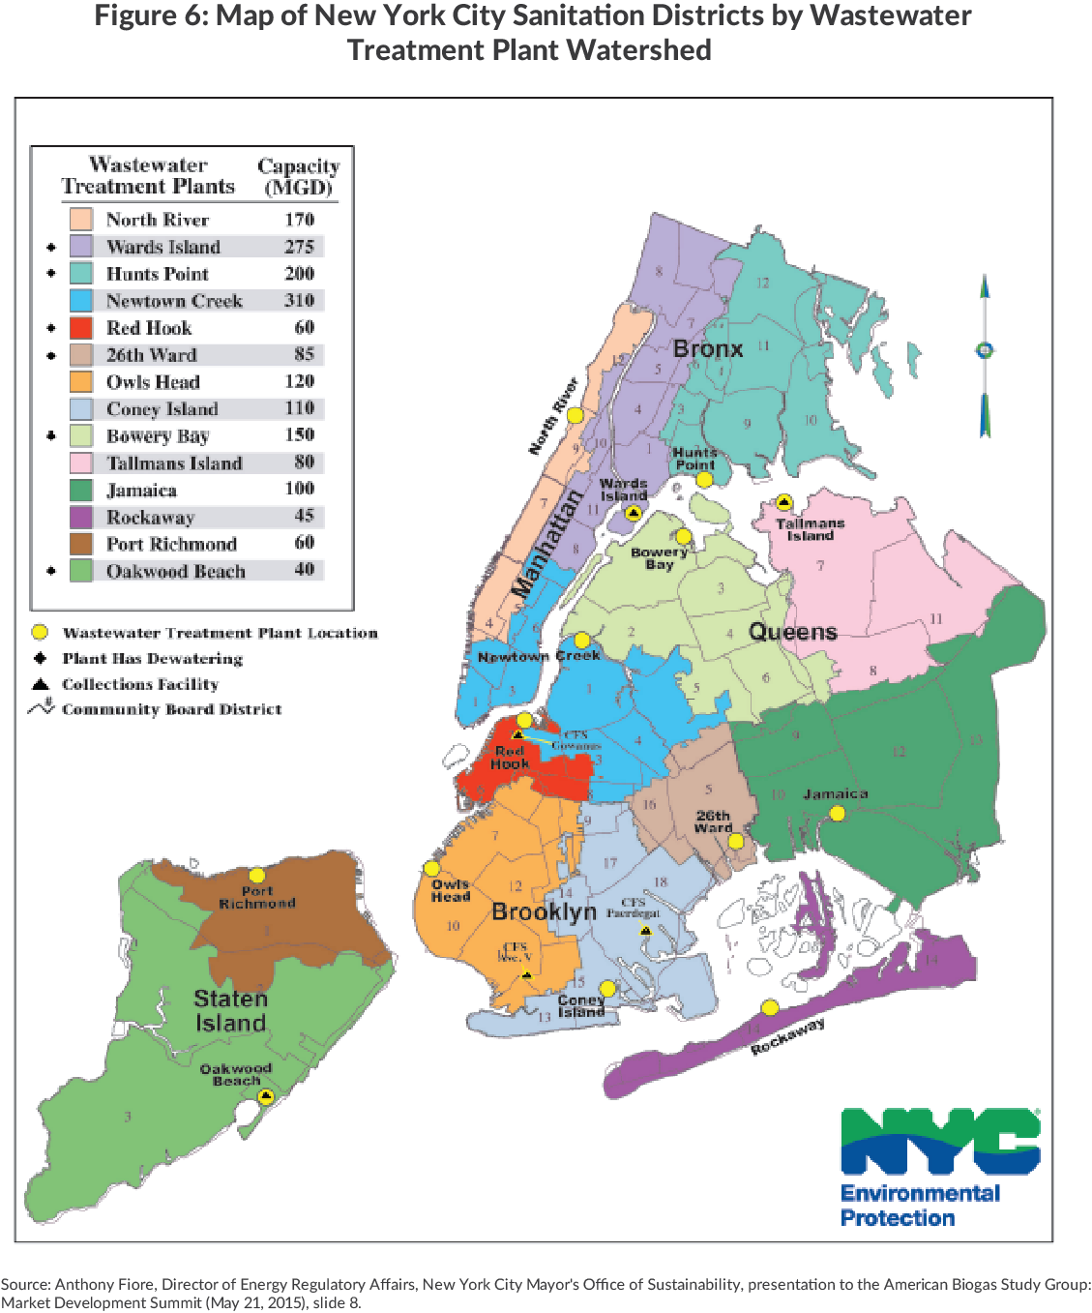
New York City trash . . .
Where does our trash go?

Slide 11

5. Develop Solutions
Lets Develop Some Solutions
With a partner, Identify what what you think YOU and your classmates can do to help?
1. 2.
3. 4.
5

Slide 12

Some Solutions are . . .
Posting on social media
Posting to all the local news media outlets
Letter writing
Emailing to our local Assemblyman
Letter writing to the Mayor’s office
Emailing the Department of Sanitation

Slide 13
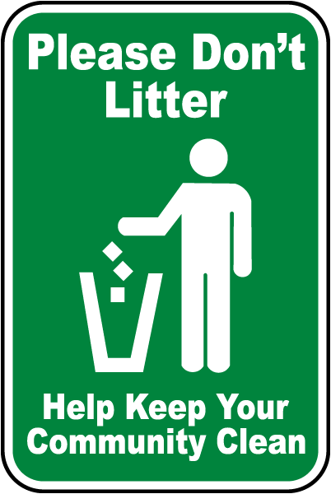

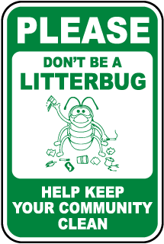
6. Select the Best Solution
Lets Select the Best Solution for our community.
Lets make our own signs to bring awareness to the community. This will help the community due their own share combatting litter in the
neighborhood.

Slide 14

Additional Solutions for our community.
We will all update our social media accounts and create a class blog. Students will use hashtags for New York City
and Harlem.

