Slide 1
Student Accountability in Room 131
Tracey Steele I.S. 286 Urban Assembly for Future Leaders
tsteele@schools.nyc.gov

Slide 2
Public Policy Analyst (PPA)
Define the Problem
Gather the Evidence
Identify the Causes
Evaluate an Existing Policy
Develop Solutions
Select the Best Solution

Slide 3
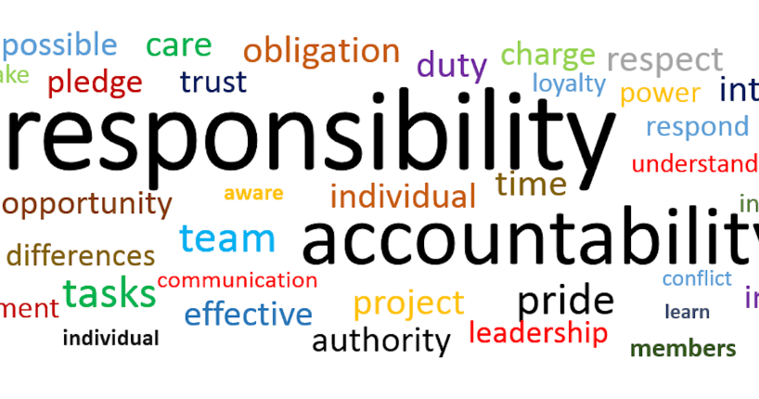
Step 1- Define the Problem
A problem I have noticed in room 131 at AFL is that many students do not want to accept responsibility for their learning.
This Photo by Unknown Author is licensed under CC BY-ND
This Photo by Unknown Author is licensed under CC BY-ND

Slide 4
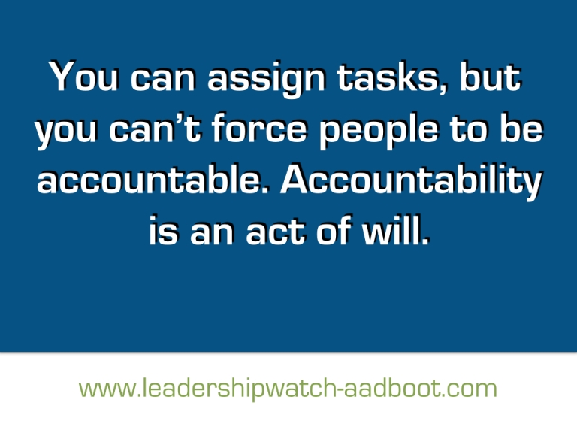
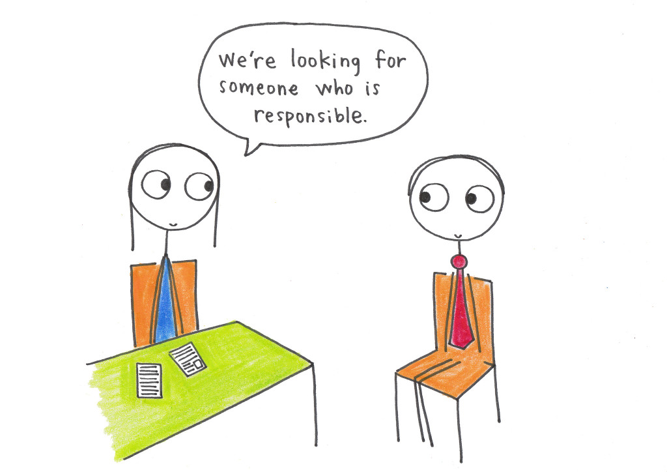
By not taking accountability for your learning you are….
Missing classes
Becoming overwhelmed
Missing out on valuable instruction
Getting poor grades & falling behind
Y

Slide 5
Step 2-Gather the evidence
60% of students do not ask clarifying questions.
An average of about 45% of students do no complete homework assignments.
Roughly about 25% of students do not finish their classwork on time.
Each week we contact parents and there seems to always be an excuse for missed work.

Slide 6
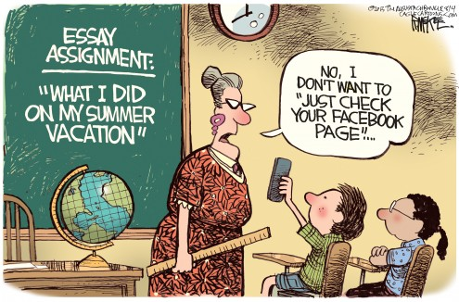
Step 3- Determine the Causes
Do a popcorn share:
Is there anyone you can go to for help/support?
Can someone help you with your homework at home?
Why do you think you’re not handing in classwork on time?
How can this situation be rectified/solved?

Slide 7
Step 4- Evaluate an Existing Policy
Math Grading Policy
Classwork 30%
Homework 15%
Test/Projects 35%
Quizzes 10%
Participation/Discussion 10%

Slide 8
Step 5- Develop a Solution
Return work prompt and allow for
students to react to feedback
Have multiple ways to involve guardians
in student learning so that both parents and teachers
can insure completion of work
Students will have an
opportunity for self reflection
and self evaluation

Slide 9
Step 6- Select the best Solution Feasibility vs. Effectiveness
Task
Select a solution that is the most feasible and effective
Show your solutions in a Feasibility vs. Effectiveness chart

Slide 10
Feasibilty vs. Effectiveness Chart
 | High | Medium | Low
High
Medium
Low

