Slide 1
Growing Pains
Difficulty adjusting in new environments?

Slide 2

Identify the Problem
Many students have difficulty adjusting to Middle School?

Slide 3
Warm -Up
Write a few sentences about “What did you expect the first day of school to be like?

Slide 4

Evidence of the Problem
MIDDLE SCHOOL IS AN ADJUSTMENT FOR CHILDREN.
Middle school is not the same as elementary school. It is a much larger facility and one enters from being at the top of the Kingdom in 5th grade to the bottom of the Kingdom in 6th grade. The greater number of students and being in the lowest grade can cause an entering sixth grader to feel overwhelmed.
Students at UAFL have had meltdowns or expressed feelings of being stressed or overwhelmed.
Students are not use to the workload or transitioning to the different classrooms.

Slide 5
Evidence of the Problem continued
THERE IS ANXIETY ABOUT ENTERING MIDDLE SCHOOL.
Suppose I can't find my way around and am late to class?" "I've heard that middle school teachers are really strict and mean." "Suppose older kids pick on younger kids?" "Suppose I have no one to sit with at lunch?" "Suppose I have no classes with any of my friends?"
Entry anxiety is common. To allay it, going to a school orientation helps as well as parents who normalize fears and assure that within the first week the new school routine will establish a sense of familiarity.
In middle school, the advent of multiple teachers means that none of them know a student as well as one dedicated teacher did in back in elementary school. For the parent, this means there is no one go-to teacher with who the parent may have cultivated a supportive and collaborative relationship.

Slide 6
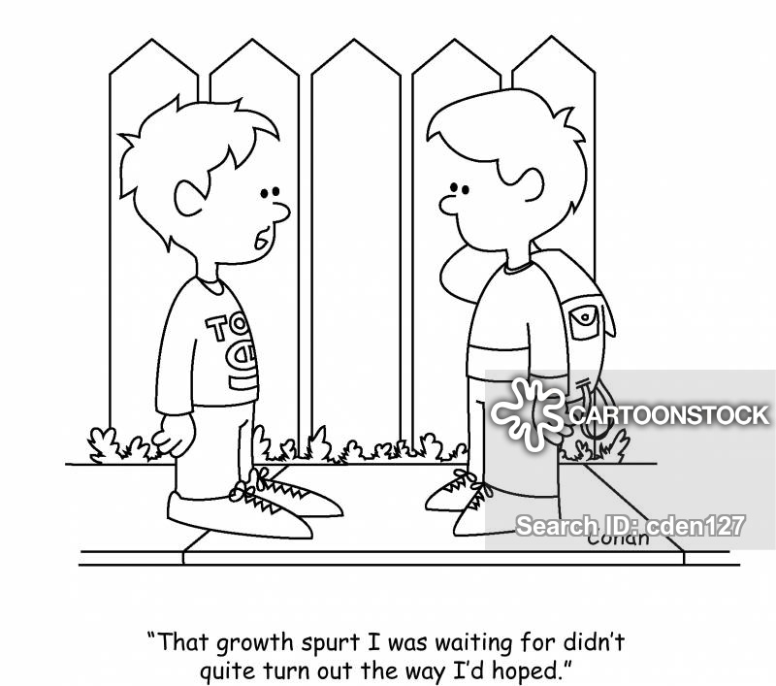
Identify the Main Causes
Bullying
Transition from room to room
Making New Friends
Lack of Parent Concern/Involvement

Slide 7
Current Policy at UAFL for helping Students Adjust
It's not that middle school teachers care less; they care differently. Part of the mission of middle school is helping students learn the self-management and social system skills that will be necessary to successfully cope with high school. Self-Management skills include developing the discipline to keep track of homework and the work ethic to process it on time. These are essential educational responsibilities students must learn to assume.
At UAFL students get Advisory 1st period which deals with social emotional learning.
Students have recess during their lunch period in order to provide an outlet for daily peer to peer interactions.
We use Parent Engagement Tuesday’s for students and parents to come in and meet with teachers to discuss any concerns.

Slide 8
Develop Solutions
Have a Welcoming BBQ for students beginning of the year (informal meet and greet)
Have Conflict Resolution periods (students have an opportunity for social emotional learning with peer to peer remediation)
Have a Buddy System (ways to connect in order to make friends)
Monthly Celebration (Highlight student Achievements)

Slide 9
What can UAFL correct the Problem ?
Task
Get into groups of 3
Research the DOE’s school wide policy on helping students adjust to school regulations. How does it compare to our school’s policies?
Write a proposal identifying a specific strategy to use in overcoming the problem.
Be prepared to share your proposal with the class and school.

