Slide 1
8TH GRADE MATH SCORES AT
MS 324 HAVE DROPPED!
Cherise Spriggs MS 324
cspriggs@ms324.org

Slide 2
Public Policy Analyst (PPA) Steps
Identify the problem.
Collect evidence.
Identify the causes.
Examine existing policy.
Develop new policy solutions.
Select the best policy solution.

Slide 3
Step One: Identify the problem.
8th Grade math scores have dropped significantly since the pandemic at MS 324.

Slide 4
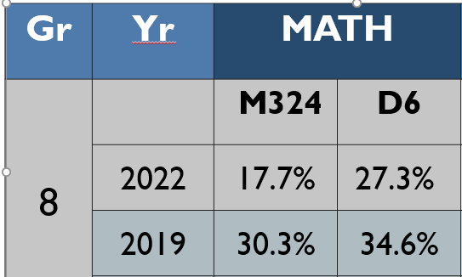
Step Two: Collect evidence.
Math Grade 8 Proficiency (L3 + 4)
at MS 324 and in District 6
https://infohub.nyced.org/reports/academics/test-results

Slide 5
This problem is not only within MS 324, but throughout the United States
Let’s read an article from the NY Times about the drops in test scores.
https://www.nytimes.com/2022/10/24/us/math-reading-scores-pandemic.html

Slide 6
Step Three: Identify the causes.
The Covid-19 Pandemic that hit NYC in March 2020 has had detrimental effects on students acquisition of math skills.
Students were forced to learn from home which introduced a number of issues including: lack of wifi, home environments that were not conducive to learning, students not logging on, students not paying attention to their lessons, and technology not working.

Slide 7
Step Four: Evaluate the existing policy
The 8th Grade Promotional Criteria taken from MS 324’s 2022-2023 Handbook

Slide 8
Step Four: Evaluate the existing policy
The 8th Grade Promotional Criteria at MS 324 only requires students to receive a Level Two on State Test Scores, but proficiency is determined Citywide from students receiving a Level Three or a Level Four.
MS 324’s policy should match that of the City’s to encourage teachers and students to reach higher expectations for “passing” the State math test.

Slide 9
Step Five: Develop New Policy Solutions
Provide students with more time to make up for lost time:
Institute small-group tutoring classes or labs
Double periods of math or three periods a day of math.
Make after school study hall available to students every day
Make Saturday school available for students
Make tutoring available during major holiday breaks

Slide 10
Step 6: Selecting the Best Solution
 | High Feasibility | Medium Feasibility | Low Feasibility
High Effectiveness | Mandatory Study Hall after school | 2 to 3 periods of Math/day | Saturday Tutoring
Medium Effectiveness | Small group tutoring sessions | Tutoring during major Holiday breaks
Low Effectiveness

Slide 11
Step Six: Select the Best Policy Solution
In the 2022-2023 School year at MS 324 all 8th graders who are failing math must attend mandatory study hall after school on Wednesdays and Thursdays each week until their grades improve. By keeping up with their current class assignments, they will be better positioned to work towards achieving a Level 3 or 4 on the Math State Test in May 2023.
This option is the best one because it immediately identifies students who are struggling with Math based on their current grades and provides them with after school tutoring every week to help improve their grade and knowledge of the content area. It is feasible because teachers are able to stay after school to tutor and all that is required from the students is a permission slip.

