Slide 1

African Americans and Latinx people are unfairly treated by law enforcement in the U. S.
Social justice
Elizabeth Smith
PS/MS 129
John H. Finley Campus School

Slide 2
The Six Steps of the PPA
1. Define the Problem
2. Gather Evidence
3. Identify Causes
4. Examine Existing Policy
5. Develop New Solutions
6. Select Best Solution

Slide 3
Step 1:The Problem
People of color are more than twice as likely to be killed by police than are persons of other racial or ethnic groups.
URL: https://scholarship.law.columbia.edu/cgi/viewcontent.cgi?article=3660&context=faculty_scholarship

Slide 4
Step 2: Gather Evidence
Pew research center found in a 2019 Center survey,
84% of black adults said that, in dealing with police, blacks are generally treated less fairly than whites; 63% of whites said the same.
87% of blacks and 61% of whites said the U.S. criminal justice system treats black people less fairly.
.
URL: https://www.pewresearch.org/fact-tank/2020/06/03/10-things-we-know-about-race-and-policing-in-the-u-s/

Slide 5
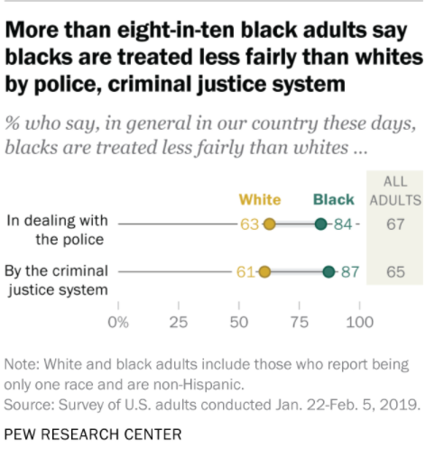
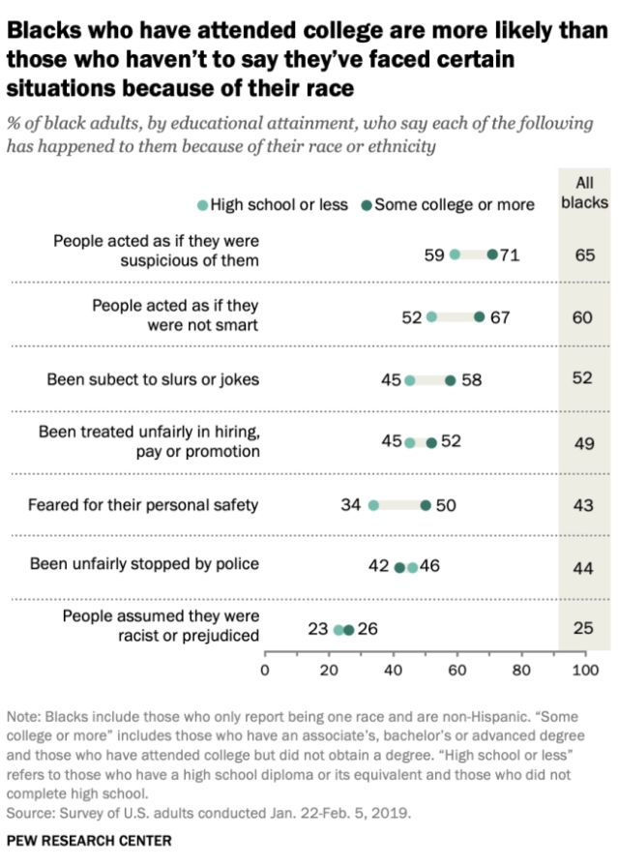
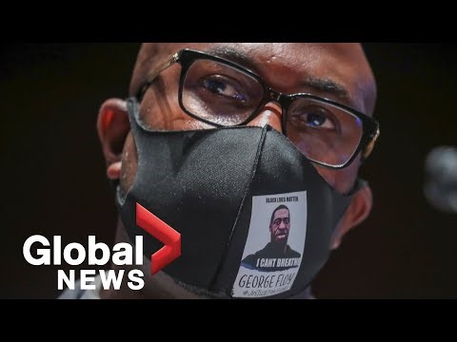
https://www.pewresearch.org/fact-tank/2020/06/03/10-things-we-know-about-race-and-policing-in-the-u-s/

Slide 6
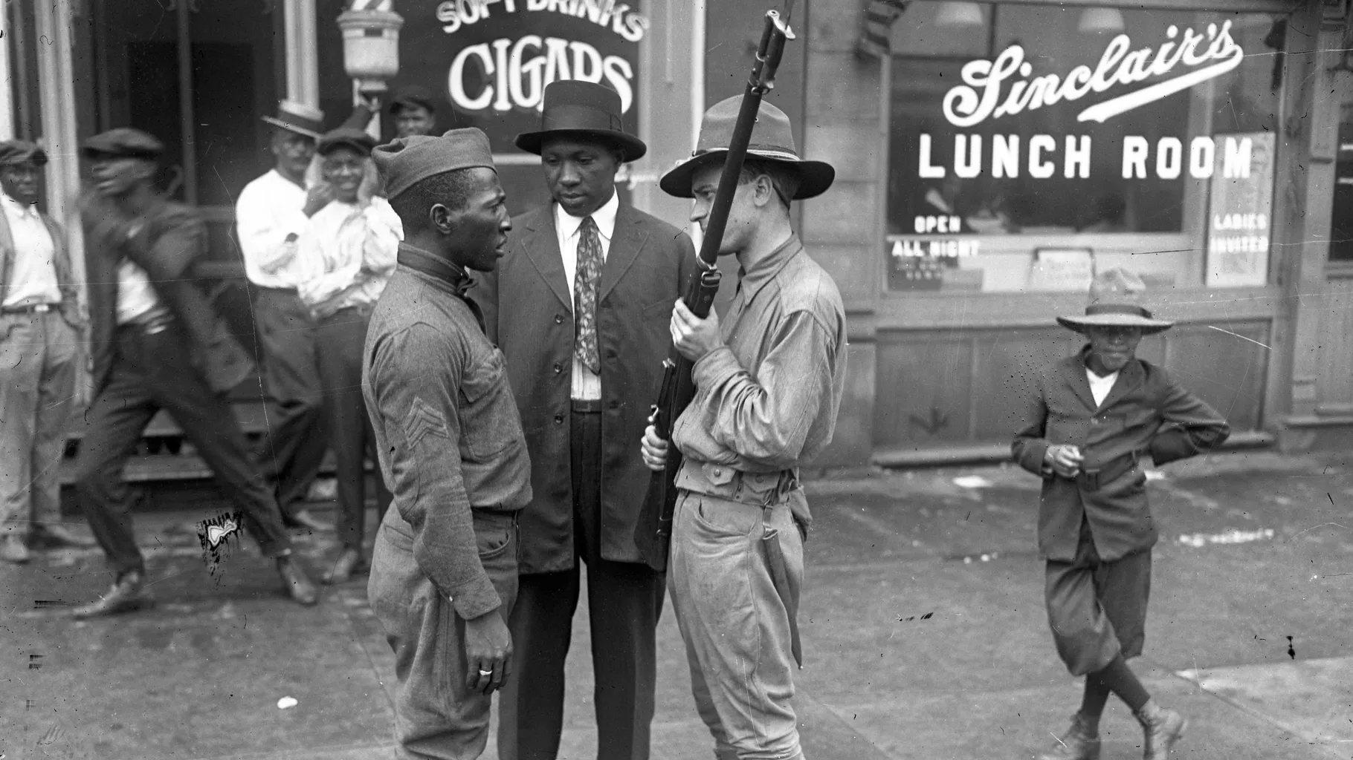
Step 3: Identify Causes
How Does Racism Cause Police Brutality?

Slide 7
Read the following story of Eugene Williams age 17 from Chicago, Illinois. (DOI: https://www.vox.com/2020/6/6/21280643/police-brutality-violence-protests-racism-khalil-Muhammad).
Quick Write:
How does this story relate to today?
How can you use it to answer the question: How does racism cause police brutality?

Slide 8


Existing federal statutes regarding policing discrimination:
“Police Misconduct Provision"
This law makes it unlawful for State or local law enforcement officers to engage in a pattern or practice of conduct that deprives persons of rights protected by the Constitution or laws of the United States. (34 U.S.C. § 12601).
https://www.justice.gov/crt/addressing-police-misconduct-laws-enforced-department-justice
Directions: Work with a partner to examine the existing policy using worksheet 4.

Slide 9
Step 5: Develop 3 New Policy Solutions
Below are 3 new Policy Solutions: Use these for Step 6 or substitute 1 or 2 of your own:
A national ban on chokeholds or strangleholds by police (Ban Chokeholds)
Every police department must develop guidelines on the use of force and submit them to their state attorney general’s office for approval. (New Guidelines)
By December 31, 2022, all police officers on the streets must wear and use body cameras in dealing with the public (Body Cams)

Slide 10
Step 6: Select Best Solution
Feasibility
 | High | Medium | Low
High
Medium
Low
Effectiveness
Use the 3 policies in Step 5 (or substitute policies from your group) to put the proposed solutions in the feasibility vs. effectiveness table above

