Slide 1
Problem with school (NYC) drinking water
Cheryl Simon

Slide 2
The 6 Steps of the Public Policy Analyst (PPA)
1. Define the Problem
2. Gather the Evidence
3. Identify the Causes
4. Evaluate an Existing Policy
5. Develop Solutions
6. Select the Best Solution (Feasibility vs. Effectiveness)

Slide 3
Gathering Evidence
An analysis of the NYC Department of Education results by Princeton University researchers found that the average student in the 2018-2019 academic year attended a school where 5.3% of water fountains, faucets, and bottle filling stations had dangerous lead levels, down from 8% two years earlier.
Black students had the biggest decrease in lead exposure because they attend schools with the greatest number of problem fixtures. The average Black student in New York City attended a school where almost 10% of fixtures had elevated lead levels from cold water sources during the 2016-2017 academic year. That fell to 6.1% in the 2018-2019 school year, based on the district’s re-testing a sample of the fixtures. Still, the results show that, even after the fixes were in place, Black students still had greater exposure to lead than the average White, Hispanic or Asian student.
“The continued presence of lead in school drinking water and persistent racial disparities in exposure demonstrate the ongoing challenges to eradicating lead exposure in schools,” Jennifer Jennings and Scott Latham wrote in their study published in Environmental Research.

Slide 4
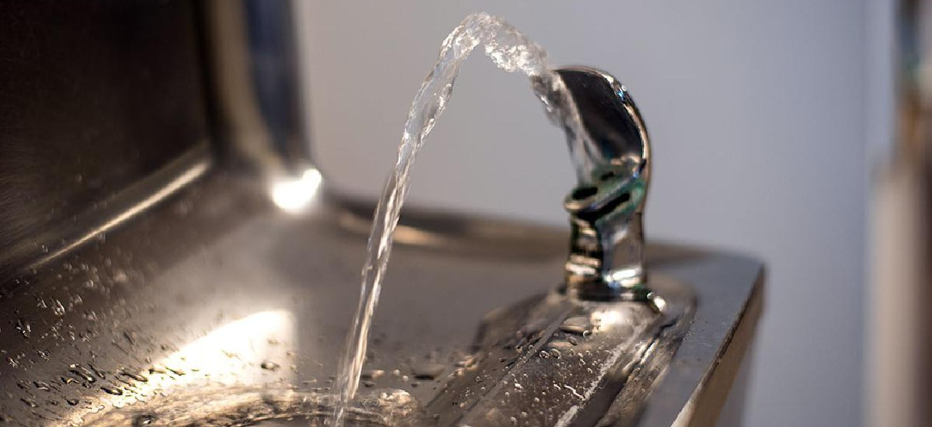
Possible Causes
Tap water contaminated with lead that has entered through water piping system.
Chromium toxic metal found in drinking water in NYC (a pollution associated with metal)
Contaminated stormwater
run off

Slide 5
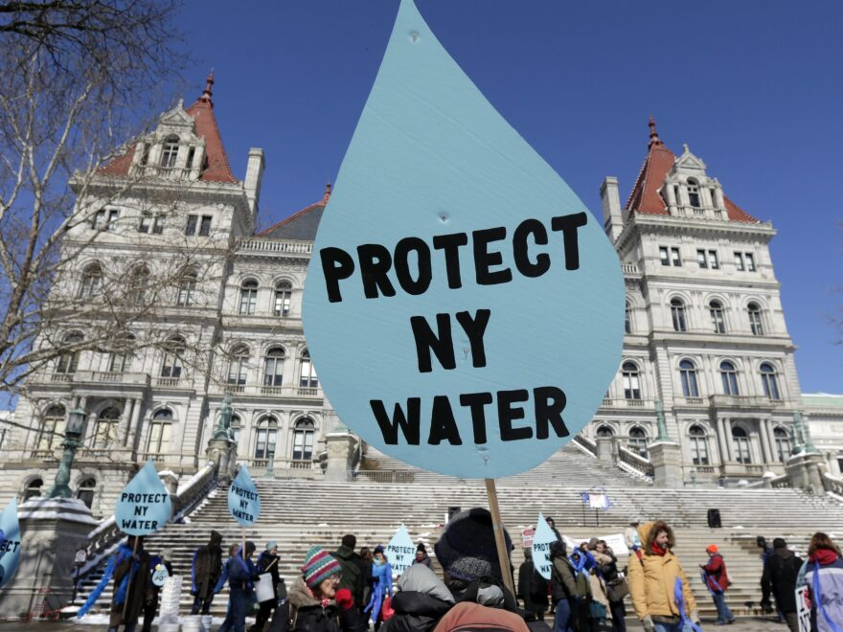
Existing Policy Evaluation
Current NYC Water Policy test water supply over 600,000 times a year
NYC water supply meets or exceeds all Federal and State standards
NYCDOE works with other Government Agencies making sure students have safe drinking water in schools.
NYC water is safe for drinking is lead free & delivered from the reservoirs from upstate systems.
NYS law requires every public school to test their water supply in 3 year intervals.

Slide 6
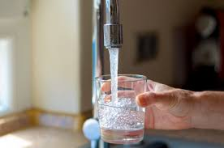
Solutions
Improvements to the water quality with continued investment in the building of new infrastructure.
Treating waste water and reduce combined sewer overflows
Maximizing the use of green infrastructure for better future outcomes
Enhancing communities and further the City’s sustainability efforts.

Slide 7
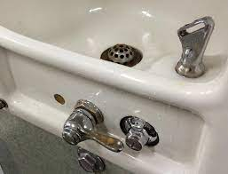
Best Solutions
Flushing all or part of the water system to eliminate water sitting in pipes overnight.
Minimizing the potential for lead exposure by running the tap for 30 seconds, or until the water gets noticeably colder, before using the water for drinking.
Conducting regular water quality testing

Slide 8
 |  | FEASIBILITY
 |  | HIGH | MEDIUM | LOW
EFFECTIVENESS | HIGH |  | Running for 30 seconds
 | MEDIUM |  | FLUSHING SYSTEM
 | LOW |  | Conduct regular testing

