Slide 1
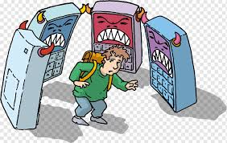
Cyberbullying at PS129
Define the Problem: Students at PS 129 are engaging in cyberbullying via various social media platforms such as Instagram and Tick Tock.
By Sahar Shabazz

Slide 2
6 Steps of the PPA: Public Policy Analysis
1. Define the problem: Various students at 129 have complained of being bullied online. Some students have admitted to partaken into the bullying of others online.
2. Gather Evidence: Students have complained about the bullying online. Some parents have also complained that their child has been a victim of cyber bullying. Some students admitted to engaging in cyber bullying.
3. Identify Causes: Why do students cyber bully? What can being done to prevent cyber bullying? Do students understand the consequences of cyber bullying?
4. Evaluate an existing policy: The New York City Department of Education has an existing public policy that all NYCDOE schools are supposed to adhere to. “Respect for All: Preventing and Addressing Student-to-Student Discrimination, Sexual and Other Harassment, Intimidation, and Bullying”. https://www.schools.nyc.gov/school-life/school-environment/respect-for-all
5. Possible Solutions: How can students stop cyber bullying in schools?
How can students take part in preventing cyber bullying in schools?
6. Best Solution: Using what you already know and what you learned, determine the best solution for ending cyber bullying in PS 129.

Slide 3
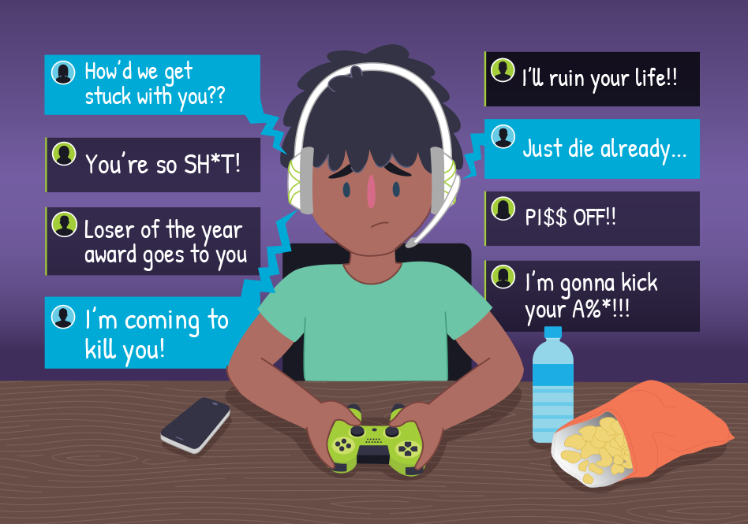
Gathering Evidence: Step 2 of PPA-What is Cyberbullying?
Using the graphic organizer, write down everything you know or think you know about cyber bullying.
Share what you know to the person next to you.
Share one thing you know about cyber bullying to the class.
Write down one or more things you would like to know more about cyberbullying.
Lets watch a video on cyberbullying: https://www.youtube.com/watch?v=6ctd75a7_Yw
https://www.youtube.com/watch?v=niaDJdEXk9U
*Write down 3 or more thing you learned about cyberbullying.

Slide 4
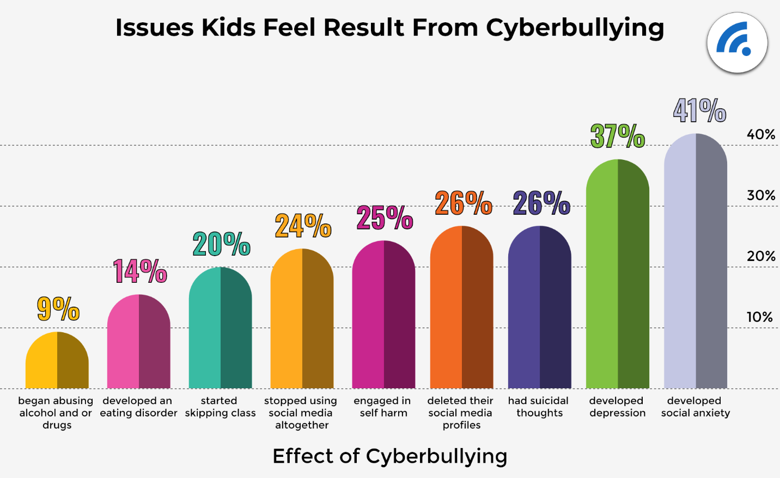
Gathering Evidence: Step 2 of PPA-Continued Getting the Facts about Cyberbullying:
About 37% of young people between the ages of 12 and 17 have been bullied online. 30% have had it happen more than once.[
95% of teens in the U.S. are online, and the vast majority access the internet on their mobile device, making it the most common medium for cyber bullying
23% of students reported that they’ve said or done something mean or cruel to another person online. 27% reported that they’ve experienced the same from someone else.
Girls are more likely than boys to be both victims and perpetrators of cyber bullying. 15% of teen girls have been the target of at least four different kinds of abusive online behaviors, compared with 6% of boys
About half of LGBTQ+ students experience online harassment -- a rate higher than average
Instagram is the social media site where most young people report experiencing cyberbullying, with 42% of those surveyed experiencing harassment on the platform.
https://www.dosomething.org/us/facts/11-facts-about-cyber-bullying

Slide 5
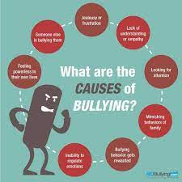
Identifying the causes: Step 3 of PPA
With a partner answer the following questions below:
Why do students Cyber Bully?
What can being done to prevent cyber bullying?
Do students understand the consequences of cyber bullying?
Jot down what you and your partners responses were to the questions. Read the articles at the links below to find more answers to the questions posed above. Record your findings.
https://www.stopbullying.gov/
https://www.ncbi.nlm.nih.gov/pmc/articles/PMC4276384/

Slide 6
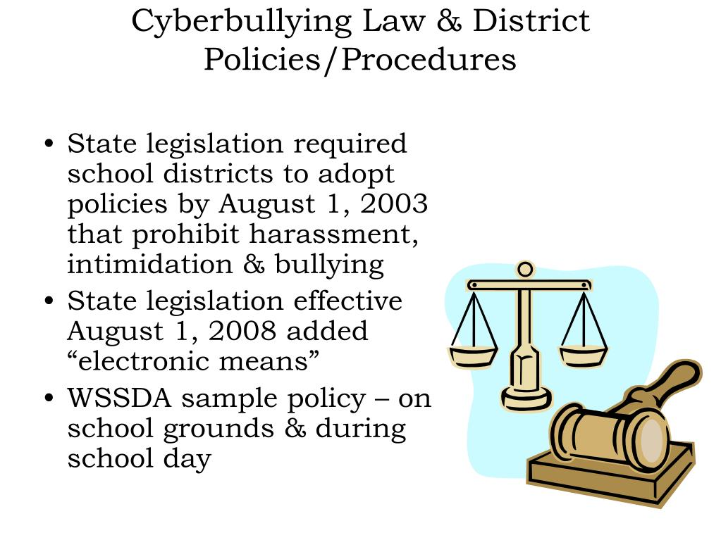
Evaluate an existing policy: Step 4 of PPA
The New York City Department of Education has an existing public policy that all NYCDOE schools are supposed to adhere to.
PS 129M has also adopted this Policy as mandated. Therefore, this is the policy for our school.
“Respect for All: Preventing and Addressing Student-to-Student Discrimination, Sexual and Other Harassment, Intimidation, and Bullying”. https://www.schools.nyc.gov/school-life/school-environment/respect-for-all

Slide 7
Possible Solutions- Step 5 of PPA
Please read article and watch video below then answer the questions that follows:
How can students stop cyber bullying in schools?
How can students take part in preventing cyber bullying in schools?
Videos: https://www.youtube.com/watch?v=dMdKmHjpgFk
https://www.youtube.com/watch?v=dMdKmHjpgFk
https://www.cdc.gov/violenceprevention/youthviolence/bullyingresearch/fastfact.html
Articles: https://www.unicef.org/end-violence/how-to-stop-cyberbullying
https://www.verywellfamily.com/how-to-prevent-cyberbullying-5113808

Slide 8
Best Solutions: What can we do to prevent and stop cyberbullying at our school? Step 6: PPA
Working in groups of three you will determine the best solution to Cyber bullying at our school. What can we do at 129 to prevent cyber bullying and put an end to cyber bullying once and for all.
Together you will create 2 or more polices to prevent cyber bullying at PS129.
You will also come up with 2 or more policies to end cyber bullying at our school.

Slide 9
Best Solutions: What policy can we agree will be best for our school? Step 6 - Continued
Using what you have learned about cyberbullying and all resources provided you will work together to create policy. In your groups you should have created 2 or policies to prevent cyberbullying and put an end to it. Now you will engage in a discussion about the feasibility and effectives of the policies you created.
Based on your discussions we will determine the best solution (cyberbullying policy) for our school.
Feasibility: What is the likelihood that the policy you determined to be the best solution can easily and most conveniently be adopted at our school?
Effectiveness: What is the likelihood that the policy will be a success at our school. Which policy that you created would be most successful at 129?

