Slide 1
The earth is running out of energy resources
Elizabeth Ruiz-Seymour
6th grade
P.S./I.S, 187
Eruiz4@schools.nyc.gov

Slide 2
Steps of Public policy analyst
Define
Define the Problem
Gather
Gather the Evidence
Identify
Identify the Causes
Evaluate
Evaluate an Existing Policy
Select
Select the Best Solution
Develop
Develop Solutions

Slide 3
Logically, how is it possible to use more resources than Earth can replenish? Turn and talk
https://www.youtube.com/watch?time_continue=310&v=inVZoI1AkC8&feature=emb_title
This Photo by Unknown Author is licensed under CC BY-SA-NC

Slide 4
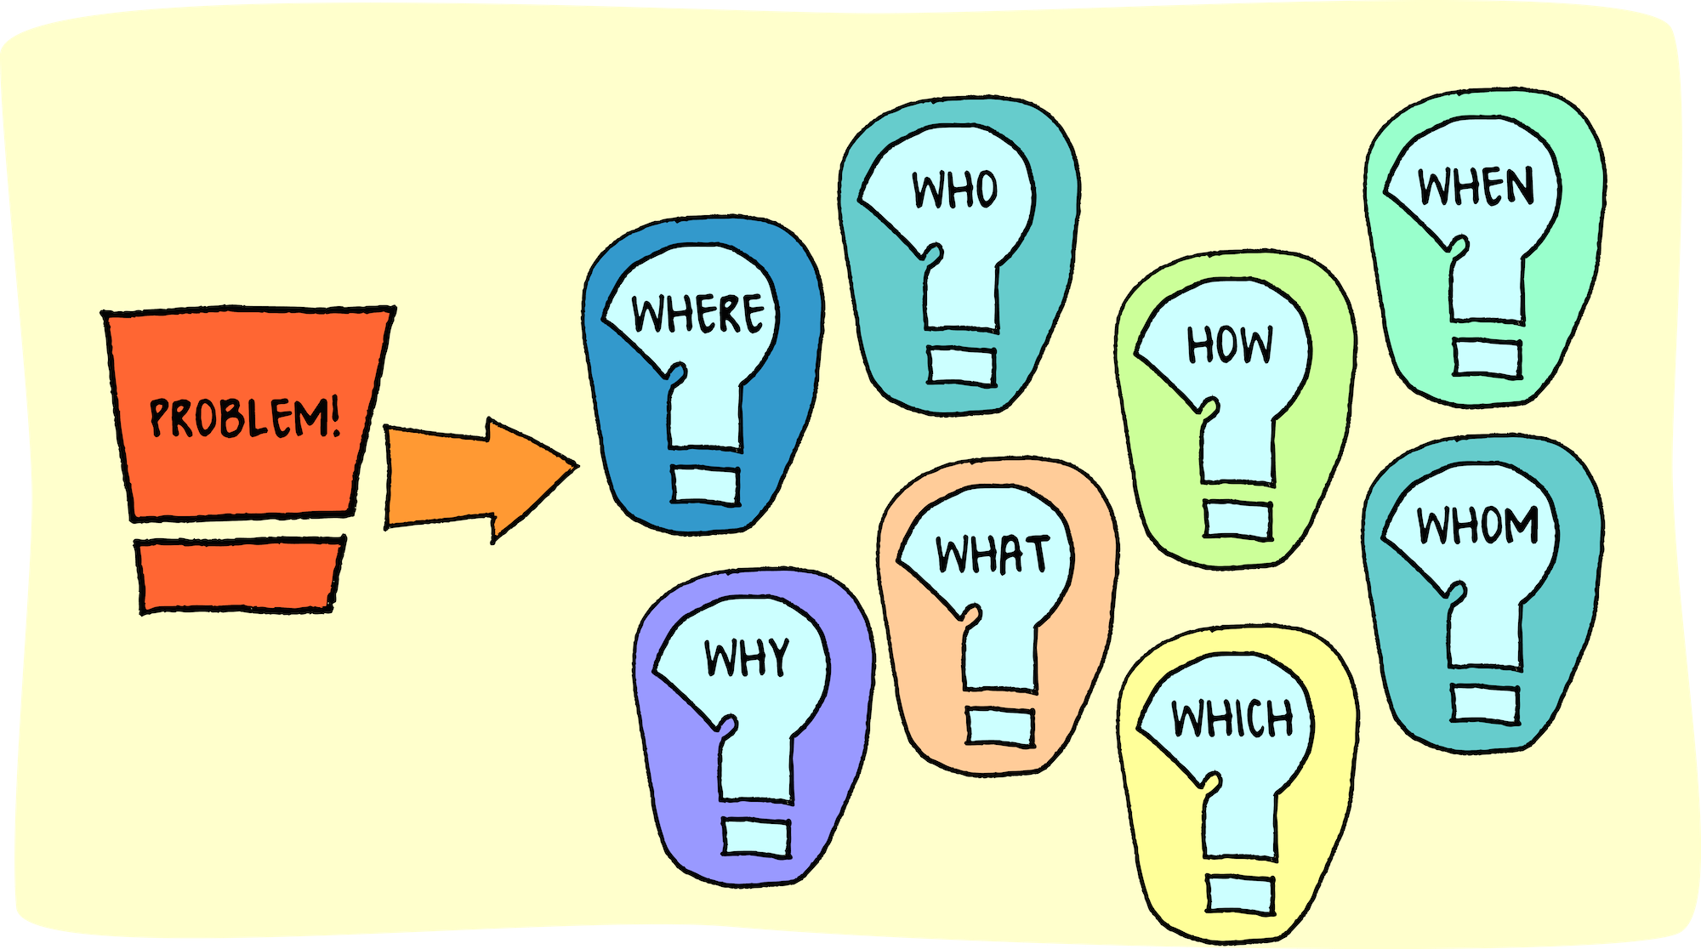
Define the Problem
The Earth is running out of energy resources.
Yes, we are rapidly depleting our resources. Unfortunately most of the demand for energy falls on the use of fossil energy, oil, gas and coal.(MAHB, 2019)
This Photo by Unknown Author is licensed under CC BY

Slide 5
Gather the Evidence
2.1% in 2017, as 72% was in fossil fuel [1] [3]. 25% in renewables and remainder by nuclear. .Naturally this results in a rise in CO2 emission – by 1.7 % in 2017 , reaching a historic high of 33.1 gigatons.
Global oil demand grew by 1.3%. in 2018. Today oil supplies about 40% of the world’s energy and 96% of its transportation energy.
Gas totaled 23% of total energy demand, but grew at a 4.6% rate in 2018, Gas had the second highest share of total electricity generation at 23%, or 6,091
Global coal demand is up 0.7% in 2018 [15]. Coal’s share of total electricity generation totaled 10,116 TWh, up 2.6% from 2017, as it commanded 38% of total generation around the world.
This Photo by Unknown Author is licensed under CC BY-SA

Slide 6
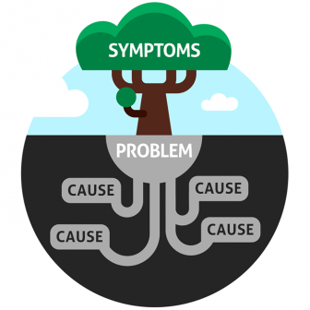
Identify the Causes
Energy consumption worldwide grew by 2.3% in 2018, nearly twice the average rate of growth since 2010, driven by the observed robust economy [3]. More than 40% of the growth in 2017.
This Photo by Unknown Author is licensed under CC BY-NC

Slide 7
Evaluate an Existing Policy
Under current administration these policies are being threatened
Affordable Clean energy
Clean Power plan
Clean air act
This Photo by Unknown Author is licensed under CC BY-SA-NC

Slide 8
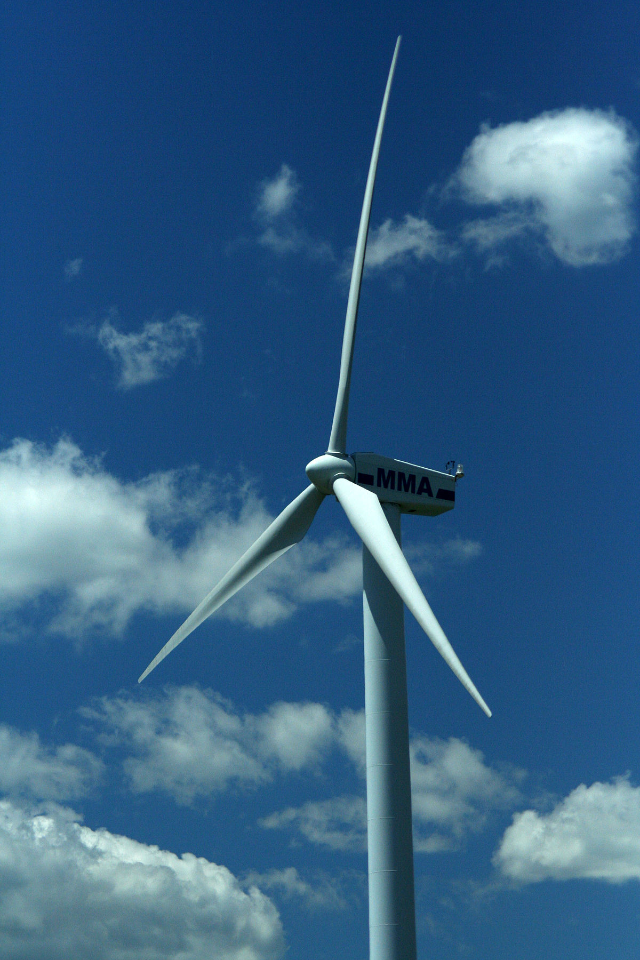
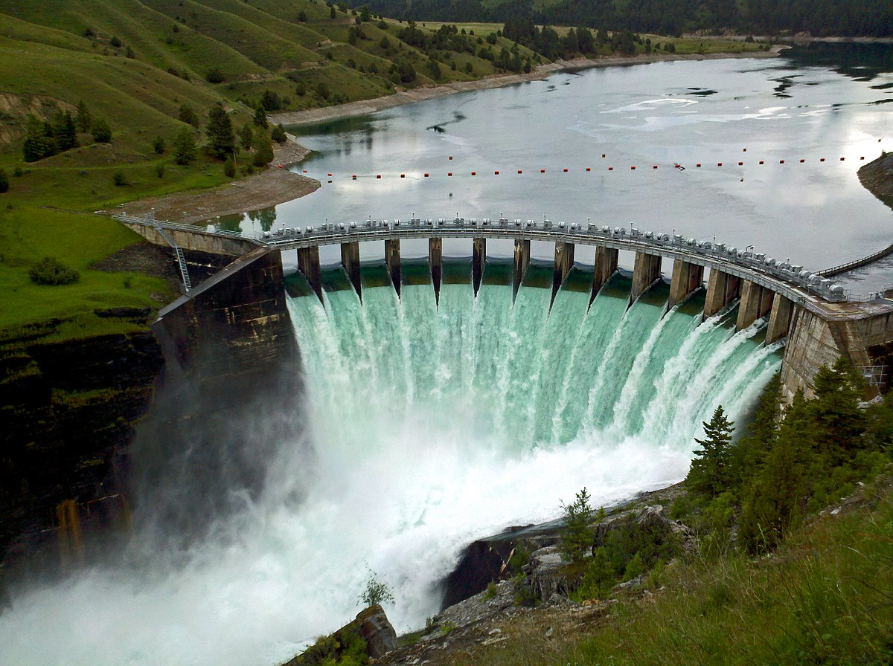
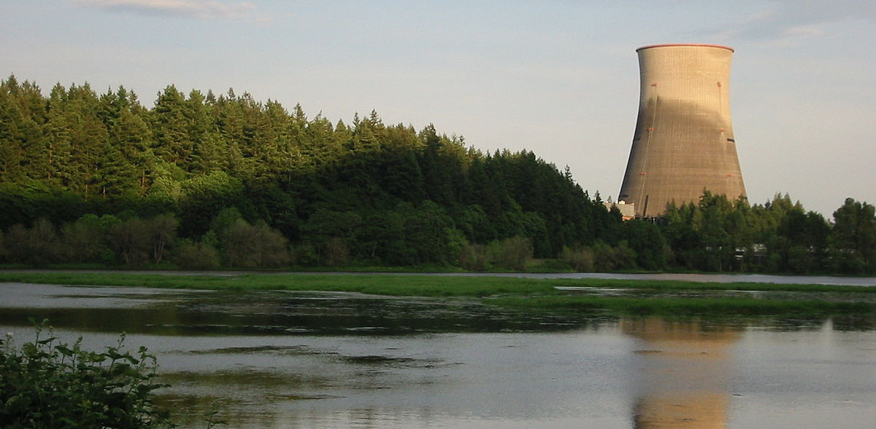
Develop Solutions
RENEWABLE ENERGY-SOLAR
RENEWABLE ENERGY- WIND
RENEWABLE ENERGY-HYDRO
NUCLEAR ENERGY
Turn and talk
Which do you think is more likely to happen?
This Photo by Unknown Author is licensed under CC BY-SA
This Photo by Unknown Author is licensed under CC BY-SA
This Photo by Unknown Author is licensed under CC BY-SA
This hoto by Unknown Author is licensed under CC BY-ND

Slide 9
Select the Best Solution
Feasibility
 | High | Medium | Low
High
Medium
Low
Effectiveness
Notes:
This hoto by Unknown Author is licensed under CC BY-ND
This Photo by Unknown Author is licensed under CC BY-SA
This Photo by Unknown Author is licensed under CC BY-SA
This Photo by Unknown Author is licensed under CC BY-SA

Slide 10
Resources
https://ballotpedia.org/Federal_policy_on_environmental_regulations,_2017-2020
https://mahb.stanford.edu/library-item/fossil-fuels-run/
https://www.epa.gov

