Slide 1
DEPRESSION IN NEW YORK CITY PUBLIC SCHOOLS
Dawn Roberts
Fifth Grade Teacher
Mary McLeod Bethune/PS 92M

Slide 2
DEPRESSION
Have you every see this word depression?
What do you think this word means?
Turn and talk to your partner about the word depression.

Slide 3
THE MEANING OF DEPRESSION
Depression is a mood disorder that causes a persistent feeling of sadness and loss of interest. Also called major depressive disorder or clinical depression, it affects how you feel, think and behave and can lead to a variety of emotional and physical problems. You may have trouble doing normal day-to-day activities, and sometimes you may feel as if life isn't worth living.

Slide 4
PPA: WHAT IS THAT?

Slide 5
PPA - WHAT ARE THE STEPS?
We are going to use these 6 Steps to address the issue of depression.
What is the problem?
What is the evidence?
What are the causes?
What is the existing policy?
What policies can we create to correct the problem?
What is the BEST policy to correct the problem?
S
T
E
P
S

Slide 6
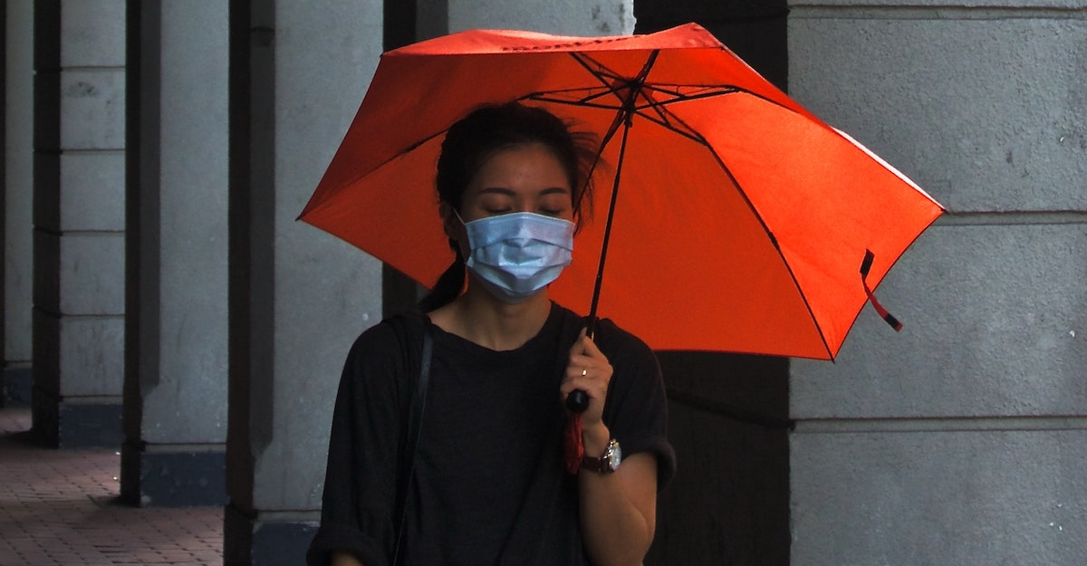
PUBLIC POLICY ANALYST
We are going to use this public policy analyst to look deeper into depression.

Slide 7
DEFINE THE PROBLEM
We know that problems can be found anywhere. It can be found in our schools, cities, neighborhoods, nations and around the world.
We have problems in our school that attract our school’s community attention.
Now let us think about a problem that our school is facing. How do you think it is affecting our community?

Slide 8
EXAMPLE OF A PROBLEM
With drastic changes made to their education, social and home lives, children are struggling with stressors they've never faced, and it's impacting their mental health.
In December 2021, the U.S. Surgeon General released a public health advisory addressing the youth mental health crisis. Around the same time, industry organizations declared a national emergency in children’s mental health. With a global pandemic exacerbating already-rising mental health issues, it is imperative that schools address the crisis.
Navigate 360

Slide 9
GATHER THE EVIDENCE
Now you have to find sources for the problem.
This can be:
Photos
Statistics
Experts
Interviews
It is important to evaluate your resources. Use the internet source evaluation worksheet and the Fact vs. Fiction graphic organizer to evaluate sources.
Example Problem:
Depression in New York City Public Schools
These are some websites that you can get some statistics information.
NYC Families Struggle With School Refusal
Institute for Children, Poverty & Homelessness
You will use the fact or opinion graphic organizer.

Slide 10
IDENTIFY THE CAUSES
Let’s look deeper into our sources and think why this problem exist?
Why do you think this problem occur?
What do you think is the driving force that is causing students to behave in this manner?
What steps or actions lead to the problem?
You are going to use your cause and effect graphic organizer to help you identify cause and effect depression have on students.
Example Problem:
Depression in New York City Public Schools
Why do you think this problem occur?
It occur because kids have had a rough couple of years of instability and loss.
It could be because pandemic continues to weigh heavily on the mental health of the city’s 1.1 million school children.
What do you think is the driving force that is causing students to behave in this manner?
Deaths of friends and loved ones, new variants and the possibility of infections they bring, changes in protocols like mask wearing or isolation time after infection and the endless debates about in-person or remote learning are just some of the issues impacting the school communities.
What steps or actions lead to the problem?
Hundreds of anxious New York City Public School students walked out of class on Jan. 11 to demand that online classes be offered to those who wanted to stay at home. The students cited teacher absences and the fear of widespread infection from the Omicron Variant of COVID-19 and academic performance among their reasons for the depression.

Slide 11
EXAMINE & EVALUATE EXISTING POLICY
Are there any policies in place to address this issue?
Policies can be guidelines, rules, regulations, laws, principles, or directions. They say what is to be done, who is to do it, how it is to be done and for (or to) whom it is to be done.
Problem: Depression in New York City Public School
Mental health services are being offered remotely to support children and family during these difficult times.
NYC-Well is a confidential mental health information and referral line with access to mobile crisis teams. Staffed by trained social workers 24 hours a day, 7 days per week, 365 days per year
More social-workers are being added in schools.
FYPS services support and empower parents/caregivers of children and youth, birth to age 24, who are experiencing social, emotional, developmental, substance use, and/or behavioral challenges, and the children and youth themselves.

Slide 12
DEVELOP SOLUTIONS
Questions to help us?
How can we help to fix this problem?
What rules can we create to assist in this problem?
How can we change this behavior?
What mind – set can we have develop toward a depress person?
Problem: Depression in New York City Public School
Some Solutions:
Improve the Care Management Treatment to start at the school level.
Hire more psychologists, psychiatrists and counselors that will help with supervision.
Place more health centers in needed communities.
Training must be on going.

Slide 13
WHAT DOES P.S.92 SAY ABOUT CLINICAL DEPRESSION
Teacher and students have to check each day to find out if everyone is okay.
Students are given a time to take a break.
Students go to the school’s social worker or the social worker will come in the room to do a check-up.
They must go outside and play.

Slide 14
WHAT CAN WE DO AS A SCHOOL COMMUNITY?
We can talk with Parents/Guardians.
We can have Friday afternoons be a time where students can choose one thing to do that they like/or are interesting to them.
We can create games that will make us laugh or see a movie of our interest.

Slide 15
NOW IT’S YOUR TURN
Now it’s time for you and your group to investigate a “social problem!”
You can use Depression in NYC Public Schools or we can make a list of social problems.
Each group will choose one of the social problems to work on.
You must use the 6 Steps of the Public Policy Analyst to get your work done.
Make sure to follow the example that I model for you.

