Slide 1
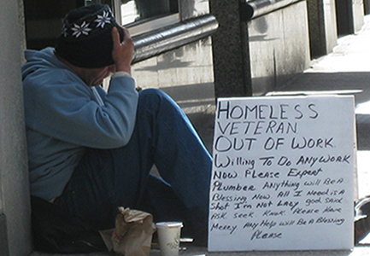
Homelessness in new york city
DAWN ROBERTS
P.S. 92M

Slide 2
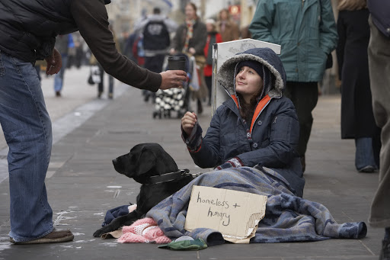
The 6 Steps of the Public Policy Analyst
DEFINE THE PROBLEM
GATHER THE EVIDENCE
IDENTIFY THE CAUSES
EVALUATE AN EXISTING POLICY

Slide 3
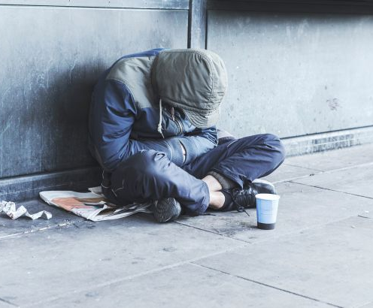
DEFINE THE PROBLEM
What is homelessness?
Homelessness: an individual or family living in housing that is below the minimum standard or lacks secure tenure.
Homelessness can be divided into three categories:
Primary Homelessness: living on the streets.
Secondary Homelessness: moving between temporary shelters, including houses of friends, family and emergency accommodation.
Tertiary Homelessness: living in private boarding houses without a private bathroom and/or security of tenure.

Slide 4
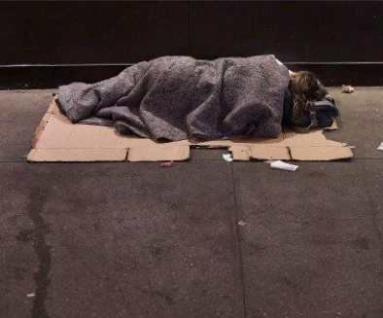
Gather The Evidence
Facts about homelessness
Fact 1: Over half a million people are homeless.
Fact 2: One quarter of homeless people are children.
Fact 3: Tens of thousands of veterans are homeless.
Fact 4: Domestic violence is the leading cause of homelessness among women.
Fact 5: Many people are homeless because they cannot afford rent.

Slide 5
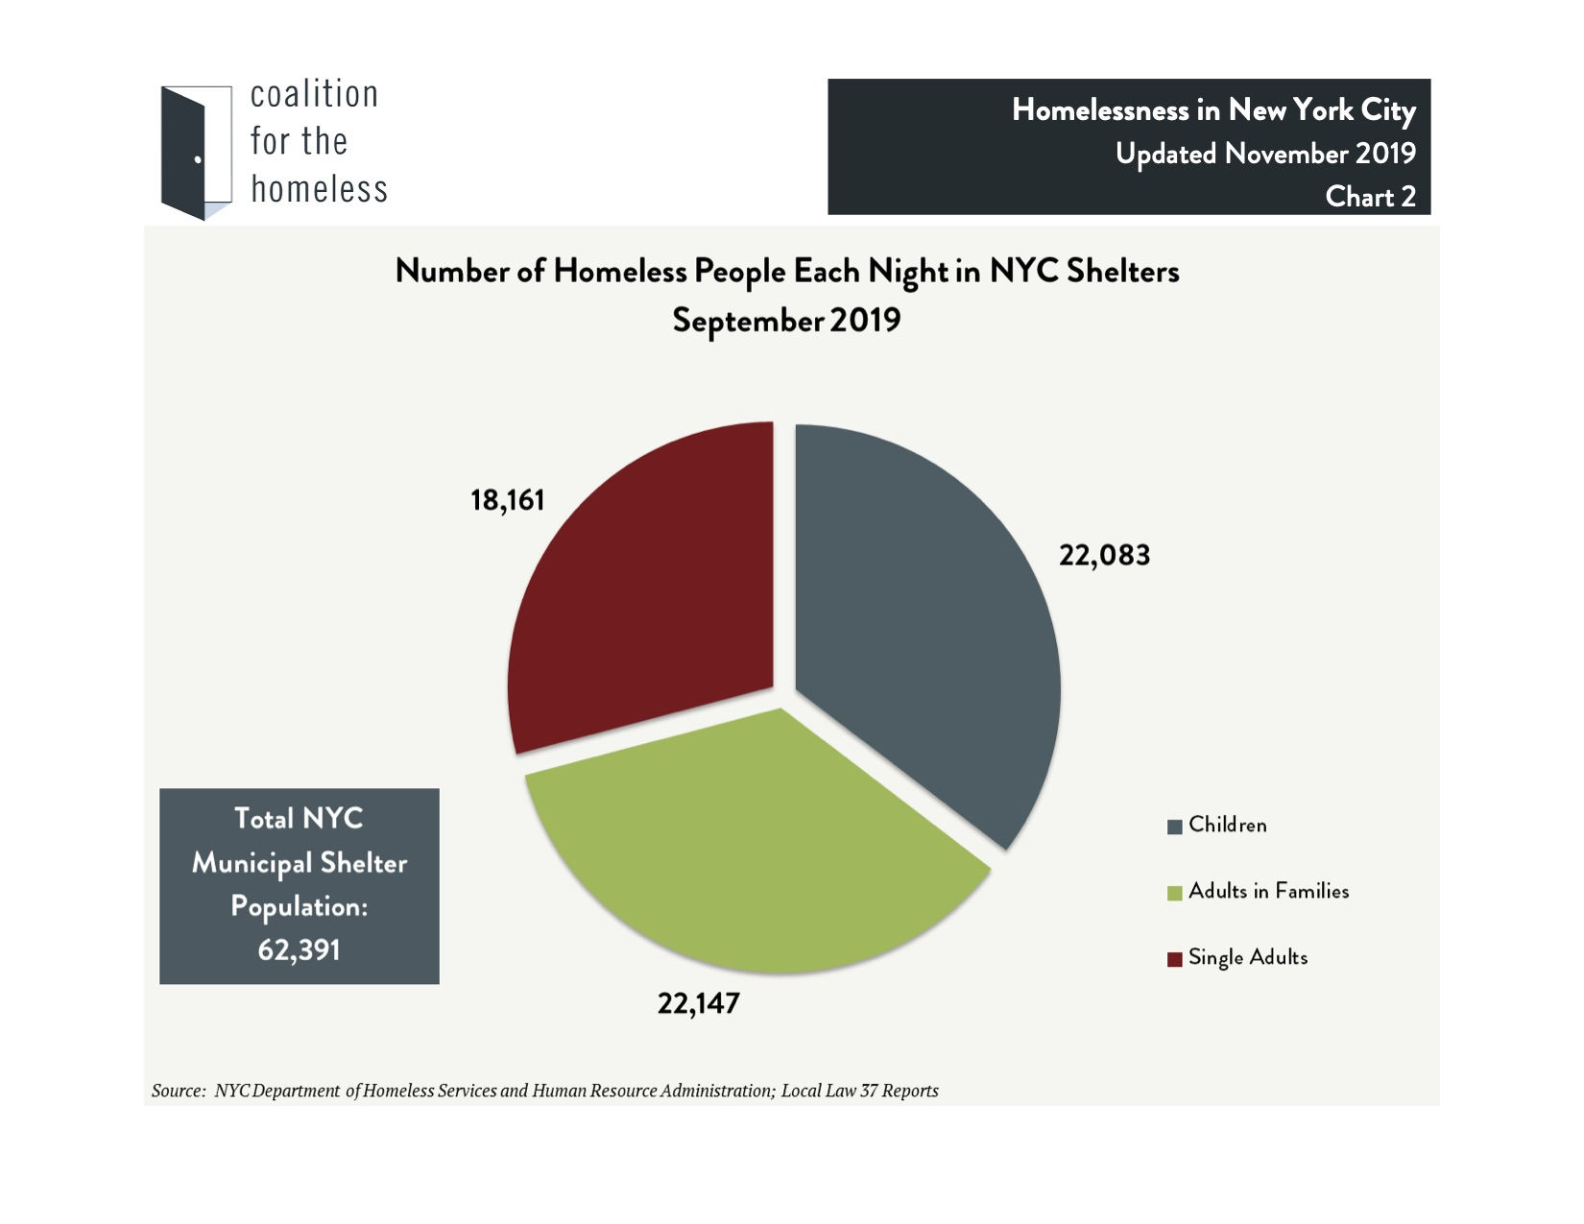

Slide 6
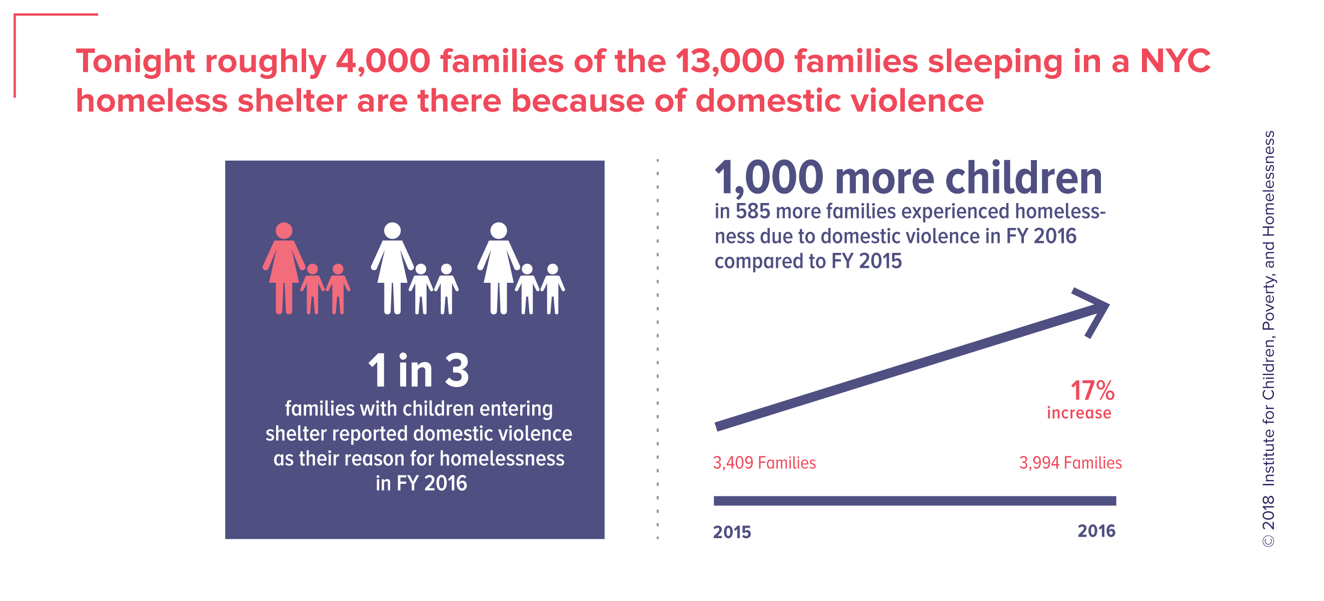
Identify the Causes
One major cause of homelessness: domestic violence
Domestic violence is the leading causes of family homelessness.
80% of domestic violence incidents can lead to social, economic, and housing instability for parents and their children.
230,000 children living in shelters have been exposed to the traumatic and long-term effects of domestic violence.
In 2016, approximately 4,000 families and an estimated 7,000 children were homeless because of domestic violence.
In June 2016, 1,152 families and 2,000 children were served in specialized domestic violence emergency shelters.

Slide 7
Step 4: Evaluation of Mayor de Blasio’s Proposed "Journey Home" policy on Homelessness
IN 2019, Mayor Bill de Blasio pledged ”to end street homelessness within five years.”

Slide 8
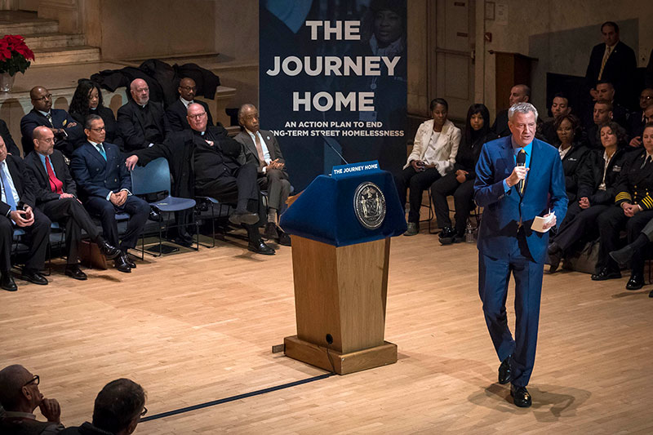
“THE JOURNEY HOME” ACTION PLAN
Open 1,000 new safe haven beds.
Build 1,000 new apartments.
Use an army of outreach workers to convince the city’s 3,600 homeless street people to come in out of the cold.
Use cops to help on the streets and in the subways.

Slide 9

HOW CAN WE IMPROVE THE
“JOURNEY HOME” ACTION PLAN
HELP WITH EMPLOYMENT:
  NYC can take more an initiative to also focus on job placements and increase salaries for the homeless.
JOB DISCRIMINATION:
  Many times when employers see a shelter listed as a applicant's address, it’s automatically assumed they’re on drugs or have a mental illness because of their housing status.

Slide 10
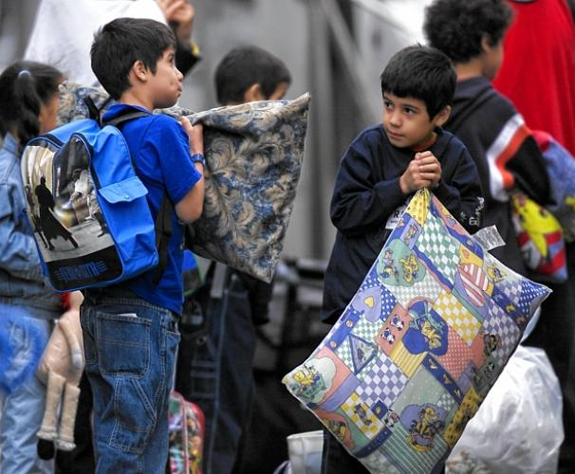
How does homelessness affect students in new york city?
Younger homeless students were under-enrolled in the city’s Pre-K programs and were more likely to have their special education needs identified late.
But the instability of homelessness creates obstacles and challenges that can adversely affect the academic outcomes of students who experience it.

Slide 11
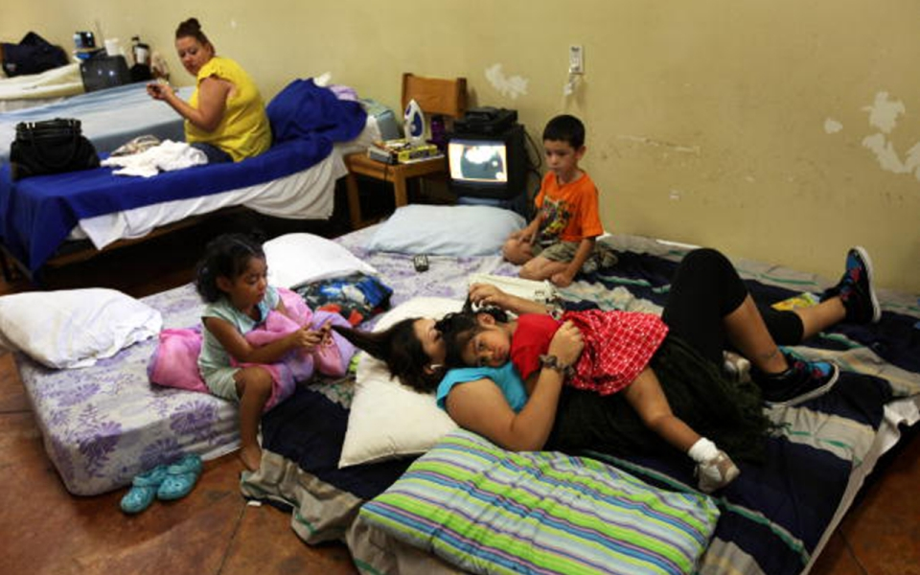
Evaluating the current Policy:
What does P.S.92 say about homelessness?
NO STUDENT SHOULD BE LEFT BEHIND.
ALL STUDENTS MUST BE FED.
ALL STUDENTS MUST BE IN UNIFORM.
ALL STUDENTS MUST RECEIVE THE SAME EDUCATION.

Slide 12
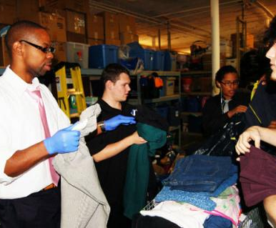
What can we do as a school community?
Food Drives:
Toilet rolls.
Sanitary towels and tampons.
Toiletries (shampoo, shower gel, deodorant).
Baby food.
Clothes Drives:
Coats
Hat
Scarves
Gloves
Shoes

Slide 13
What Can students do?

Slide 14

Developing a solution for the homelessness in our city
Students will create a worksheet for each of the four provisions.
They will work in groups of four.
Each group will select one provision and develop its advantages and disadvantages and how they can improve on it.

