Slide 1
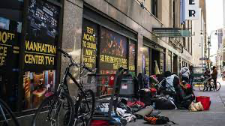
Project CRITICAL Public Policy Analysis Presentation
Social Problem:
There are too many
homeless people in
New York City
Teacher: Ms. Riviere
School: M286
January 2023

Slide 2
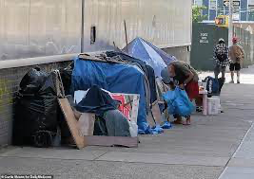
There are too many homeless people in New York City
Do Now
Write 3-4 sentences to answer:
Why do you think there are so many homeless people in New York City?

Slide 3
Today we will use The 6 Steps of the Public Policy Analyst (PPA) to understand, analyze and address the issue of excessive homelessness in NYC.
Step # 1- Define the Problem
Step # 2- Gather the Evidence
Step # 3- Identify the Causes
Step # 4- Evaluate an Existing Policy
Step # 5- Develop Solutions
Step # 6- Select the Best Solution (Feasibility vs. Effectiveness)

Slide 4
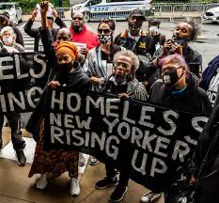
Step # 1- Define the Problem
Social Problem:
There are too many homeless people in
New York City

Slide 5
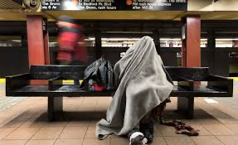
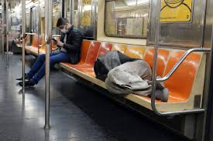
Turn and Talk
What are 3-5 ways that the excessive homelessness affects New York City?

Slide 6
Step # 2- Gather the Evidence
Each group will have 3 students; total 7 groups.
Each student will read/annotate one article from the list shown on the next two slides.
TASK-Identify (list) 7-8 of the most important ideas discussed in the article
Make sure that your list gathers evidence regarding the social problem “there are too many homeless people in New York City.”

Slide 7
Step # 2-Gather the Evidence-Articles
1- “Facts about Homelessness”, by Coalitionforthehomeless.org
https://www.coalitionforthehomeless.org/facts-about-homelessness/
2- “A hard look at New York’s controversial new approach to the Homeless””, by Zachary B. Wolf, CNN.com, December 3, 2022
https://www.cnn.com/2022/12/03/politics/nyc-hospitalize-mentally-ill-what-matters/index.html
3- “Chase banks in New York City will shut ‘a number’ of ATMs by 6pm due to rising crime and vagrancy..”, by Ross Ibbetson, DailyMail.com, January 23, 2023
https://www.dailymail.co.uk/news/article-11667995/Chase-banks-New-York-City-SHUT-ATMs-6pm-rising-crime-vagrancy.html
4- “Nearly 2,600 apartments for mentally ill and homeless people sit vacant”, by Andy Newman, New York Times, November 4, 2022
https://www.nytimes.com/2022/11/04/nyregion/nearly-2600-apartments-for-mentally-ill-and-homeless-people-sit-vacant.html
--Short Video included with the last article
Notes:
https://www.coalitionforthehomeless.org/facts-about-homelessness/

Slide 8
Step # 2-Gather the Evidence-Articles
5- NYC homeless advocates say Mayor Eric Adams’ street sweeps aren’t working”, by Emma Bowman, NPR.org, May 13, 2022
https://www.npr.org/2022/05/13/1097528966/nyc-eric-adams-homeless-sweeps
6- “Strategies for solving homelessness in New York City and Across the U.S.”, by Molly Bolan and Pete Tomao, CityandStateNY.com, August 26, 2022
https://www.cityandstateny.com/policy/2022/08/strategies-solving-homelessness-new-york-city-and-across-us/376338/
7- “With Homeless Population at an all-time high, Public Advocate Calls for Citywide Shelter Plan”, by David Brand, Jenna Zaza, et al, CityLimits.org, October 14, 2022
https://citylimits.org/2022/10/14/with-homeless-population-at-all-time-high-public-advocate-calls-for-citywide-shelter-plan/
8- ”Homelessness is a shared experience in the New York Metro Area”, by Bowery.org
https://www.bowery.org/homelessness/
9- “Mental Health Legislation to be introduced, one year after Michelle Go fatally pushed in NYC subway”, by Sarah Belle Lin, AMNY.com, January 20, 2023
https://www.amny.com/news/legislation-addressing-mental-health-crisis-to-be-introduced-one-year-after-michelle-go-fatally-pushed-at-nyc-subway/
--Short Video included with the last article

Slide 9
Step # 2-Gather the Evidence-Sources
Step # 2-Gather the Evidence-Videos
-Video # 1- ”NYC Homeless Shelter System ‘Near Breaking Point’”, FOX 5 New York, September 15, 2022
https://www.youtube.com/watch?v=hdk6xIT-C6I
-Video # 2- “Men living in NYC Homeless Shelter Criticize Migrant Relief Center”, CBS New York, October 20, 2022
https://www.youtube.com/watch?v=6Ue4vsGaYTk
-Video # 3- “NYC Homeless now filling JFK Airport”, Fox5 News, January. 23, 2023
https://www.news.com.au/world/nyc-homeless-now-filling-jfk-airport/video/33c03b870924aa73913b6e7fb0fd59bd
-Video # 4- “How Unhoused New Yorkers Feel About Mayor Adams’ Homelessness Initiatives”, NBC News, May 18, 2022
https://www.youtube.com/watch?v=44Vf4Z20_kg
--Short Video included with the last article

Slide 10
Model-Step # 2-Gather the Evidence
According to Bowery.org, “Today, more New Yorkers are experiencing homelessness than ever before. In a city of more than 8.4 million people, nearly one in every 120 New Yorkers is homeless-that’s 70,000 men, women and children. An estimated 3,400 people are living unsheltered in the subways or on the streets of Manhattan and the other boroughs.”
Statistics from the Coalition for the Homeless show that “in November 2022, 67,150 people slept in the main NYC shelter system each night. This number includes 21,089 homeless children.”
On January 15, 2022, Melissa Go was at the Times Square subway station when a mentally unstable man pushed her in front of an oncoming train causing her tragic death. Recently, AMNY quoted NYC Councilmember Bottcher, “the horrific murder of Michelle Go was preventable. So is the suffering of countless Americans with untreated mental illness. It’s unconscionable that current federal law prohibits Medicaid from covering most impatient psychiatric services.”

Slide 11
Model-Step # 3- Identify the Causes -Why are there so many homeless people in New York City?
The Coalition for the Homeless reports how there are several factors leading people to be homeless. These causes vary from homeless single individuals to homeless families.”
TASK
Identify the causes of homelessness in New York City.

Slide 12
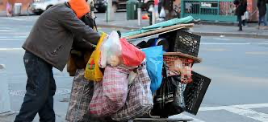
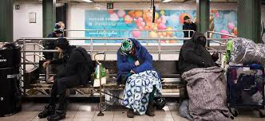
NYC’s Homeless Crisis

Slide 13
Step # 4- Evaluate Existing Policies
TASK
While you read/analyze the sources provided:
Outline 3-4 existing government public policies intended to decrease homelessness in New York City.

Slide 14
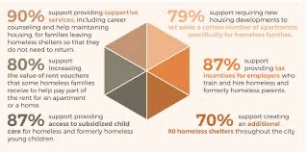
Step # 4- Evaluate an Existing Policy -Report by WIN NYC (largest provider of supportive housing and family shelter in NYC).

Slide 15
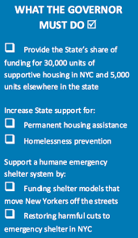
Step # 4- Evaluate an Existing Policy -Report by Coalition for The Homeless (Non-profit organization that works to end the homeless crisis in NYC).

Slide 16
Step # 5- Develop Solutions
TASK
Develop 4-6 policies/strategies to address the issue of homelessness in New York City.

Slide 17
Step # 6- Select the Best Solution (Feasibility vs. Effectiveness)
TASK
Narrow down your proposed solutions from Step # 5, then:
Select the solution that is the most feasible and effective.
Show your solutions in a
Feasibility vs. Effectiveness Chart.

Slide 18
Step # 6- Select the Best Solution (Feasibility vs. Effectiveness) Feasibility
Effec
tive
ness
 | High | Medium | Low
High
Medium
Low

