Slide 1
Childhood Obesity
Mr. Rappaport
Living Environment
Frederick Douglass Academy

Slide 2
The Six Steps of the Public Policy Analyst (PPA)
How Do We Analyze this Social Problem?
Define the Problem
Examine an Existing Policy
Step 1:
Step 4:
Gather the Evidence
Develop New Policies
Step 2:
Step 5:
Identify the Causes
Select the Best Policy Solution
Step 3:
Step 6:

Slide 3
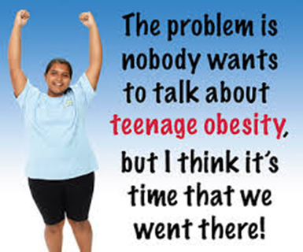
Step 1: Define the Problem
Nearly 40% of NYC school children are overweight or obese.
Childhood Obesity is when a teen has too much body fat.
A body mass index (BMI) at or above the 95th percentile of the CDC sex-specific BMI-for-age growth charts (for simplicity we’ll use a BMI of 30 or greater).
Obesity is a serious, long-term disease.

Slide 4
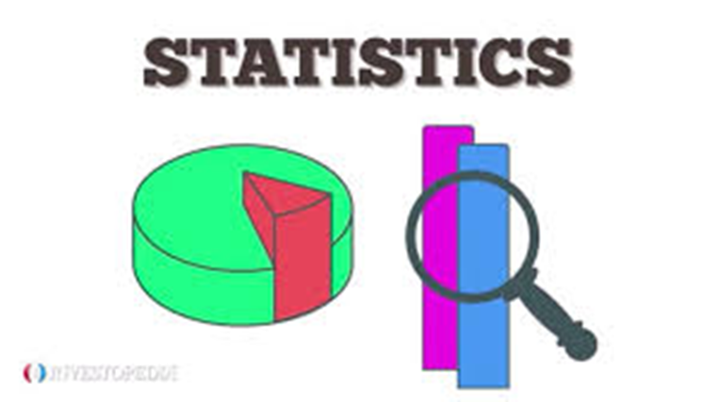
Step 2: Gather Evidence
In Step 2, we conduct research to find evidence that shows that this problem exists.
We use three types of evidence we to support that there is a problem that we can study. The three types are:
Statistics
Case Studies
Articles by Experts

Slide 5
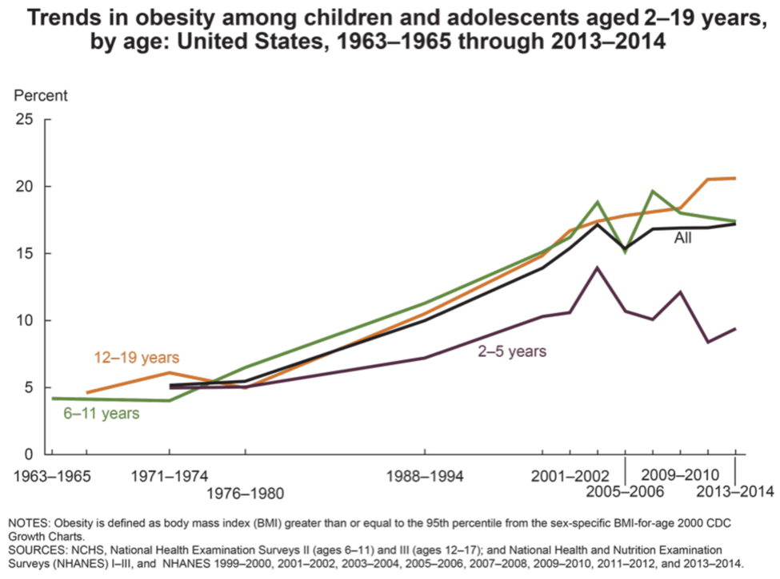
Step 2: Gather Evidence - Evidence of Teenage Obesity
STATISTICS:
ARTICLE:
Obesity In Children And Teens
CASE STUDY:
Case Reports: Multifaceted Experiences Treating Youth with Severe Obesity
https://www.nycfoodpolicy.org/combatting-childhood-obesity-by-reducing-sugar-in-school-beverages/

Slide 6
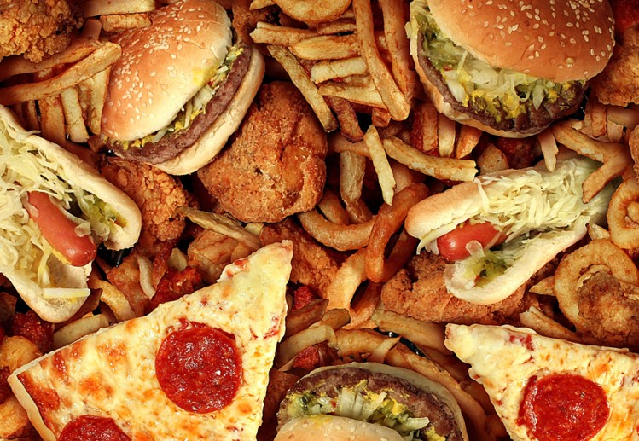
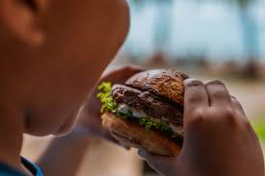
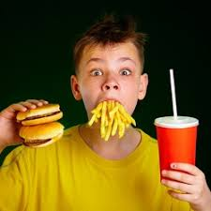
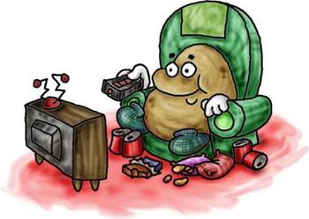
Step 3: Identifying the Causes
While in the process of doing the research to find evidence of our problem in the previous step, we probably uncovered some of the reasons why many teenagers have become obese.
What do you think some of the causes of teenage obesity are?
Turn and talk with your elbow partner
Come up with what you believe are the possible causes of teenage obesity.
Make a list of at least three causes.

Slide 7
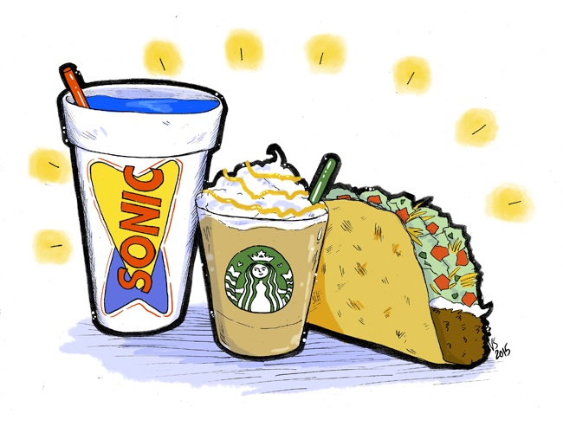
Step 3: Identifying the Causes
What Did You Come Up With?
Causes of Teenage Obesity
A lack of affordable and healthy food options.
Limited opportunities for safe physical activity outdoors.
Advertisements for junk foods and sugary drinks targeted at children.

Slide 8
Step 4: Evaluating Existing Policies
Let’s examine an existing policy in New York City:
Obesity Outreach Campaign
New York City created a program to target pediatricians and family practitioners.
These providers help educate parents about childhood obesity.
Pediatric Obesity Action Kit provides resources about obesity and how to help children with obesity.

Slide 9
Step 5: Developing Solutions
What are some solutions to the problem?
Parent workshops on healthy eating habits/choices (The Breakfast Club Curriculum - DOH)
Implement curriculum for healthy eating (Eating Healthy for Success curriculum - DOH)
The New York City Healthy Schools Initiative (DOH program that promotes healthy and equitable school environments).

Slide 10
Step 6: Select the Best Policy Solution
What does feasibility mean?
What does effectiveness mean?
EFFECTIVENESS | FEASIBILITY
 |  | HIGH | MEDIUM | LOW
 | HIGH
 | MEDIUM
 | LOW
Breakfast club
Eating Healthy for Success
Healthy And Equitable School

