Slide 1

Tardiness and Excessive Absences at
Frederick Douglass Academy
Nisha Ramirez
FDA

Slide 2
School starts at 8:15am. What time do you get to school?
Do-Now

Slide 3
What is Public Policy?
A real basic definition of a public policy is any type of government action.

Slide 4
Public Policy
A social problem such as crime, drugs, or violence that needs to be corrected by government.
Individuals (like you), groups (like your class) or organizations called players who are upset by the social problem and want to improve or make
A public policy to try to correct the social problem.

Slide 5
Public Policy Analyst (PPA) Steps
What is the problem?
2. What is the evidence?
3. What are the causes ?
4. What is the existing policy?
5. What policies can we create to correct the problem?
6. What is the best policy to correct the problem? (feasibility vs. effectiveness)

Slide 6

What is the problem?
Students at Frederick Douglass Academy are tardy or absent for school.
Complete worksheet #1 in groups.

Slide 7
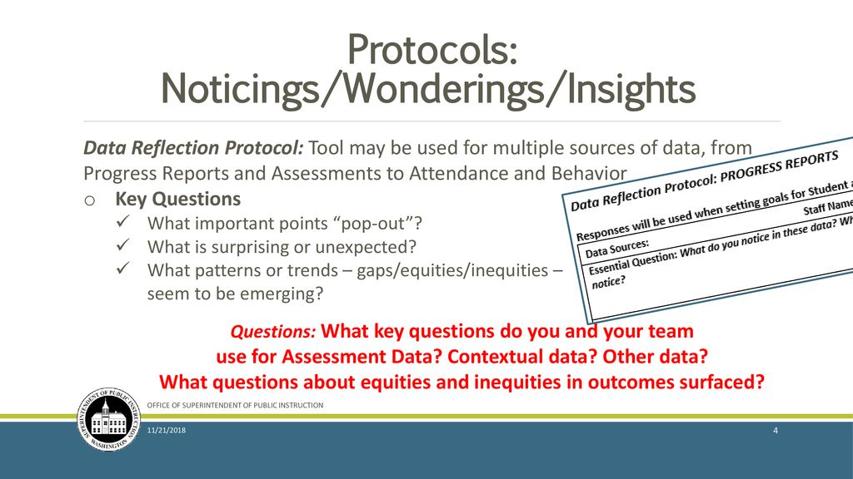
2.What is the evidence?
Read the NYC DOE data on End of Year Attendance and the daily attendance for DOE schools in NYC.
Review the U.S. Data on chronic absenteeism and tardiness.
Use the Noticings/Wonderings/Insights protocol for group discussion.
Complete worksheet #2 in groups.

Slide 8
3. What are the causes ?
Do-Now
Ink, Pair, Share
What makes or has made you late for school? Why have you missed days of school?
Class Work
Review FDA students survey results on reasons for being late and absent.
Complete worksheet #3 in groups.

Slide 9
4. What is the existing policy?
Review existing DOE policies.
Does FDA have an existing policy? Review FDA handbook.
Complete worksheet #4 in groups.

Slide 10
5.What policies can we create to correct the problem?
Let’s brainstorm ways we can fix the problem of tardiness and excessive absences at FDA.
Complete worksheet #5

Slide 11
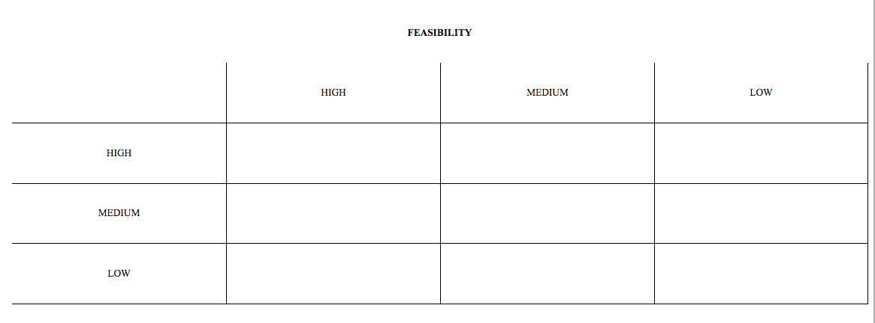
6. What is the best policy to correct the problem?
Complete worksheet #6 in groups.

