Slide 1
Housing Discrimination in 1950s Chicago
Text: A Raisin in the Sun by Lorraine Hansberry
Nisha Ramirez
Frederick Douglass Academy
AHPPA
Project Critical

Slide 2
What are we learning?
We are learning how to use Public Policy Analyst (AHPPA) to study the historical and current public policy regarding housing discrimination in 1950s Chicago.
Why are we learning this?
African Americans in the 1940s and 1950s were prohibited to purchase homes in the suburbs of the Chicago.
Where is this leading?
Policy decisions play a very large part in shaping our American and global history, as well as a member of today’s global community.
We will analyze the American dream of homeownership in “A Raisin in the Sun” and how public policy leads to external and internal conflicts for the characters throughout the play.

Slide 3
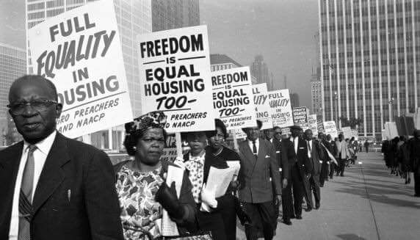
1. Define the Problem
Topic: Housing Discrimination
Social Issue: African Americans in the 1940s and 1950s were prohibited to purchase homes in the suburbs of Chicago.

Slide 4
The 4 Steps of the American History Public Policy Analyst (AHPPA)
1. Define the Problem
2. Gather the Evidence
3. Identify the Causes
4. Evaluate the Policy
(Optional Step) Do a Comparative Analysis of the Policy

Slide 5
Neighbors have the right to decide what kind of community they want to have—including who lives in that neighborhood.

Slide 6
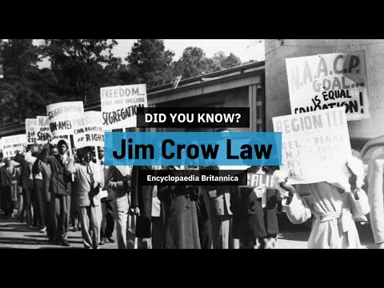
Jim Crow Laws in the South
Jim Crow laws were any state or local laws that enforced or legalized racial segregation. These laws lasted for almost 100 years, from the post-Civil War era until around 1968, and their main purpose was to legalize the marginalization of African Americans.

Slide 7
Black Families Move to the North
Many black families moved to the North to escape Jim Crow Laws.
Mama and her late husband moved to Chicago from the South to escape Jim Crow Laws. Mama hoped to eventually purchase a home.
Unfortunately, housing laws in the North continued to perpetuate racial segregation.

Slide 8
Redlining (1934-1958) Activity
While we watch the video on redlining (stop at 3:29), complete the two charts for each neighborhood.
Who lived in the red neighborhood? | Disadvantages from living in red neighborhood. | Benefits from living in red neighborhood.
Who lived in the green neighborhood? | Disadvantages from living in green neighborhood. | Benefits from living in green neighborhood.

Slide 9
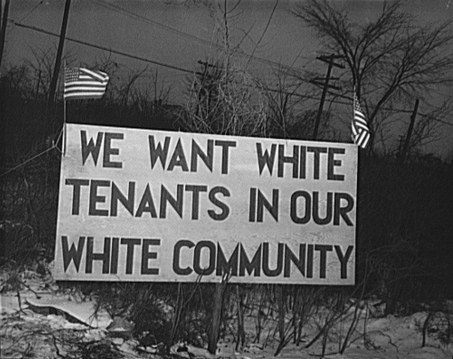
Redlining
Pair Work
Why was redlining considered the Jim Crow of the North?

Slide 10
What is intergenerational wealth?
Money found on the street.
Wealth passed down from parent to child.
Winning the lottery.

Slide 11
Thinking about intergenerational wealth, why does Mama want to buy a house for the family? What is the long term benefit? Does redlining allow her to achieve this American dream?

Slide 12
2. Gather the Evidence

Slide 13
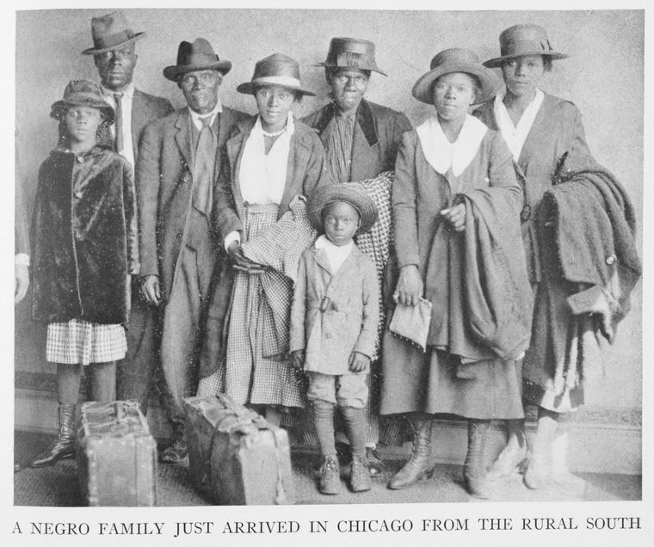
The 1930s
“The Great Depression, which led to the establishment of the Home Owners’ Loan Corporation and the still operational Federal Housing Administration (FHA), prompted a “two-tier approach” to housing.”
“After the passage of the Housing Act of 1937, low-income public housing projects mushroomed in inner cities, replacing slums and consolidating “minority neighborhoods.” Major road construction and suburbanization further segregated American cities.”
“At the same time, black Americans as well as other citizens of color found it extremely hard to qualify for home loans, as the FHA and the Veterans Administration’s mortgage programs largely served only white applicants. Those discriminatory practices prevented people of color from accumulating wealth through homeownership.”
“A Negro family just arrived in Chicago from the rural south.” Creator: Chicago Commission on Race Relations, 1922. Schomburg Center for Research in Black Culture, Jean Blackwell Hutson Research and Reference Division, The New York Public Library. New York Public Library Digital Collections. Accessed January 6, 2021. https://digitalcollections.nypl.org/items/510d47de-1a10-a3d9-e040-e00a18064a99

Slide 14
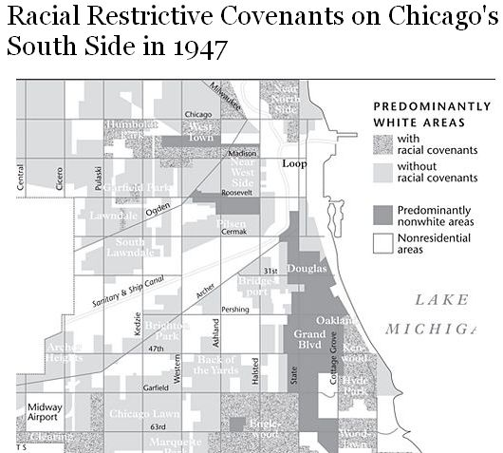
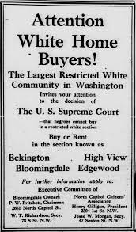
Racial Covenants
The typical formulation banned the ownership or rental of property by “any person other than of the white or Caucasian race,” often specifically barring members of ethnic and national origin groups such as Negroes, Africans, Chinese, Japanese, Mexicans, Puerto Ricans, American Indians, and Jews (described as Semites or Hebrews).

Slide 15
.
1940s-1950s
“African American families that were prohibited from buying homes in the suburbs in the 1940s and 50s, and even into the 1960s, by the Federal Housing Administration gained none of the equity appreciation that whites gained,” says historian and academic Richard Rothstein in the film Segregated by Design, which is based on his acclaimed book, The Color of Law.”
“The urban renewal program initiated by the Housing Act of 1949, in combination with the 1956 Interstate Highway Act and the Model Cities legislation of the Great Society era, provided federal funds for transportation networks and urban redevelopment projects that razed low-income and minority neighborhoods and displaced millions of residents into segregated ghetto housing.”
“In metropolitan Chicago, more than three-fourths of the homes built between 1946 and 1960 were located in the suburbs, 96 percent of new suburban arrivals were White, and the records of several hundred banks reveal only one mortgage loan made to a Black family in a majority-white neighborhood.97 FHA evaluators categorically redlined an entire third of the city of Chicago and half of the city of Detroit, a self-fulfilling divestment policy that turned neighborhoods into slums.”

Slide 16
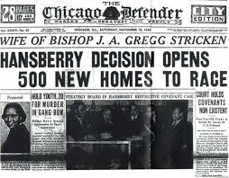
Despite their middle-class status, the Hansberrys were subject to segregation. When she was 8 years old, Hansberry’s family deliberately attempted to move into a restricted neighborhood. Restrictive covenants, in which white property owners agreed not to sell to blacks, created a ghetto known as the “Black Belt” on Chicago’s South Side. Carl Hansberry, with the help of Harry H. Pace, president of the Supreme Liberty Life Insurance Company and several white realtors, secretly bought property at 413 E. 60th Street and 6140 S. Rhodes Avenue. The Hansberrys moved into the house on Rhodes Avenue in May 1937. The family was threatened by a white mob, which threw a brick through a window, narrowly missing Lorraine. The Supreme Court of Illinois upheld the legality of the restrictive covenant and forced the family to leave the house. The U.S. Supreme Court reversed the decision on a legal technicality. The result was the opening of 30 blocks of South Side Chicago to African Americans. Although the case did not argue that racially restrict covenants were unlawful, it marked the beginning of their end.

Slide 17
https://www.forbes.com/sites/dimawilliams/2020/06/03/in-light-of-george-floyd-protests-a-look-at-housing-inequality/?sh=7357fa4d39ef
https://www.npr.org/2017/05/17/528822128/the-color-of-law-details-how-u-s-housing-policies-created-segregation
https://www.nps.gov/subjects/nationalhistoriclandmarks/upload/Civil_Rights_Housing_NHL_Theme_Study_final.pdf

Slide 18
3. Identify the Causes

Slide 19
Racism
Act 2 Scene 3
Mr. Linder visits
page 114- 119
Audio: 1:29:53- 1:36:35
1. Why does Mr. Lindner come to the Younger’s apartment?
2. Why don’t the residents and Clybourne Park want the Youngers to move there?

Slide 20
Poverty
“Mama: Oh—So now it’s life. Money is life. Once upon a time freedom used to be life—now it’s money. I guess the world really do change . . .
Walter: No—it was always money, Mama. We just didn’t know about it.”
“I’m thirty-five years old; I been married eleven years and I got a boy who sleeps in the living room – (very quietly) – and all I got to give him are stories about how rich white people live…” –WALTER

Slide 21
4. Evaluate the Policy

Slide 22
Fair Housing Act of 1968
The Fair Housing Act of 1968 prohibited discrimination concerning the sale, rental and financing of housing based on race, religion, national origin or sex.

Slide 23
Complete the following worksheet to evaluate the advantages and disadvantages of The Fair Housing Act of 1968.
https://flippedtips.com/plegal/ppa/worksheet4us.html

Slide 24
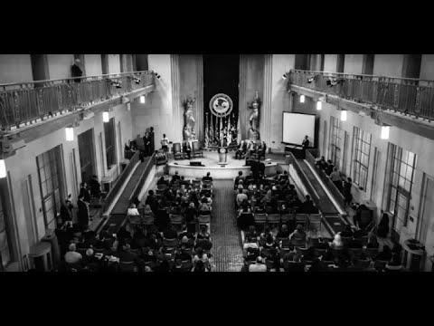
Advantages and Disadvantages
Even after the 1968 passage of the Fair Housing Act, black Americans and other minorities have continued to experience housing inequalities.
In the first quarter of 2020, the Census Bureau reported that black households had the lowest homeownership rate at 44%, nearly 30 percentage points behind white households. https://www.forbes.com/sites/dimawilliams/2020/06/03/in-light-of-george-floyd-protests-a-look-at-housing-inequality/?sh=7357fa4d39ef

Slide 25
Do a Comparative Analysis of the Policy

Slide 26
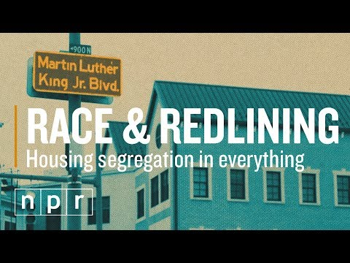
Housing Discrimination Today
Complete the Comparative Analysis Worksheet below:
https://flippedtips.com/plegal/ppa/worksheet7us.html
Think about how the following social issues arise from housing discrimination:
Housing segregation in schools
Housing segregation in health
Housing segregation in policing
H

