Slide 1
NDMS Social Studies
Gentrification and West Harlem

Slide 2
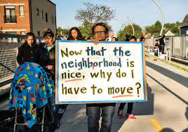
Do Now and Vocabulary:
What does it mean to improve or update a neighborhood? What are some possible consequences?
Gentrification: the process whereby the character of a poor urban area is changed by wealthier people moving in, improving housing, and attracting new businesses, typically displacing current inhabitants in the process.

Slide 3
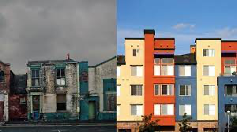
The Public Policy Analyst: Modeled through Gentrification
We will be looking at the process of “gentrification” and how West Harlem has changed so much in the past few years. Please speak to your partner about some of the changes you have noticed as you have grown older.
Public Policy Analyst: Someone who provides an approach to solving a problem using a specific set of steps

Slide 4
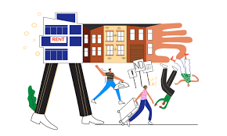
Define the Problem
Gentrification is a complex problem that both improves the area we live in but also pushes out poorer people who live in the improved area since improvements are expensive.

Slide 5
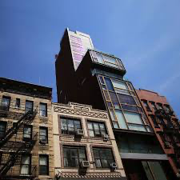
Gather the Evidence
Gentrification is occurring all over the world. As people want to have higher property prices, not live in squalor, and generally improve their standards of living.
In Harlem, the movement of Columbia University into the Manhattanville Neighborhood has displaced a great deal of local residents.

Slide 6
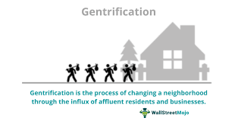
Identify the Causes
Developers wish to convert valuable land into housing for richer people.
Businesses would like to sell to people with more money.
Landlords would have less to tend to and take care of.

Slide 7
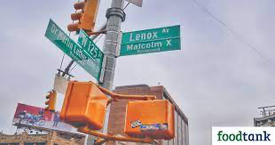
Evaluate Existing Policy
NYC welcomes gentrification as it increases property value and makes the standard of living higher. However, NYC has also designated specific buildings and regions that are not available for purchase based on Eminent Domain rules.
Eminent Domain: Eminent domain refers to the process by which the government may seize private property with proper compensation, but without the owner's consent.

Slide 8
Develop Solutions
1) Zoning specific neighborhoods and buildings from property developers.
2) Utilize night schooling to get older community members to encourage better occupations and higher wages.
3) Appoint a community watchdog who oversees the clean up and shepherding of the current community.

Slide 9
Select the Best Solution - Evaluate Effectiveness/Feasibility
I believe educating and training current occupants so they can help to finance the improvement of their surroundings by introducing job training programs, online coursework, and pathways to lucrative employment is the most effective way at addressing this problem.
The feasibility of this is apparent since many community members may be open to new opportunities that pay them higher salaries. This can be initiated through schools and scholarships that their children are already a part of.
“We need a “people-driven” economic development program that creates access to good jobs for the people who need them most.”

Slide 10
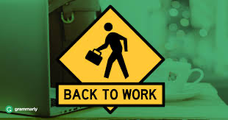
Now It’s Your Turn
Please get into groups of 3 and think about some problems and issues that you see in either West Harlem, all of NYC or NDMS that you can and would like to solve.

