Slide 1
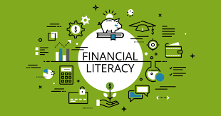
Bridging the gaps in financial literacy at New Design Middle School
Abdur Rahaman
Notes:
Arthur, C. (2012). Financial literacy education. In Financial literacy education (pp. 1-12). SensePublishers, Rotterdam.
Mandell, L., & Klein, L. S. (2009). The impact of financial literacy education on subsequent financial behavior. Journal of Financial Counseling and Planning, 20(1).

Slide 2
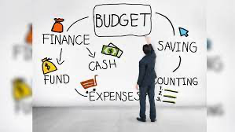
Steps of the PPA
Step 1 Define the problem
Step 2 Gather the Evidence
Step 3 Identify the Cause
Step 4 Evaluate an Existing Policy
Step 5 Develop Solutions
Step 6 Select the Best Solution
Notes:
https://heinonline.org/HOL/LandingPage?handle=hein.journals/sanlr46&div=17&id=&page=
https://onlinelibrary.wiley.com/doi/abs/10.1002/ijfe.2005

Slide 3

Define the Problem
-Black and Brown students have historically lacked financial knowledge and how to navigate institutions that may further their own interests (Fox, 2021).
-Lack of financial knowledge causes greater social, physical, and emotional strain on families as their needs become more diverse as they grow older (Mollenkamp, 2021).
-The lack of financial literacy may lead to higher incidences of crime and incarceration (University of Arkansas, 2014).
Notes:
https://www.cnbc.com/2021/04/06/teaching-financial-literacy-to-kids-can-shrink-the-black-wealth-gap.html
https://www.investopedia.com/the-racial-gap-in-financial-literacy-5119258
https://www.sciencedaily.com/releases/2014/06/140618163924.htm

Slide 4
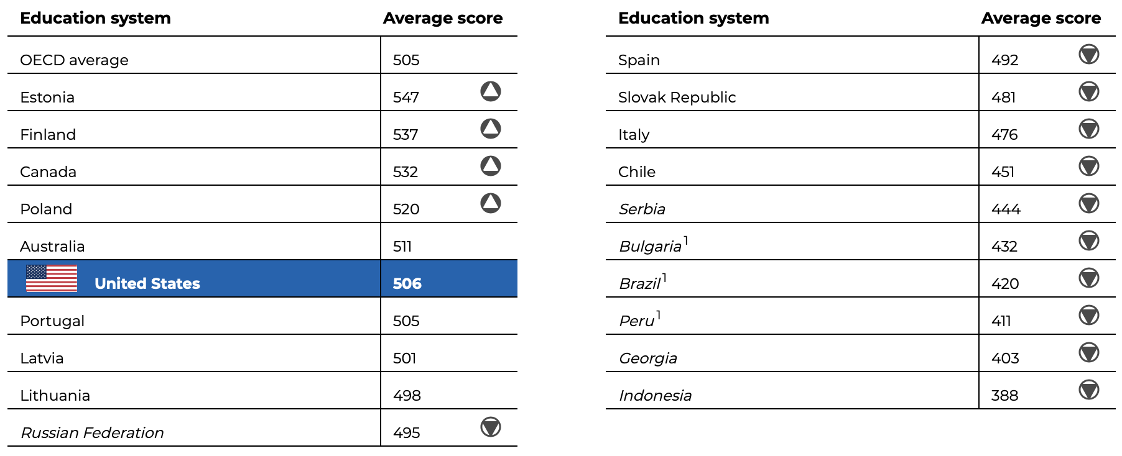
Gather Evidence
-
Notes:
https://nces.ed.gov/surveys/pisa/pisa2018/#/finance/intlcompare

Slide 5
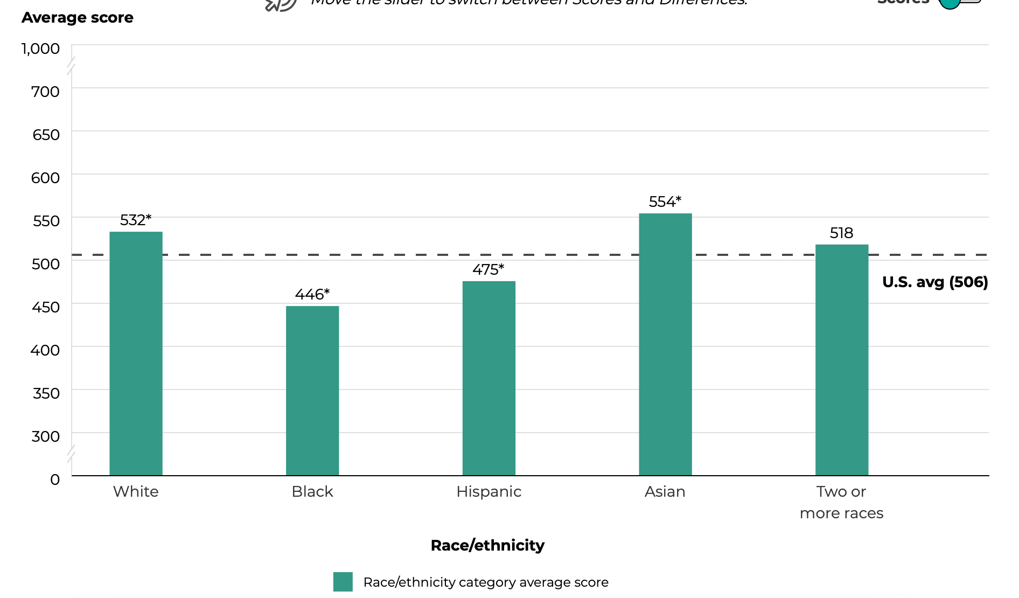
Notes:
https://nces.ed.gov/surveys/pisa/pisa2018/#/finance/intlcompare

Slide 6

Identify the Cause
-Financial literacy has been a later stage of linguistic and mathematical literacy (Champlain College, 2021).
-As society has become more equitable, schools put an emphasis on ELA and Math but often leave out the importance of financial knowledge from their curriculum and school planning (Doyne, 2021).
-Many teachers themselves lack the knowledge required to teach financial literacy (Zingg, 2020).
Notes:
https://www.champlain.edu/centers-of-experience/center-for-financial-literacy/report-national-high-school-financial-literacy/the-case-for-high-school-financial-literacy
https://www.nytimes.com/2021/04/20/learning/should-all-schools-teach-financial-literacy.html
https://www.teachforamerica.org/one-day/ideas-and-solutions/closing-the-financial-literacy-gap

Slide 7


Social and Structural Changes
-PISA or Program for International Student Assessment has been issued by the OECD or group of developed nations to measure educational attainment students in member countries.
-The PISA assessment has started measuring financial literacy as of 2018 in addition to Math, Science, and Reading aptitudes (OECD, 2018).
-Many curriculums in the largest school districts including New York City have started to offer financial literacy as an elective after acknowledging its priority (Barry, 2013).
Notes:
https://www.oecd-ilibrary.org/docserver/48ebd1ba-en.pdf?expires=1632793230&id=id&accname=guest&checksum=1B6B1FA3418525443EADFBF68B3C9F34
https://www.oecd.org/finance/financial-education/oecdpisafinancialliteracyassessment.htm

Slide 8
Evaluate an existing Policy
-Self learning or using online resources has been a readily recommended approach to bridging the financial literacy gap (Reinicke, 2020).
-Smartphones and the use of portable devices has allowed the dissemination of information to enable practice and learning of financial literacy (MX, 2019).
-This may lead to some socioeconomic disparities between those who can afford these devices and those who cannot. This point is furthered by assessing broadband and data access.
-While schools attempt to create and implement financial literacy curriculum, the following of this inadvertent and increasingly democratized approach to learning has contributed to many students improving their knowledge of this topic.
Notes:
https://nces.ed.gov/surveys/pisa/pisa2018/#/finance/intlcompare

Slide 9
Develop Solutions
-From 2012, to 2018, The United States improved its PISA financial literacy score by 14 points from 492 to 506, slightly above the OECD average of 505 (OECD, 2018).
-In this same time period, many online forums on Youtube and money tracking apps have proliferated as more adolescents have also started to use devices at an earlier age with higher and higher screen time (Thompson, 2019).
-Though the added screen time brings its own host of challenges, for the purposes of learning financial literacy, students have more options available more easily for them.
-Students can be incentivized to watch videos and have money tracking apps in accordance with their household chores which may lead to parental involvement.
-Schools can tap into this by offering classes that incentivize similar initiatives.
Notes:
https://medicalxpress.com/news/2019-02-screen-young-years.html

Slide 10
Select the best Solutions
-Financial literacy in accordance with familial and parental involvement can be delivered through making Financial Literacy an elective course starting at the later elementary school level and continuing into High School.
-Parents and students can follow in accordance with the school’s financial literacy program and develop spending habits, track budgets, save up for large expenses, and invest for future returns.
-Utilizing Youtube, Robinhood, the Stock Market Game, Acorns, and calculators can all be utilized as resources for students to develop greater financial literacy.

