Slide 1

The negative effects of waste disposal in communities of color
By: Ysraelina Paula

Slide 2
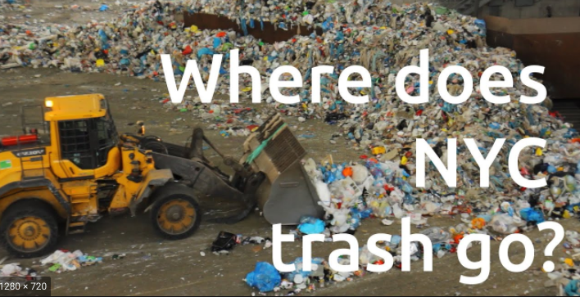

Slide 3
Public Policy Analyst (PPA):
Define the Problem
Gather Evidence
Identify Causes
Evaluate An Existing Policy
Develop Solutions
Select the Best Solution

Slide 4
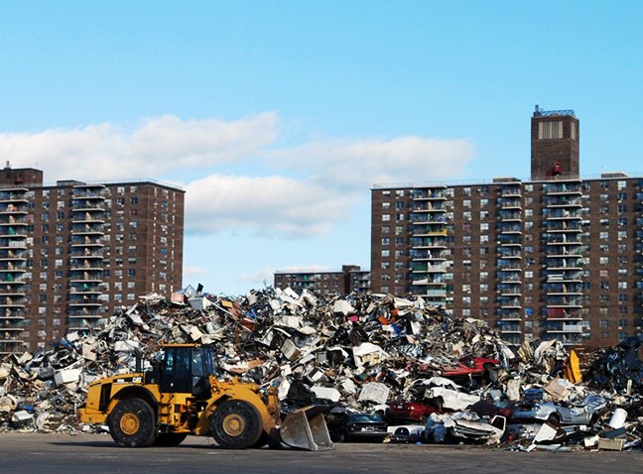

Define the Problem-1
Waste disposal in NYC are designated to “transfer stations” that are mandated to be located in “M¨ zones that are poorer communities with people of color. There are significant negative effects stemming from the waste trucks located in these communities.

Slide 5
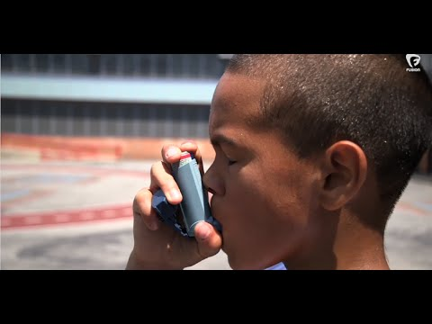
Watch the video and complete the following
List the factors that are causing a high incident of asthma in children in the Bronx
What questions do you have on the information presented in the video

Slide 6
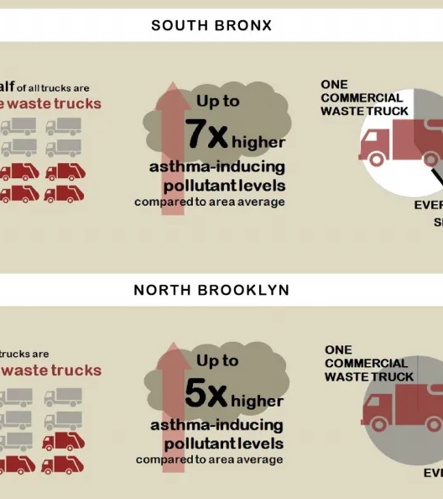
Gather Evidence-2
South Bronx and North Brooklyn are two neighborhoods that are greatly affected by waste trucks.
These neighborhoods have a higher pollutant concentration leading to higher incidence of asthma in the residents of these communities

Slide 7
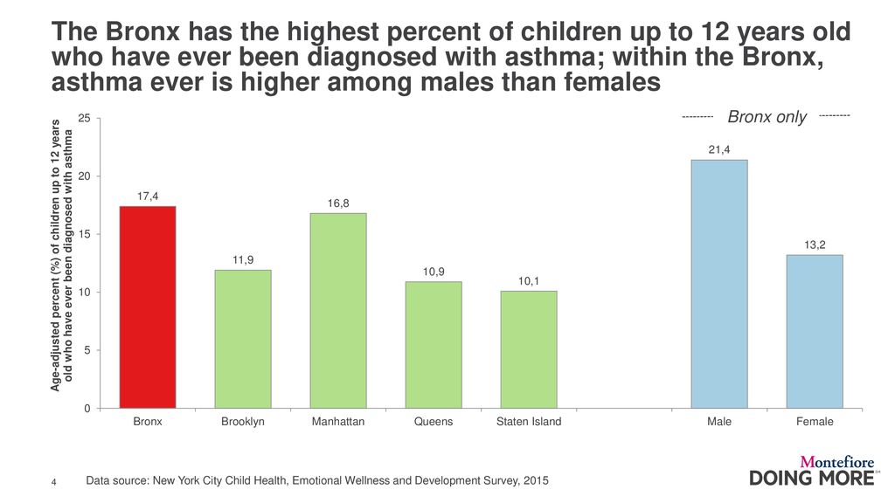
Data is worth a thousand words
Vestibulum congue
Vestibulum congue

Slide 8
Identify Causes- 3
Increased population leading to an increase production of waste.
Waste zoning is limited and restricted to specific locations, and these locations are in poor communities of people of color.

Slide 9
Evaluate An Existing Policy- 4
How can we reduce the amount of pollutants that are released in these designated waste stations communities?
Environmentalist and other professionals are “calling on the city to not only pursue “zone-based” commercial waste collection, but to further incentivize the use of clean-fuel technologies, barges, and trains.¨

Slide 10
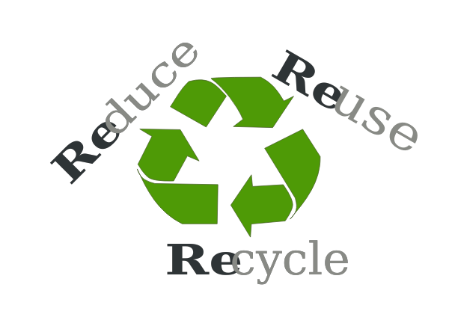

Develop Solutions-5
Out of 58 waste transfer stations 32 are located in the Bronx and North Brooklyn. A possible solution can be dispersing waste disposals to other destinations.
Another solution will be to reduce waste, by reusing and recycling

Slide 11

Select the Best Solution-6
The best solution is the triple R’s, reduce, reuse and recycle. This is a solution that is best accessible to the people. Everyone can contribute to this change and don't depend on government officials to take action.

