Slide 1
Low Make Up Work Submission
at FDA School
Dessy Natalia
FDA
Notes:
https://flippedtips.com/plegal/javits/111423.htm

Slide 2
Do Now
How many times have you been absent in this marking period?

Slide 3
Attendance
Why attendance is important?
Time lost in learning
More than 3 absences per marking period is count as CHRONIC absence

Slide 4
The Importance of School Attendance

Slide 5
Background - Reason for absence
Cannot be avoided/reduced → need letter from parents
Sick
Doctor appointment
Family issue
Can be avoided/reduced
Wake up late
Holiday
Skip class

Slide 6
Steps in the PPA (Public Policy Analyst)
Define the problem
Gather the evidence
Identify the causes
Evaluate an existing policy
Develop solutions
Select the best solution

Slide 7
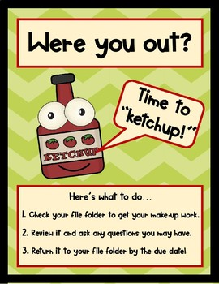
Define the Problem
When the students absent for any reason, many of them do not have the initiative to make up the work that they missed
Low submission for make up work

Slide 8
What is “Make Up Work”
Any work that you missed while you were absent from class
Classwork
Lab
Test

Slide 9
2. Evidence
 | 10.30.23 | 10.31.23 | 11.01.23 | 11.02.23
Student 1 | A | A | T | T
Student 2 | A | A | P | P
Student 3 | A | A | P | T
Student 4 | P | P | T | P
Student 5 | P | A | P | P
Student 6 | A | A | P | A
10.30.23 | 10.31.23 | 11.01.23 | 11.02.23
Mis | Mis | 65 | 65
Mis | Mis | 75 | 90
65 | 87 | 75 | 100
75 | 93 | 65 | 75
75 | Mis | 75 | 100
Mis | Mis | 65 | Mis
Student absent → student do not submit the work
Source: Jupiter attendance and gradebook

Slide 10
3. Causes
Forget to come and get the missing work
Too much work to make up (added up for each class, each day they missed class)
Think they do not need to do that
Wait till the end of marking period
Does not bother to know what they missed

Slide 11
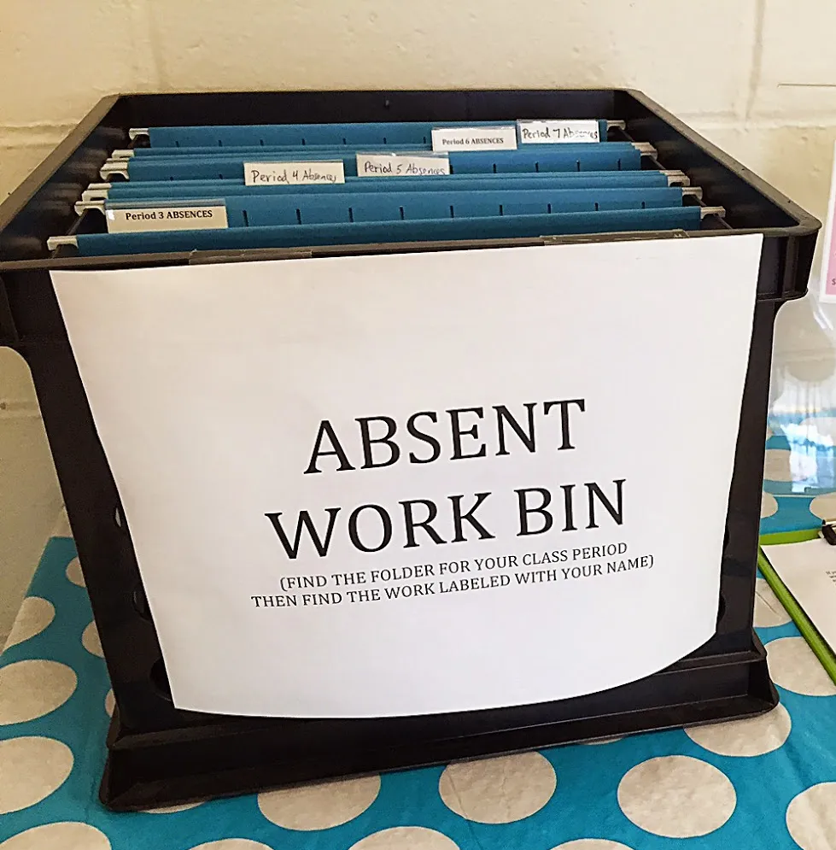
4. Existing Policy
2 days
Make up work SHOULD be done at the latest 2 days after students come back to school
Work is available on google classroom or on the bin in the classroom
LATE WORK
DEDUCT POINT
After School tutoring and HW help available to all students
Late work will get deducted point

Slide 12
5. Solution
Don’t wait → Check google classroom daily even when you are not in the school and try to do the work while you are at home (the more you do the work now, the less you will need to do later)
Check in with your teacher → Once you are back to school, ask teacher to make up any test/lab that you missed
Need more help?
→ come afterschool for tutoring or HW help

Slide 13
7. Feasibility/Effectiveness Chart
Matrix |  | Feasibility
 |  | High | Medium | Low
 | High | Create a reminder on your phone
 | Medium |  | Print out schedule and make sure to come to all classes to get the work and ask teacher to sign the paper once you have the work and once you submitted the work
 | Low |  |  | Don’t be absent
Effectiveness

