Slide 1

Bullying at PS 129
Why do students bully others?
How can school address/end it?
Allary Montague
PS 129 John H Finley
Amontague2@schools.nyc.gov

Slide 2

PURPOSE
Define bullying
Analyze and examine reasons students may bully
Determine most efficient manner to end bullying within our school

Slide 3

What is Bullying?
According to https://www.stopbullying.gov/, bullying is defined as “…unwanted, aggressive behavior among school aged children that involves a real or perceived power imbalance. The behavior is repeated, or has the potential to be repeated, over time. Both kids who are bullied and who bully others may have serious, lasting problems.”
In order to be considered bullying, the behavior must be aggressive and include:
An Imbalance of Power: Kids who bully use their power—such as physical strength, access to embarrassing information, or popularity—to control or harm others. Power imbalances can change over time and in different situations, even if they involve the same people.
Repetition: Bullying behaviors happen more than once or have the potential to happen more than once. Bullying includes actions such as making threats, spreading rumors, attacking someone physically or verbally, and excluding someone from a group on purpose.

Slide 4

Be The Change!
This video is an Anti-Bullying film that has been streamed more than 6.6. million times worldwide.
https://www.youtube.com/watch?v=A90Wv_1pNJo

Slide 5

Dig Deeper!!!
What does Bullying look like?
Let’s closely examine what bullying is and all that it entails. Additionally, let’s examine reasons why bullying is identified as a social problem and needs to be stopped. https://www.youtube.com/watch?v=sY8IhIPIaxw
Before the Video:
Talk with a partner about what comes to your mind when you think of bullying.
After the Video:
Has your perception of bullying changed? please share with your partner.

Slide 6
Different Types of Bullying
While bullying can appear in many different forms, according to www.VeryWellFamily.com, the 6 main types of bullying are:
Verbal Bullying
Prejudicial Bullying
Sexual Bullying
Cyber Bullying
Relational Aggression
Physical Bullying

Slide 7

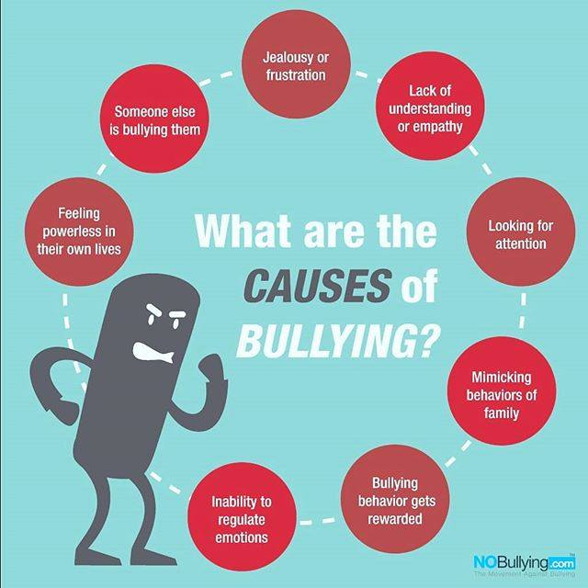
Why BULLY?
It seems like everyone knows that bullying is wrong, and yet students are still doing it?
Why?

Slide 8
Evaluate the Policy
We know bullying is bad and needs to be stopped. How can we go about stopping it in our school?
With your partner, answer the following questions:
1)Does PS 129 have a policy for bullying currently in place?
2)Does NYC have a current policy for bullying in place?
3) Does the Country have a policy for bullying in place?

Slide 9
Identify
Next, you’re going to identify the specific problem of bullying within our school, PS 129.
You and your partner are instructed to interview ten students (at least one from each class/grade).
You may use the questions below or formulate your own.
    How would you define bullying?
    Have you or a close friend/sibling ever experienced bullying at PS 129?
    Have you ever witnessed any type of bullying at PS 129?
    Does the school have a system or policy in place to address bullying?
    Do you think the school’s current policy is sufficient regarding addressing bullying? If yes, why? If no, what would you change?
    Are there specific roles/actions clearly outlined in the school’s policy? (What is expected of administration, teachers, support staff, parents, and students?)

Slide 10


Develop Solutions
With your partner, write down three negative ways in which a student being bullied may address and deescalate the situation
Now, list three positive ways in which a student being bullied may address and deescalate the situation

Slide 11
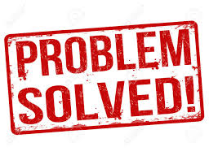
The Best Solution!
After comprising your list with your partner, determine the absolute best solution. Make sure you have considered all angles of this problem.
Once you and your partner have chosen the best possible solution, you are to create a one-page pamphlet detailing the reasons why your chosen solution is the best. Additionally, your pamphlet must include at least two reasons why other solutions were rejected.

