Slide 1
Collaboration during a pandemic @ Chelsea CTE High School
Or: How do you expect us to work together Miss?
By Lisa V. Martin for Project: CRITICAL year 5

Slide 2
Steps for Public Policy Analysts: (PPA)
Step 1: Define the problem
Step 2: Gather the Evidence
Step 3: Identify Causes
Step 4: Evaluate Policy
Step 5: Develop Solutions
Step 6: Select Best Solution

Slide 3
Introduction
Hello Scholar!
If you are reading this, you are a student living in uncertain times. After about 18 months of being told to keep 6ft away from anyone outside your home, you are now face to face in a classroom and it may seem surreal.
FEAR NOT! The purpose of this exercise is to re-acclimate you to not only being back in class but working with others. Is it really doable, Miss? Yes it is, so let’s do this.

Slide 4
Defining The Problem
Collaboration is defined as:
To work jointly with others or together especially in an intellectual endeavor.
At Chelsea CTE, a school of ~500 Scholars, there is a pulse of anxiety after the return to our building after 18 month out due to the pandemic, March 2020- September 2021.
Problem: Upon return, Scholars are re-adjusting to working together both academically (mental collaboration) and within close physical proximity, in consideration to the regulations.
Notes:
https://www.merriam-webster.com › dictionary › collab...

Slide 5
To understand how Students are affected by their return they are asked to fill in a Google Survey. Link below:
https://docs.google.com/forms/d/e/1FAIpQLSdC4cvf9wDDVIiS4tPw5wVMyfGgU_8Td6L1-iXuVq0EwfXiTA/viewform?usp=sf_link
Gather the Evidence

Slide 6



Slide 7
Activity 1: A Quote to Remember
Instructions:
On the previous slide you will have noticed 2 quotes. In 2-3 sentences, summarize one of the quotes.
Looking ahead: Based on the topic, Collaboration during a Pandemic, and the provided definition, relate the quote you summarized to our overall theme.

Slide 8
Identifying (possible) Causes
Based on how you interpreted the quotes, Turn & Talk about what may cause anxiety in working with others now that we are back together, in-building. Note your partner’s strongest claim.

Slide 9
Evaluate Policy
NYC DOE Health and Safety Protocols
The link above lists the Safety Precautions for New york City’s Department of Education. They are categorized below:
Vaccinations
School Visitor Policy
Vaccination Portal
Health Screening
Face Coverings and PPE
Physical Distancing in Schools
Ventilation
Cleaning
Outdoor Learning Continues
COVID-19 Testing in Schools
Positive Cases: Closure and Quarantine
Medically Necessary Instruction

Slide 10
Develop Solutions
As we adjust to the new normal, that is, life during a pandemic, it is important to who we are, what we offer, and what we may need.
Personality Quiz
The link above is a free personality test that provides insight on our strength and needs as well as helps us to understand our similarities and our differences.
Click the link to take the quiz and fill in the graphic organizer on the next 2 slides.
*Graphic Organizer designed by and used with the permission of Jessica Kim, Chelsea HS 2021 JKim45@schools.nyc.gov *

Slide 11
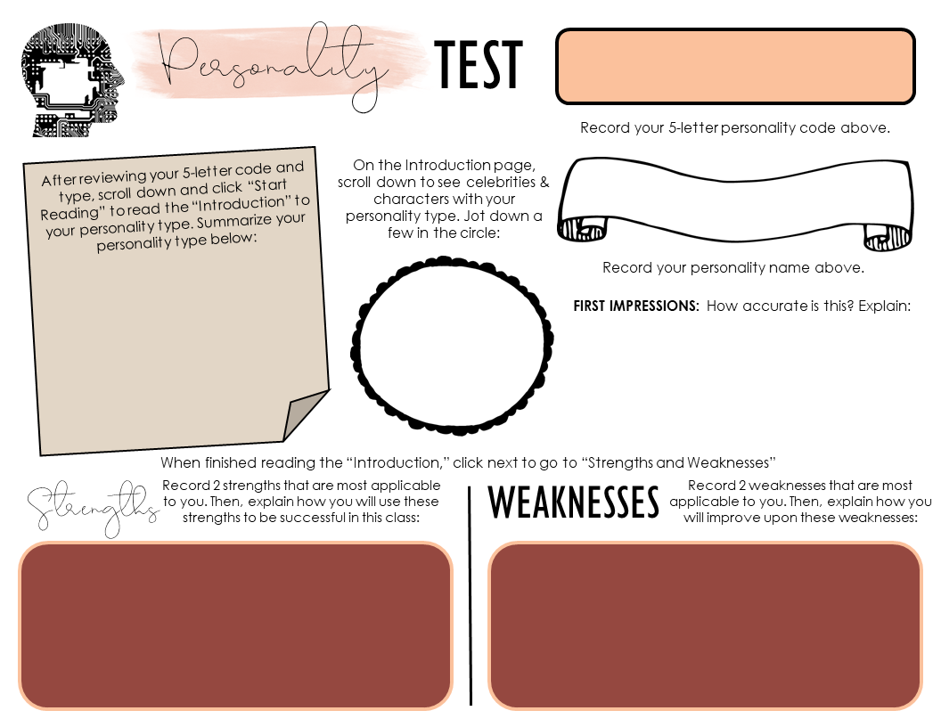
TYPE HERE
https://www.16personalities.com/free-personality-test
Type here.
Type here.
Type here.
Type here.
Type here.
Type here.
Notes:
Take the test HERE: https://www.16personalities.com/free-personality-test

Slide 12

Type here.
Type here.
Type here.
Type here.
Type here.

Slide 13
Possible solutions
Now that we have discovered a little more about ourselves, how can we use the information in your graphic organizers to pick the best solution to our stated issue of Collaboration during a Pandemic?
Task: Using the outcome of your personality test, find 2 other people that got different results. Compare and contrast each individual’s strengths. List the main strength from each person and jot down how each one would benefit in collaborative work.
What does your personality type bring as a solution or partial solution to easing the anxiety/ disinterest in group work, in our current school setting?
We will use the scale on the next slide to determine the best/ most feasible solutions based on your group’s listings

Slide 14
