Slide 1
Teenage Drunk Driving:
Public Policy Analyst Steps
Laura Martinez
lmartinez@uafutureleaders.com
UAAFL

Slide 2

What is Public Policy?
“Public Policy is a purposive course of action followed by government in dealing with some topic or matter of public concern.” - JE Anderson, 1975

Slide 3

What is a Public Policy Analyst?
Policy analysts collect information, mainly statistical data, to assist with the investigation of issues and in order to explain the solutions that they suggest.

Slide 4
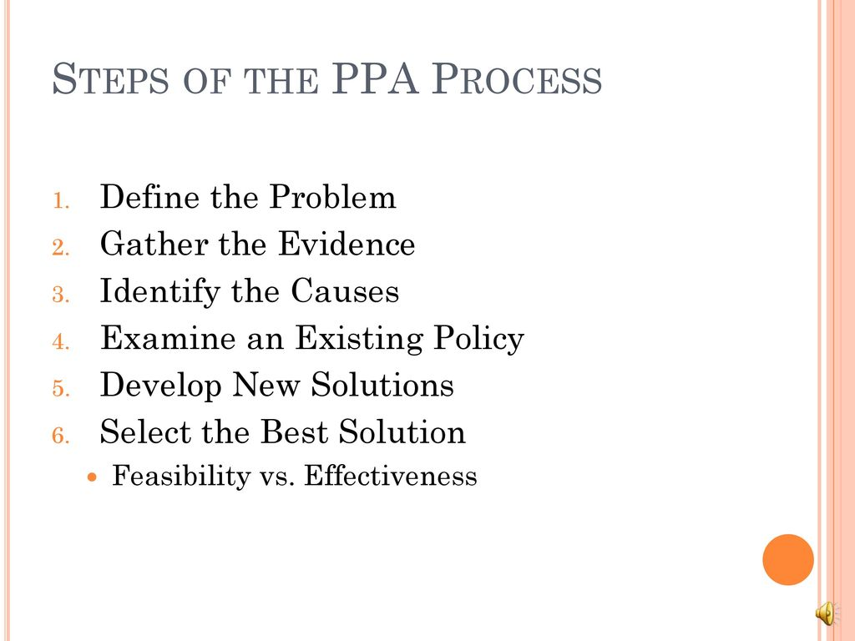
The PPA Process
Public Policy Analysts follow 6 steps in order to find solutions to social issues.

Slide 5

Step 1 - Define the problem
In Step 1 of the PPA process, we identify the social problem we want to study and the location in which the problem is occurring.
Example:
A large number of teenagers drive drunk in the United States.

Slide 6

Step 2 - Gather Evidence
In Step 2, we conduct research to find evidence that shows that this problem exists.
The three types of evidence we will search for to support the existence of the problem we are studying are:
Statistics
Case Studies
Articles by Experts
Example:
“60% of all teen deaths from car accidents involve alcohol.”
https://www.drive-safely.net/teenage-drunk-driving/

Slide 7
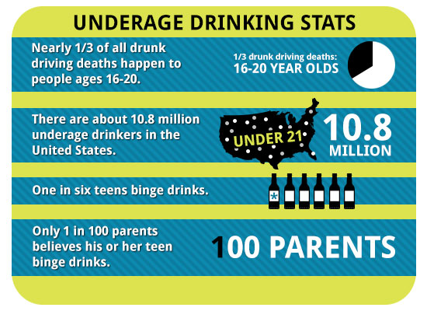
Statistics
Statistics refers to numerical facts or data. Usually statistics are organized and tabulated to present significant information. Statistical data are essential to demonstrate the existence of a social problem. Statistics regarding specific social conditions can be compared among different locations or over a period of time to demonstrate that an undesirable social condition is worse in one community or has increased over a number of years.

Slide 8

Case Studies
A case study is a description of a particular type of social condition, organization, group, or individual. Generally, statistical data provides stronger evidence than individual case studies. For example, to demonstrate the problem of unemployment in your city, one would want to know the statistical rate of unemployment provided by the US Department of Labor. However, a case study might shed some additional insights into the actual effects of unemployment on a typical family. Therefore, never use case study data as a sole source of evidence in doing PPA. If you use them at all, include a reference to a case study to supplement statistical data.

Slide 9

Articles By Experts
Like case studies, articles by experts are generally less persuasive as evidence in doing PPA than statistics. First, for the article to have any value, the author has to be a recognized expert in the field that he or she is writing about. For example, during the middle of the twentieth century, Dr. Benjamin Spock was one of the country’s most well known experts on baby and child care. His books and articles on the subject influenced policies used by other doctors and hospitals. During the 1960’s, Dr. Spock also became an outspoken critic of the nation’s policies in Vietnam. Serious policy analysts, though, would not be influenced by his views on the war since he had no real expertise in that area.
Like case studies, if you use quotes or excerpts from articles by experts, use them only to supplement already existing strong statistical data that you have gathered.

Slide 10

Step 3 - Identify The Causes of the Problem
In Step 3, we continue our research to identify the reasons why the social problem we are studying exists.
Example:
Peer Influence
https://www.livescience.com/44132-teens-drinking-driving-intoxicated-drivers.html

Slide 11

Step 4 - Evaluate Existing Policies
In Step 4, we conduct further research into the policies that are already in place to address the social problem we are studying.
Through our evaluation of those policies, we identify their advantages and disadvantages, and determine if they should be replaced, strengthened, or improved.
Example:
Sobriety Checkpoints
https://www.madd.org/the-solution/drunk-driving/support-our-heroes/

Slide 12

Step 5 - Develop Solutions
In Step 5, we propose three solutions to the social problem we are studying in one of two ways:
Eliminate or lessen the causes or contributing factors through a new public policy
or
Strengthen or improve a current public policy in place.

Slide 13
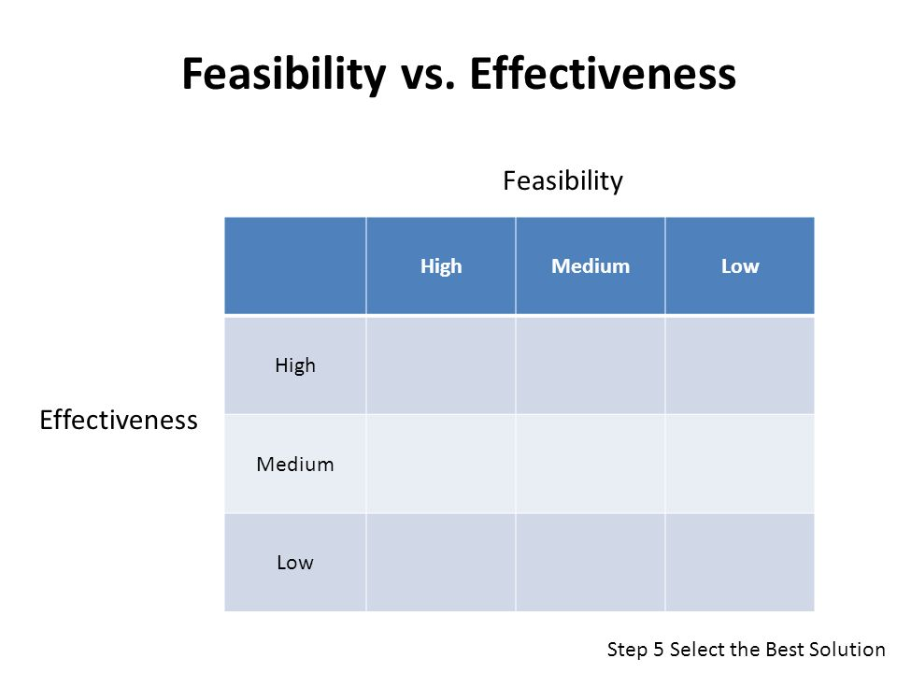
Step 6 - Select the Best Solution
In Step 6, we select the best solution to the problem we are studying.
We do so by determining which solution is the most feasible AND effective.
The policy you choose should rate high in both.
Example:
Sobriety Checkpoints
Raise Age for getting Driver’s License
Implement MADD program in schools

Slide 14

Feasibility
Feasibility refers to the likelihood that your policy would be enacted by the government or government agency. Feasibility can be affected by factors such as cultural acceptance and the anticipated costs in comparison to the benefits. For example, a policy to cut off the hands of thieves might be highly effective in reducing stealing, but it would not be culturally acceptable in the United States. A policy to triple the size of a city’s police force may have the benefit of lowering crime, but the increased costs to taxpayers would greatly lower the feasibility of the policy being passed by the city council.

Slide 15
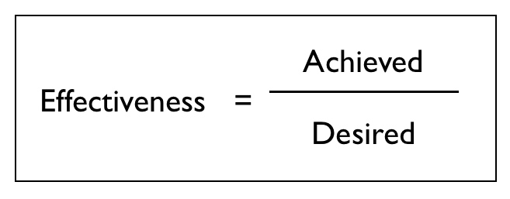
Effectiveness
Effectiveness refers to the likelihood that your policy will produce results that lessen the social problem. To be able to anticipate the effectiveness, it is essential that your problem in step 1 is narrowly and specifically stated.

Slide 16
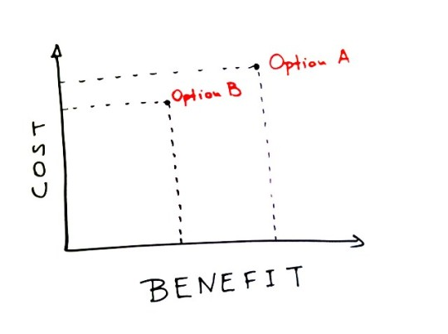
Bonus Step - Evaluating Costs and Benefits
Now it is time to examine effectiveness more closely. You probably selected your policy because you believe it will bring about good or desirable consequences. These future good consequences are called benefits. Your policy may also bring about some bad or undesirable consequences. These are called costs. The process of studying the benefits and costs of a public policy is called evaluation.

Slide 17

Bullying in AFL...
Apply the Public Policy Analyst Steps to solve the problem of Bullying in AFL.

