Slide 1
Lack of Motivation in
“The Fun They Had”
Mrs. Marte
H.S for Media and Communications
mmarte@hsmcnyc.org

Slide 2

Public Policy Analyst Steps (PPA)
Define the Problem
Gather the Evidence
Identify the Causes
Evaluate an Existing Policy
Develop Solutions
Select the Best Solution (feasibility vs. effectiveness)

Slide 3

PPA #1: Define the Problem
In “The Fun They Had” the main character feels discouraged and lacks motivation.

Slide 4

Turn & Talk
What motivates you to do well in any area of your life? (sports, school, job, etc.)

Slide 5


Motivation matters!
It is the biggest determiner of success.
Turn & Talk: What happens when you lose motivation on something?

Slide 6


PPA #2: Gather the Evidence
Lack of motivation is a problem because...
ACTIVITY: How is Margie’s lack of motivation a problem in the story?
Complete the Gathering Evidence of the Problem worksheet.

Slide 7

PPA #3: Identify the Causes
Students lack motivation because:
They don’t feel competent enough to complete the task at hand
They don’t see a direct link between their actions and an outcome and have no control over whether or how to undertake a task
The task has no interest or value to them
The task doesn’t bring social rewards, such as a sense of belonging to a group or approval from someone they care about.
ACTIVITY: Why does Margie feel discouraged and unmotivated?
Complete the Identifying the Causes of the Problem worksheet

Slide 8

PPA #4: Evaluate an Existing Policy
What policies have been put in place to address
student motivation?
Teachers everywhere are evaluated on making sure we are engaging you all. Below is a tool that outlines a positive learning experience for you.
Danielson Framework Domain 3C
Also, all students have academic requirements they must meet to be successful in school.
High School Academic Policy
ACTIVITY: Are these policies appropriate for Margie?
Choose one of the following policies and complete the Evaluating Existing Public Policies worksheet.

Slide 9


PPA #5: Develop Solutions
Let’s come up with some solutions to Margie’s discouragement and lack of motivation.
ACTIVITY:
In your groups, complete the
Developing Public Policy Solutions
worksheet. Be ready to share your
solutions with the class.

Slide 10


PPA #6: Select the best solution
ACTIVITY: In your groups, complete the Selecting the Best Public Policy Solution worksheet.
Let’s fill out the chart together.
Feasibility
 | High | Medium | Low
High
Medium
Low
Effectiveness

Slide 11
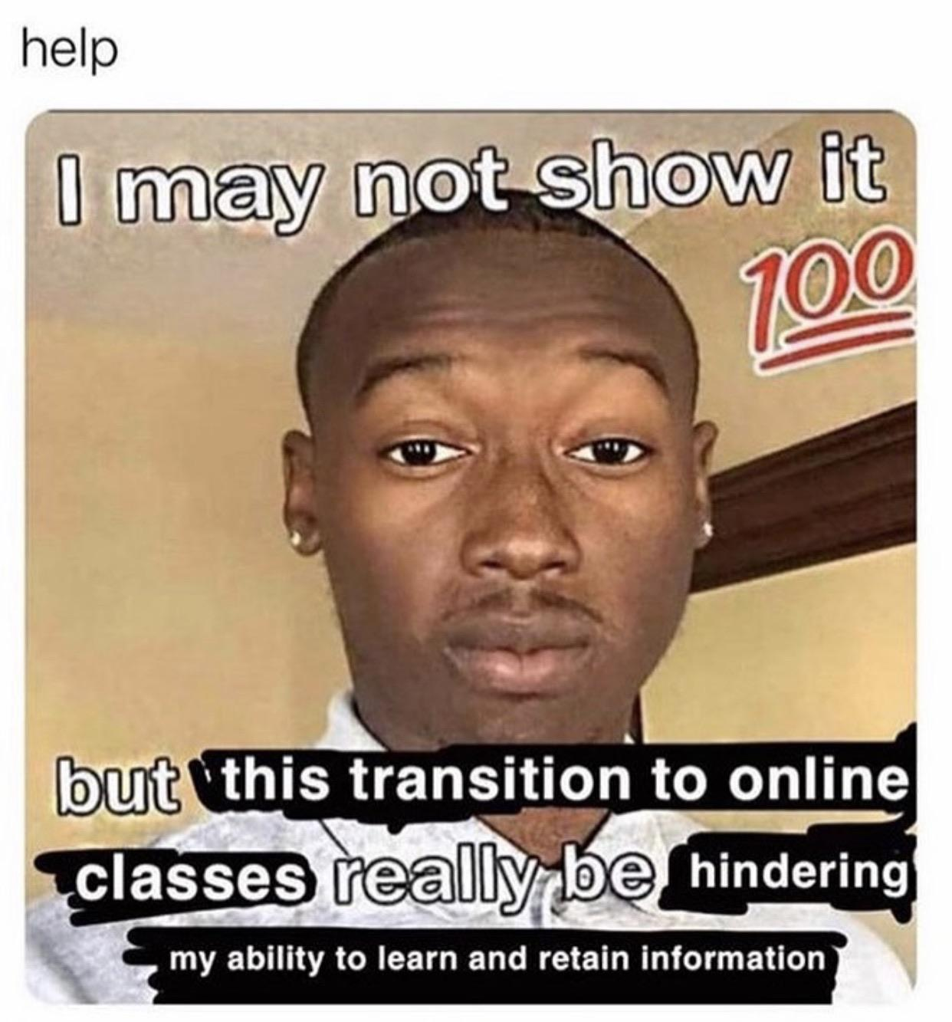
Summary
Like us, Margie craves an education that is interactive, engaging, and involves other people. However, she is not able to get that kind of education because her school is a schoolroom in her house where she sits in front of a computer all day. Ironically we can relate to her in this moment.

