Slide 1
Pollution in the Hudson River in Harlem
Victoria Lodi, New Design Middle School

Slide 2
Do Now
Do you think it is important to clean up after yourself? What about cleaning up after a stranger?

Slide 3
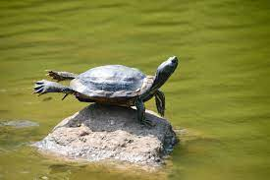
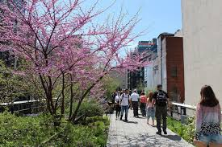
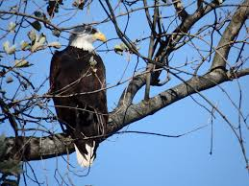
Guiding Question/Class Conversation
What can you do to keep your neighborhood beautiful?

Slide 4
Agenda
Do Now
Guiding Question
Agenda
Review PPA
Slides/Class Conversation
Independent work
Exit ticket

Slide 5
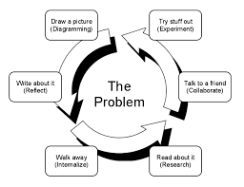
PPA- Steps to solve a problem
The PPA is steps we can use to solve a problem. If we check off all the steps in the PPA, we will be closer to solving a problem than when we started!

Slide 6
PPA Steps
What is the problem?
What is the Evidence?
What are the causes?
What is the existing policy?
What policies can we create to correct the problem?
What is the BEST policy to correct the problem?

Slide 7
PPA
We will be working as a team to go through the stages of the PPA to try to solve the problem of:
Pollution of the Hudson River in Harlem, NYC

Slide 8
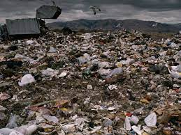
What is pollution?
Pollution is the introduction of harmful materials into the environment.
Based on this definition, where do you see pollution in your day to day life?

Slide 9
What is water pollution?
Water pollution is the contamination of water bodies, usually as a result of human activities, so that it negatively affects its uses. Water bodies include lakes, rivers, oceans, aquifers, reservoirs and groundwater. Water pollution results when contaminants are introduced into these water bodies.

Slide 10
Based on that definition, how might the Hudson River get polluted in Harlem?

Slide 11
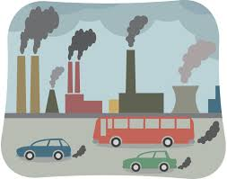
Why do you think pollution is bad for the environment?

Slide 12
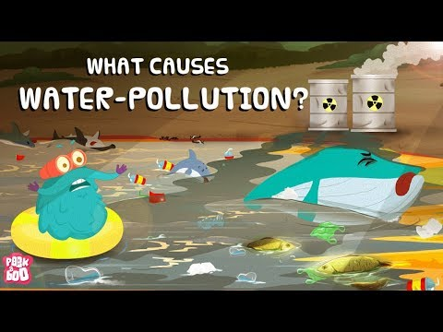
What is water pollution?
https://www.youtube.com/watch?v=MEb7nnMLcaA

Slide 13
What is the Evidence?
***Turn and Talk with your table partner***
What evidence can we gather that there is too much pollution in Harlem that could end up in the Hudson River???

Slide 14
What is the Evidence?

Slide 15
What causes pollution in Harlem?
*** Lets work as a class and try to think of 10 different causes of Hudson River water pollution!***
6.
7.
8.
9.
10.
Watch a video about NYC waterway pollution HERE

Slide 16
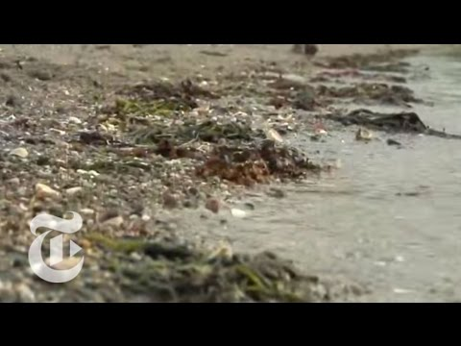
NYC Water Pollution Video:

Slide 17
What is the Existing policy?
Laws against not recycling
NYC air pollution control program
Read about it HERE and HERE
What other policies can you find?
Work with a partner to research other laws and policies in place to reduce water pollution in the Hudson River from Harlem, NYC

Slide 18
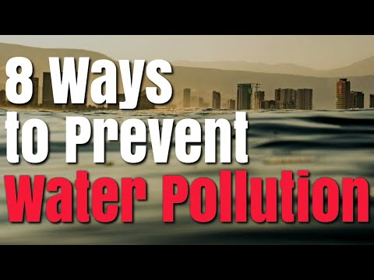
What can we do to fix this problem?
https://www.youtube.com/watch?v=sYIoPIstObU

Slide 19
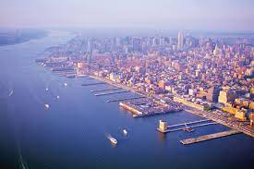
What can we do to fix this problem in Harlem?
Read this article, and then think about what YOU can personally do to reduce pollution in the Hudson River
Fill out your answers in your notebook!!!

Slide 20
Policies we can implement in our community:
1. No littering
2. Making sure to recycle ALWAYS
3. Educate others about how easy it is to not litter
4. Educate others on the repercussions of littering on the Hudson River
5. Pick up after pets when we walk them.

Slide 21
Notes:
Article: https://www.kleankanteen.co.uk/blogs/news/9-ways-to-reduce-plastic-in-your-school

Slide 22
Chart our policies based on Feasibility and Effectiveness
Feasibility: How easy it is to dosomething
It is feasible to run in the yard at school. It is not feasible to run on the moon.
Effectiveness: How good of a job it does at solving our problem
Water plants and giving them sunlight is an effective way to help them grow.

Slide 23
Create your own sentence for feasible and effectiveness!
In your notebook, spend 5 minutes creating your own sentence that describes feasibility and effectiveness

Slide 24
Feasibility/Effectiveness Chart
Feasibility
 | High feasibility | Medium Feasibility | Low Feasibility
High Effectiveness | Not littering Recycling every single time Reduce plastic use Reuse instead of throwing out | Planting many trees in Harlem | Hiring a staff of people to make sure there is no litter making its way to the Hudson river.
Medium Effectiveness | Picking up litter in the streets when you see it. | Educating peers and family members about why littering is not good for the Hudson River
Low Effectiveness | Completing this slideshow and doing nothing afterwards
Effectiveness

Slide 25
Exit Ticket
Based on our chart, which solution do you think is the best option to reduce pollution in the Hudson River and why??
Notes:
Possibility for next class to either make something with single use plastic (Like a planter or other arts and crafts project), or also create a newsletter as a class to give to principal/school about reducing our footprint at NDMS.

