Slide 1
Too much single-use plastic waste being created in NDMS
Victoria Lodi, New Design Middle School

Slide 2
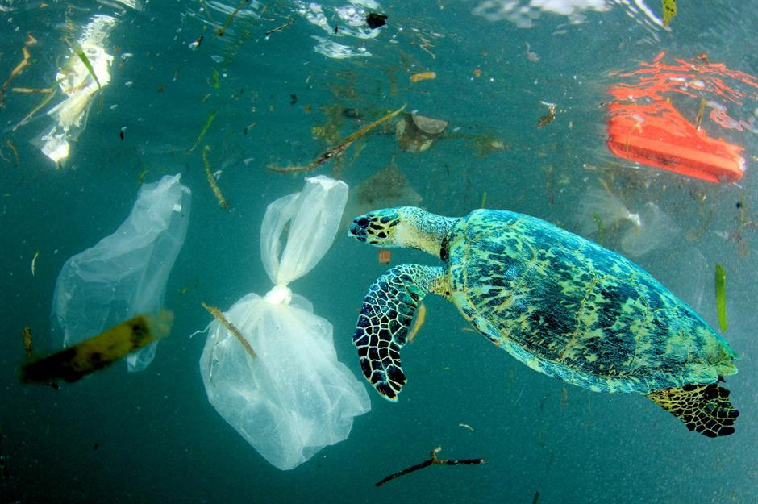
Do Now
Why do you think that plastic in the ocean is a bad thing?

Slide 3
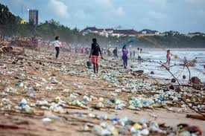
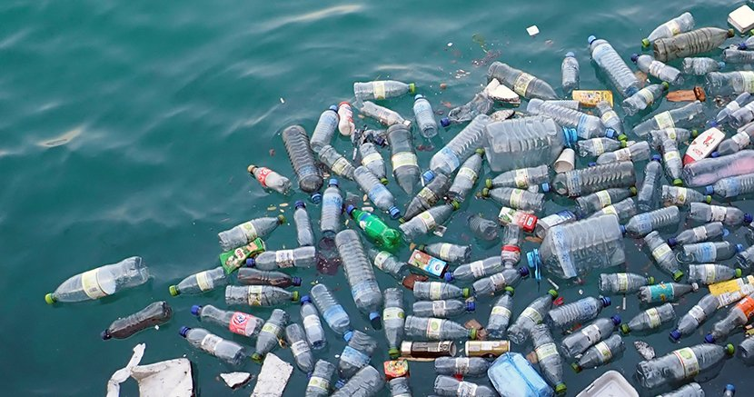
Guiding Question/Class Conversation
Why do you think that plastic is found in the ocean, but cardboard is not?

Slide 4

Agenda
Review PPE
Slides/Class Conversation
Independent work
Exit ticket

Slide 5
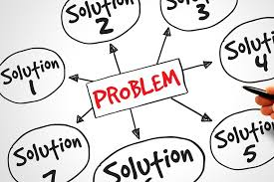
PPE- Steps to solve a problem
The PPE is steps we can use to solve a problem. If we check off all the steps in the PPE, we will be closer to solving a problem than when we started!

Slide 6
PPE Steps
What is the problem?
What is the Evidence?
What are the causes?
What is the existing policy?
What policies can we create to correct the problem?
What is the BEST policy to correct the problem?

Slide 7
PPE
We will be working as a team to go through the stages of the PPE to try to solve the problem of:
Too Much Single use Plastic Waste Being Created in NDMS

Slide 8
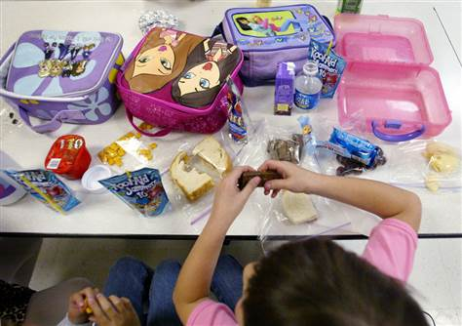
What is single-use plastic?
Single use plastic is plastic that you would use one time, and then throw out.
Based on this definition, what single-use plastic do you use?

Slide 9
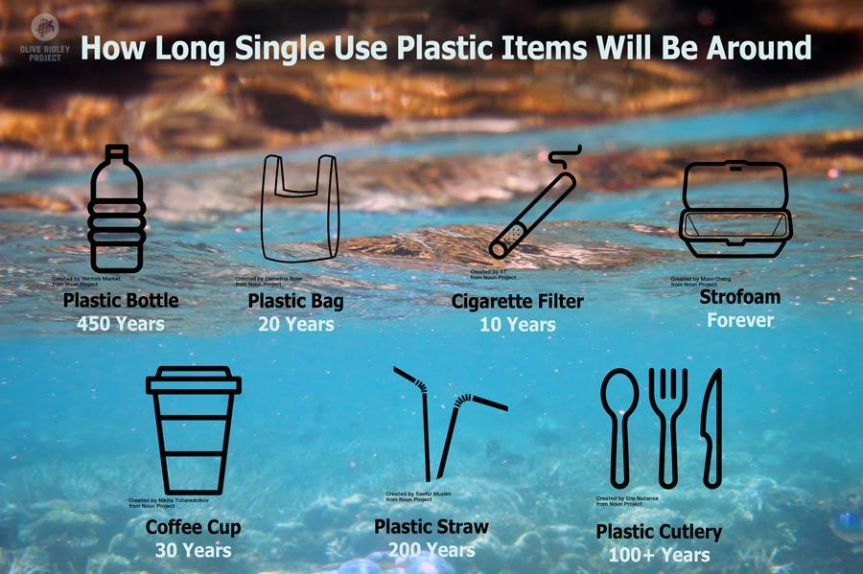
Why is single use plastic bad for the environment?

Slide 10
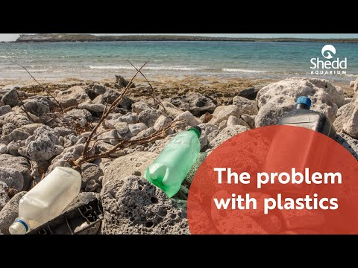
Why is single use plastic bad?
The Problem with Plastics

Slide 11
What is the Evidence?
***Turn and Talk with your table partner***
What evidence can we gather that there is too much single-use plastic being used in NDMS???

Slide 12
What is the Evidence?

Slide 13
What causes single use plastic waste at NDMS?
*** Lets work as a class and try to think of 10 different causes of plastic waste!***
6.
7.
8.
9.
10.

Slide 14
What is the Existing policy?
NYC banned plastic bags at store in 2020, but delayed it because of Covid-19
No other concrete policy exists

Slide 15
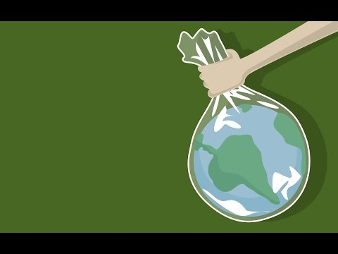
What can we do to fix this problem at NDMS?
Notes:
Video: https://www.youtube.com/watch?v=KONkzQNYJQY

Slide 16
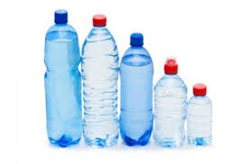
What can we do to fix this problem at NDMS?
Read this article, and then think about what YOU can personally do to reduce the use of single-use plastic at NDMS.
Fill out your answers in your worksheet!
Notes:
Article: https://www.greenchildmagazine.com/single-use-plastic/#:~:text=Animals%20also%20mistake%20single%20use,by%20immobilizing%20or%20strangling%20them.

Slide 17
Policies we can implement at NDMS
Banning all single-use plastic
Providing reusable water bottles for student and staff
Using reusable lunch trays instead of plastic ones
Using reusable utensils instead of plastic ones
Using reusable lunch containers when you bring your lunch from home.
Using cardboard cups instead of plastic cups for water
ELiminating all straws from the cafeteria
Repurpose single-use plastic for other uses

Slide 18
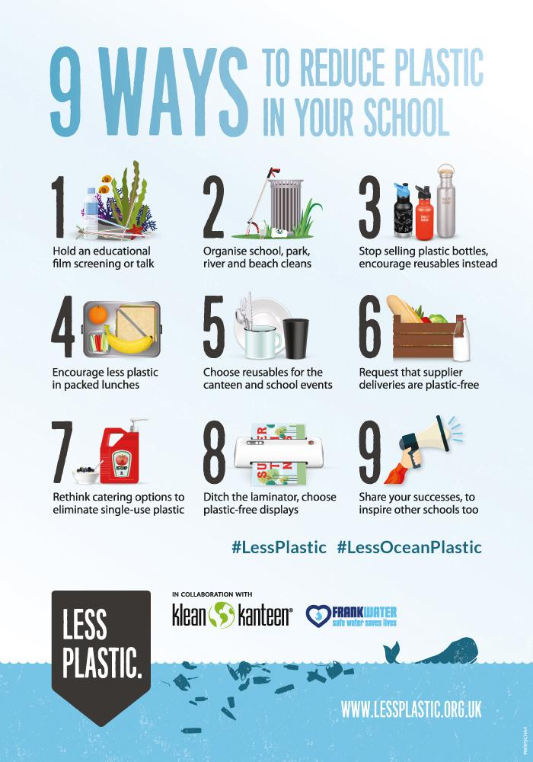
Notes:
Article: https://www.kleankanteen.co.uk/blogs/news/9-ways-to-reduce-plastic-in-your-school

Slide 19
Chart our policies based on Feasibility and Effectiveness
Feasibility: How easy it is to dosomething
It is feasible to run in the yard at school. It is not feasible to run on the moon.
Effectiveness: How good of a job it does at solving our problem
Water plants and giving them sunlight is an effective way to help them grow.

Slide 20
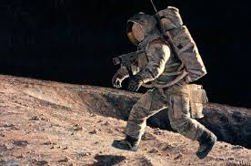
Create your own sentence for feasible and effectiveness!
In your graphic organizer, spend 2 minutes creating your own sentence that describes feasibility and effectiveness

Slide 21
Feasibility/Effectiveness Chart
Feasibility
 | High feasibility | Medium Feasibility | Low Feasibility
High Effectiveness |  |  | Banning All SIngle- Use Plastics Using reusable lunch trays/Utensils
Medium Effectiveness | Replacing Plastic water cups with cardboard water cups Banning all plastic straws | Providing Reusable Water Bottles
Low Effectiveness | Using reusable lunch containers
Effectiveness

Slide 22
Exit Ticket
Based on our chart, which solution do you think is the best option for NDMS and why?
Notes:
Possibility for next class to either make something with single use plastic (Like a planter or other arts and crafts project), or also create a newsletter as a class to give to principal/school about reducing our footprint at NDMS.

