Slide 1


Social Problem: Students do not have access to enough technology and information in class.
By Joe Liebowitz, PS 149, JLiebowitz3@schools.nyc.gov

Slide 2

Public Policy Analyst Steps
Define the Problem: Students do not have access to enough technology and information in class.
Gather Evidence: Find credible articles and videos about the limitations students have accessing information and up to date technology.
Causes: Lack of funding, school policies on technology, lack of training
Evaluate: Analyze how a lack of technology in schools hinders learning.
Possible Solutions: How can we adjust rules/policies to provide students with more technology?
Select the Best Solution: Present the most Feasible Solution based on the evidence provided.

Slide 3
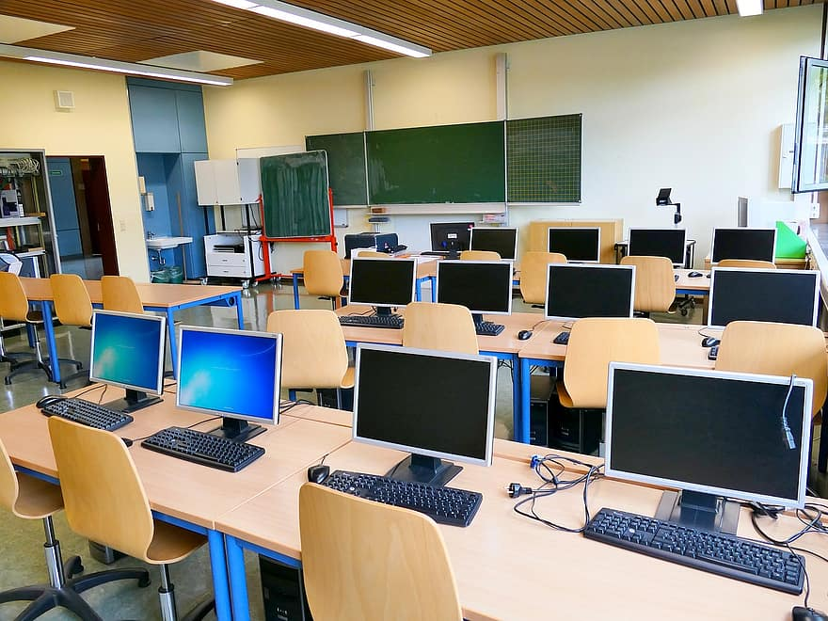
Gather Evidence: Technological Limitations
Students in school do not have up-to-date technology and enough access to credible information in school.
Here are articles that support the statement as well as solutions:
Lack of Technology Hinders Student Learning
Benefits of Technology in School
Negatives of Outdated Technology in School
Benefits of Cell Phone Usage in Schools
Lack of Funding for Remote Learning

Slide 4
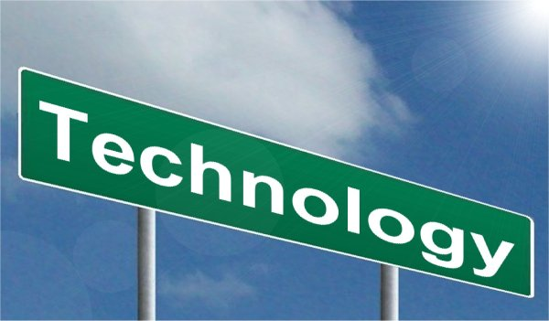
Causes: Why do schools not have enough access to technology?
Turn and Talk: 2 Minutes
Possible Reasons:
Poor Funding in Schools and Education
Technology isn’t emphasized in the classroom
Lack of training for students and teachers with technology
Lack of Internet Access outside of school

Slide 5

Evaluate: How does lack of technology impact our class at PS 149?
Turn and Talk: 2 Minutes
Possible Answers:
Students do not have access to important information/programs
Teachers cannot differentiate instruction for all students
Students are not as prepared for life after school without technological skills.

Slide 6

Possible Solutions: How can schools provide more access to technology for students?
Turn and Talk: 2 Minutes
Possible Answers:
The NYC DOE must provide more funding for updated technology (Chromebooks, Tablets, Computer Rooms, etc.)
Allow students to use their cellphones in class under teacher supervision
Provide PD opportunities for teachers to learn how to use technology in the classroom

Slide 7
Feasibility/Effectiveness of Each Solution
Feasibility
 | High | Medium | Low
High
Medium | Technology PD’s for teachers | Allowing student cell phone usage in class
Low |  |  | More funding from the NYC DOE

Slide 8


Exit Ticket: List ONE Social Problem you would like addressed at PS 149.
Timer: 5 Minutes

Slide 9
Citations: Full Links to Articles
https://educationbusinessuk.net/news/25042019/lack-technology-classroom-hinders-literacy-and-work-readiness#:~:text=Lack%20of%20technology%20in%20the%20classroom%20hinders%20literacy%20and%20work%2Dreadiness,-EB%20News%3A%2025&text=A%20new%20teacher%20survey%20has,means%20many%20are%20missing%20out.
https://www.waldenu.edu/programs/education/resource/top-five-benefits-of-technology-in-the-classroom#:~:text=Creates%20a%20More%20Engaged%20Environment,into%20interactive%20and%20fun%20activities.
https://www.nsiserv.com/blog/8-reasons-outdated-technology-is-holding-back-your-schools-potential
https://www.schoolmoney.org/advantages-using-cell-phones-classroom/
https://ktvz.com/news/national-world/2020/08/26/st-louis-public-schools-may-not-have-enough-technology-for-students-on-first-day-of-virtual-learning/

