Slide 1
Impact of Parental Involvement Claudette Lewin-Rabb MARY MCLEOD BETUNE ELEMENTARY SCHOOL FIFTH GRADE P.S. 92

Slide 2
THE PUBLIC POLICY ANALYST
The Public Policy Analyst is a six step tool that allows you to focus on a specific issue by the means of evidence.
Here is a presentation using the PPA with a focus on the topic on the impact of parent involvement.

Slide 3
DEFINE THE PROBLEM:
Parent Involvement makes students academic performance better.

Slide 5
GATHER THE EVIDENCE:
After two months of parental involvement, it shows that when parents are involved in their child’s education it can improve their academic performance and positively influence a child’s attitude about school.

Slide 6
Parental Involvement and Student Success
According to, Anna Sudderth When parents are stakeholders in students’ education, there’s a positive impact on student success. When parents get involved and engaged in their child’s education, students are more likely to graduate, earn higher grades, improve their attendance, and go to college. Parent involvement has been defined and measured in multiple ways, including activities that parents engage in at home and at school and positive attitudes parents have towards their child's education, school, and teacher. Based on previous research, it was hypothesized that parents who have a positive attitude towards their child's education, school, and teacher are able to positively influence their child's academic performance by two mechanisms: (a) by being engaged with the child to increase the child's self-perception of cognitive competence and (b) by being engaged with the teacher and school to promote a stronger and more positive student-teacher relationship.

Slide 7
IDENTIFY THE CAUSE
The impact of Parental involvement is positively associated with students’ educational success. However, research shows that levels of involvement and participation vary considerably, depending on parents’ social and economic resources.

Slide 9
Parental Involvement Build Positive Result.
Parental involvement helps give children attention and praise which, in turn, helps them recognize their education is good of adult interest. As children tend to model adult behaviors, when parents are actively involved with their schooling, children will learn the importance of education and try to copy those behaviors from their parents. It also helps children understand that their schooling isn’t just about them. It’s a collaborative approach between students, teachers and their parents. This team approach can further motivate them to work hard and produce positive results. Children who receive help from their parents are also more likely to feel empowered, and their academic achievement becomes more important to them.

Slide 10
EVALUATE THE EXISTING POLICY
What do schools do to reinforce parental involvement?
NYCDOE Policies
Each school is assigned a Parent Coordinator
Schools are encouraged to host Family workshops
Schools have PTC for to five times each year.
Institute parental Engagement once per week.
Schools host Parent Orientations at the beginning of the school year.
.

Slide 11
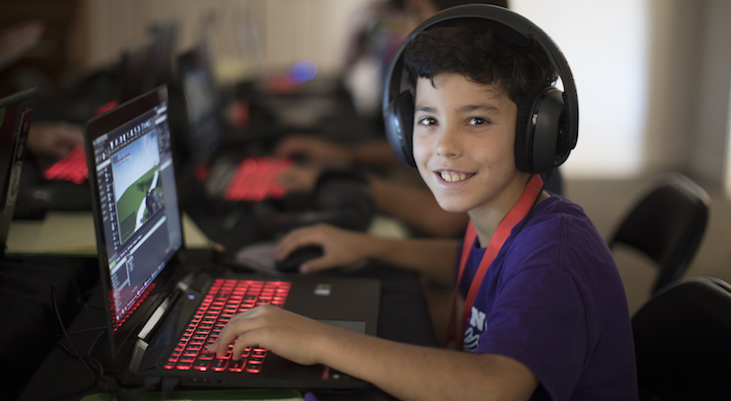
Is Parental involvement increasing?
In NYCDOE it shows that nearly every school with a parent/guardian response rate over 80% has for schools wishing to increase family engagement with the survey at their school is to follow up! The most effective strategies schools found for guaranteeing as many parents/guardians participated in the survey as possible was to track completion and follow up with a personal phone call from the principal or other trusted staff member – for example, the school’s parent coordinator or guidance counselor – and home visits when feasible. Schools also use automated message systems like Phone Masters or Robo Calls.

Slide 12
DEVELOP SOLUTIONS
Schools that successfully engage families in the annual NYC School Survey are located in all five boroughs and serve diverse students and families. One thing these schools have in common is a strong culture of family engagement year-round tailored to the distinct communication styles and needs of their school communities. Therefore, it is evident that teachers should push for more parental involvement in their student’s life.

Slide 13
TIME SCREENING
The American Academy of Pediatrics (AAP) recommends that parents place consistent limits on time spent using video games on gaming consoles, tablets, or smartphones to keep game-playing from interfering with schoolwork, household chores, and the physical activity your son needs every day.

Slide 14
SELECT THE BEST SOLUTION – EVALUATE EFFECTIVENESS/FEASIBILITY
Parents should monitor the video games their children are playing. Make sure games are suitable for their age as games rated "M" for "mature" can contain heavy-duty violence, strong language, and sexual content.

Slide 15
Build a Team
Principals should recruit parents from the school community to help plan ways parents can become involved in their child’s school life by coordinate events and reach out to other families at school. Parent volunteers can help make personal phone calls to parents to encourage attendance at events and participation in activities in their children’s school life. Teachers can discuss the importance of their parents participating with their classes and share with them how this help to build academically and socially success of their children. Students can have discussion with their parent on how to be more involved in their education. Last, but not least, schools with high parent response rates leverage the expertise of their parent coordinators who are critical partners in building and maintaining strong relationships with students’ families.

Slide 16
NOW, IT’S YOUR TURN!
What are some ways parents can be involved in their children’s education?

Slide 17
RESOURCES
BLOG
HOW PARENTAL INVOLVEMENT AFFECTS STUDENT ACHIEVEMENT
BLOG
HOW PARENTAL INVOLVEMENT AFFECTS STUDENT ACHIEVEMENT
BLOG
HOW PARENTAL INVOLVEMENT AFFECTS STUDENT ACHIEVEMENT
Parental Involvement by NYC DOE PRESS RELEASE – SCHOOLS CHANCELLOR DAVID C. BANKS
Parental Involvement in Education by Nancy E. Hill Educational Psychologist Published online: 15 Nov 2022
www.teacherph.com/parental-involvement-education/
https://gpcalour.com/blog-post/parental-involvement-affects-student

