Slide 1
Access to Clean Water
Flint, Michigan
Miss Larkin klarkin@newdesignmiddle.org
New design middle school
703 7th grade ela

Slide 2
Do Now
What are all of the ways that you use water?
Flint, Michigan
What do you know and want to know/ wonder about the city of Flint, Michigan?
Know | Want to know/ Wonder | Learn

Slide 3
The Public Policy Analyst Model (PPA)
The Public Policy Analyst is a tool made up of 6 steps.
These steps help you take a very close look at an issue by using evidence.

Slide 4
Public Policy Analyst Model: 6 Steps
1. Define the problem.
2. Gather the evidence.
3. Identify the causes.
4. Evaluate existing policy.
5. Develop solutions.
6. Select the best solution
  Evaluate effectiveness and feasibility

Slide 5
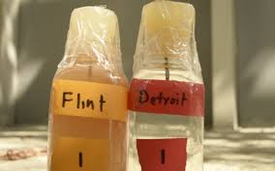
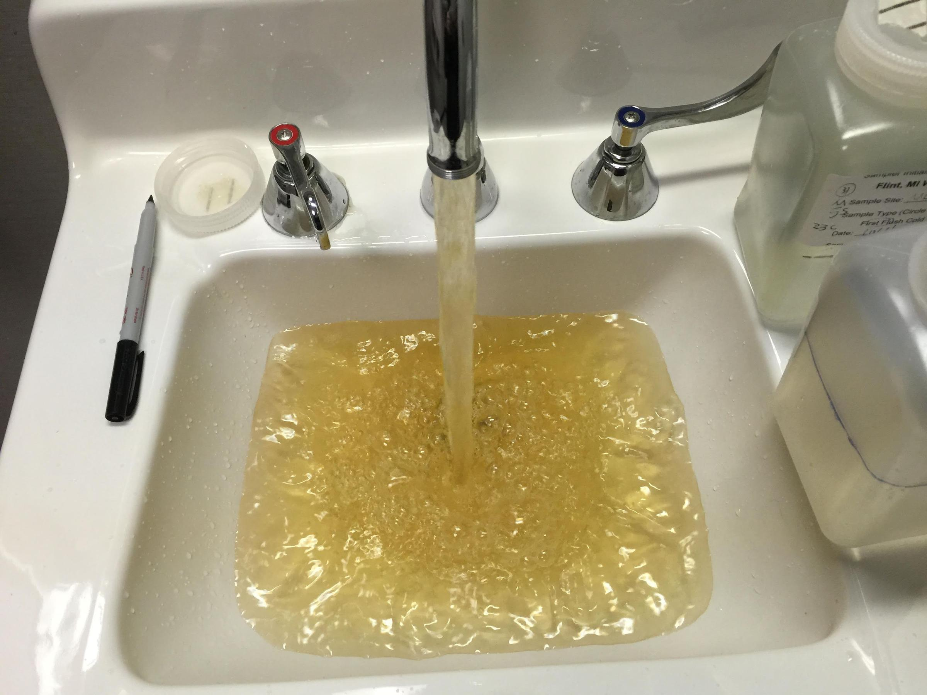
1. Define the problem
The city of Flint, Michigan had a contaminated water supply for years. The city’s tap water had dangerous levels of lead in it. It caused health problems and made people very sick.
Check out this video to learn more about the issue:
  https://www.youtube.com/watch?v=872Xz63b9VU

Slide 6
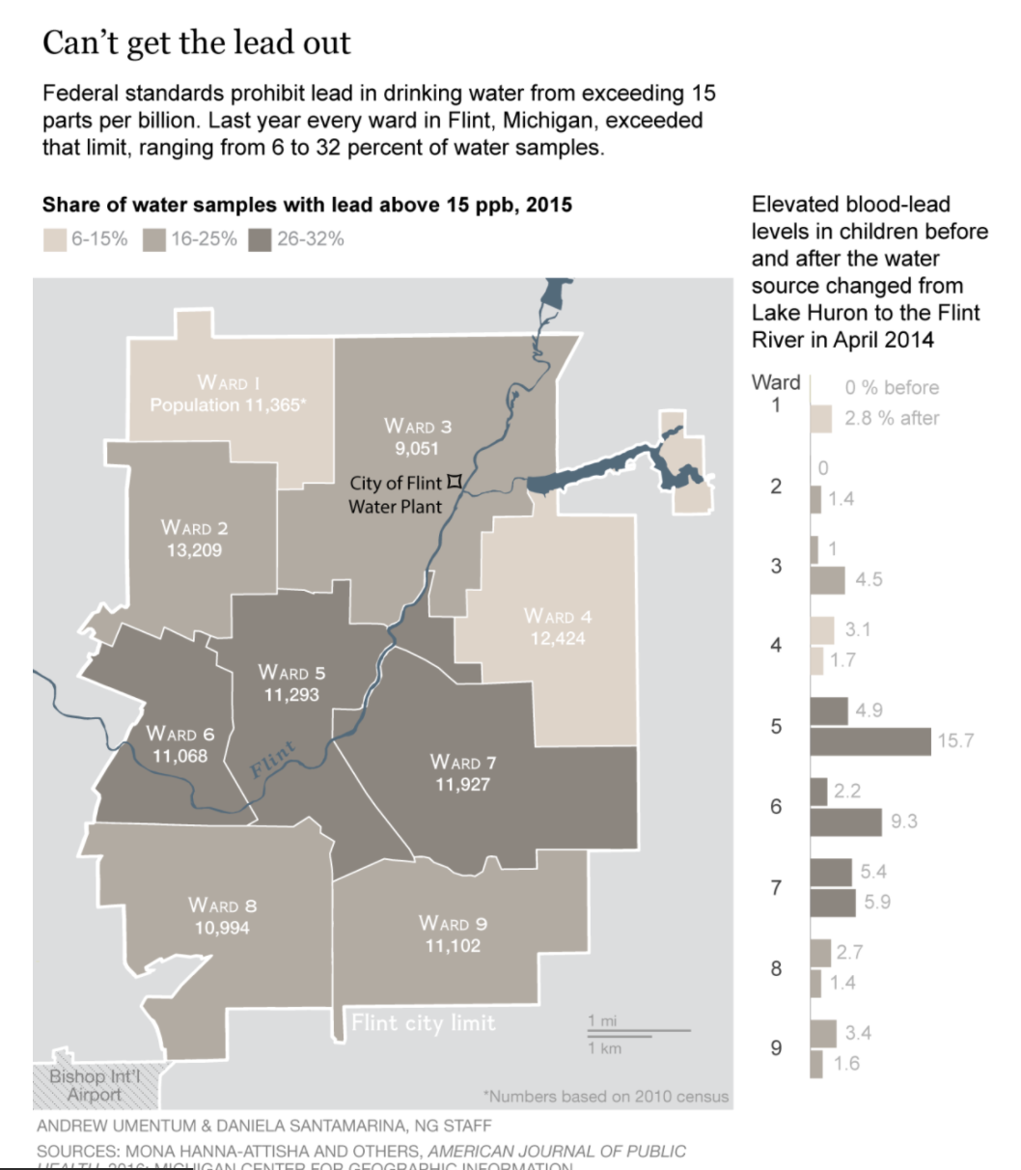
2. Gather the evidence
Research: Article https://newsela.com/read/flint-residents/id/14324/?_flash_query_param_1=?
Website https://www.nrdc.org/flint?gclid=CjwKCAjwkJj6BRA-EiwA0ZVPVsP93JP3UCsnfVVFrtk1PCLT8VAxicFUQkTHvyHRkTt2CQe3iTNwrxoCGhsQAvD_BwE
Research Catcher

Slide 7
3. Identify causes
1. The city of Flint, Michigan changed its water supply to the Flint River in order to save money.
2. The river water contained high levels of coliform bacteria.
3. Officials knew the water was contaminated, but allowed it to remain as the city’s water source.

Slide 8
4. Evaluate an existing policy
The EPA (Environmental Protection Agency) awarded the city of Flint, Michigan $100 Million for infrastructure updates for their water supply system
They have been monitoring the situation to ensure that the city transitions to a safe water source
They have been monitoring the lead and copper levels in the water to make sure that it is safe to drink.
Read more about the policy here: https://www.epa.gov/flint

Slide 9
5. Develop solutions
What are some solutions to this problem?
Research Catcher

Slide 10
6. Select the best solution
What is the most effective solution for this problem?
Research Catcher

