Slide 1
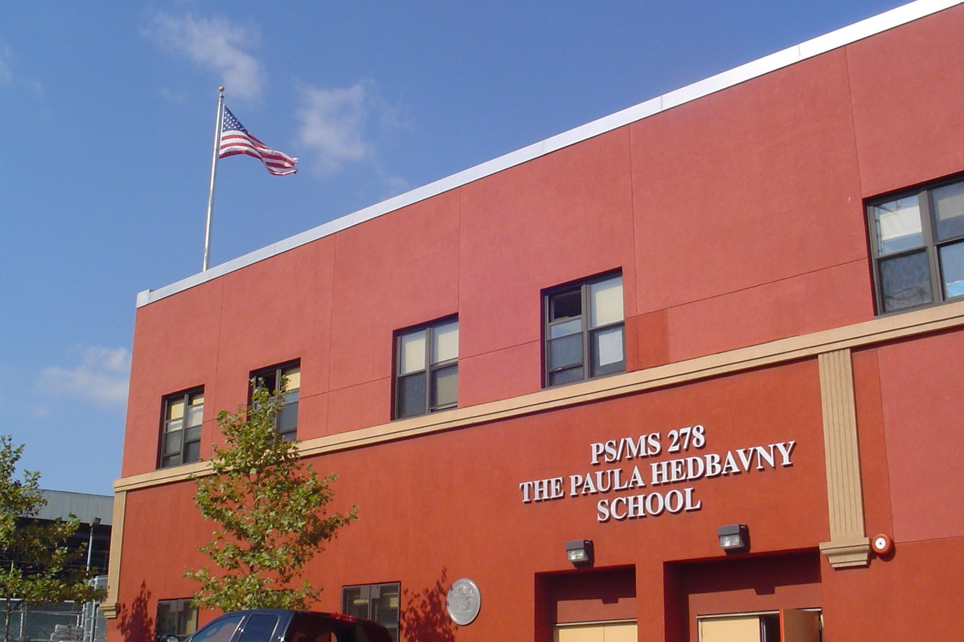
The Impact of Poor Academic Performance
At PS/MS 278

Slide 2

Step 1: Define The Problem
Many New York City students struggle academically at school.
https://www.nytimes.com/2019/08/22/nyregion/new-york-city-school-test-scores.html
About 46% of 3-8th graders achieved proficiency on state math test
About 47% of 3-8th graders achieved proficiency on state ELA test
Gaps persist between achievement of black and Hispanic students compared with white and Asian students, as well as with special needs students

Slide 3
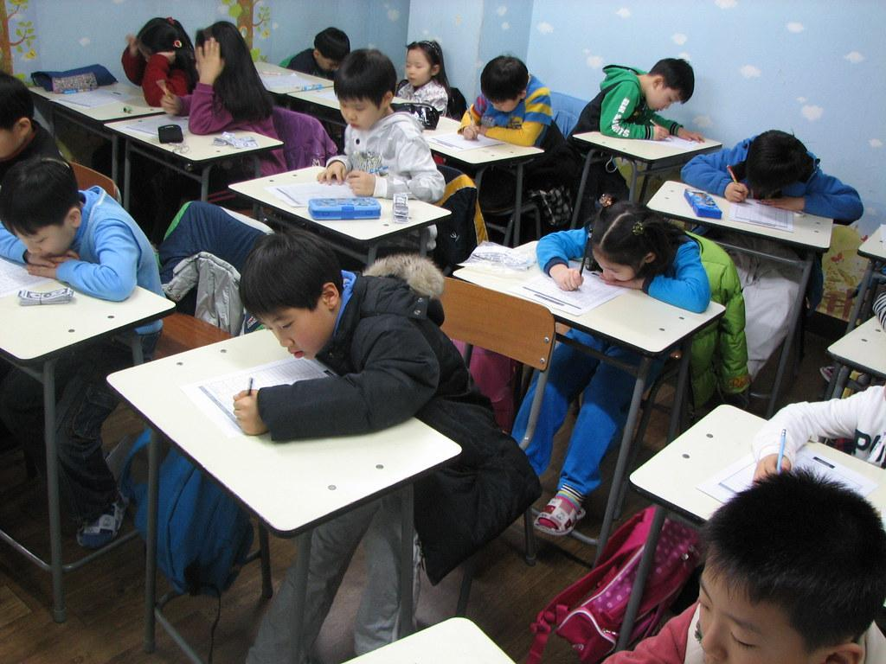
Step 2: Gather the evidence
Test scores at PS/MS 278:
https://www.chalkbeat.org/posts/ny/2019/08/22/2019-state-test-scores-are-out-find-out-how-your-nyc-school-fared/
52% of 3-8th graders achieved proficiency on state math test
53% of 3-8th graders achieved proficiency on state ELA test
https://flagpole.com/news/news-features/2019/10/09/poverty-is-the-biggest-hurdle-to-closing-student-achievement-gaps
Poverty and racial segregation may be barriers to achievement

Slide 4
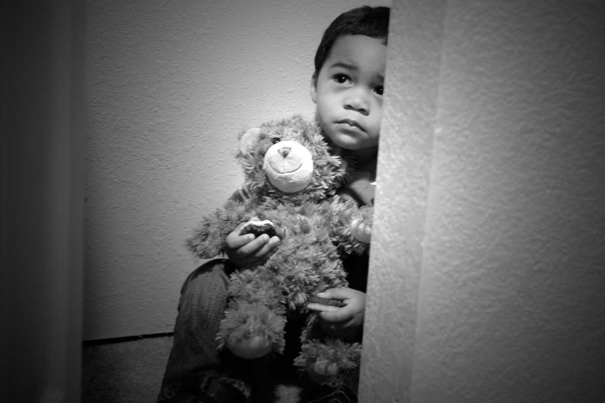
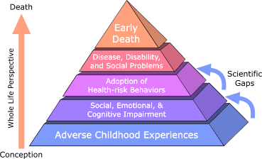
Step 3: Identify the causes
One major cause of poor academic performance is poor mental health:
https://www.nbcnews.com/better/health/fall-all-new-york-students-will-be-learning-about-mental-ncna911031
Mental health is now part of the health curriculum in New York State
https://www.nytimes.com/2019/09/12/learning/students-mental-health-days.html
Some states are allowing students time off for mental health issues

Slide 5

Step 3: Identify the causes
Another major cause of poor academic performance is poor attendance:
https://nces.ed.gov/pubs2009/attendancedata/chapter1a.asp
As teacher effectiveness is the strongest school-related determinant of student success, chronic student absence reduces even the best teacher's ability to provide learning opportunities.
https://www.attendanceworks.org/chronic-absence/the-problem/10-facts-about-school-attendance/
When students improve their attendance rates, they improve their academic prospects and chances for graduating.

Slide 6

Step 3: Identify the causes
Another major cause of poor academic performance are learning disabilities:
https://ldaamerica.org/support/new-to-ld/
2.3 million students are diagnosed with learning disabilities and receive services, which represents 35% of all students receiving special education services. 75% – 80% of special education students identified as LD have their basic deficits in language and reading
Student Worksheet

Slide 7
Step 4: Evaluate an existing policy
What policies or systems are in place at PS/MS 278 to help support students academic performance? How are students supported to address or make good choices about mental health issues, attendance, and maximizing their own learning? Think about our classroom, school, and your time with other teachers!
EXISTING POLICIES:
Policy #1
Policy #2
Policy #3

Slide 8
Step 5: Develop solutions
Brainstorm with your group. What is a solution you’d like to see at PS/MS 278 to address or improve students’ academic performance? Please aim to come up with 2-3 ideas!
POSSIBLE SOLUTIONS:
Idea #1
Idea #2
Idea #3

Slide 9
Step 6: Select the best solution
Many solutions have both pros (positives) and cons (negatives). Together, let’s focus on one (or more) solution your groups brainstormed to think about:
What is the FEASIBILITY of each solution?
How easily or well can the solution realistically be put in place?
What is the EFFECTIVENESS of each solution?
How likely is the solution to have the intended or expected outcome?
Which solution seems to have the highest feasibility and effectiveness?

Slide 10

Conclusion: Key Take-Aways
Various Factors May Impact Academic Performance
Mental health issues, attendance, or learning disabilities present challenges for many students. Please reach out if you have any questions or need assistance with your learning. Your school community is here to help you!
The 6-step PPA process (define the problem, gather the evidence, identify the causes, evaluate existing policies, develop solutions, choose the best solution) can be used to tackle MANY social problems!
YOU are part of the solution!

